Slide 1
CMSC 28100
Introduction to Complexity Theory
Autumn 2025
Instructor: William Hoza
⏳

Slide 2
Which problems can be solved through computation?

Slide 3
Complexity theory:
The study of computational resources

Slide 4
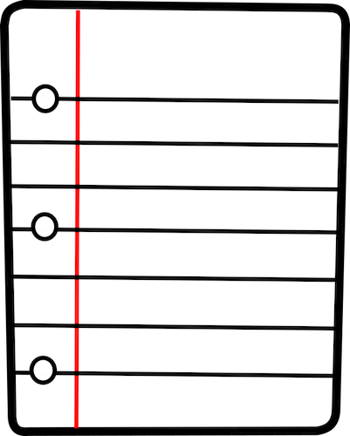
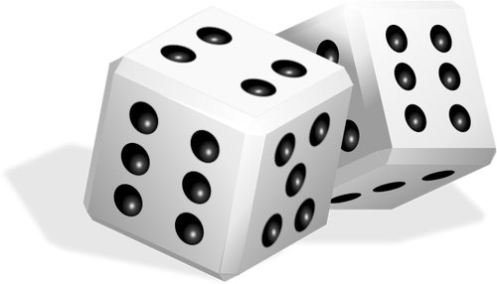




Computational resources: Fuel for algorithms
⏳
TIME
SPACE
RANDOMNESS
ADVICE
QUANTUM PHYSICS
COMMUNICATION

Slide 5
Communication Complexity

Slide 6

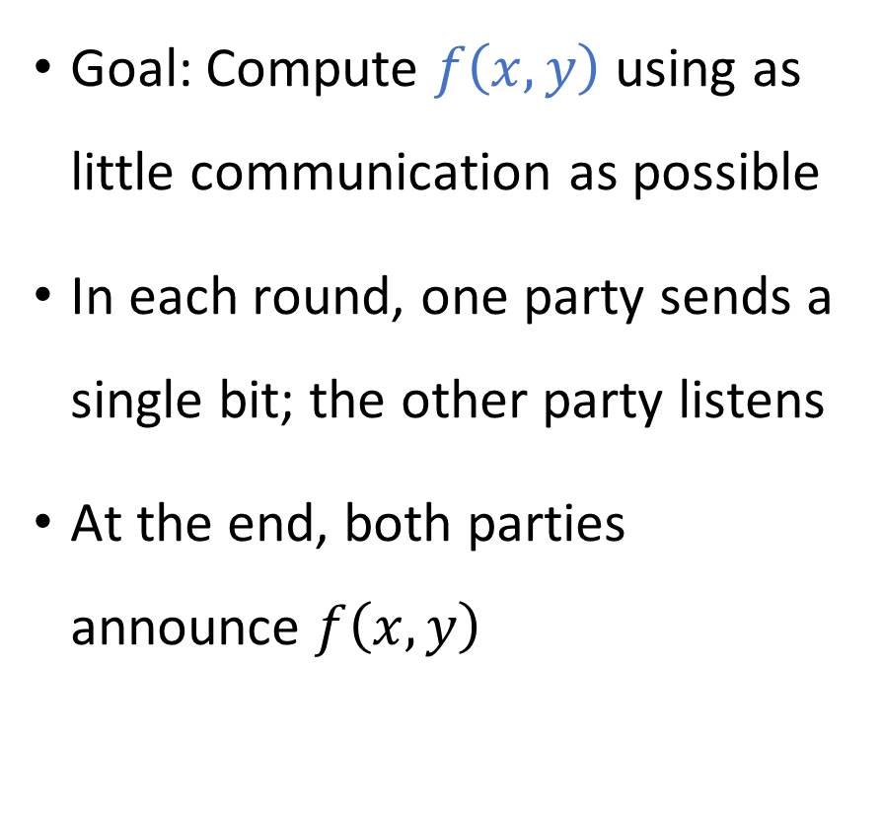


Communication complexity
Goal: Compute $f\left(x, y\right)$ using as little communication as possible
In each round, one party sends a single bit; the other party listens
At the end, both parties announce $f\left(x, y\right)$
Communication channel
Alice holds $x$
Bob holds $y$

Slide 7
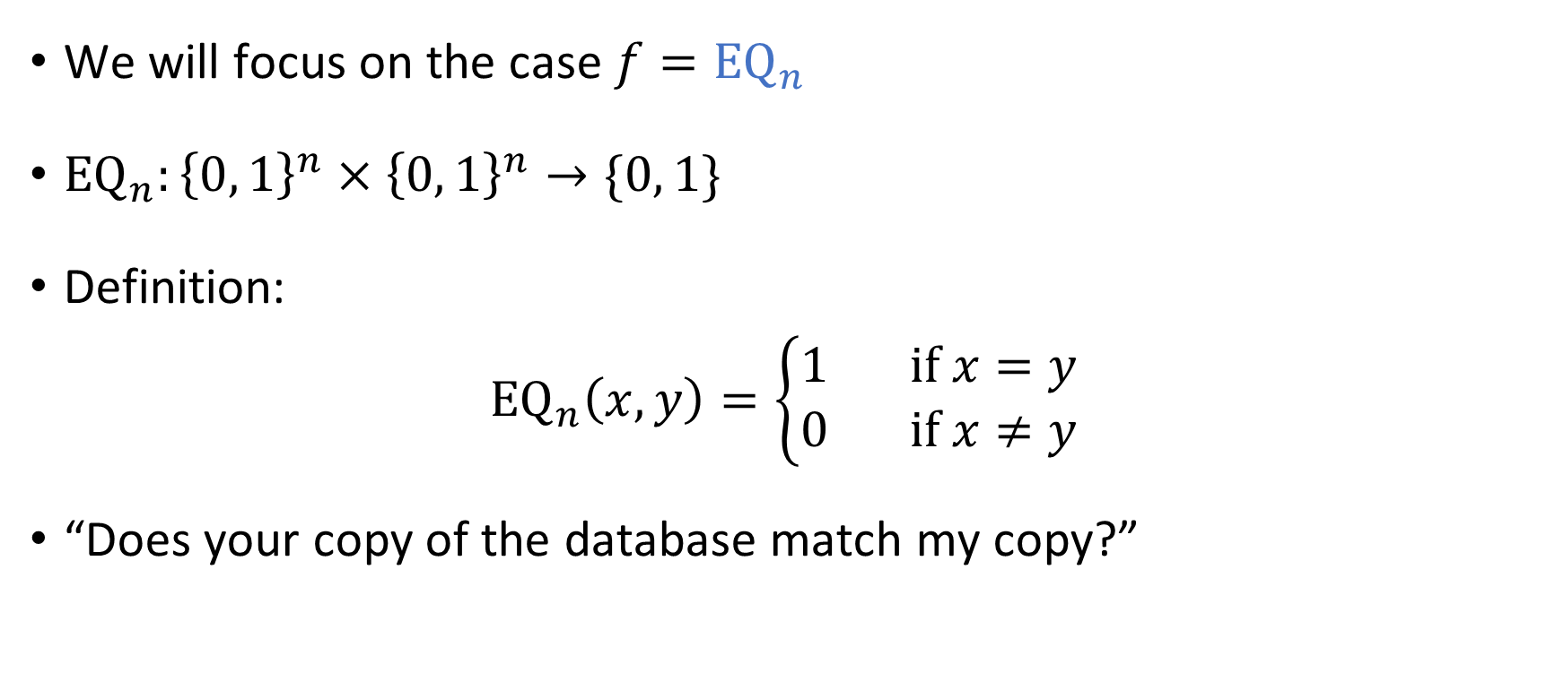
The equality function
We will focus on the case $f={\text{EQ}}_{n}$
${\text{EQ}}_{n}:{\left\{0, 1\right\}}^{n}×{\left\{0, 1\right\}}^{n}→\{0, 1\}$
Definition:
$${\text{EQ}}_{n}\left(x, y\right)=\left\{\begin{aligned}1 \text{if} x=y \\ 0 \text{if} x≠y\end{aligned}\right.$$
“Does your copy of the database match my copy?”

Slide 8
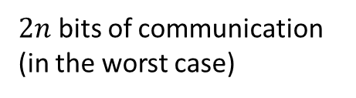


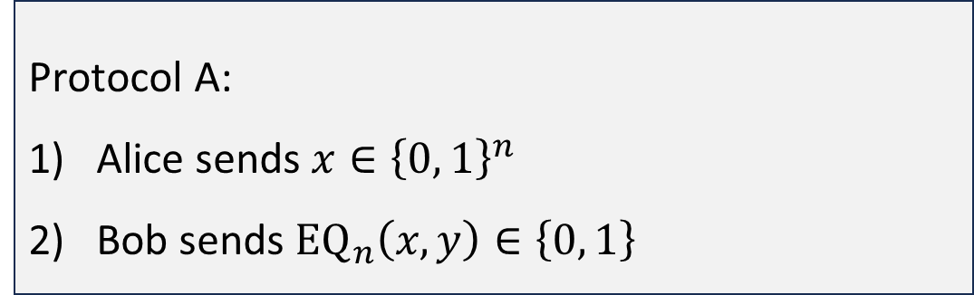
Protocols for equality
Protocol A:
Alice sends $x∈{\left\{0, 1\right\}}^{n}$
Bob sends ${\text{EQ}}_{n}\left(x, y\right)∈\left\{0, 1\right\}$
$n+1$ bits of communication
Protocol B:
For $i=1$ to $n$:
  Alice sends $x_{i}$
  Bob sends a bit indicating whether $x_{i}=y_{i}$
$2n$ bits of communication (in the worst case)

Slide 9
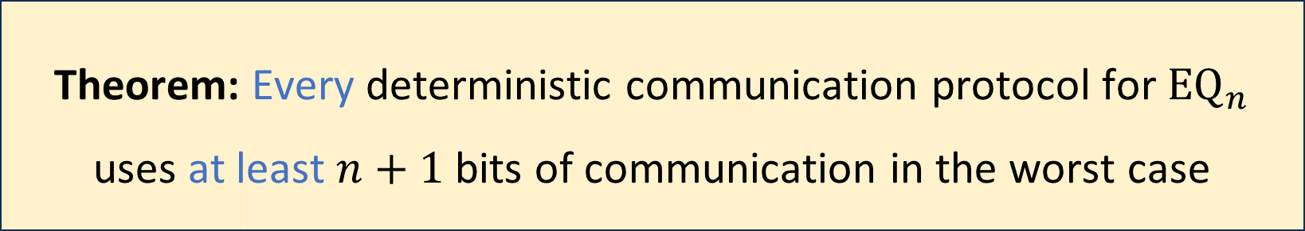
Communication complexity of equality
Is there a better protocol?
Before we can prove it, we must clarify how we model communication protocols mathematically
Theorem: Every deterministic communication protocol for ${\text{EQ}}_{n}$ uses at least $n+1$ bits of communication in the worst case

Slide 10
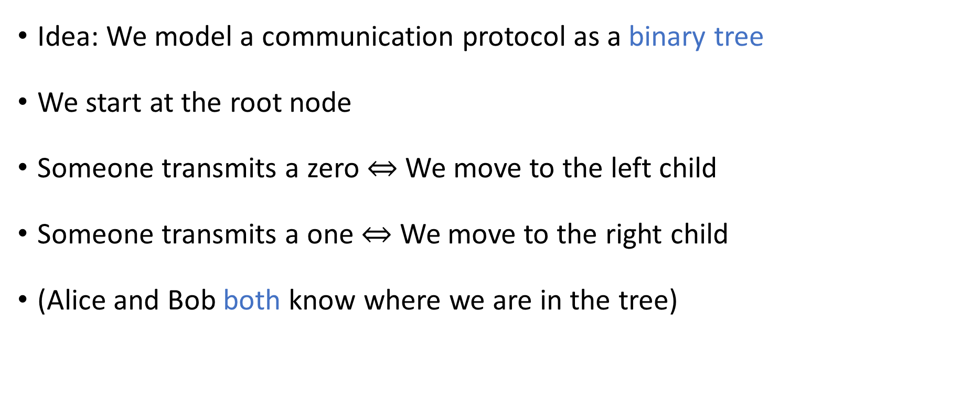
Communication protocol model
Idea: We model a communication protocol as a binary tree
We start at the root node
Someone transmits a zero $⇔$ We move to the left child
Someone transmits a one $⇔$ We move to the right child
(Alice and Bob both know where we are in the tree)

Slide 11

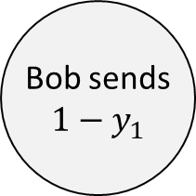

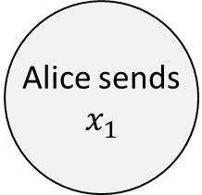

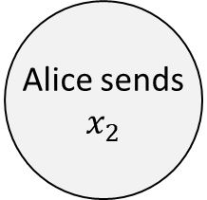

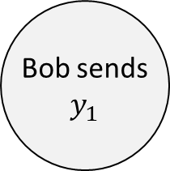

Example protocol tree
Alice sends
$$x_{1}$$
0
1
Bob sends
$$1−y_{1}$$
Bob sends
$$y_{1}$$
0
1
0
1
Alice sends
$$x_{2}$$
Alice sends
$$x_{2}$$
Reject
Reject
$$⋮$$
$$⋮$$
$$⋮$$
$$⋮$$

Slide 12
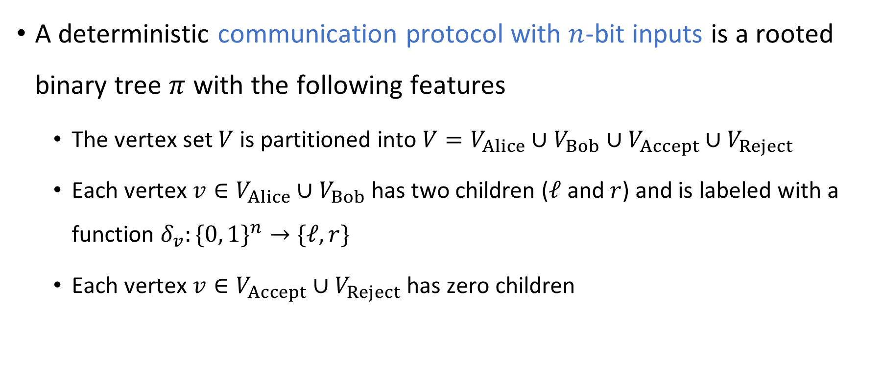
Rigorously defining communication protocols
A deterministic communication protocol with $n$-bit inputs is a rooted binary tree $π$ with the following features
  The vertex set $V$ is partitioned into $V=V_{Alice}∪V_{Bob}∪V_{Accept}∪V_{Reject}$
  Each vertex $v∈V_{Alice}∪V_{Bob}$ has two children ($ℓ$ and $r$) and is labeled with a function $δ_{v}:\{0, 1\}^{n}→\text{\{}ℓ, r\}$
  Each vertex $v∈V_{Accept}∪V_{Reject}$ has zero children

Slide 13
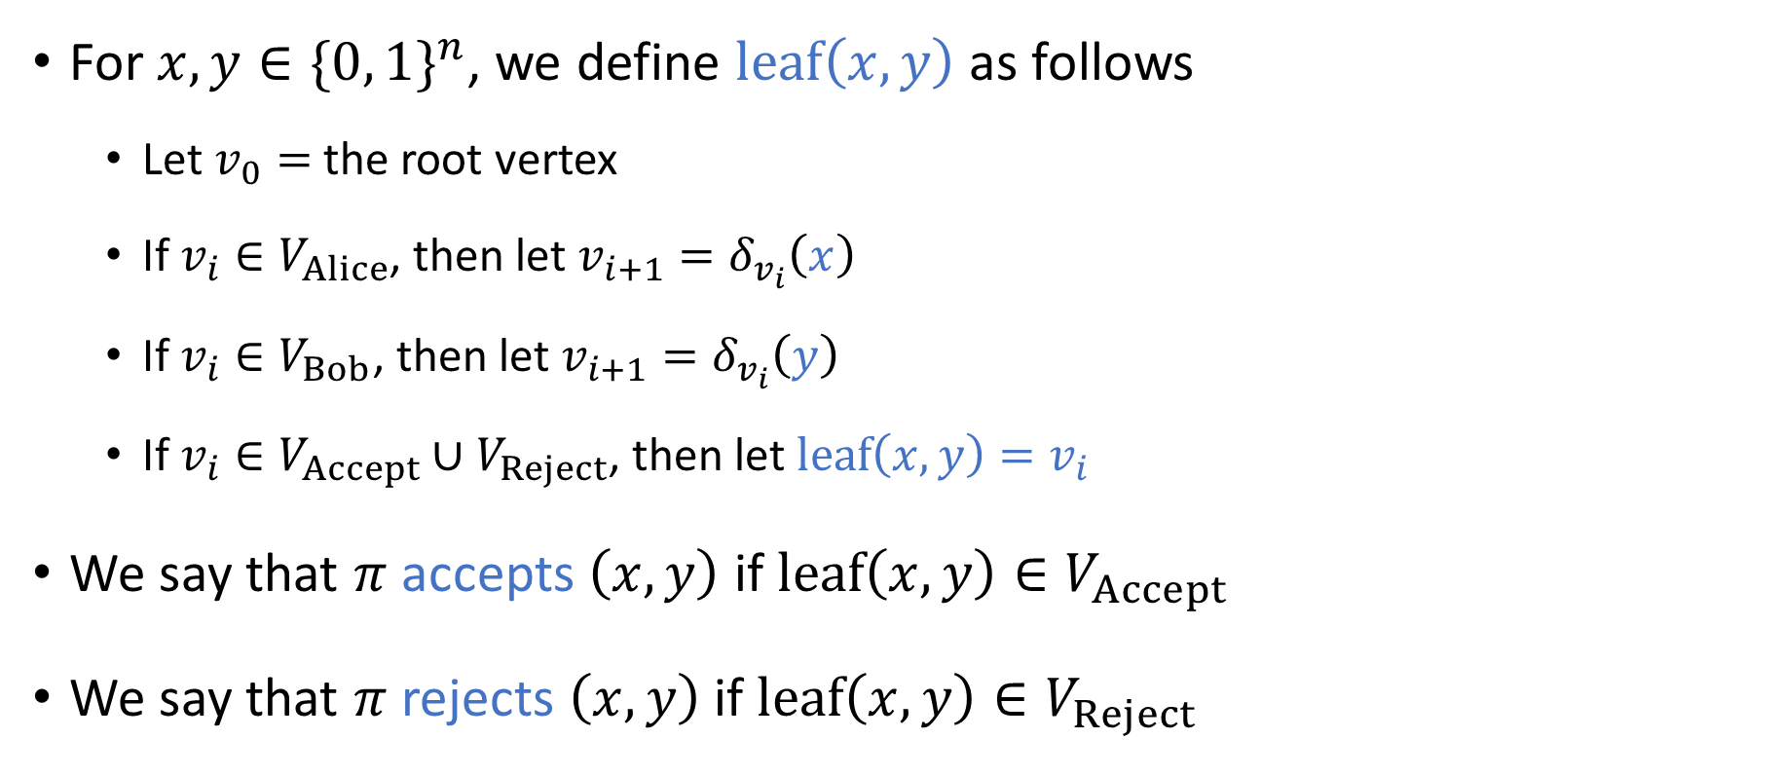
Rigorously defining communication protocols
In this model, what happens if Alice and Bob speak at the same time?
A: Trick question. In this model,
they never speak simultaneously
B: Only one of the messages is
successfully transmitted
For $x, y∈\{0, 1\}^{n}$, we define $\text{leaf}\left(x,y\right)$ as follows
  Let $v_{0}=$ the root vertex
  If $v_{i}∈V_{Alice}$, then let $v_{i+1}=δ_{v_{i}}\left(x\right)$
  If $v_{i}∈V_{Bob}$, then let $v_{i+1}=δ_{v_{i}}\left(y\right)$
  If $v_{i}∈V_{Accept}∪V_{Reject}$, then let $\text{leaf}\left(x,y\right)=v_{i}$
We say that $π$ accepts $\left(x, y\right)$ if $\text{leaf}\left(x,y\right)∈V_{Accept}$
We say that $π$ rejects $\left(x,y\right)$ if $\text{leaf}\left(x,y\right)∈V_{Reject}$
C: Both of the messages are
successfully transmitted
D: Neither message is successfully
transmitted
Respond at PollEv.com/whoza or text “whoza” to 22333

Slide 14
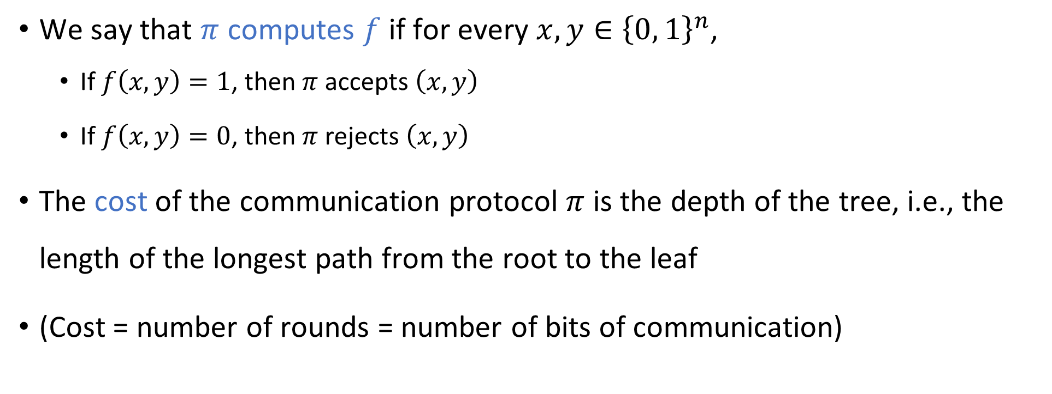
Communication complexity
We say that $π$ computes $f$ if for every $x, y∈{\left\{0, 1\right\}}^{n}$,
  If $f\left(x,y\right)=1$, then $π$ accepts $\left(x,y\right)$
  If $f\left(x,y\right)=0$, then $π$ rejects $\left(x,y\right)$
The cost of the communication protocol $π$ is the depth of the tree, i.e., the length of the longest path from the root to the leaf
(Cost = number of rounds = number of bits of communication)

Slide 15
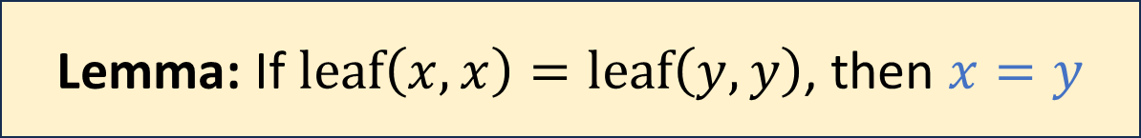
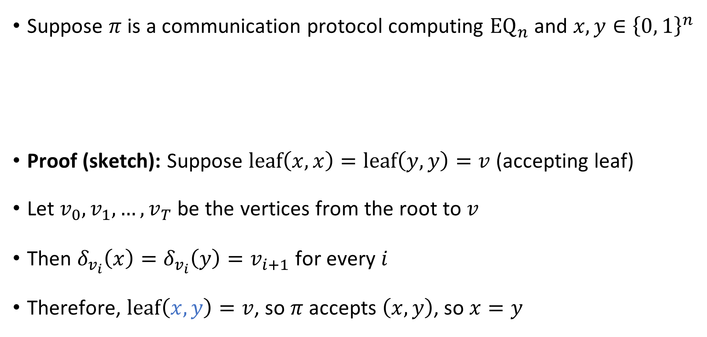
Leaf structure
Suppose $π$ is a communication protocol computing ${\text{EQ}}_{n}$ and $x,y∈{\left\{0, 1\right\}}^{n}$
Proof (sketch): Suppose $\text{leaf}\left(x,x\right)=\text{leaf}\left(y,y\right)=v$ (accepting leaf)
Let $v_{0},v_{1},…, v_{T}$ be the vertices from the root to $v$
Then $δ_{v_{i}}\left(x\right)=δ_{v_{i}}\left(y\right)=v_{i+1}$ for every $i$
Therefore, $\text{leaf}\left(x,y\right)=v$, so $π$ accepts $\left(x,y\right)$, so $x=y$
Lemma: If $\text{leaf}\left(x,x\right)=\text{leaf}\left(y,y\right)$, then $x=y$

Slide 16
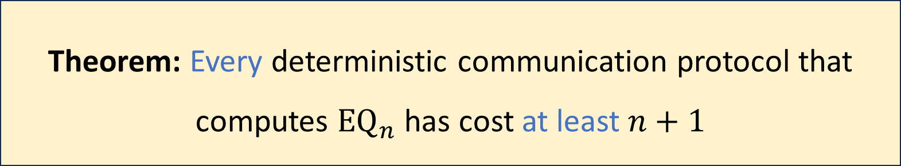
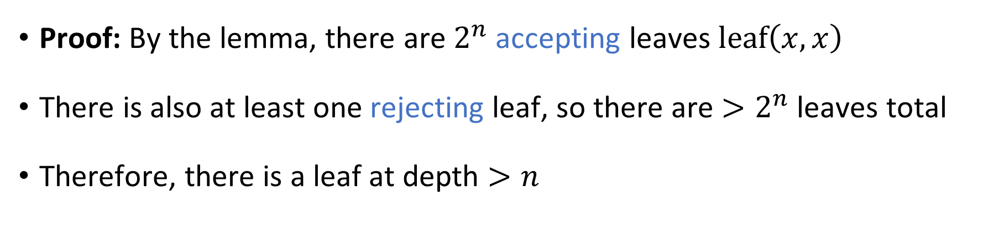
Communication complexity of equality
Theorem: Every deterministic communication protocol that computes ${\text{EQ}}_{n}$ has cost at least $n+1$
Proof: By the lemma, there are $2^{n}$ accepting leaves $\text{leaf}\left(x, x\right)$
There is also at least one rejecting leaf, so there are $>2^{n}$ leaves total
Therefore, there is a leaf at depth $>n$

Slide 17
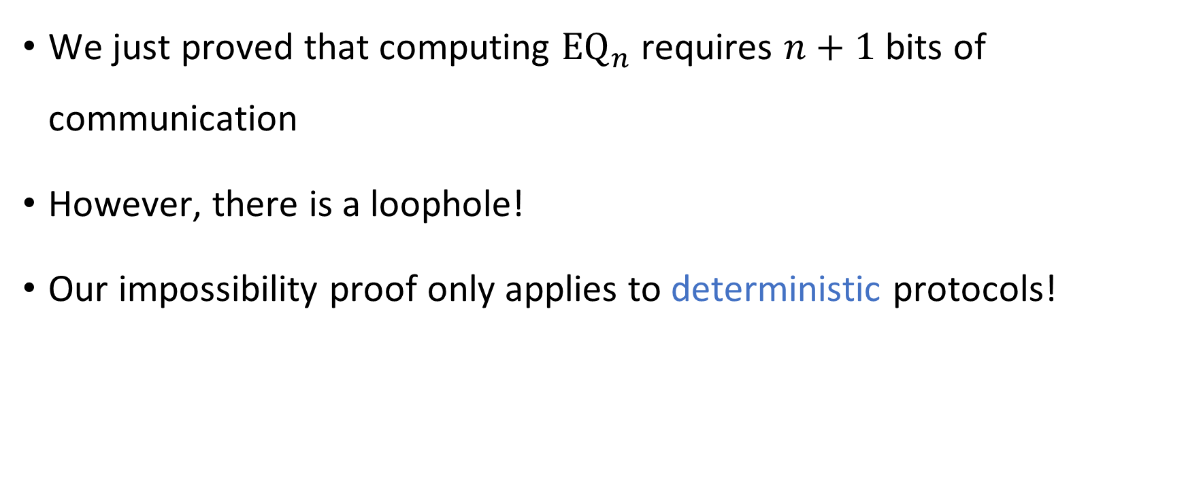

Communication complexity of ${\text{EQ}}_{n}$
We just proved that computing ${\text{EQ}}_{n}$ requires $n+1$ bits of communication
However, there is a loophole!
Our impossibility proof only applies to deterministic protocols!

Slide 18


Randomized communication complexity
In a randomized communication protocol, Alice and Bob are permitted to make decisions based on coin tosses
Communication channel
Alice holds $x$
Bob holds $y$

Slide 19
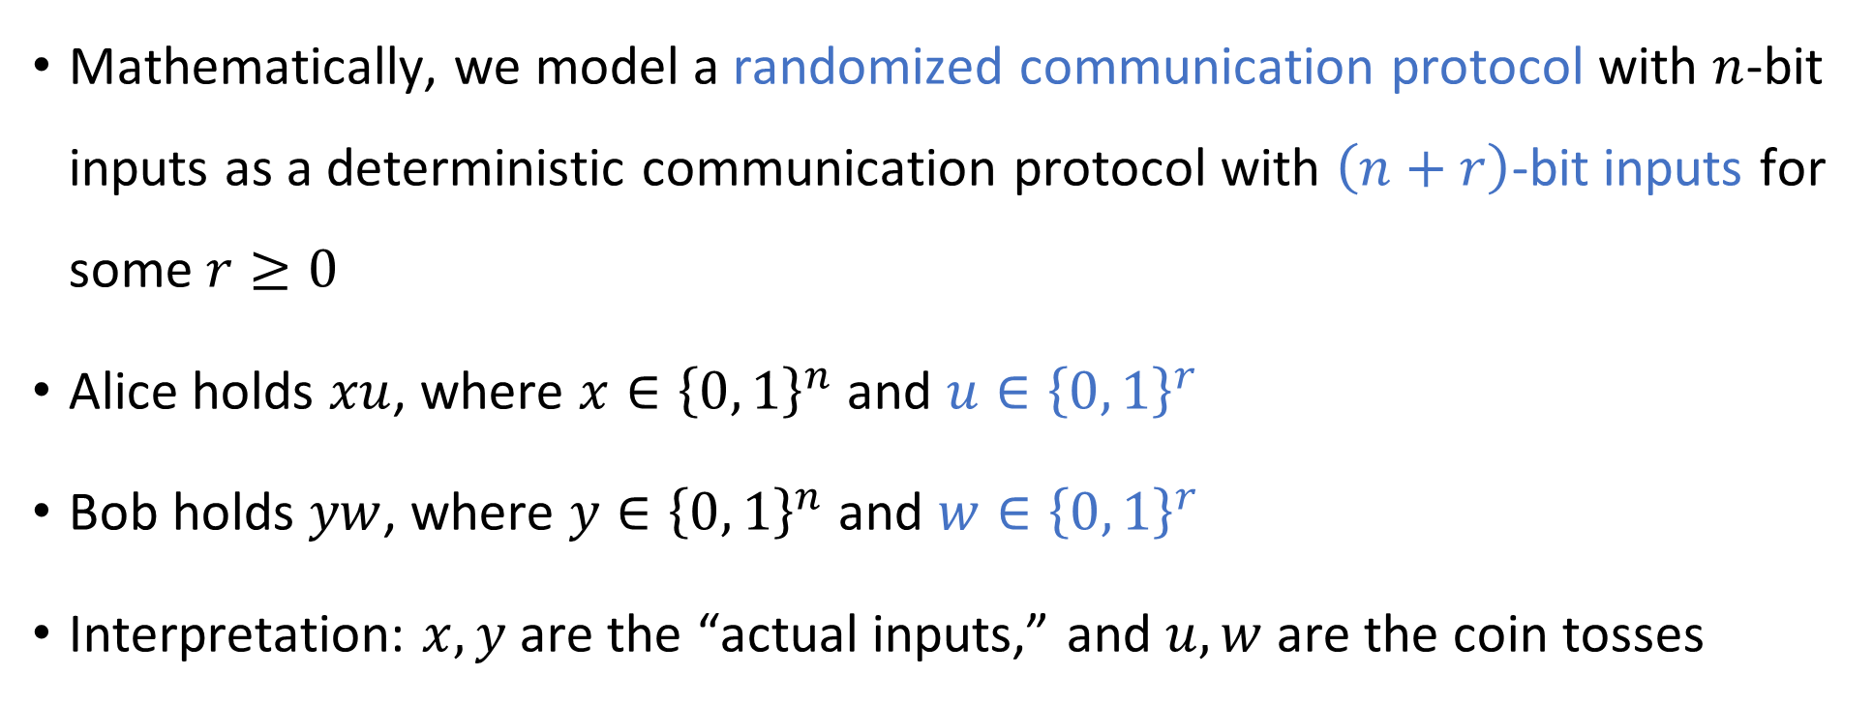
Randomized communication protocols
Mathematically, we model a randomized communication protocol with $n$-bit inputs as a deterministic communication protocol with $\left(n+r\right)$-bit inputs for some $r≥0$
Alice holds $xu$, where $x∈{\left\{0, 1\right\}}^{n}$ and $u∈{\left\{0, 1\right\}}^{r}$
Bob holds $yw$, where $y∈{\left\{0, 1\right\}}^{n}$ and $w∈{\left\{0, 1\right\}}^{r}$
Interpretation: $x, y$ are the “actual inputs,” and $u, w$ are the coin tosses

Slide 20
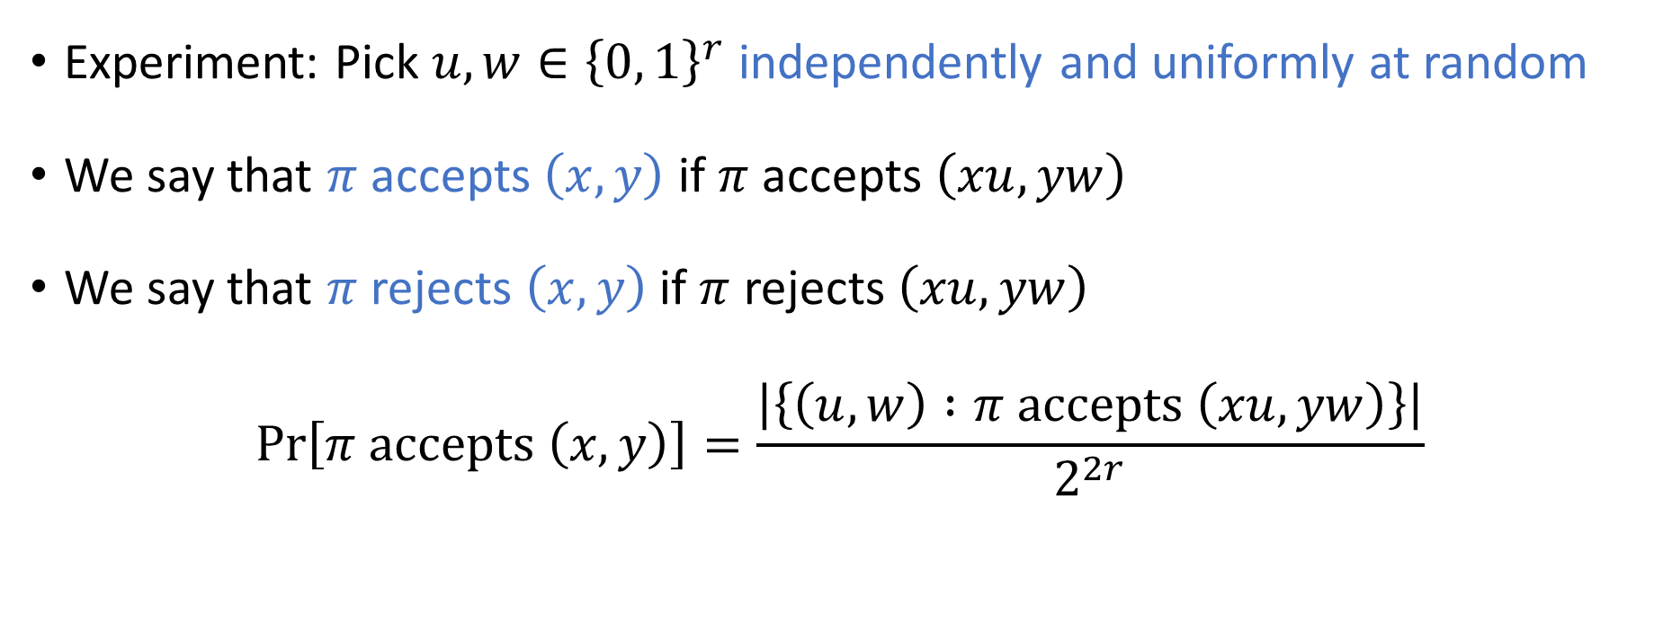
Randomized protocols: Accepting/rejecting
Experiment: Pick $u,w∈{\left\{0, 1\right\}}^{r}$ independently and uniformly at random
We say that $π$ accepts $\left(x,y\right)$ if $π$ accepts $\left(xu, yw\right)$
We say that $π$ rejects $\left(x,y\right)$ if $π$ rejects $\left(xu, yw\right)$
$$\operatorname{Pr}\left[π \text{accepts} \left(x, y\right)\right]=\frac{\left|\left\{\left(u, w\right) :π \text{accepts} \left(xu, yw\right)\right\}\right|}{2^{2r}}$$

Slide 21
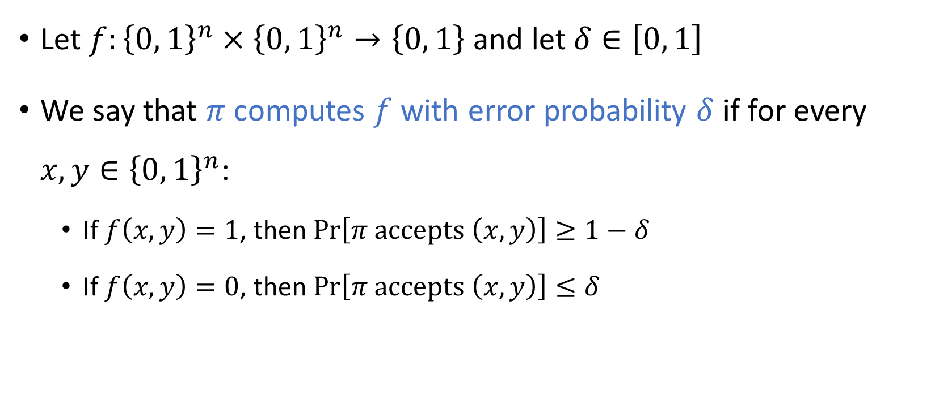
Randomized protocols: Computing a function
Let $f:{\left\{0, 1\right\}}^{n}×{\left\{0, 1\right\}}^{n}→\left\{0, 1\right\}$ and let $δ∈\left[0, 1\right]$
We say that $π$ computes $f$ with error probability $δ$ if for every $x,y∈{\left\{0, 1\right\}}^{n}$:
  If $f\left(x,y\right)=1$, then $\operatorname{Pr}\left[π \text{accepts} \left(x,y\right)\right]≥1−δ$
  If $f\left(x,y\right)=0$, then $\operatorname{Pr}\left[π \text{accepts} \left(x,y\right)\right]≤δ$

Slide 22

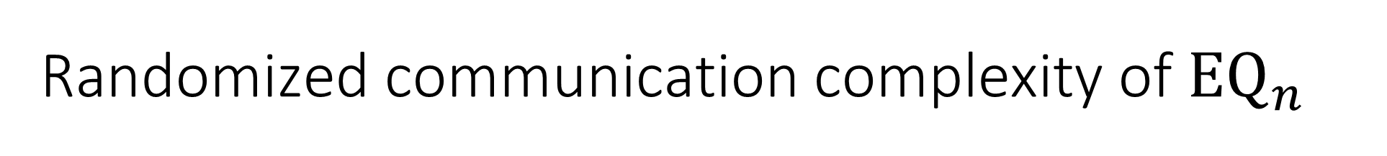
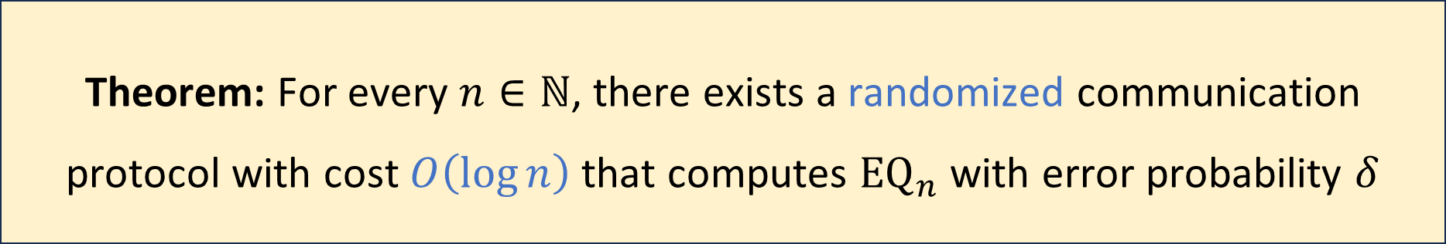
Randomized communication complexity of ${\text{EQ}}_{n}$
Let $δ>0$ be any constant
Randomized protocols are exponentially better than deterministic protocols!
Proof: Next three slides
Theorem: For every $n∈ℕ$, there exists a randomized communication protocol with cost $O\left(\log{n}\right)$ that computes ${\text{EQ}}_{n}$ with error probability $δ$

Slide 23
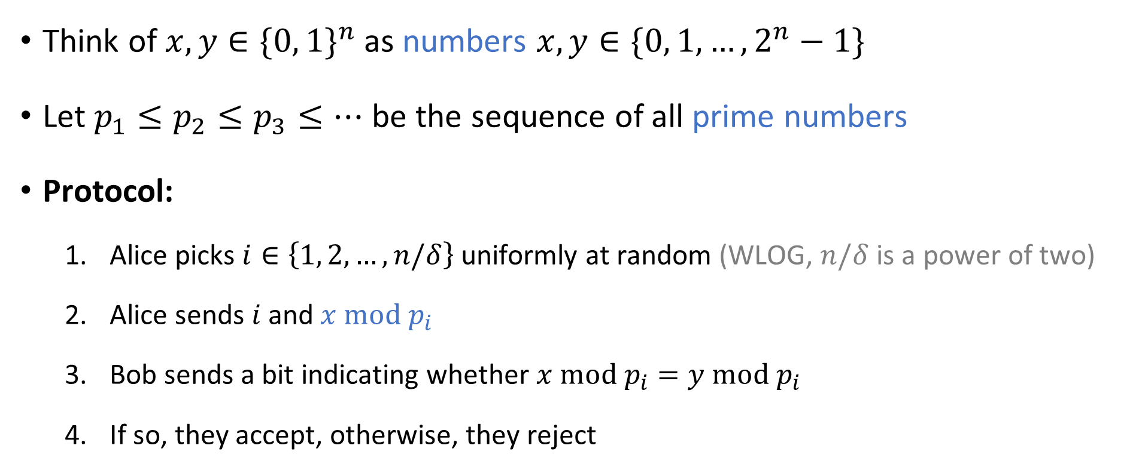

Randomized protocol for ${\text{EQ}}_{n}$
Think of $x,y∈\{0, 1\}^{n}$ as numbers $x,y∈\{0, 1, …, 2^{n}−1\}$
Let $p_{1}≤p_{2}≤p_{3}≤…$ be the sequence of all prime numbers
Protocol:
  Alice picks $i∈\left\{1, 2, …, n/δ\right\}$ uniformly at random (WLOG, $n/δ$ is a power of two)
  Alice sends $i$ and$x \text{mod} p_{i}$
  Bob sends a bit indicating whether $x \text{mod} p_{i}=y \text{mod} p_{i}$
  If so, they accept, otherwise, they reject

Slide 24

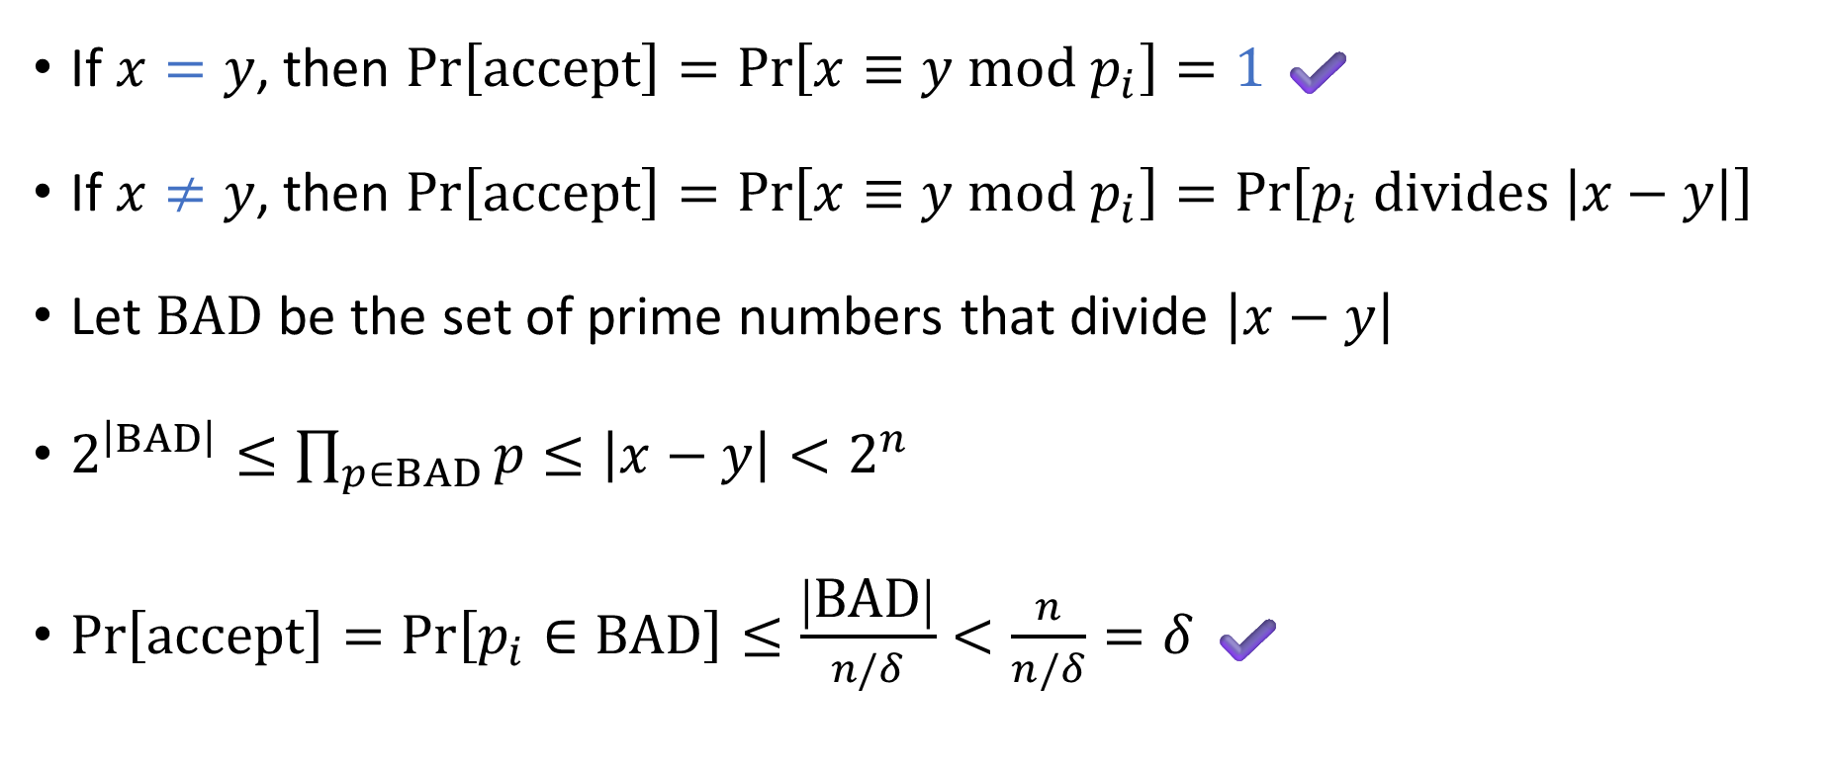
Analysis of the protocol: Correctness
Protocol:
Pick $i∈\left\{1, 2, …, n/δ\right\}$ u.a.r.
Send $i$ and $x \text{mod} p_{i}$
Check whether $x≡y \text{mod} p_{i}$
If $x=y$, then $Pr\left[\text{accept}\right]=\operatorname{Pr}\left[x≡y \text{mod} p_{i}\right]=1$ ✔️
If $x≠y$, then $\operatorname{Pr}\left[\text{accept}\right]=\operatorname{Pr}\left[x≡y \text{mod} p_{i}\right]=\operatorname{Pr}\left[p_{i} \text{divides} \left|x−y\right|\right]$
Let $\text{BAD}$ be the set of prime numbers that divide $\left|x−y\right|$
$2^{\left|BAD\right|}≤\prod_{p∈BAD}{p}≤\left|x−y\right|<2^{n}$
$\operatorname{Pr}\left[\text{accept}\right]=\operatorname{Pr}\left[p_{i}∈\text{BAD}\right]≤\frac{\left|\text{BAD}\right|}{n/δ}<\frac{n}{n/δ}=δ$ ✔️

Slide 25
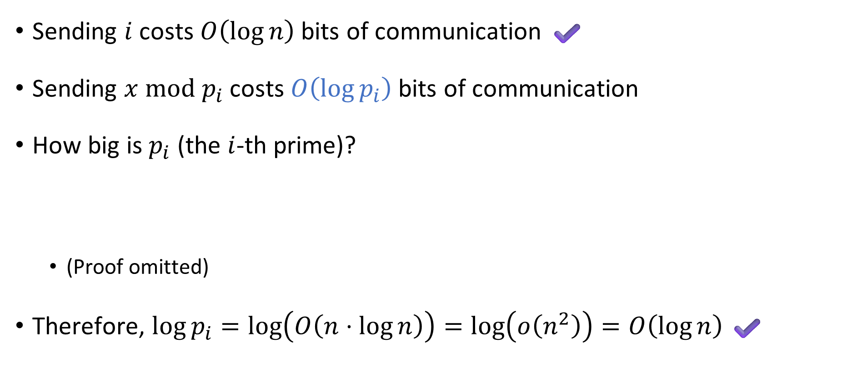
Analysis of the protocol: Efficiency
Protocol:
Pick $i∈\left\{1, 2, …, n/δ\right\}$ u.a.r.
Send $i$ and $x \text{mod} p_{i}$
Check whether $x≡y \text{mod} p_{i}$
Sending $i$ costs $O\left(\log{n}\right)$ bits of communication ✔️
Sending $x \text{mod} p_{i}$ costs $O\left(\log{p_{i}}\right)$ bits of communication
How big is $p_{i}$ (the $i$-th prime)?
  (Proof omitted)
Therefore, $\log{p_{i}}=\log\left(O\left(n⋅\log{n}\right)\right)=\log\left(o\left(n^{2}\right)\right)=O\left(\log{n}\right)$ ✔️
Chebyshev’s Estimate: Let $p_{k}$ be the $k$-th prime. Then $p_{k}=O\left(k⋅\log{k}\right)$.
Notes:
The “Prime Number Theorem” is a famous, more refined variant of Chebyshev’s Estimate. https://en.wikipedia.org/wiki/Prime_number_theorem

Slide 26

Recap: The power of randomness
Is randomness useful?
For communication protocols: Yes!
For Turing machines: Probably not much
  Conjecture: $\text{P}=\text{BPP}$

