Slide 1
CMSC 28100
Introduction to Complexity Theory
Autumn 2025
Instructor: William Hoza
⏳

Slide 2

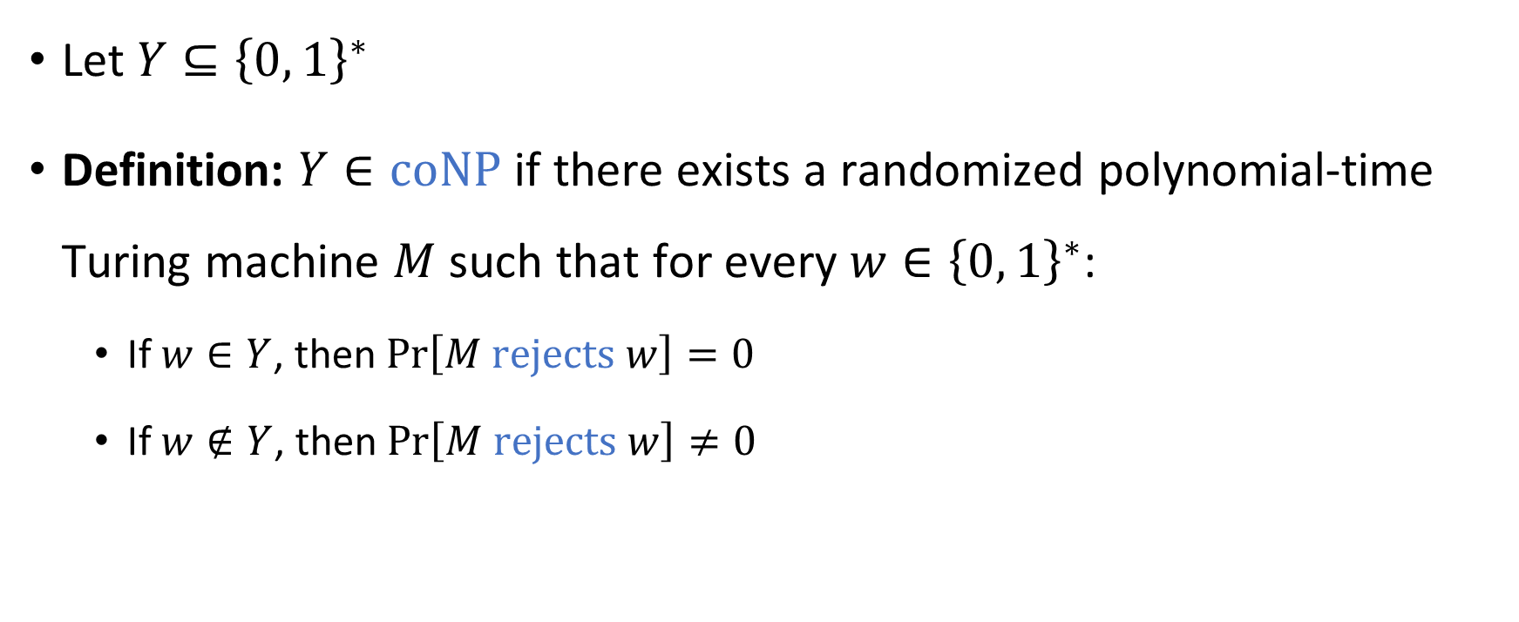

The complexity class $co\text{NP}$
Let $Y⊆{\left\{0, 1\right\}}^{∗}$
Definition: $Y∈\text{coNP}$ if there exists a randomized polynomial-time Turing machine $M$ such that for every $w∈{\left\{0, 1\right\}}^{∗}$:
  If $w∈Y$, then $\operatorname{Pr}\left[M \text{rejects} w\right]=0$
  If $w∉Y$, then $\operatorname{Pr}\left[M \text{rejects} w\right]≠0$

Slide 3


The complexity class $\text{coNP}$
Let $Y⊆{\left\{0, 1\right\}}^{∗}$ and let $\overline{Y}={\left\{0, 1\right\}}^{∗}∖Y$
Fact: $Y∈\text{NP}$ if and only if $\overline{Y}∈\text{coNP}$
$\text{coNP}$ is the set of complements of languages in $\text{NP}$

Slide 4
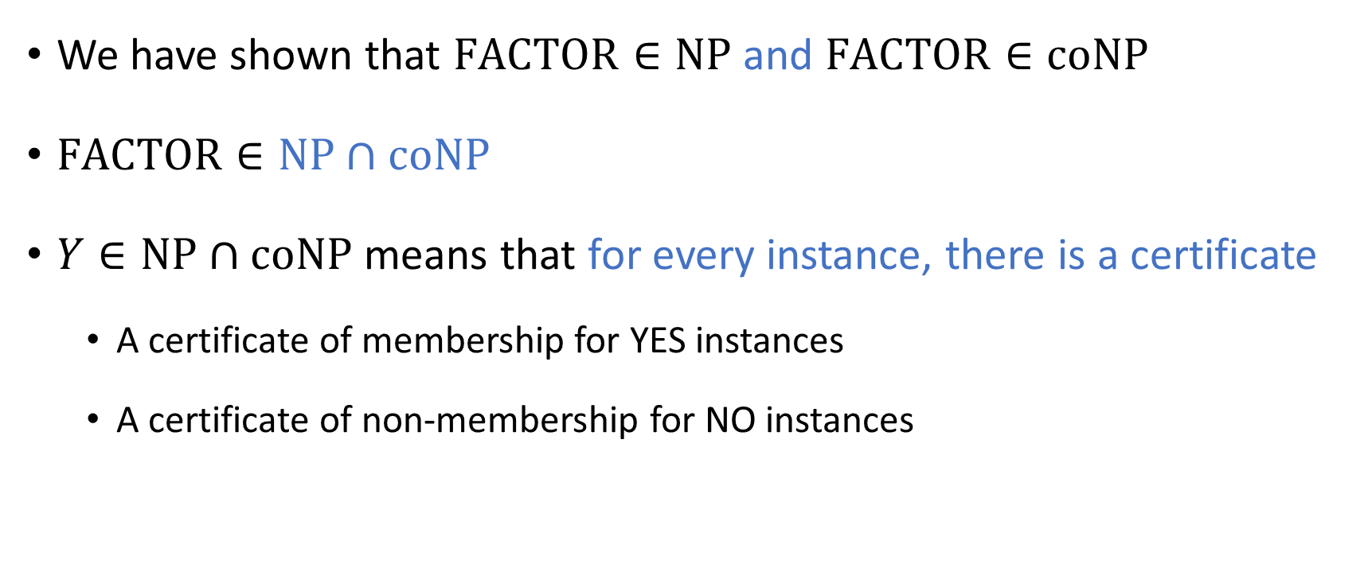

The complexity class $\text{NP}∩\text{coNP}$
We have shown that $\text{FACTOR}∈\text{NP}$ and $\text{FACTOR}∈\text{coNP}$
$\text{FACTOR}∈\text{NP}∩\text{coNP}$
$Y∈\text{NP}∩\text{coNP}$ means that for every instance, there is a certificate
  A certificate of membership for YES instances
  A certificate of non-membership for NO instances

Slide 5
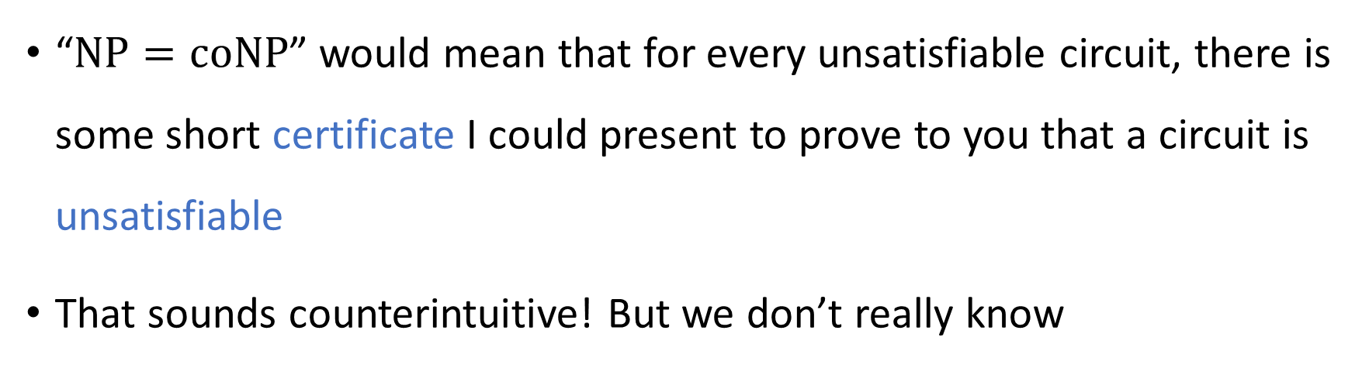


The $\text{NP}$ vs. $\text{coNP}$ problem
Conjecture: $\text{NP}≠\text{coNP}$
“$\text{NP}=\text{coNP}$” would mean that for every unsatisfiable circuit, there is some short certificate I could present to prove to you that a circuit is unsatisfiable
That sounds counterintuitive! But we don’t really know

Slide 6






$$\text{PSPACE}$$
$$\text{coNP}$$
$$\text{NP}$$
$$\text{FACTOR}$$
$$\text{NP}∩\text{coNP}$$
$$\text{P}$$

Slide 7
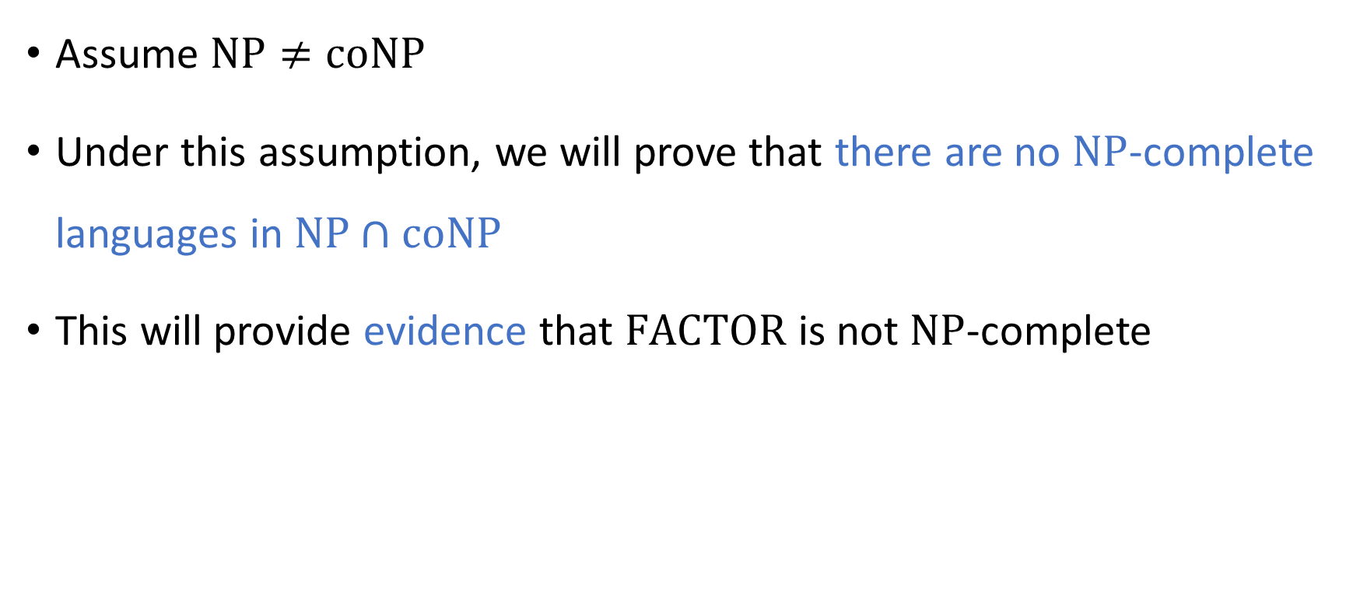
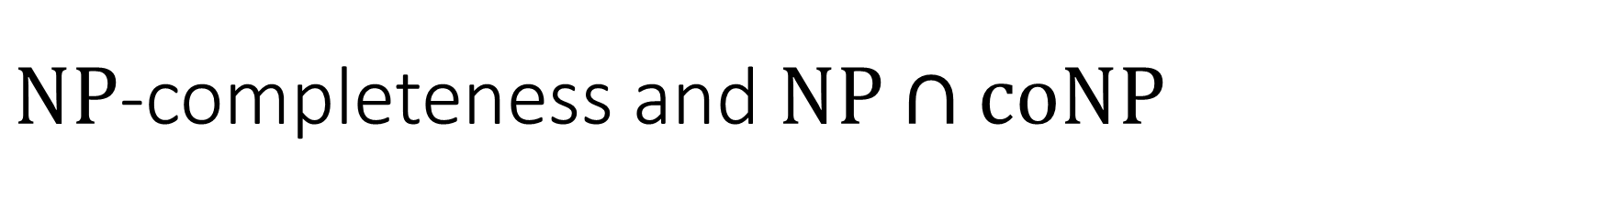
$\text{NP}$-completeness and $\text{NP}∩\text{coNP}$
Assume $\text{NP}≠\text{coNP}$
Under this assumption, we will prove that there are no $\text{NP}$-complete languages in $\text{NP}∩\text{coNP}$
This will provide evidence that $\text{FACTOR}$ is not $\text{NP}$-complete

Slide 8







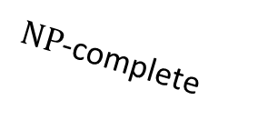

$\text{coNP}$-hard
$\text{NP}$-hard
$\text{coNP}$-complete
$\text{NP}$-complete
$$\text{coNP}$$
$$\text{NP}$$
$$\text{FACTOR}$$
$$\text{NP}∩\text{coNP}$$
$$\text{P}$$

Slide 9
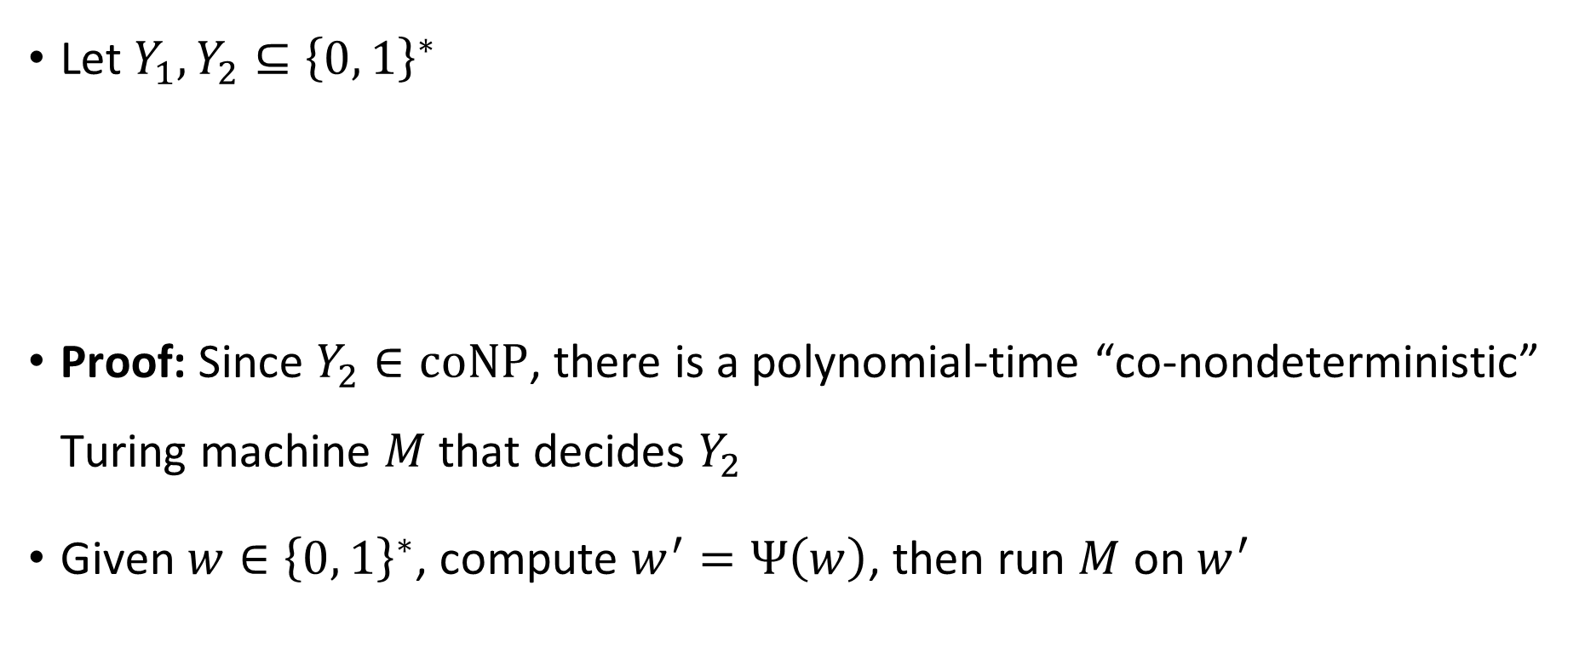

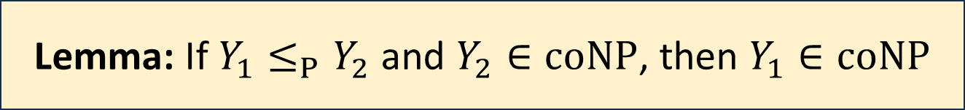
$\text{coNP}$ is closed under reductions
Let $Y_{1},Y_{2}⊆{\left\{0, 1\right\}}^{∗}$
Proof: Since $Y_{2}∈\text{coNP}$, there is a polynomial-time “co-nondeterministic” Turing machine $M$ that decides $Y_{2}$
Given $w∈{\left\{0, 1\right\}}^{∗}$, compute $w^{′}=Ψ\left(w\right)$, then run $M$ on $w^{′}$
Lemma: If $Y_{1}≤_{P}Y_{2}$ and $Y_{2}∈\text{coNP}$, then $Y_{1}∈\text{coNP}$

Slide 10

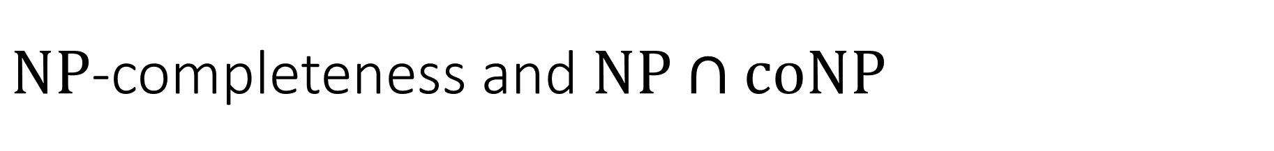

$\text{NP}$-completeness and $\text{NP}∩\text{coNP}$
Let $Y∈\text{NP}∩\text{coNP}$
Proof: For any $Z∈\text{NP}$, we have $Z≤_{P}Y$ and $Y∈\text{coNP}$
By the lemma, $Z∈\text{coNP}$, so $\text{NP}⊆\text{coNP}$
By symmetry, we also have $\text{coNP}⊆\text{NP}$
Claim: If $Y$ is $\text{NP}$-complete, then $\text{NP}=\text{coNP}$

Slide 11
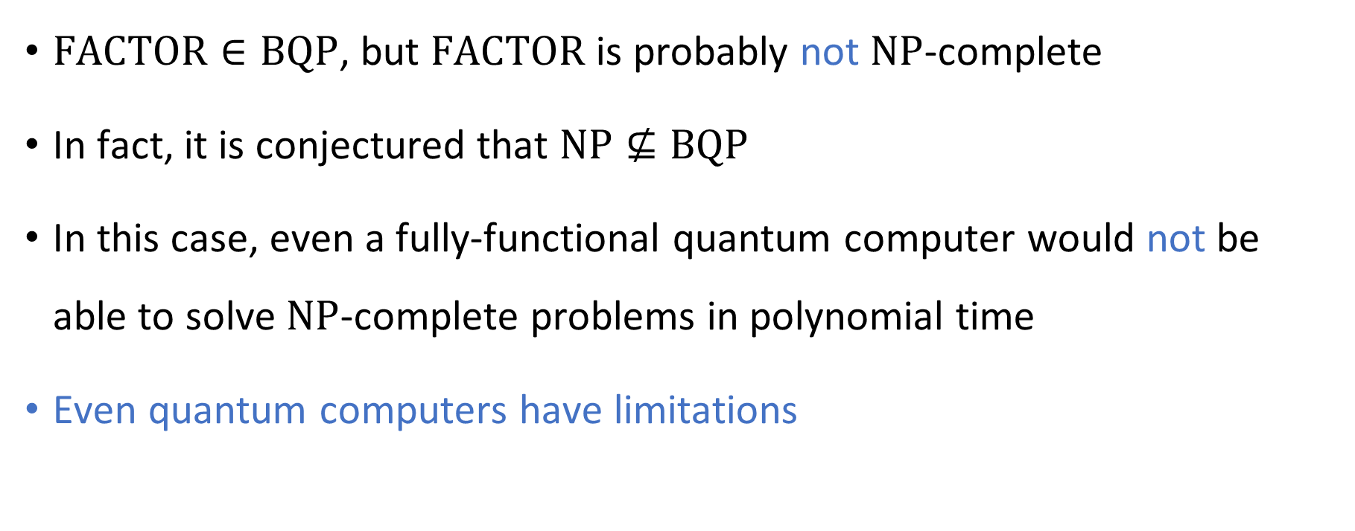
Quantum computing is not a panacea
$\text{FACTOR}∈\text{BQP}$, but $\text{FACTOR}$ is probably not $\text{NP}$-complete
In fact, it is conjectured that $\text{NP}⊈\text{BQP}$
In this case, even a fully-functional quantum computer would not be able to solve $\text{NP}$-complete problems in polynomial time
Even quantum computers have limitations

Slide 12








$\text{NP}$-hard
$$\text{3}\text{‑}\text{SAT}$$
$$\text{PSPACE}$$
$\text{NP}$-complete
$$\text{NP}$$
$$\text{FACTOR}$$
$$\text{BQP}$$
$$\text{P}$$

Slide 13
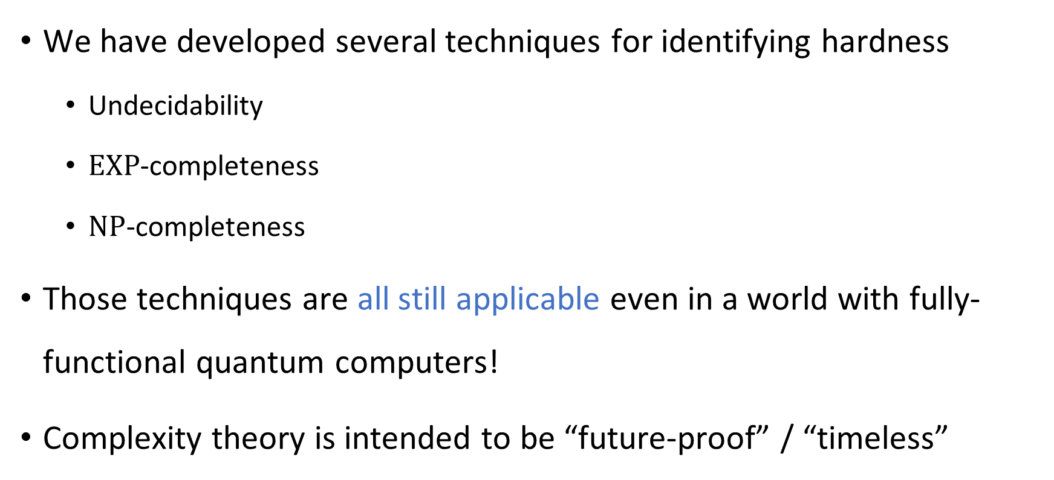
Limitations of quantum computers
We have developed several techniques for identifying hardness
  Undecidability
  $\text{EXP}$-completeness
  $\text{NP}$-completeness
Those techniques are all still applicable even in a world with fully-functional quantum computers!
Complexity theory is intended to be “future-proof” / “timeless”

Slide 14
Which problems can be solved through computation?
CLASSICAL

Slide 15
Intractability
Main topic of this course: How to identify intractability
Previous few days: How to cope with intractability
Up next: How to exploit intractability

Slide 16
Cryptography

Slide 17


Public-key encryption
How can Alice send a private message to Bob?
Public key
Public key
Public key
Private key
“My address is 5730 S Ellis Ave, Chicago, IL”
bW9ua2V5ZXF1aXBtZW50bnV0c3doZXJldmVyZmluZG5lYXJieWhpc3RvcnlvcmJpdGNyZXdi
bW9ua2V5ZXF1aXBtZW50bnV0c3doZXJldmVyZmluZG5lYXJieWhpc3RvcnlvcmJpdGNyZXdi
“My address is 5730 S Ellis Ave, Chicago, IL”
Ciphertext
Encrypt
Decrypt
Plaintext
Ciphertext
Ciphertext
Plaintext
😈
Alice
Bob
Eve

Slide 18
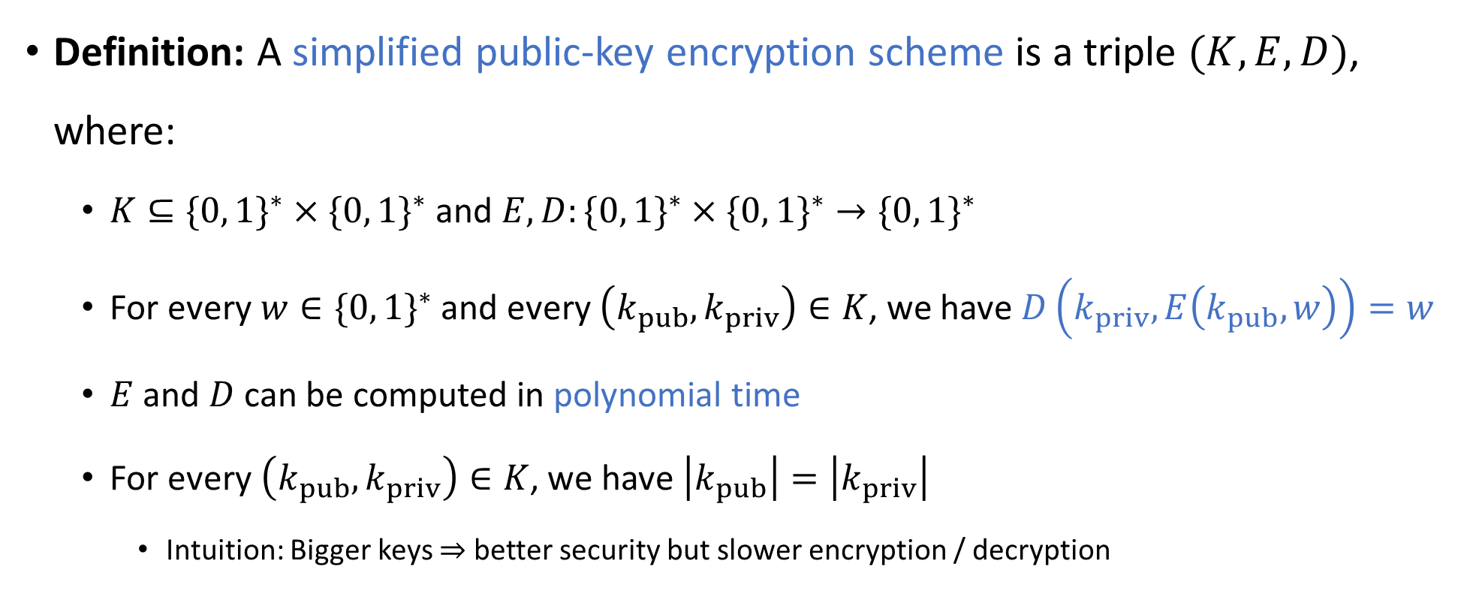
Public-key encryption scheme
“encrypt”
“keys”
“decrypt”
Definition: A simplified public-key encryption scheme is a triple $(K,E,D)$, where:
  $K⊆\{0, 1\}^{∗}×\{0, 1\}^{∗}$ and $E,D:\{0, 1\}^{∗}×\{0, 1\}^{∗}→\{0, 1\}^{∗}$
  For every $w∈\{0, 1\}^{∗}$ and every $\left(k_{pub},k_{priv}\right)∈K$, we have $D\left(k_{priv},E\left(k_{pub},w\right)\right)=w$
  $E$ and $D$ can be computed in polynomial time
  For every $\left(k_{pub},k_{priv}\right)∈K$, we have $\left|k_{pub}\right|=\left|k_{priv}\right|$
    Intuition: Bigger keys $⇒$ better security but slower encryption / decryption
Notes:
Justification for the last condition: This means that E and D have the same time budget

Slide 19
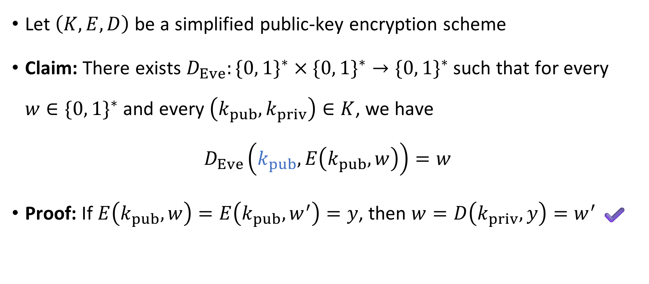

Decrypting without $k_{priv}$
😈
Let $\left(K,E,D\right)$ be a simplified public-key encryption scheme
Claim: There exists $D_{Eve}:\{0, 1\}^{∗}×\{0, 1\}^{∗}→\{0, 1\}^{∗}$ such that for every $w∈\{0, 1\}^{∗}$ and every $\left(k_{pub},k_{priv}\right)∈K$, we have
$$D_{Eve}\left(k_{pub},E\left(k_{pub},w\right)\right)=w$$
Proof: If $E\left(k_{pub},w\right)=E\left(k_{pub},w^{′}\right)=y$, then $w=D\left(k_{priv},y\right)=w^{′}$ ✔️

Slide 20
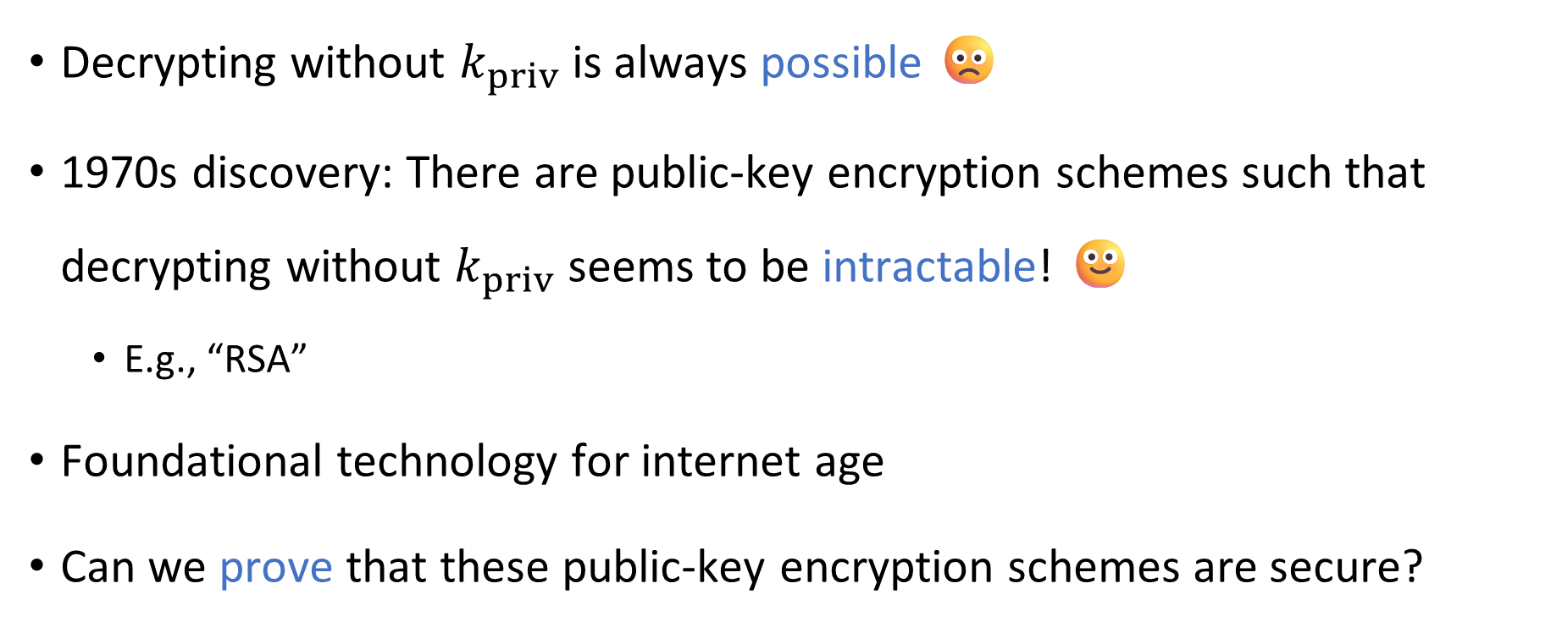
Complexity theory to the rescue?
⏳
Decrypting without $k_{priv}$ is always possible 🙁
1970s discovery: There are public-key encryption schemes such that decrypting without $k_{priv}$ seems to be intractable! 🙂
  E.g., “RSA”
Foundational technology for internet age
Can we prove that these public-key encryption schemes are secure?

Slide 21


Cryptography and $\text{P}$ vs. $\text{NP}$
Let $\left(K, E, D\right)$ be a simplified public-key encryption scheme
There is a function $D_{Eve}$ such that $D_{Eve}\left(k_{pub}, E\left(k_{pub},w\right)\right)=w$
Theorem: If $\text{P}=\text{NP}$, then $D_{Eve}$ can be computed in polynomial time ☹️
Notes:
A technicality: D_Eve isn’t completely well-defined, due to invalid public keys. The meaning of the theorem is that there exists a poly-time algorithm that computes D_Eve in the cases where it is well-defined.

Slide 22

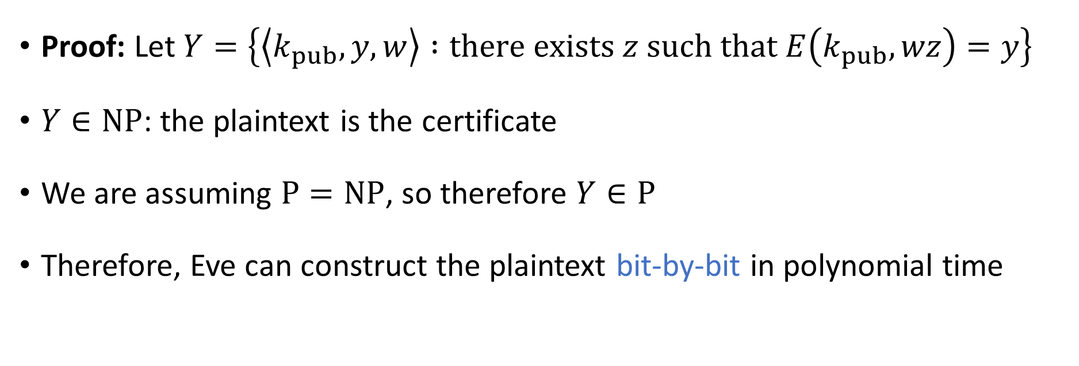
Cryptography and $\text{P}$ vs. $\text{NP}$
Theorem: If $\text{P}=\text{NP}$, then $D_{Eve}$ can be computed in polynomial time ☹️
Proof: Let $Y=\left\{\left\langle k_{pub},y,w\right\rangle :\text{there} \text{exists} z \text{such} \text{that} E\left(k_{pub},wz\right)=y\right\}$
$Y∈\text{NP}$: the plaintext is the certificate
We are assuming $\text{P}=\text{NP}$, so therefore $Y∈\text{P}$
Therefore, Eve can construct the plaintext bit-by-bit in polynomial time

Slide 23

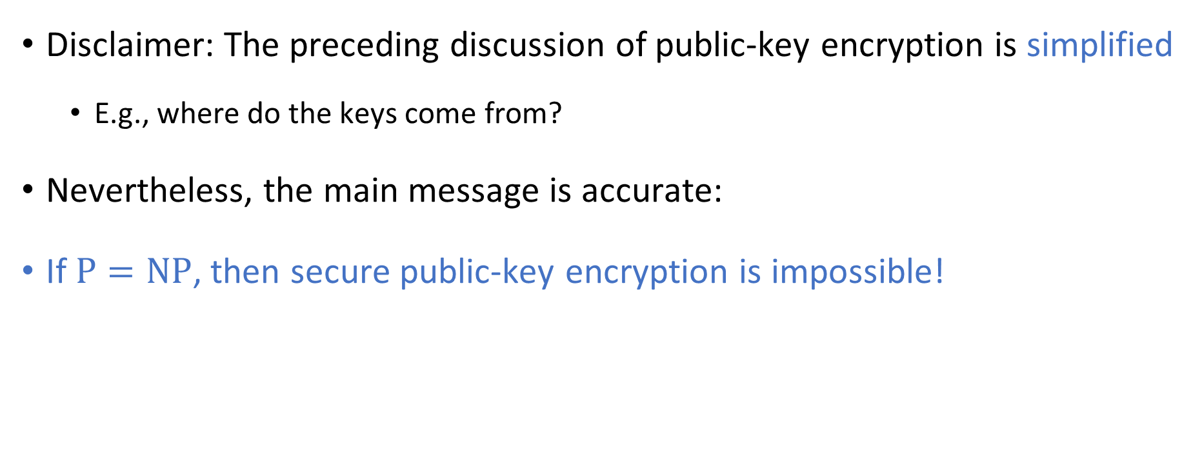
Cryptography and $\text{P}$ vs. $\text{NP}$
Disclaimer: The preceding discussion of public-key encryption is simplified
  E.g., where do the keys come from?
Nevertheless, the main message is accurate:
If $\text{P}=\text{NP}$, then secure public-key encryption is impossible!
Notes:
See, e.g., “Introduction to Modern Cryptography” by Katz and Lindell if you want to see a proper definition of a secure public-key encryption scheme.

Slide 24
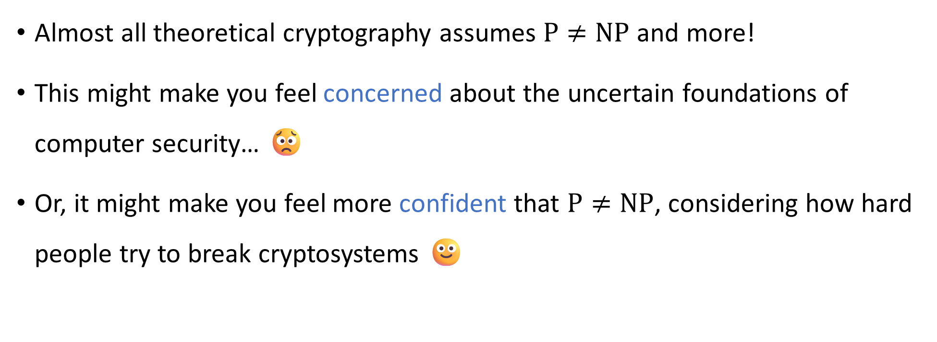
Cryptography and $\text{P}$ vs. $\text{NP}$
Almost all theoretical cryptography assumes $\text{P}≠\text{NP}$ and more!
This might make you feel concerned about the uncertain foundations of computer security… 😟
Or, it might make you feel more confident that $\text{P}≠\text{NP}$, considering how hard people try to break cryptosystems 🙂

