Slide 1
CMSC 28100
Introduction to Complexity Theory
Autumn 2025
Instructor: William Hoza
⏳

Slide 2
Coping with intractability

Slide 3

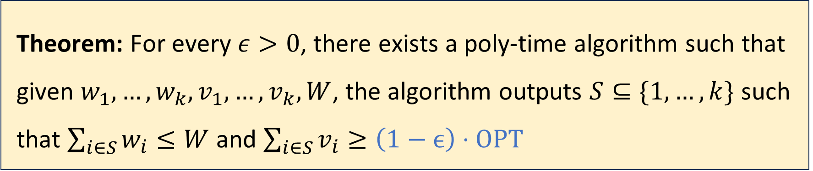
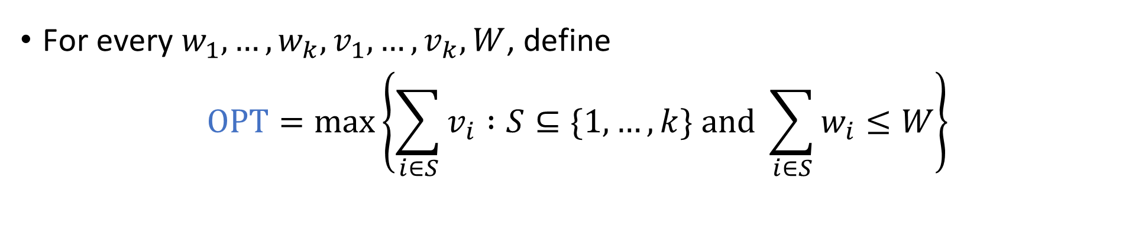
Approximation algorithm for Knapsack
For every $w_{1},…, w_{k}, v_{1},…, v_{k},W$, define
$$\text{OPT}=\max\left\{\sum_{i∈S}{v_{i}} :S⊆\{1, …, k\} \text{and} \sum_{i∈S}{w_{i}}≤W\right\}$$
Theorem: For every $ε>0$, there exists a poly-time algorithm such that given $w_{1},…, w_{k}, v_{1},…, v_{k}, W$, the algorithm outputs $S⊆\{1, …, k\}$ such that $\sum_{i∈S}{w_{i}}≤W$ and $\sum_{i∈S}{v_{i}}≥\left(1−ϵ\right)⋅\text{OPT}$

Slide 4
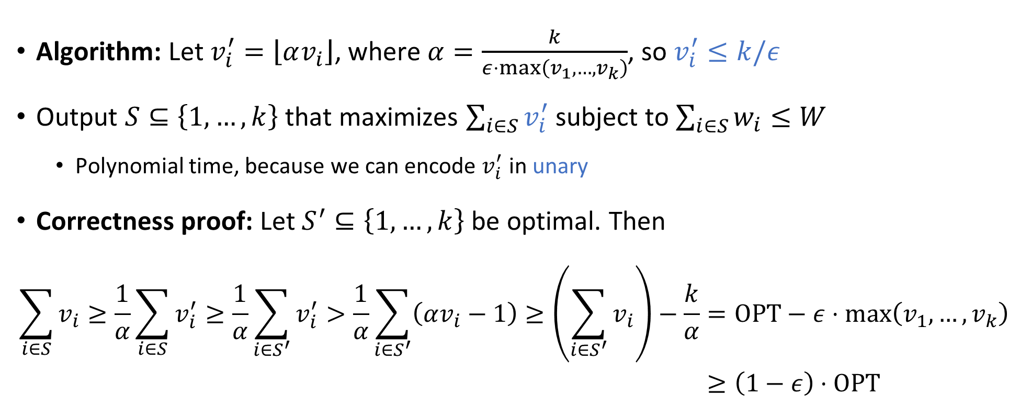
Approximation algorithm for Knapsack
Algorithm: Let $v_{i}^{′}=\left\lfloor αv_{i}\right\rfloor$, where $α=\frac{k}{ε⋅\max\left(v_{1},…, v_{k}\right)}$, so $v_{i}^{′}≤k/ε$
Output $S⊆\left\{1, …, k\right\}$ that maximizes $\sum_{i∈S}{v_{i}^{′}}$ subject to $\sum_{i∈S}{w_{i}}≤W$
  Polynomial time, because we can encode $v_{i}^{′}$ in unary
Correctness proof: Let $S^{′}⊆\left\{1, …, k\right\}$ be optimal. Then
$$\sum_{i∈S}{v_{i}}≥\frac{1}{α}\sum_{i∈S}{v_{i}^{′}}≥\frac{1}{α}\sum_{i∈S^{′}}{v_{i}^{′}}>\frac{1}{α}\sum_{i∈S^{′}}{\left(αv_{i}−1\right)}≥\left(\sum_{i∈S^{′}}{v_{i}}\right)−\frac{k}{α}=\text{OPT}−ε⋅\max\left(v_{1},…, v_{k}\right) \\ ≥\left(1−ε\right)⋅\text{OPT}$$

Slide 5
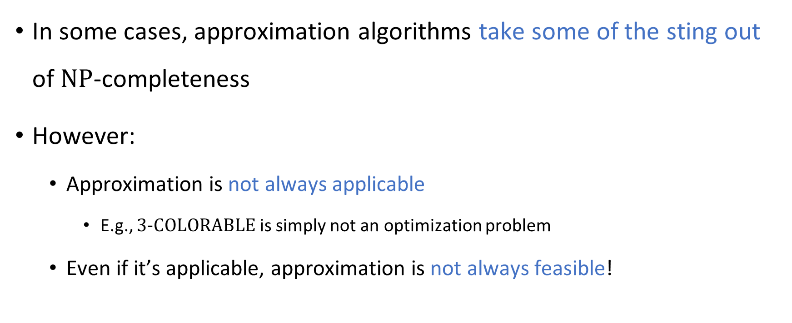
Approximation algorithms are not a panacea
In some cases, approximation algorithms take some of the sting out of $\text{NP}$-completeness
However:
  Approximation is not always applicable
    E.g., $\text{3}‑\text{COLORABLE}$ is simply not an optimization problem
  Even if it’s applicable, approximation is not always feasible!

Slide 6
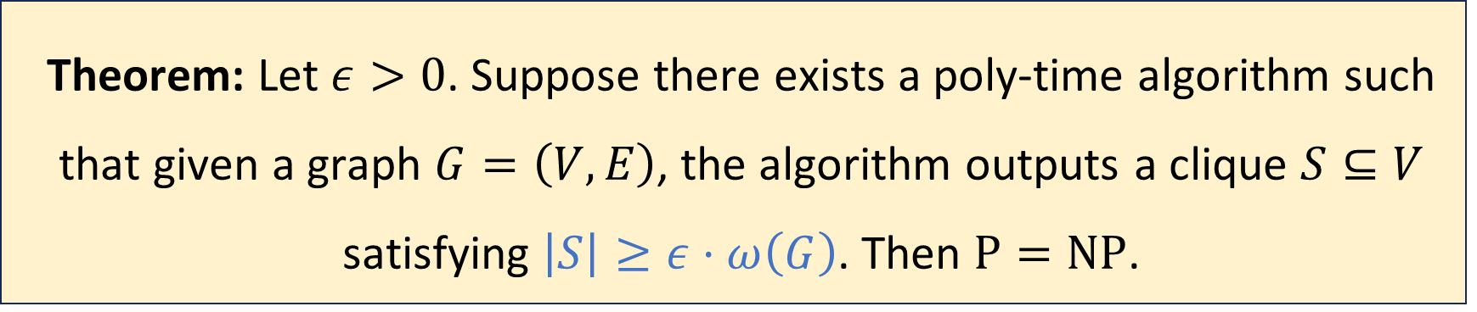

Inapproximability of the clique problem
For a graph $G$, let $ω\left(G\right)$ denote the size of the largest clique in $G$
(Proof omitted. Not on exercises / exams)
Theorem: Let $ε>0$. Suppose there exists a poly-time algorithm such that given a graph $G=\left(V, E\right)$, the algorithm outputs a clique $S⊆V$ satisfying $\left|S\right|≥ε⋅ω\left(G\right)$. Then $\text{P}=\text{NP}$.

Slide 7

Quantum computing
Another approach for coping with intractability: Quantum Computing
A quantum computer is a computational device that uses special features of quantum physics
A detailed discussion of quantum computing is outside the scope of this course
We will discuss only some key facts about quantum computing

Slide 8
Quantum computing
So far, researchers have constructed rudimentary quantum computers
There are huge ongoing efforts to build fully-functional quantum computers

Slide 9
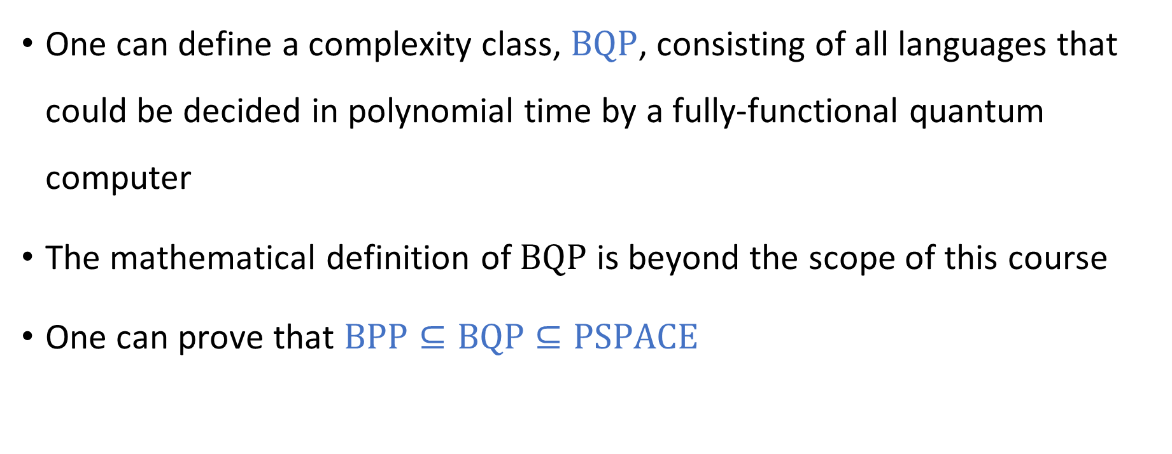
Quantum complexity theory
One can define a complexity class, $\text{BQP}$, consisting of all languages that could be decided in polynomial time by a fully-functional quantum computer
The mathematical definition of $\text{BQP}$ is beyond the scope of this course
One can prove that $\text{BPP}⊆\text{BQP}⊆\text{PSPACE}$

Slide 10

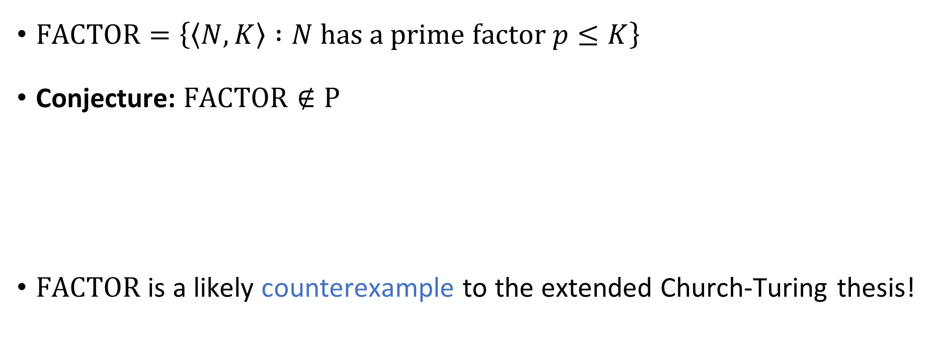
Shor’s algorithm
$\text{FACTOR}=\left\{\left\langle N, K\right\rangle :N \text{has} \text{a} \text{prime} \text{factor} p≤K\right\}$
Conjecture: $\text{FACTOR}∉\text{P}$
$\text{FACTOR}$ is a likely counterexample to the extended Church-Turing thesis!
Theorem (Shor’s algorithm): $\text{FACTOR}∈\text{BQP}$

Slide 11


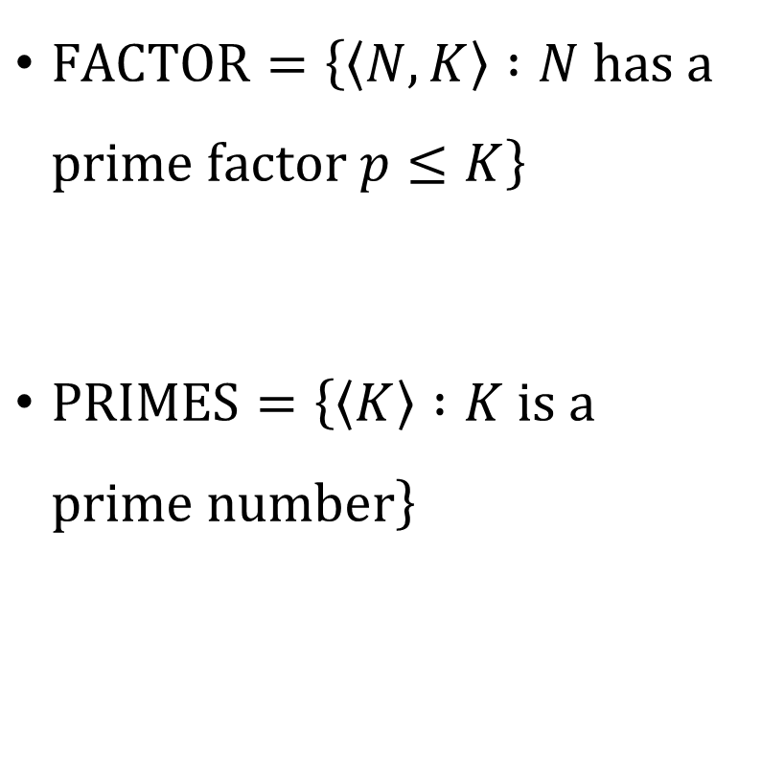


$\text{FACTOR}=\left\{\left\langle N, K\right\rangle :N \text{has} \text{a} \text{prime} \text{factor} p≤K\right\}$
$\text{PRIMES}=\left\{\left\langle K\right\rangle :K \text{is} \text{a} \text{prime} \text{number}\right\}$
$$\text{FACTOR}$$
$$\text{BQP}$$
$$\text{P}$$
$$\text{PRIMES}$$

Slide 12
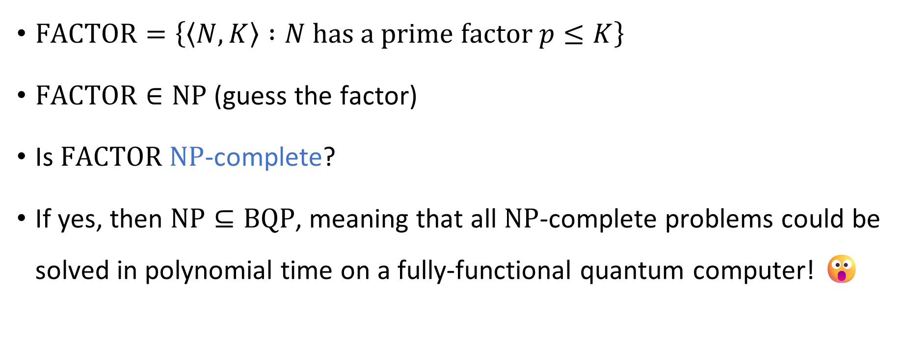

Quantum computing and $\text{NP}$-completeness
$\text{FACTOR}=\left\{\left\langle N, K\right\rangle :N \text{has} \text{a} \text{prime} \text{factor} p≤K\right\}$
$\text{FACTOR}∈\text{NP}$ (guess the factor)
Is $\text{FACTOR}$ $\text{NP}$-complete?
If yes, then $\text{NP}⊆\text{BQP}$, meaning that all $\text{NP}$-complete problems could be solved in polynomial time on a fully-functional quantum computer! 😮

Slide 13
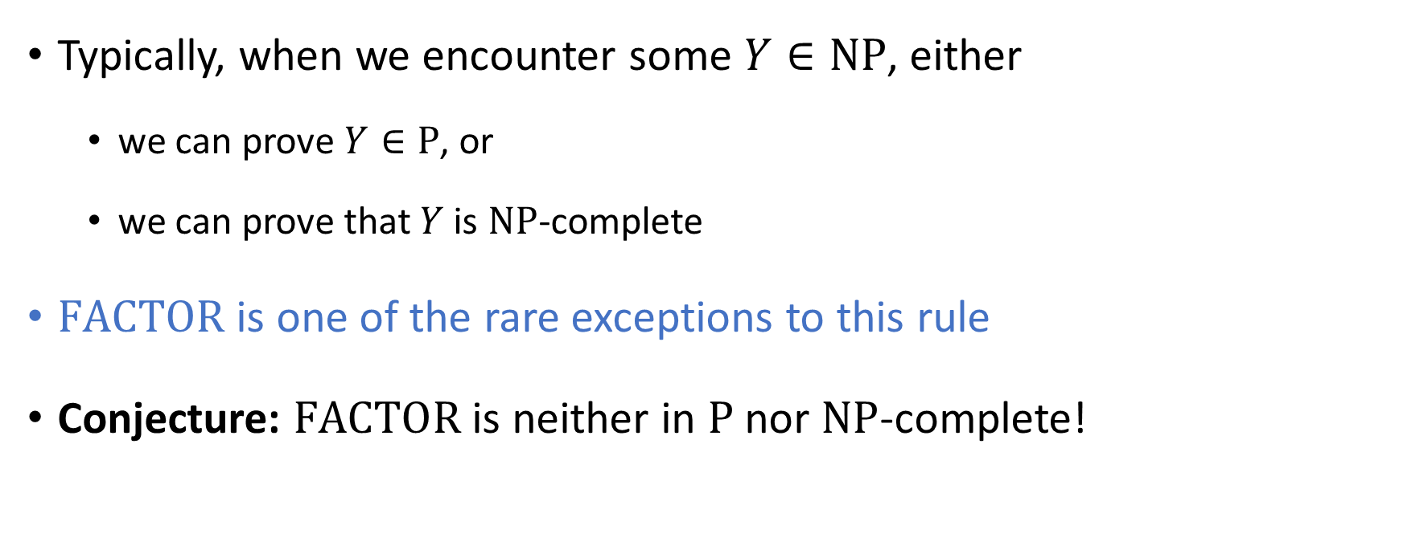
Complexity of factoring integers
Typically, when we encounter some $Y∈\text{NP}$, either
  we can prove $Y∈\text{P}$, or
  we can prove that $Y$ is $\text{NP}$-complete
$\text{FACTOR}$ is one of the rare exceptions to this rule
Conjecture: $\text{FACTOR}$ is neither in $\text{P}$ nor $\text{NP}$-complete!

Slide 14


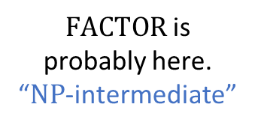




$\text{NP}$-hard
$$\text{3}\text{‑}\text{SAT}$$
$\text{NP}$-complete
$\text{FACTOR}$ is probably here. “$\text{NP}$-intermediate”
$$\text{NP}$$
$$\text{P}$$
$$\text{PRIMES}$$

Slide 15
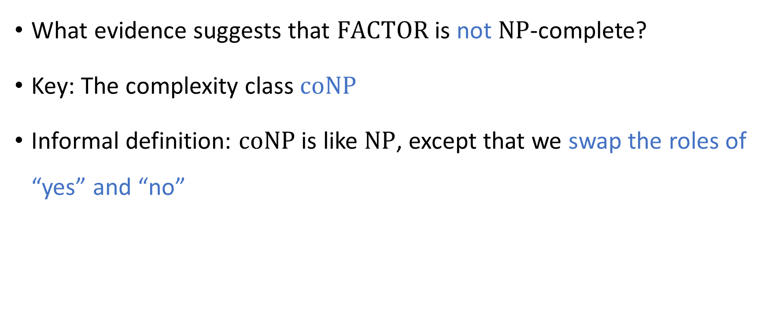
Complexity of factoring integers
What evidence suggests that $\text{FACTOR}$ is not $\text{NP}$-complete?
Key: The complexity class $\text{coNP}$
Informal definition: $\text{coNP}$ is like $\text{NP}$, except that we swap the roles of “yes” and “no”

Slide 16
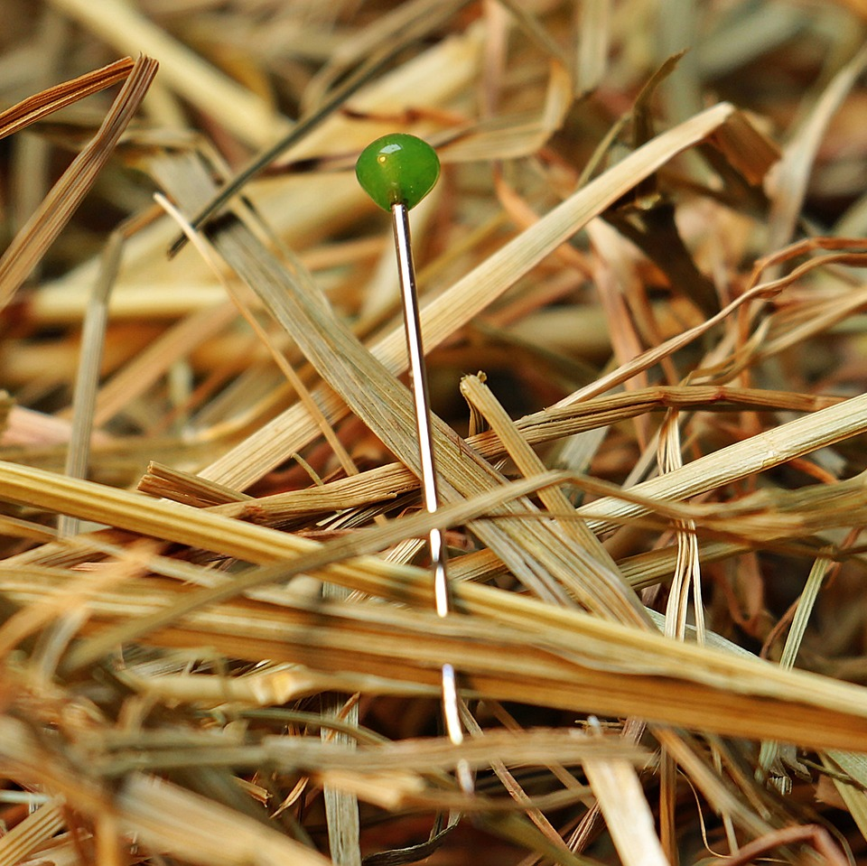
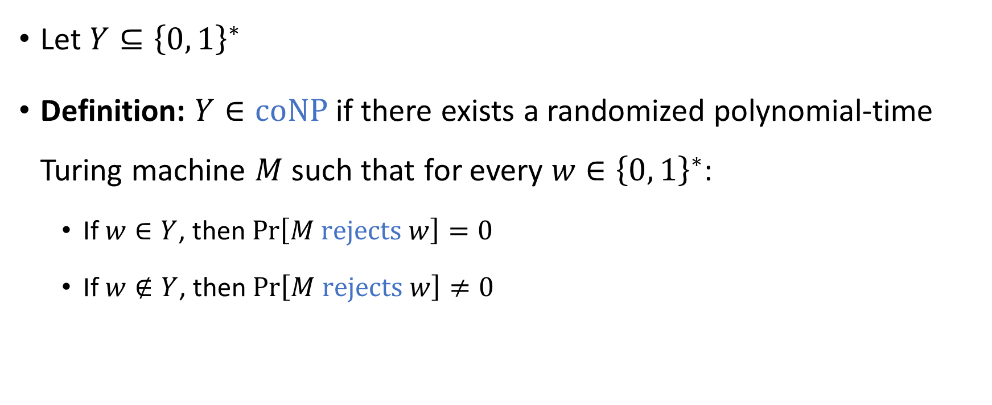

The complexity class $co\text{NP}$
Let $Y⊆{\left\{0, 1\right\}}^{∗}$
Definition: $Y∈\text{coNP}$ if there exists a randomized polynomial-time Turing machine $M$ such that for every $w∈{\left\{0, 1\right\}}^{∗}$:
  If $w∈Y$, then $\operatorname{Pr}\left[M \text{rejects} w\right]=0$
  If $w∉Y$, then $\operatorname{Pr}\left[M \text{rejects} w\right]≠0$

Slide 17

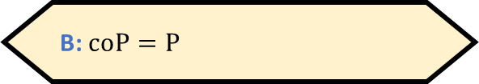

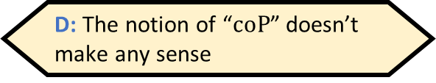
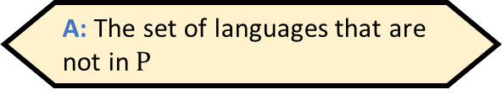
The complexity class $\text{coNP}$
Let $Y⊆{\left\{0, 1\right\}}^{∗}$ and let $\overline{Y}={\left\{0, 1\right\}}^{∗}∖Y$
Fact: $Y∈\text{NP}$ if and only if $\overline{Y}∈\text{coNP}$
$\text{coNP}$ is the set of complements of languages in $\text{NP}$
What is $\text{coP}$?
A: The set of languages that are
not in $\text{P}$
B: $\text{coP}=\text{P}$
C: The set of algorithms that do
not run in polynomial time
D: The notion of “$\text{coP}$” doesn’t
make any sense
Respond at PollEv.com/whoza or text “whoza” to 22333

Slide 18
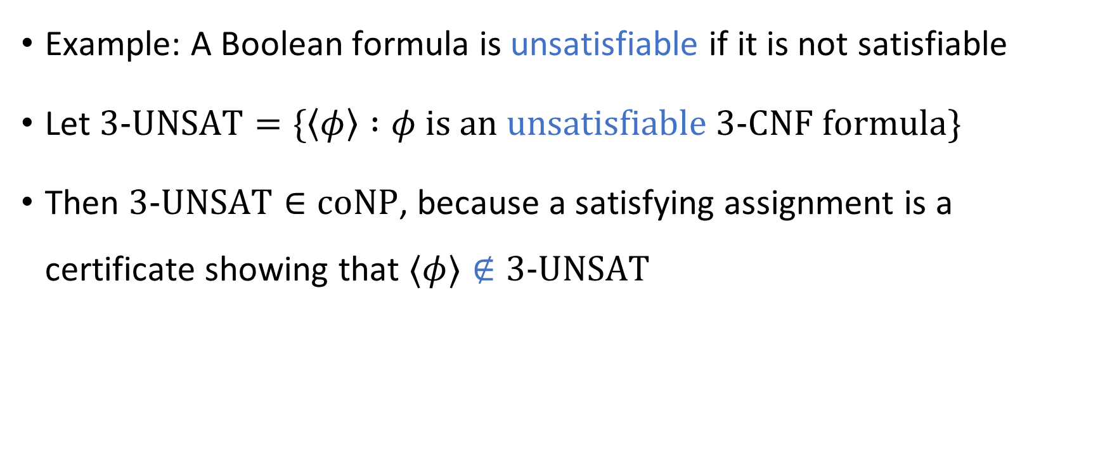
The complexity class $\text{coNP}$
Example: A Boolean formula is unsatisfiable if it is not satisfiable
Let $\text{3‑}\text{UNSAT}=\{\left\langle φ\right\rangle :φ is an unsatisfiable \text{3‑}\text{CNF} formula\}$
Then $\text{3‑}\text{UNSAT}∈\text{coNP}$, because a satisfying assignment is a certificate showing that $⟨φ⟩∉\text{3‑}\text{UNSAT}$

Slide 19
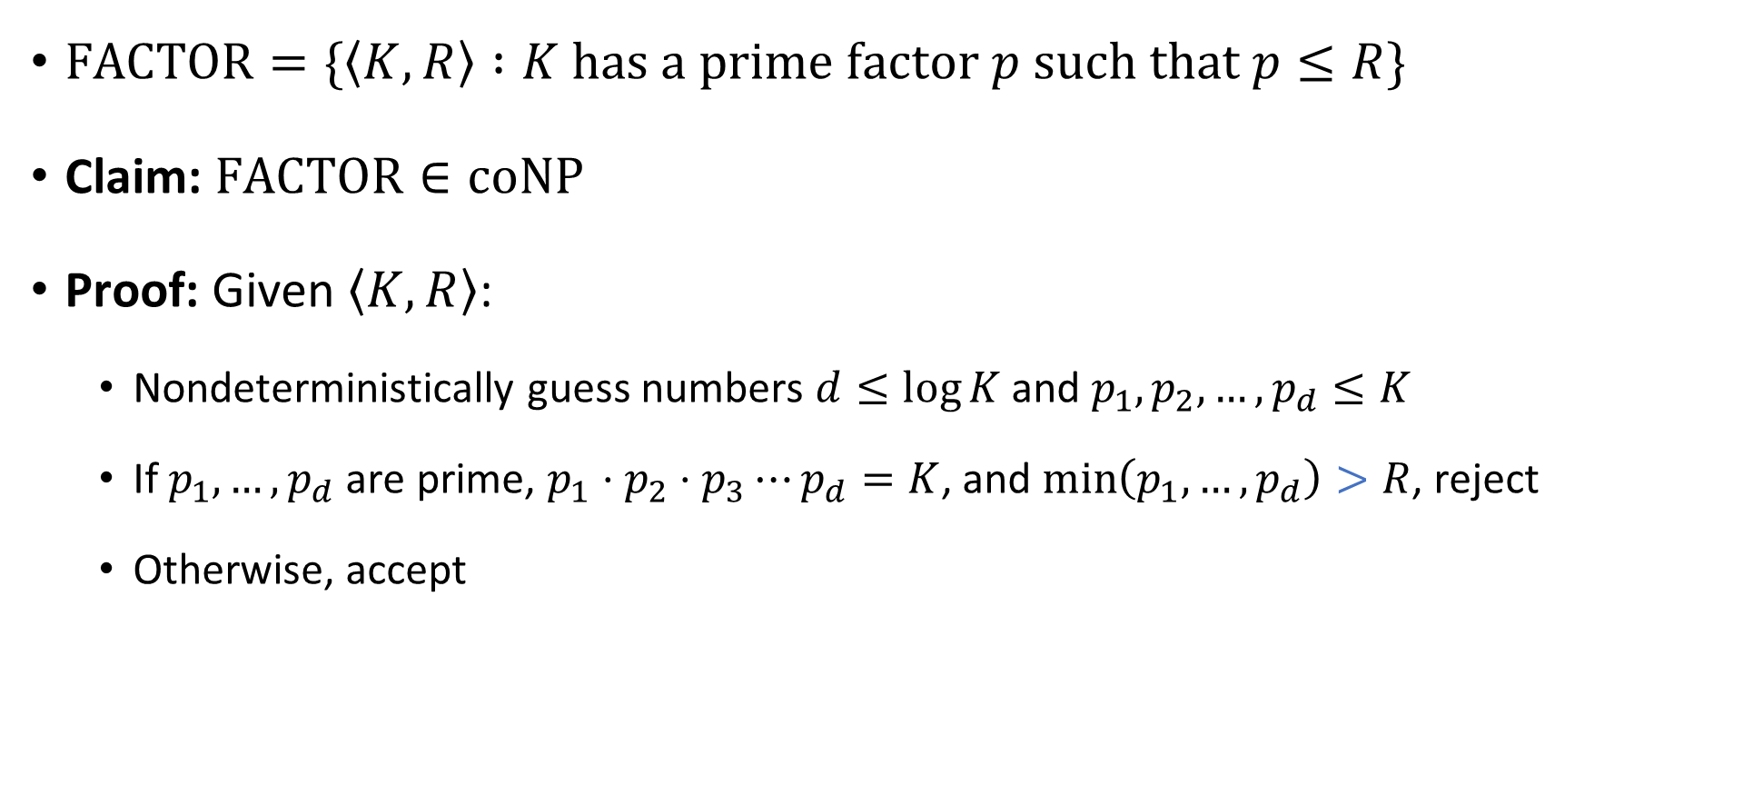


$\text{FACTOR}∈\text{coNP}$
$\text{FACTOR}=\{\left\langle K,R\right\rangle :K \text{has} \text{a} \text{prime} \text{factor} p \text{such} \text{that} p≤R\}$
Claim: $\text{FACTOR}∈\text{coNP}$
Proof: Given $\left\langle K,R\right\rangle$:
  Nondeterministically guess numbers $d≤\log{K}$ and $p_{1},p_{2},…, p_{d}≤K$
  If $p_{1},…, p_{d}$ are prime, $p_{1}⋅p_{2}⋅p_{3}⋯p_{d}=K$, and $\min\left(p_{1},…, p_{d}\right)>R$, reject
  Otherwise, accept
$$\text{PRIMES}∈\text{P}$$

Slide 20
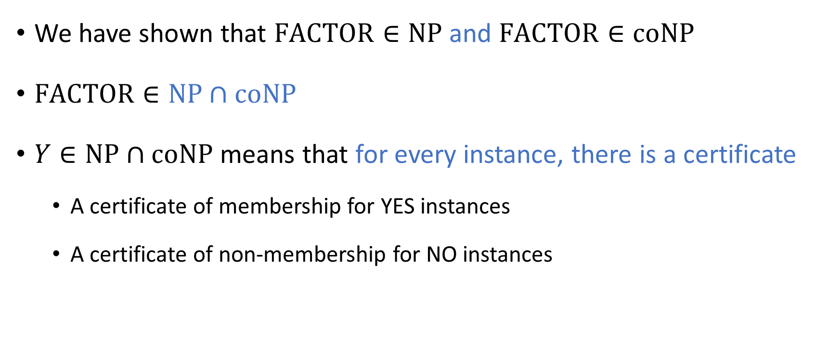

The complexity class $\text{NP}∩\text{coNP}$
We have shown that $\text{FACTOR}∈\text{NP}$ and $\text{FACTOR}∈\text{coNP}$
$\text{FACTOR}∈\text{NP}∩\text{coNP}$
$Y∈\text{NP}∩\text{coNP}$ means that for every instance, there is a certificate
  A certificate of membership for YES instances
  A certificate of non-membership for NO instances

