Slide 1
CMSC 28100 Introduction to Complexity Theory Autumn 2025 Instructor: William Hoza
⏳

Slide 2







$\text{NP}$-hard
$$\text{CIRCUIT}\text{‑}\text{SAT}$$
$$\text{CLIQUE}$$
$\text{NP}$-complete
$$\text{3}\text{‑}\text{SAT}$$
$$\text{NP}$$
$$\text{P}$$

Slide 3

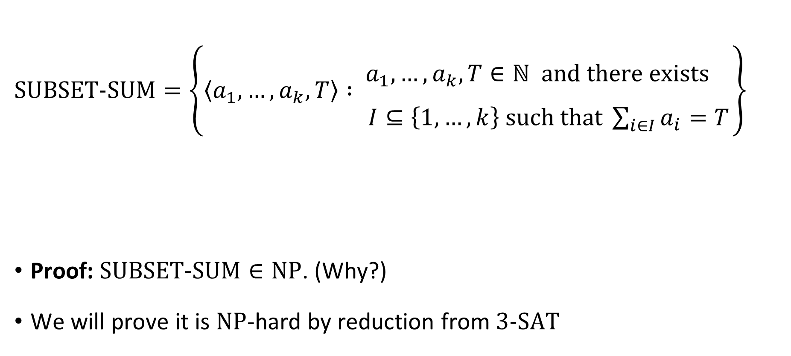
The subset sum problem
$\text{SUBSET}\text{‑}\text{SUM}=\left\{\left\langle a_{1},…, a_{k},T\right\rangle : \begin{matrix}a_{1},…, a_{k},T∈ℕ \text{and} \text{there} \text{exists}\begin{matrix} \\ \end{matrix} \\ I⊆\left\{1, …, k\right\} \text{such} \text{that} \sum_{i∈I}{a_{i}}=T\end{matrix}\right\}$
Proof: $\text{SUBSET}\text{‑}\text{SUM}∈\text{NP}$. (Why?)
We will prove it is $\text{NP}$-hard by reduction from $\text{3}\text{‑}\text{SAT}$
Theorem: $\text{SUBSET}\text{‑}\text{SUM}$ is $\text{NP}$-complete

Slide 4

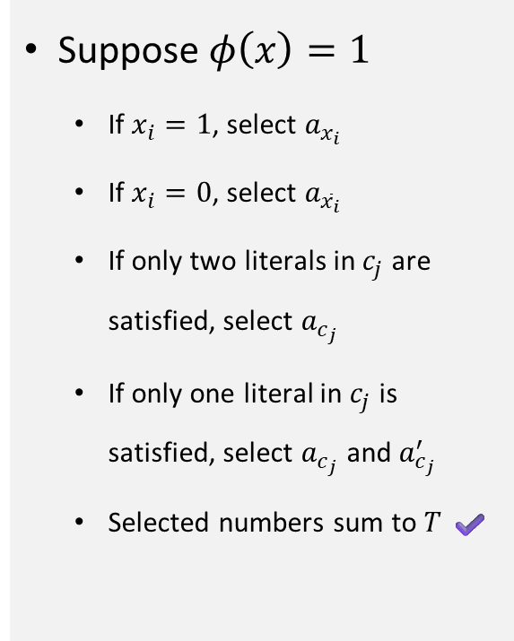



Proof that $\text{3}\text{‑}\text{SAT}≤_{P}\text{SUBSET}\text{‑}\text{SUM}$
If $φ$ is a 3-CNF formula with variables $x_{1},…,x_{n}$ and clauses $c_{1},…, c_{m}$, then $Ψ\left(\left\langle φ\right\rangle \right)=$ the following:
$$\begin{matrix} & x_{1} & x_{2} & ⋯ & x_{n} & c_{1} & c_{2} & ⋯ & c_{m} \\ & & & & & & & & \\ a_{x_{1}}= & 1 & 0 & ⋯ & 0 & 1 & 0 & ⋯ & 0 \\ a_{{\overline{x}}_{1}}= & 1 & 0 & ⋯ & 0 & 0 & 0 & ⋯ & 0 \\ a_{x_{2}}= & & 1 & ⋯ & 0 & 0 & 1 & ⋯ & 0 \\ a_{{\overline{x}}_{2}}= & & 1 & ⋯ & 0 & 1 & 0 & ⋯ & 0 \\ ⋮ & & & ⋱ & ⋮ & ⋮ & ⋮ & ⋮ & ⋮ \\ a_{x_{n}}= & & & & 1 & 1 & 0 & ⋯ & 1 \\ a_{{\overline{x}}_{n}}= & & & & 1 & 0 & 1 & ⋯ & 1 \\ & & & & & & & & \\ a_{c_{1}}= & & & & & 1 & 0 & ⋯ & 0 \\ a_{c_{1}}^{′}= & & & & & 1 & 0 & ⋯ & 0 \\ a_{c_{2}}= & & & & & & 1 & ⋯ & 0 \\ a_{c_{2}}^{′}= & & & & & & 1 & ⋯ & 0 \\ ⋮ & & & & & & & ⋱ & ⋮ \\ a_{c_{m}}= & & & & & & & & 1 \\ a_{c_{m}}^{′}= & & & & & & & & 1 \\ & & & & & & & & \\ T= & 1 & 1 & ⋯ & 1 & 3 & 3 & 3 & 3\end{matrix}$$
Does $x_{2}$ appear in $c_{2}$?
Suppose $φ\left(x\right)=1$
If $x_{i}=1$, select $a_{x_{i}}$
If $x_{i}=0$, select $a_{{\overline{x}}_{i}}$
If only two literals in $c_{j}$ are satisfied, select $a_{c_{j}}$
If only one literal in $c_{j}$ is satisfied, select $a_{c_{j}}$ and $a_{c_{j}}^{′}$
Selected numbers sum to $T$ ✔️
Does ${\overline{x}}_{n}$ appear in $c_{m}$?
Integers represented in base 8

Slide 5
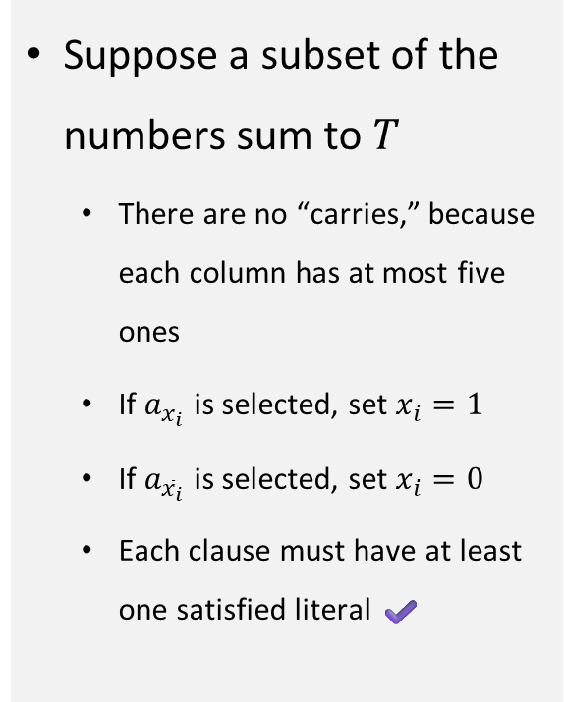

Proof that $\text{3}\text{‑}\text{SAT}≤_{P}\text{SUBSET}\text{‑}\text{SUM}$
If $φ$ is a 3-CNF formula with variables $x_{1},…,x_{n}$ and clauses $c_{1},…, c_{m}$, then $Ψ\left(\left\langle φ\right\rangle \right)=$ the following:
$$\begin{matrix} & x_{1} & x_{2} & ⋯ & x_{n} & c_{1} & c_{2} & ⋯ & c_{m} \\ & & & & & & & & \\ a_{x_{1}}= & 1 & 0 & ⋯ & 0 & 1 & 0 & ⋯ & 0 \\ a_{{\overline{x}}_{1}}= & 1 & 0 & ⋯ & 0 & 0 & 0 & ⋯ & 0 \\ a_{x_{2}}= & & 1 & ⋯ & 0 & 0 & 1 & ⋯ & 0 \\ a_{{\overline{x}}_{2}}= & & 1 & ⋯ & 0 & 1 & 0 & ⋯ & 0 \\ ⋮ & & & ⋱ & ⋮ & ⋮ & ⋮ & ⋮ & ⋮ \\ a_{x_{n}}= & & & & 1 & 1 & 0 & ⋯ & 1 \\ a_{{\overline{x}}_{n}}= & & & & 1 & 0 & 1 & ⋯ & 1 \\ & & & & & & & & \\ a_{c_{1}}= & & & & & 1 & 0 & ⋯ & 0 \\ a_{c_{1}}^{′}= & & & & & 1 & 0 & ⋯ & 0 \\ a_{c_{2}}= & & & & & & 1 & ⋯ & 0 \\ a_{c_{2}}^{′}= & & & & & & 1 & ⋯ & 0 \\ ⋮ & & & & & & & ⋱ & ⋮ \\ a_{c_{m}}= & & & & & & & & 1 \\ a_{c_{m}}^{′}= & & & & & & & & 1 \\ & & & & & & & & \\ T= & 1 & 1 & ⋯ & 1 & 3 & 3 & 3 & 3\end{matrix}$$
Does $x_{2}$ appear in $c_{2}$?
Suppose a subset of the numbers sum to $T$
There are no “carries,” because each column has at most five ones
If $a_{x_{i}}$ is selected, set $x_{i}=1$
If $a_{{\overline{x}}_{i}}$ is selected, set $x_{i}=0$
Each clause must have at least one satisfied literal ✔️
Does ${\overline{x}}_{n}$ appear in $c_{m}$?
Integers represented in base 8

Slide 6
Proof that $\text{3}\text{‑}\text{SAT}≤_{P}\text{SUBSET}\text{‑}\text{SUM}$
If $φ$ is a 3-CNF formula with variables $x_{1},…,x_{n}$ and clauses $c_{1},…, c_{m}$, then $Ψ\left(\left\langle φ\right\rangle \right)=$ the following:
$$\begin{matrix} & x_{1} & x_{2} & ⋯ & x_{n} & c_{1} & c_{2} & ⋯ & c_{m} \\ & & & & & & & & \\ a_{x_{1}}= & 1 & 0 & ⋯ & 0 & 1 & 0 & ⋯ & 0 \\ a_{{\overline{x}}_{1}}= & 1 & 0 & ⋯ & 0 & 0 & 0 & ⋯ & 0 \\ a_{x_{2}}= & & 1 & ⋯ & 0 & 0 & 1 & ⋯ & 0 \\ a_{{\overline{x}}_{2}}= & & 1 & ⋯ & 0 & 1 & 0 & ⋯ & 0 \\ ⋮ & & & ⋱ & ⋮ & ⋮ & ⋮ & ⋮ & ⋮ \\ a_{x_{n}}= & & & & 1 & 1 & 0 & ⋯ & 1 \\ a_{{\overline{x}}_{n}}= & & & & 1 & 0 & 1 & ⋯ & 1 \\ & & & & & & & & \\ a_{c_{1}}= & & & & & 1 & 0 & ⋯ & 0 \\ a_{c_{1}}^{′}= & & & & & 1 & 0 & ⋯ & 0 \\ a_{c_{2}}= & & & & & & 1 & ⋯ & 0 \\ a_{c_{2}}^{′}= & & & & & & 1 & ⋯ & 0 \\ ⋮ & & & & & & & ⋱ & ⋮ \\ a_{c_{m}}= & & & & & & & & 1 \\ a_{c_{m}}^{′}= & & & & & & & & 1 \\ & & & & & & & & \\ T= & 1 & 1 & ⋯ & 1 & 3 & 3 & 3 & 3\end{matrix}$$
Does $x_{2}$ appear in $c_{2}$?
Reduction can be performed in polynomial time ✔️
Does ${\overline{x}}_{n}$ appear in $c_{m}$?
Integers represented in base 8

Slide 7


$\text{NP}$-hard
$$\text{CIRCUIT}\text{‑}\text{SAT}$$
$$\text{CLIQUE}$$
$\text{NP}$-complete
$$\text{3}\text{‑}\text{SAT}$$
$$\text{SUBSET}\text{‑}\text{SUM}$$
$$\text{NP}$$
$$\text{P}$$

Slide 8
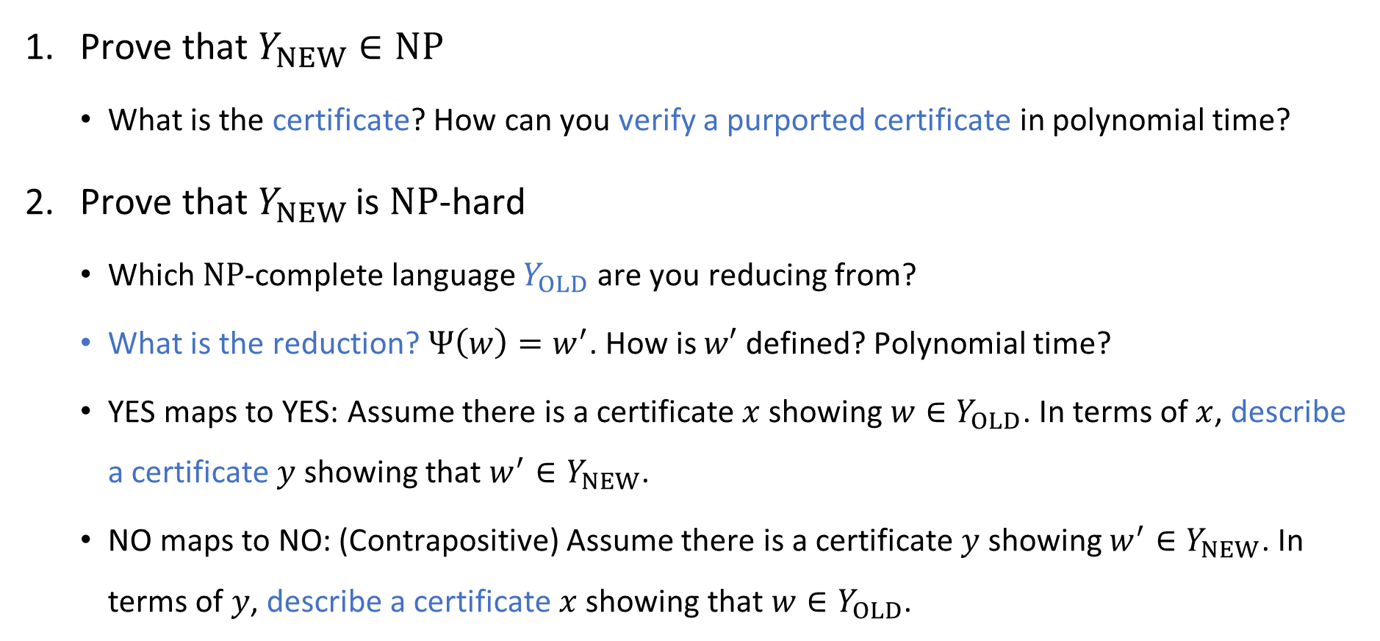
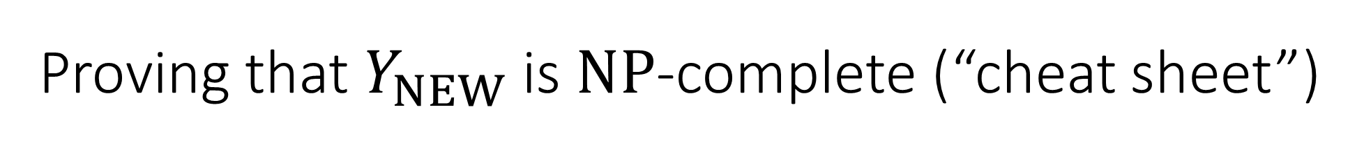
Proving that $Y_{NEW}$ is $\text{NP}$-complete (“cheat sheet”)
Prove that $Y_{NEW}∈\text{NP}$
What is the certificate? How can you verify a purported certificate in polynomial time?
Prove that $Y_{NEW}$ is $\text{NP}$-hard
Which $\text{NP}$-complete language $Y_{OLD}$ are you reducing from?
What is the reduction? $Ψ\left(w\right)=w^{′}$. How is $w′$ defined? Polynomial time?
YES maps to YES: Assume there is a certificate $x$ showing $w∈Y_{OLD}$. In terms of $x$, describe a certificate $y$ showing that $w^{′}∈Y_{NEW}$.
NO maps to NO: (Contrapositive) Assume there is a certificate $y$ showing $w^{′}∈Y_{NEW}$. In terms of $y$, describe a certificate $x$ showing that $w∈Y_{OLD}$.

Slide 9

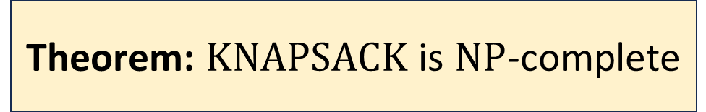
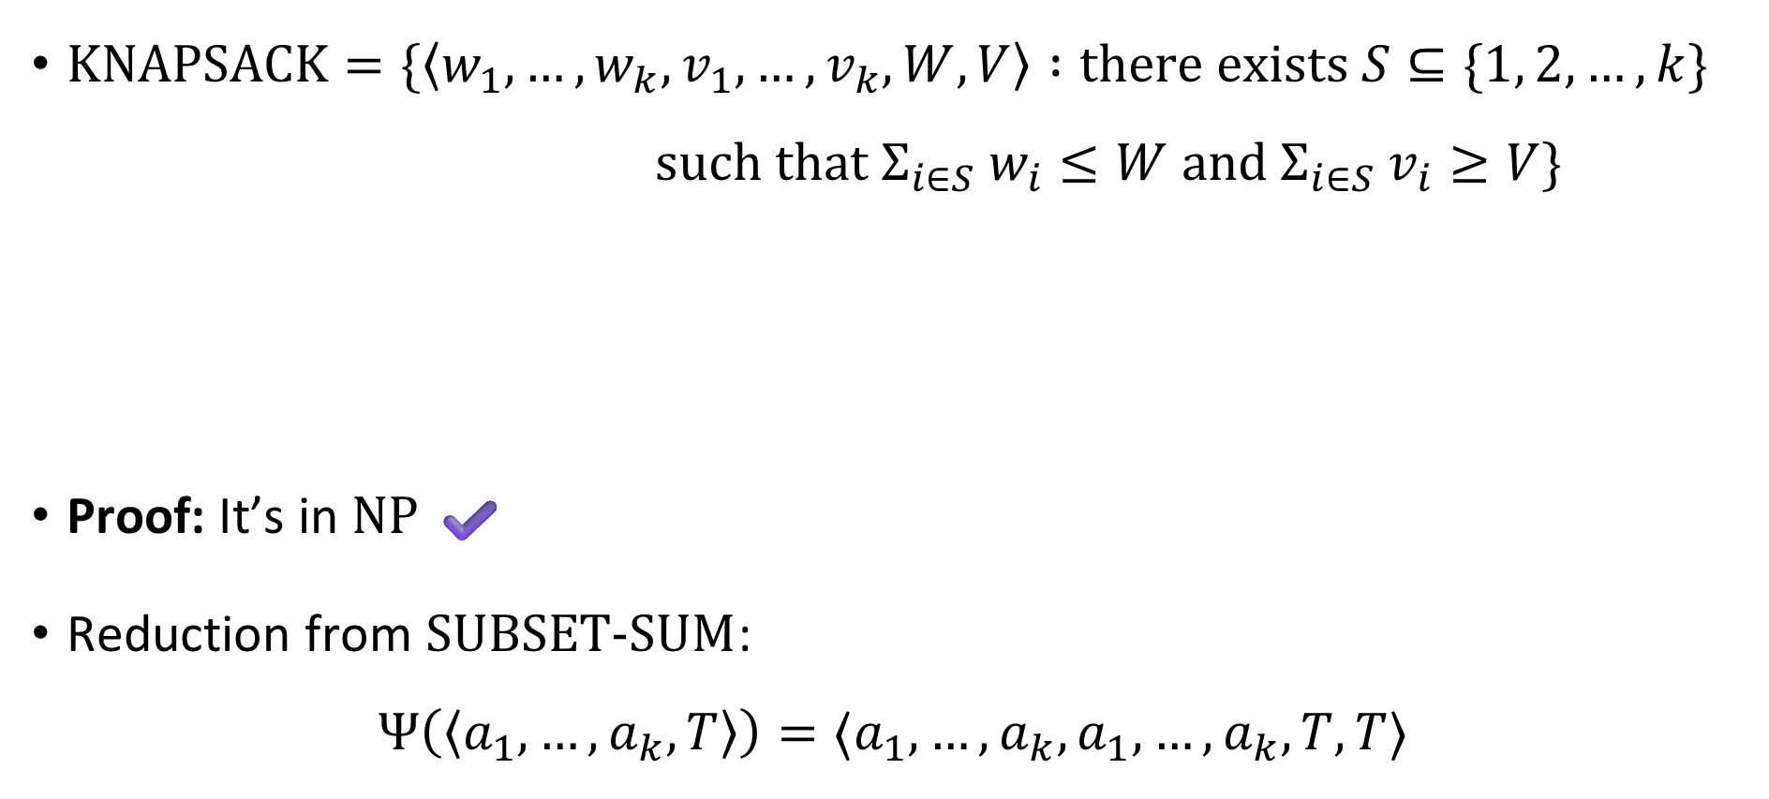
The Knapsack problem
$\text{KNAPSACK}=\{\left\langle w_{1},…, w_{k}, v_{1},…, v_{k}, W, V\right\rangle :\text{there} \text{exists} S⊆\{1, 2, …, k\}$ $\text{such} \text{that} Σ_{i∈S} w_{i}≤W \text{and} Σ_{i∈S} v_{i}≥V\}$
Proof: It’s in $\text{NP}$ ✔️
Reduction from $\text{SUBSET}‑\text{SUM}$:
$$Ψ\left(\left\langle a_{1},…, a_{k},T\right\rangle \right)=⟨a_{1},…, a_{k}, a_{1},…, a_{k}, T,T⟩$$
Theorem: $\text{KNAPSACK}$ is $\text{NP}$-complete

Slide 10

$\text{NP}$-hard
$$\text{CIRCUIT}\text{‑}\text{SAT}$$
$$\text{KNAPSACK}$$
$$\text{CLIQUE}$$
$\text{NP}$-complete
$$\text{3}\text{‑}\text{SAT}$$
$$\text{SUBSET}\text{‑}\text{SUM}$$
$$\text{NP}$$
$$\text{P}$$

Slide 11
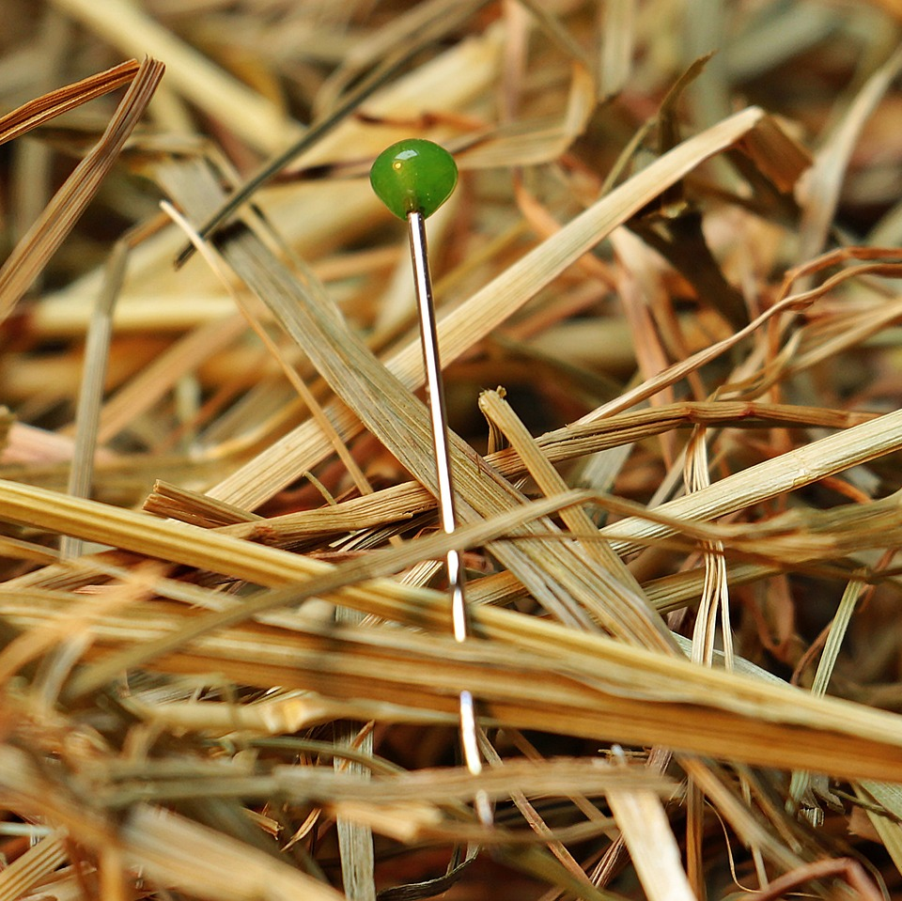
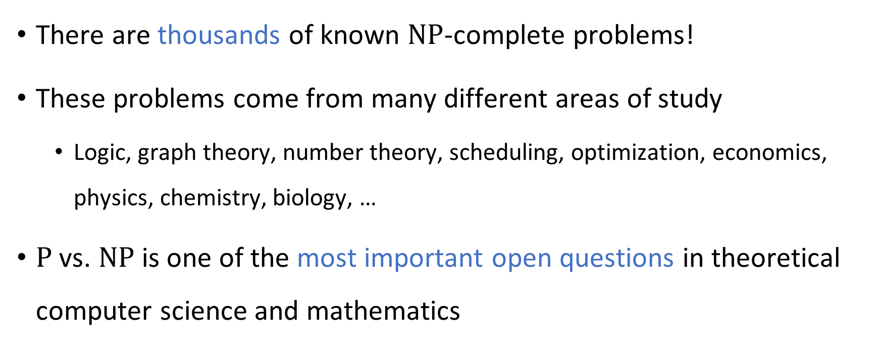
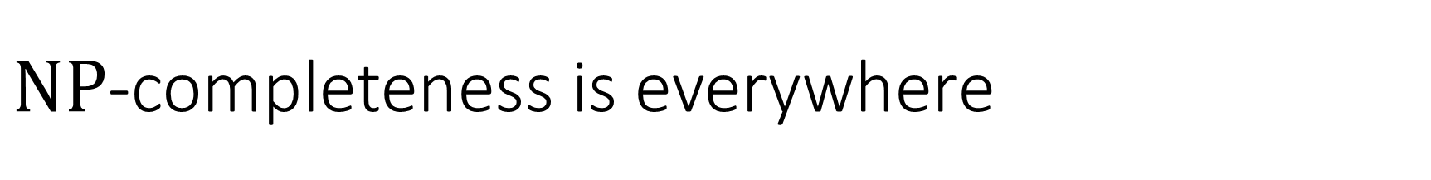
$\text{NP}$-completeness is everywhere
There are thousands of known $\text{NP}$-complete problems!
These problems come from many different areas of study
Logic, graph theory, number theory, scheduling, optimization, economics, physics, chemistry, biology, …
$\text{P}$ vs. $\text{NP}$ is one of the most important open questions in theoretical computer science and mathematics

Slide 12
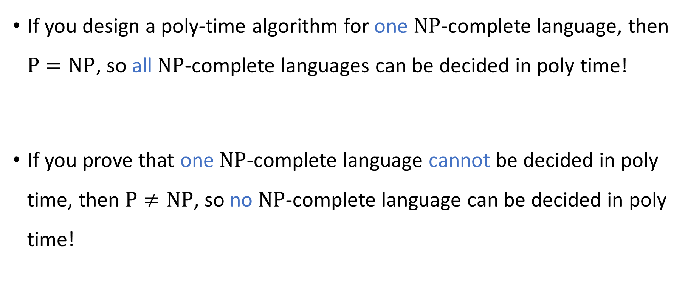
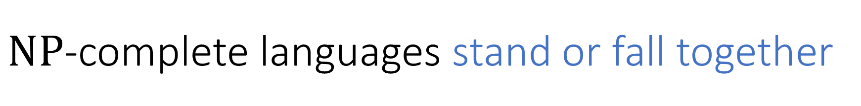
$\text{NP}$-complete languages stand or fall together
If you design a poly-time algorithm for one $\text{NP}$-complete language, then $\text{P}=\text{NP}$, so all $\text{NP}$-complete languages can be decided in poly time!
If you prove that one $\text{NP}$-complete language cannot be decided in poly time, then $\text{P}≠\text{NP}$, so no $\text{NP}$-complete language can be decided in poly time!

Slide 13
Intractability
This course so far: How to identify intractability
Up next: How to cope with intractability

Slide 14
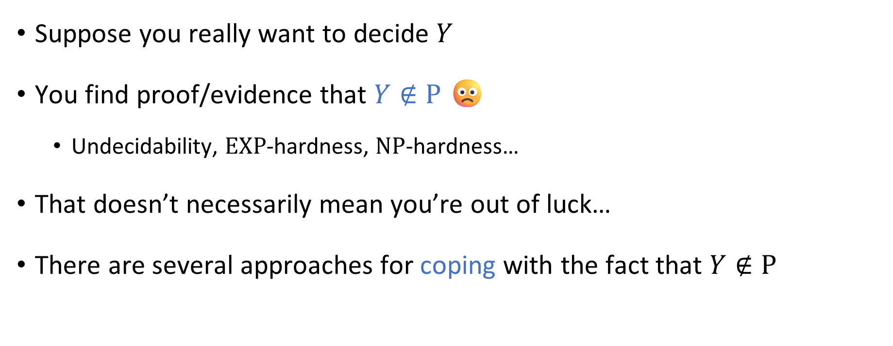
Coping with intractability
Suppose you really want to decide $Y$
You find proof/evidence that $Y∉\text{P}$ 🙁
Undecidability, $\text{EXP}$-hardness, $\text{NP}$-hardness…
That doesn’t necessarily mean you’re out of luck…
There are several approaches for coping with the fact that $Y∉\text{P}$

Slide 15
Coping with intractability

Slide 16
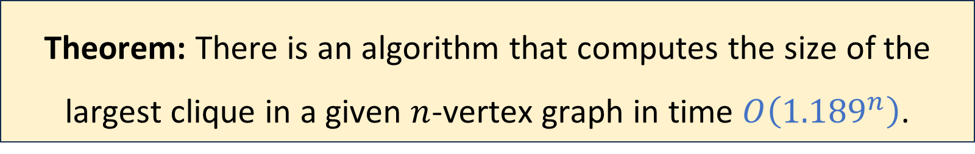
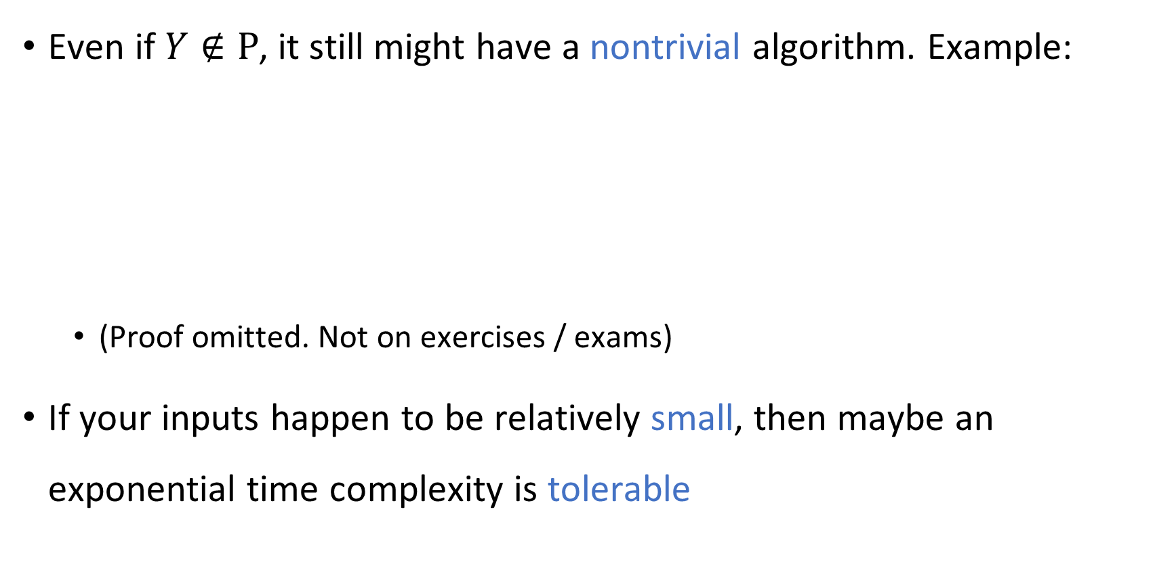
Nontrivial exponential-time algorithms
Even if $Y∉\text{P}$, it still might have a nontrivial algorithm. Example:
(Proof omitted. Not on exercises / exams)
If your inputs happen to be relatively small, then maybe an exponential time complexity is tolerable
Theorem: There is an algorithm that computes the size of the largest clique in a given $n$-vertex graph in time $O\left({1.189}^{n}\right)$.

Slide 17
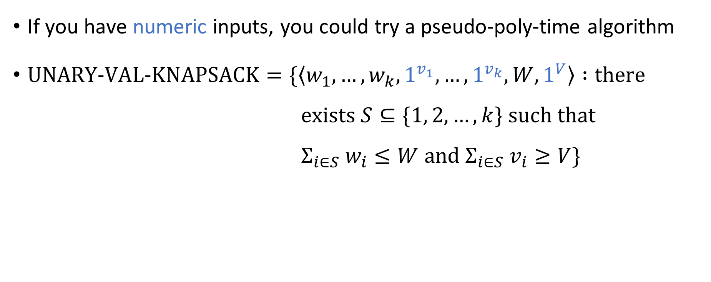
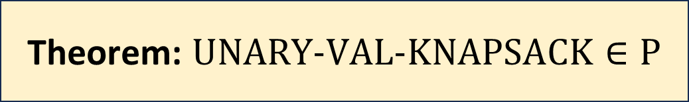
Pseudo-polynomial time algorithms
If you have numeric inputs, you could try a pseudo-poly-time algorithm
$\text{UNARY}‑\text{VAL}‑\text{KNAPSACK}=\{\left\langle w_{1},…, w_{k}, 1^{v_{1}},…, 1^{v_{k}}, W, 1^{V}\right\rangle :\text{there}$ $\text{exists} S⊆\{1, 2, …, k\} \text{such} \text{that}$ $Σ_{i∈S} w_{i}≤W \text{and} Σ_{i∈S} v_{i}≥V\}$
Theorem: $\text{UNARY}‑\text{VAL}‑\text{KNAPSACK}∈\text{P}$

Slide 18
Approximation algorithms
Next approach for coping with intractability: approximation algorithms
Example: Knapsack

Slide 19
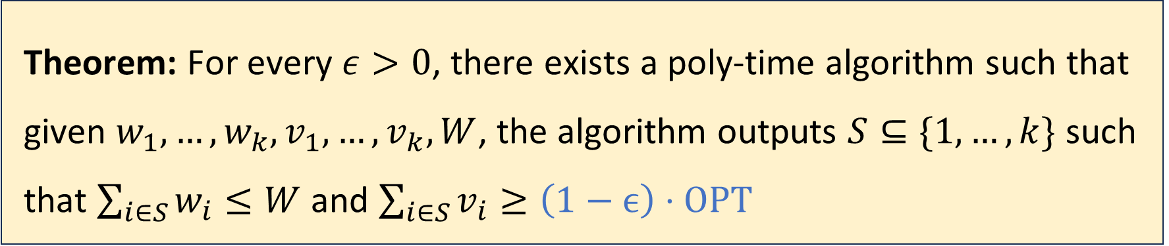
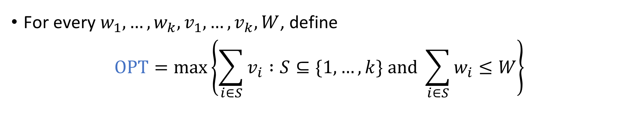
Approximation algorithm for Knapsack
For every $w_{1},…, w_{k}, v_{1},…, v_{k},W$, define
$$\text{OPT}=\max\left\{\sum_{i∈S}{v_{i}} :S⊆\{1, …, k\} \text{and} \sum_{i∈S}{w_{i}}≤W\right\}$$
Theorem: For every $ε>0$, there exists a poly-time algorithm such that given $w_{1},…, w_{k}, v_{1},…, v_{k}, W$, the algorithm outputs $S⊆\{1, …, k\}$ such that $\sum_{i∈S}{w_{i}}≤W$ and $\sum_{i∈S}{v_{i}}≥\left(1−ϵ\right)⋅\text{OPT}$

