Slide 1
CMSC 28100 Introduction to Complexity Theory Autumn 2025 Instructor: William Hoza
⏳

Slide 2
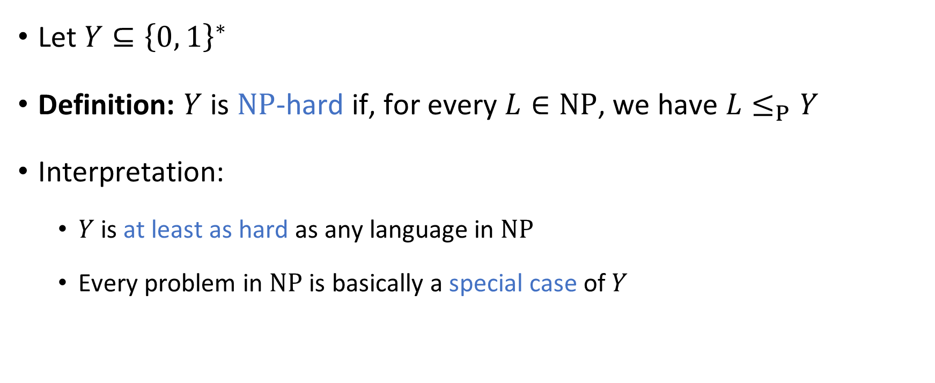
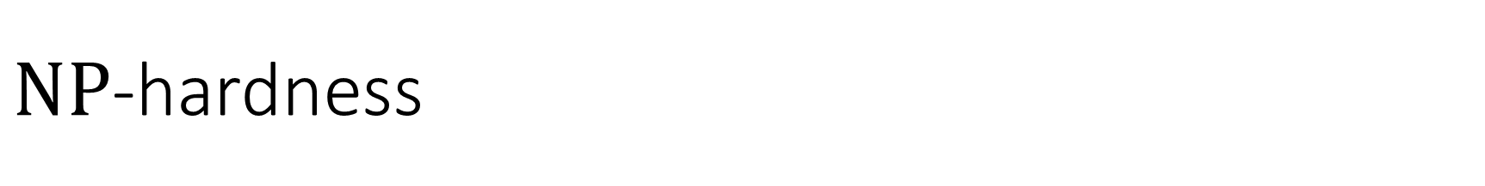
$\text{NP}$-hardness
Let $Y⊆{\left\{0, 1\right\}}^{∗}$
Definition: $Y$ is $\text{NP}$-hard if, for every $L∈\text{NP}$, we have $L≤_{P}Y$
Interpretation:
$Y$ is at least as hard as any language in $\text{NP}$
Every problem in $\text{NP}$ is basically a special case of $Y$

Slide 3
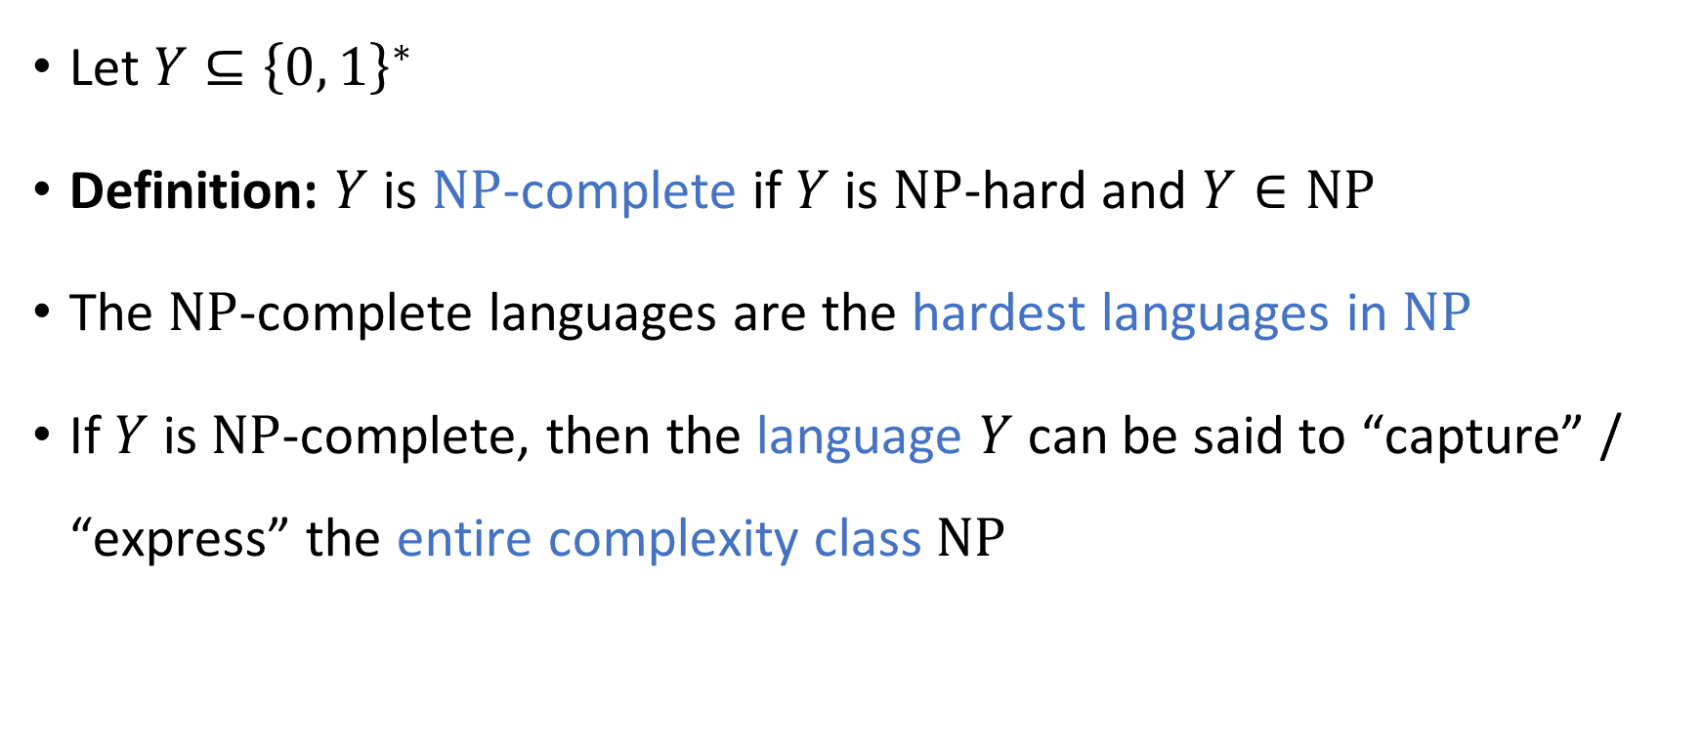
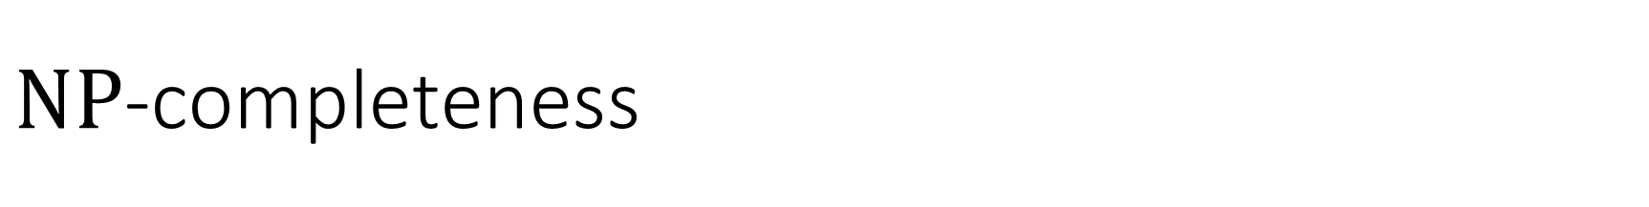
$\text{NP}$-completeness
Let $Y⊆{\left\{0, 1\right\}}^{∗}$
Definition: $Y$ is $\text{NP}$-complete if $Y$ is $\text{NP}$-hard and $Y∈\text{NP}$
The $\text{NP}$-complete languages are the hardest languages in $\text{NP}$
If $Y$ is $\text{NP}$-complete, then the language $Y$ can be said to “capture” / “express” the entire complexity class $\text{NP}$

Slide 4







$\text{NP}$-completeness
$\text{NP}$-hard
$$\text{CIRCUIT}\text{‑}\text{SAT}$$
$\text{NP}$-complete
$$\text{NP}$$
$$\text{CIRCUIT}\text{‑}\text{SAT}=\{\left\langle C\right\rangle :C \text{is} \text{a} \text{satisfiable} \text{circuit}\}$$
$$\text{P}$$

Slide 5

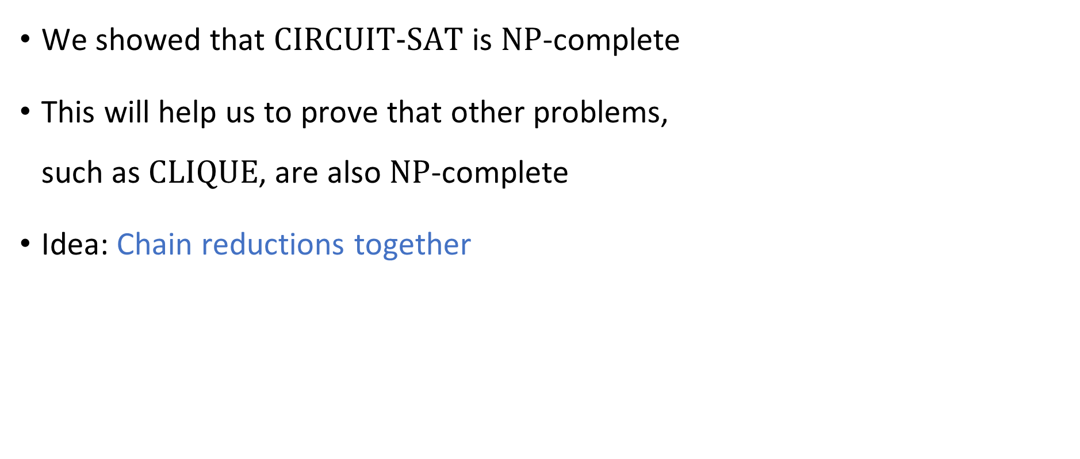

What else is $\text{NP}$-complete?
We showed that $\text{CIRCUIT}\text{‑}\text{SAT}$ is $\text{NP}$-complete
This will help us to prove that other problems, such as $\text{CLIQUE}$, are also $\text{NP}$-complete
Idea: Chain reductions together

Slide 6











Chaining reductions together
If $Y_{1}≤_{P}Y_{2}≤_{P}Y_{3}$, then $Y_{1}≤_{P}Y_{3}$
$$Ψ_{1→2}$$
$$Ψ_{2→3}$$
$$Y_{2}$$
$$Y_{1}$$
$$Y_{3}$$
$$Ψ_{1→2}$$
$$Ψ_{2→3}$$
$${\left\{0, 1\right\}}^{∗}$$
$${\left\{0, 1\right\}}^{∗}$$
$${\left\{0, 1\right\}}^{∗}$$

Slide 7
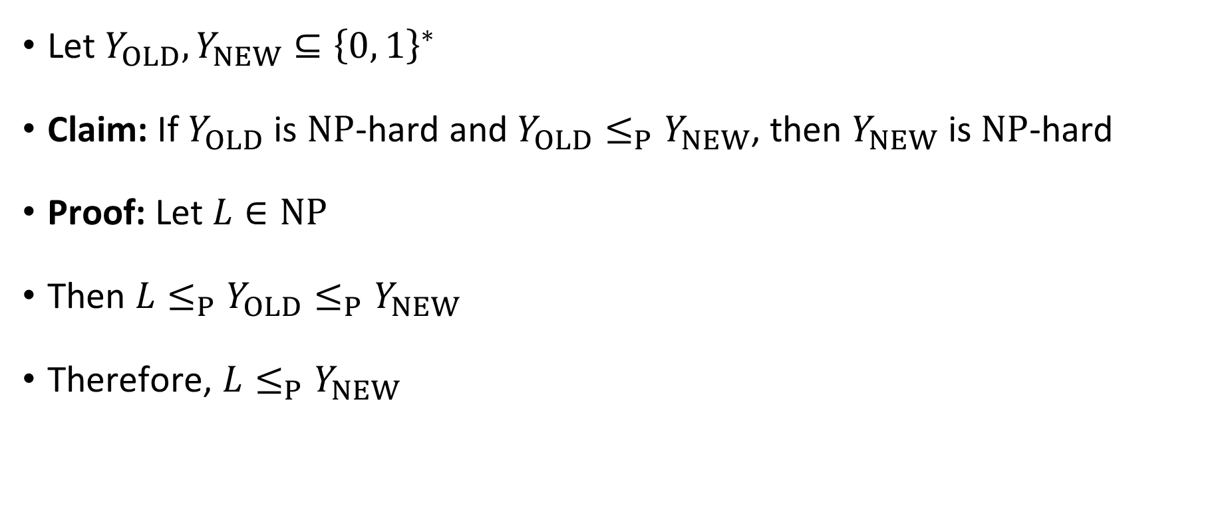
Chaining reductions together
Let $Y_{OLD},Y_{NEW}⊆{\left\{0, 1\right\}}^{∗}$
Claim: If $Y_{OLD}$ is $\text{NP}$-hard and $Y_{OLD}≤_{P}Y_{NEW}$, then $Y_{NEW}$ is $\text{NP}$-hard
Proof: Let $L∈\text{NP}$
Then $L≤_{P}Y_{OLD}≤_{P}Y_{NEW}$
Therefore, $L≤_{P}Y_{NEW}$

Slide 8

Roadmap
We will define a language called “$3‑\text{SAT}$”
We will prove $\text{CIRCUIT}‑\text{SAT}≤_{P}\text{3}‑\text{SAT}≤_{P}\text{CLIQUE}$
This will show that $\text{CLIQUE}$ is $\text{NP}$-hard

Slide 9
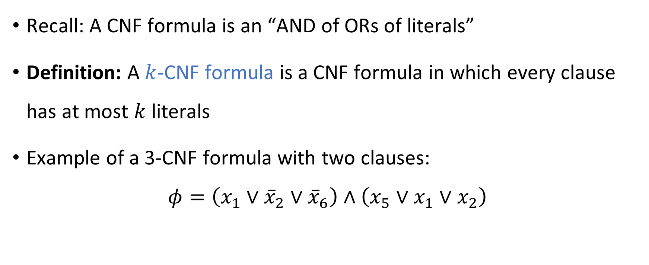
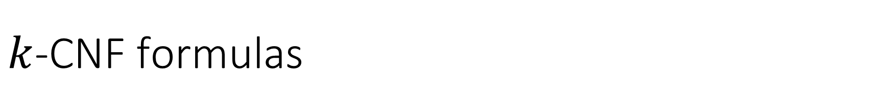
$k$-CNF formulas
Recall: A CNF formula is an “AND of ORs of literals”
Definition: A $k$-CNF formula is a CNF formula in which every clause has at most $k$ literals
Example of a 3-CNF formula with two clauses:
$$φ=\left(x_{1}∨{\overline{x}}_{2}∨{\overline{x}}_{6}\right)∧\left(x_{5}∨x_{1}∨x_{2}\right)$$

Slide 10

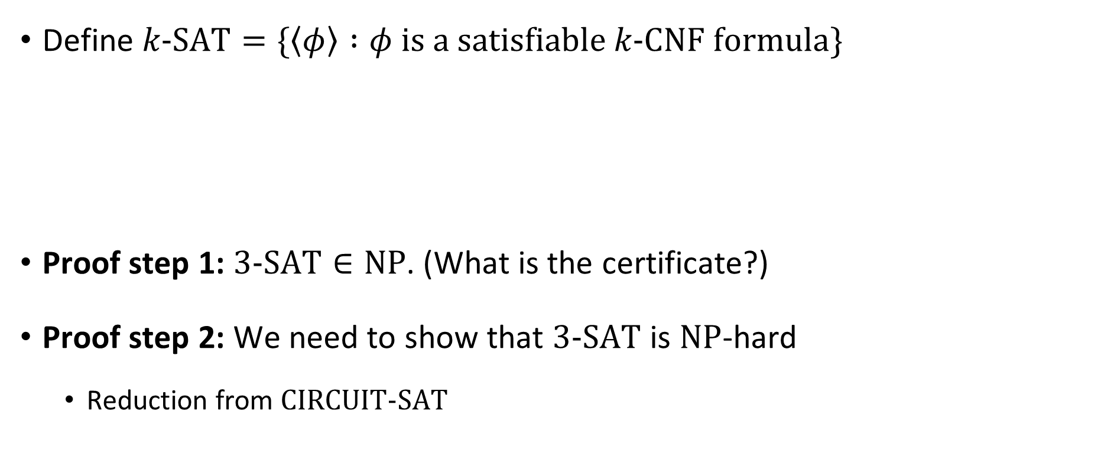
The Cook-Levin Theorem
Define $k\text{‑}\text{SAT}=\{\left\langle φ\right\rangle :φ \text{is} \text{a} \text{satisfiable} k\text{‑}\text{CNF} \text{formula}\}$
Proof step 1: $3\text{‑}\text{SAT}∈\text{NP}$. (What is the certificate?)
Proof step 2: We need to show that $3\text{‑}\text{SAT}$ is $\text{NP}$-hard
Reduction from $\text{CIRCUIT}\text{‑}\text{SAT}$
The Cook-Levin Theorem: $3\text{‑}\text{SAT}$ is $\text{NP}$-complete

Slide 11









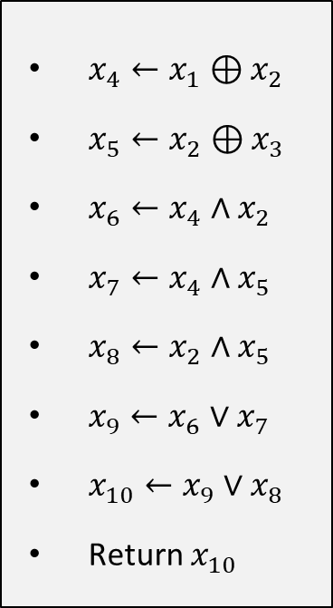









Step 1: Circuit $⇒$ Program
$$x_{10}$$
$x_{4}←x_{1}⊕x_{2}$
$x_{5}←x_{2}⊕x_{3}$
$x_{6}←x_{4}∧x_{2}$
$x_{7}←x_{4}∧x_{5}$
$x_{8}←x_{2}∧x_{5}$
$x_{9}←x_{6}∨x_{7}$
$x_{10}←x_{9}∨x_{8}$
Return $x_{10}$
$$∨$$
$$x_{9}$$
$$∨$$
$$x_{6}$$
$$x_{8}$$
$$x_{7}$$
$$∧$$
$$∧$$
$$∧$$
$$x_{4}$$
$$x_{5}$$
$$⊕$$
$$⊕$$
$$x_{2}$$
$$x_{1}$$
$$x_{3}$$
Circuit (3 input variables)
Program (3 input variables)

Slide 12


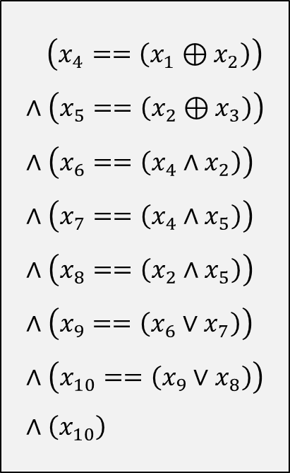
Step 2: Program $⇒$ Formula
$x_{4}←x_{1}⊕x_{2}$
$x_{5}←x_{2}⊕x_{3}$
$x_{6}←x_{4}∧x_{2}$
$x_{7}←x_{4}∧x_{5}$
$x_{8}←x_{2}∧x_{5}$
$x_{9}←x_{6}∨x_{7}$
$x_{10}←x_{9}∨x_{8}$
Return $x_{10}$
$\left(x_{4}==\left(x_{1}⊕x_{2}\right)\right)$ $$∧\left(x_{5}==\left(x_{2}⊕x_{3}\right)\right) \\ ∧\left(x_{6}==\left(x_{4}∧x_{2}\right)\right) \\ ∧\left(x_{7}==\left(x_{4}∧x_{5}\right)\right) \\ ∧\left(x_{8}==\left(x_{2}∧x_{5}\right)\right) \\ ∧\left(x_{9}==\left(x_{6}∨x_{7}\right)\right) \\ ∧\left(x_{10}==\left(x_{9}∨x_{8}\right)\right) \\ ∧\left(x_{10}\right)$$
Program (3 input variables)
Formula (10 input variables)

Slide 13
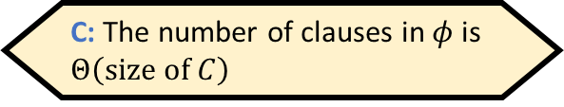

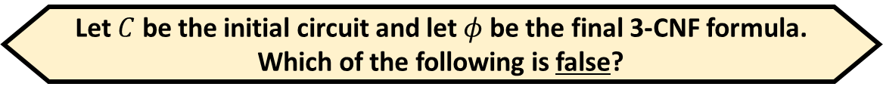

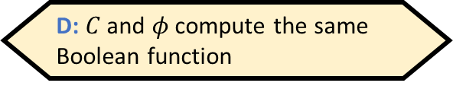


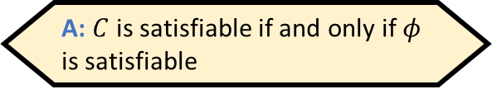
Step 3: Formula $⇒$ 3-CNF Formula
Let $C$ be the initial circuit and let $φ$ be the final 3-CNF formula. Which of the following is false?
A: $C$ is satisfiable if and only if $φ$ is satisfiable
B: $\left|\left\langle φ\right\rangle \right|≤\text{poly}\left(\left|\left\langle C\right\rangle \right|\right)$
$\left(x_{4}==\left(x_{1}⊕x_{2}\right)\right)$ $$∧\left(x_{5}==\left(x_{2}⊕x_{3}\right)\right) \\ ∧\left(x_{6}==\left(x_{4}∧x_{2}\right)\right) \\ ∧\left(x_{7}==\left(x_{4}∧x_{5}\right)\right) \\ ∧\left(x_{8}==\left(x_{2}∧x_{5}\right)\right) \\ ∧\left(x_{9}==\left(x_{6}∨x_{7}\right)\right) \\ ∧\left(x_{10}==\left(x_{9}∨x_{8}\right)\right) \\ ∧\left(x_{10}\right)$$
C: The number of clauses in $φ$ is $Θ\left(\text{size} \text{of} C\right)$
$$\left({\overline{x}}_{4}∨x_{1}∨x_{2}\right)∧\left(x_{4}∨x_{1}∨{\overline{x}}_{2}\right)∧\left(x_{4}∨{\overline{x}}_{1}∨x_{2}\right)∧\left({\overline{x}}_{4}∨{\overline{x}}_{1}∨{\overline{x}}_{2}\right) \\ ∧\left({\overline{x}}_{5}∨x_{2}∨x_{3}\right)∧\left(x_{5}∨x_{2}∨{\overline{x}}_{3}\right)∧\left(x_{5}∨{\overline{x}}_{2}∨x_{3}\right)∧\left({\overline{x}}_{5}∨{\overline{x}}_{2}∨{\overline{x}}_{3}\right) \\ ∧\left({\overline{x}}_{6}∨x_{4}\right)∧\left({\overline{x}}_{6}∨x_{2}\right)∧\left({\overline{x}}_{4}∨{\overline{x}}_{2}∨x_{6}\right) \\ ∧\left({\overline{x}}_{7}∨x_{4}\right)∧\left({\overline{x}}_{7}∨x_{5}\right)∧\left({\overline{x}}_{4}∨{\overline{x}}_{5}∨x_{7}\right) \\ ∧\left({\overline{x}}_{8}∨x_{2}\right)∧\left({\overline{x}}_{8}∨x_{5}\right)∧\left({\overline{x}}_{2}∨{\overline{x}}_{5}∨x_{8}\right) \\ ∧\left({\overline{x}}_{9}∨x_{6}∨x_{7}\right)∧\left(x_{9}∨{\overline{x}}_{6}\right)∧\left(x_{9}∨{\overline{x}}_{7}\right) \\ ∧\left({\overline{x}}_{10}∨x_{9}∨x_{8}\right)∧\left(x_{10}∨{\overline{x}}_{9}\right)∧\left(x_{10}∨{\overline{x}}_{8}\right) \\ ∧\left(x_{10}\right)$$
D: $C$ and $φ$ compute the same Boolean function
Respond at PollEv.com/whoza or text “whoza” to 22333
Every Boolean function has a CNF representation!
3-CNF Formula (10 input variables)
Formula (10 input variables)

Slide 14
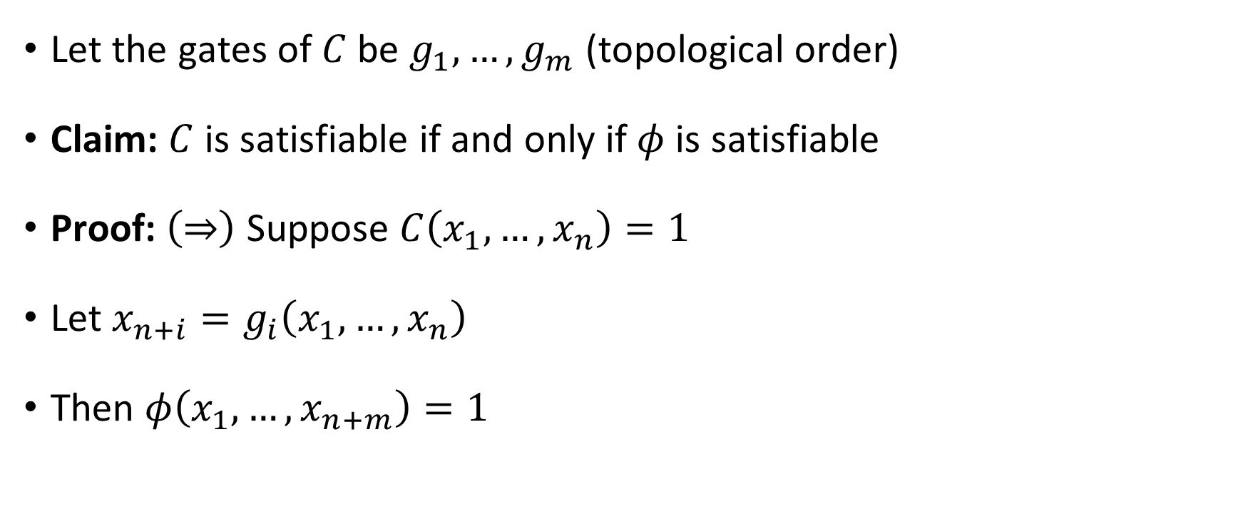
Reduction correctness
Let the gates of $C$ be $g_{1},…, g_{m}$ (topological order)
Claim: $C$ is satisfiable if and only if $φ$ is satisfiable
Proof: $\left(⇒\right)$ Suppose $C\left(x_{1},…, x_{n}\right)=1$
Let $x_{n+i}=g_{i}\left(x_{1},…, x_{n}\right)$
Then $φ\left(x_{1},…, x_{n+m}\right)=1$

Slide 15
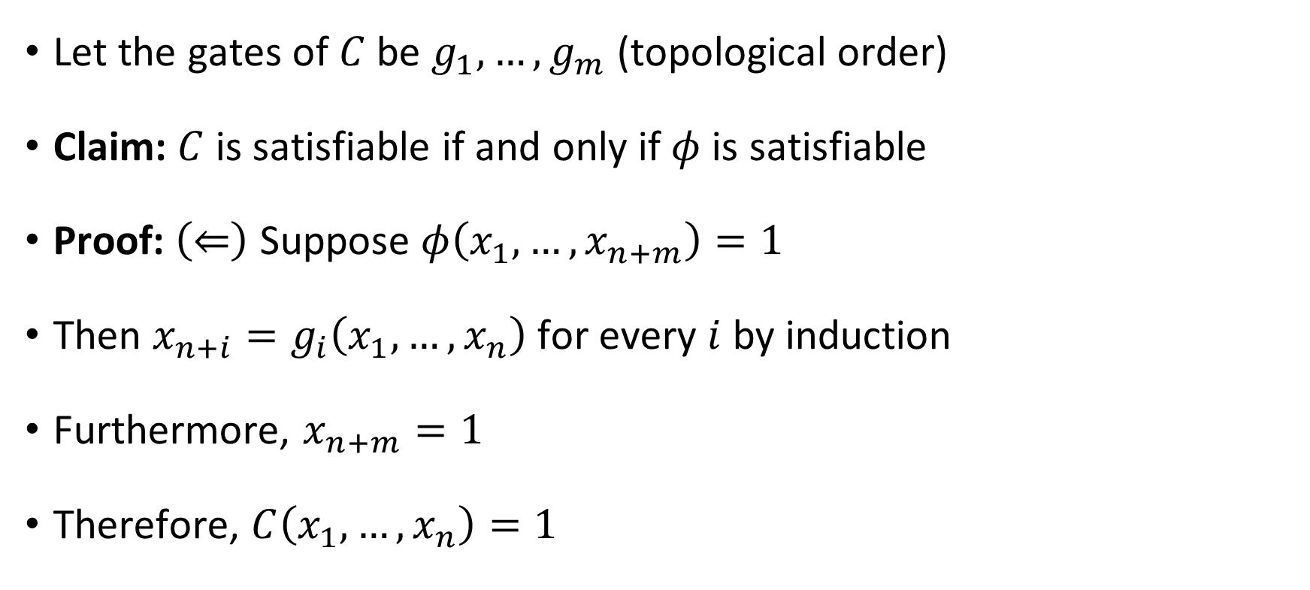
Reduction correctness
Let the gates of $C$ be $g_{1},…, g_{m}$ (topological order)
Claim: $C$ is satisfiable if and only if $φ$ is satisfiable
Proof: $\left(⇐\right)$ Suppose $φ\left(x_{1},…, x_{n+m}\right)=1$
Then $x_{n+i}=g_{i}\left(x_{1},…, x_{n}\right)$ for every $i$ by induction
Furthermore, $x_{n+m}=1$
Therefore, $C\left(x_{1},…, x_{n}\right)=1$

Slide 16






$\text{NP}$-hard
$$\text{CIRCUIT}\text{‑}\text{SAT}$$
$$\text{3}\text{‑}\text{SAT}$$
$\text{NP}$-complete
$$\text{NP}$$
$$\text{P}$$

Slide 17

Chaining reductions together
$\text{3}\text{‑}\text{SAT}$ is the starting point for many $\text{NP}$-hardness proofs
We are finally ready to prove that $\text{CLIQUE}$ is $\text{NP}$-complete

Slide 18
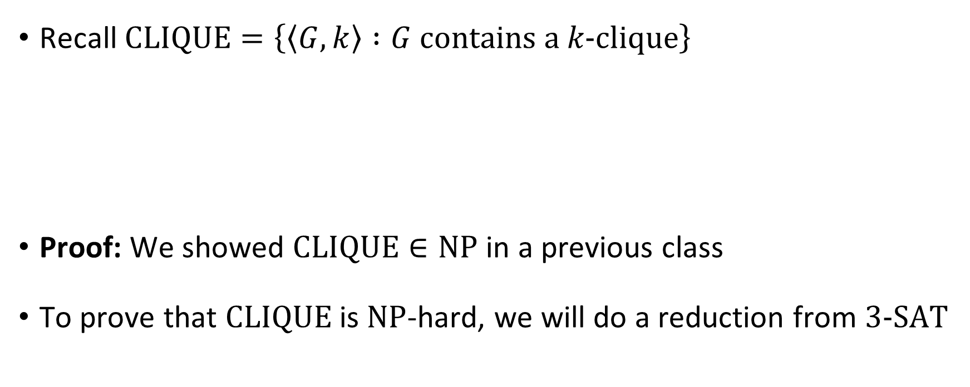


$\text{CLIQUE}$ is $\text{NP}$-complete
Recall $\text{CLIQUE}=\left\{\left\langle G,k\right\rangle :G \text{contains} \text{a} k‑\text{clique}\right\}$
Proof: We showed $\text{CLIQUE}∈\text{NP}$ in a previous class
To prove that $\text{CLIQUE}$ is $\text{NP}$-hard, we will do a reduction from $\text{3‑}\text{SAT}$
Theorem: $\text{CLIQUE}$ is $\text{NP}$-complete

Slide 19


Proof that $\text{3}\text{‑}\text{SAT}≤_{P}\text{CLIQUE}$
Let $φ$ be a $3$-CNF formula (an instance of $\text{3}\text{‑}\text{SAT}$)
Reduction: $Ψ\left(\left\langle φ\right\rangle \right)=\left\langle G,k\right\rangle$
$k$ is the number of clauses in $φ$
$G$ is a graph on $≤3k$ vertices defined as follows

Slide 20






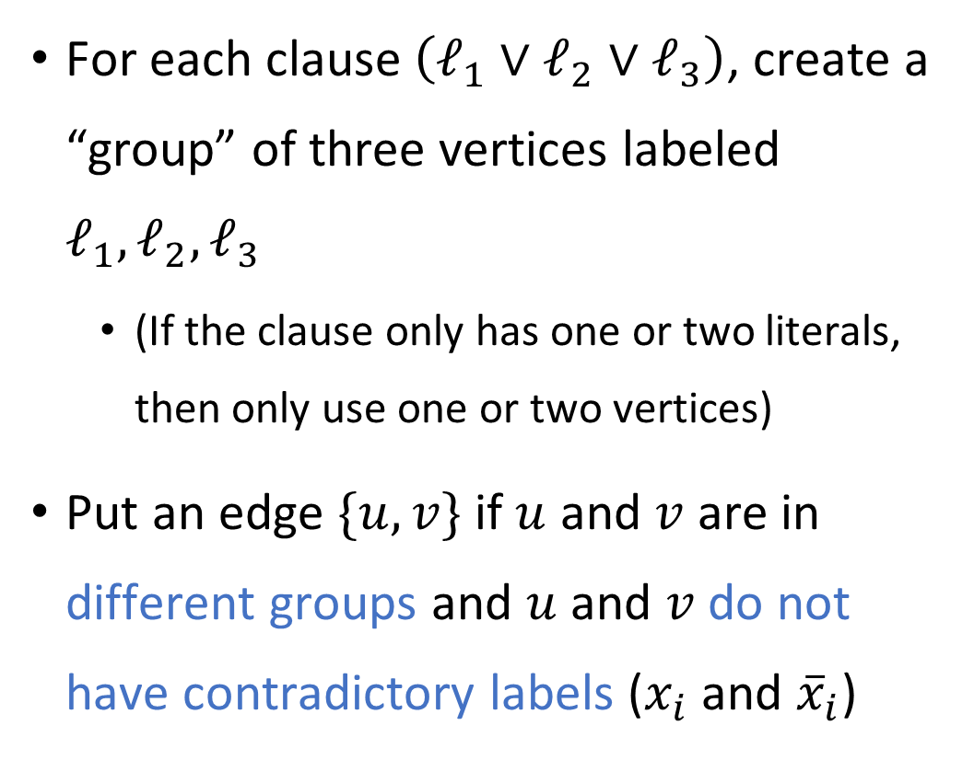








Reduction from $\text{3}\text{‑}\text{SAT}$ to $\text{CLIQUE}$
For each clause $\left(ℓ_{1}∨ℓ_{2}∨ℓ_{3}\right)$, create a “group” of three vertices labeled $ℓ_{1},ℓ_{2},ℓ_{3}$
(If the clause only has one or two literals, then only use one or two vertices)
Put an edge $\{u, v\}$ if $u$ and $v$ are in different groups and $u$ and $v$ do not have contradictory labels ($x_{i}$ and ${\overline{x}}_{i}$)
E.g., $φ=\left(x_{1}∨x_{2}∨{\overline{x}}_{5}\right)∧\left({\overline{x}}_{1}∨x_{4}∨x_{6}\right)$ $∧\left(x_{2}∨x_{4}∨{\overline{x}}_{3}\right)∧\left(x_{3}∨{\overline{x}}_{6}∨x_{1}\right)$
$$x_{1}$$
$$x_{2}$$
$${\overline{x}}_{5}$$
$${\overline{x}}_{1}$$
$$x_{2}$$
$$x_{4}$$
$$x_{4}$$
$$x_{6}$$
$${\overline{x}}_{3}$$
$$x_{3}$$
$${\overline{x}}_{6}$$
$$x_{1}$$

Slide 21











YES maps to YES
$$x_{1}$$
$$x_{2}$$
$${\overline{x}}_{5}$$
$${\overline{x}}_{1}$$
$$x_{2}$$
$$x_{4}$$
$$x_{4}$$
Suppose there exists $x$ such that $φ\left(x\right)=1$
In each clause, at least one literal is satisfied by $x$
Therefore, in each group, at least one vertex is “satisfied by $x$,” i.e., it is labeled by a literal that is satisfied by $x$
Let $S$ be a set consisting of one satisfied vertex from each group
Then $S$ is a $k$-clique (vertices in $S$ cannot have contradictory labels)
$$x_{6}$$
$${\overline{x}}_{3}$$
$$x_{3}$$
$${\overline{x}}_{6}$$
$$x_{1}$$

Slide 22
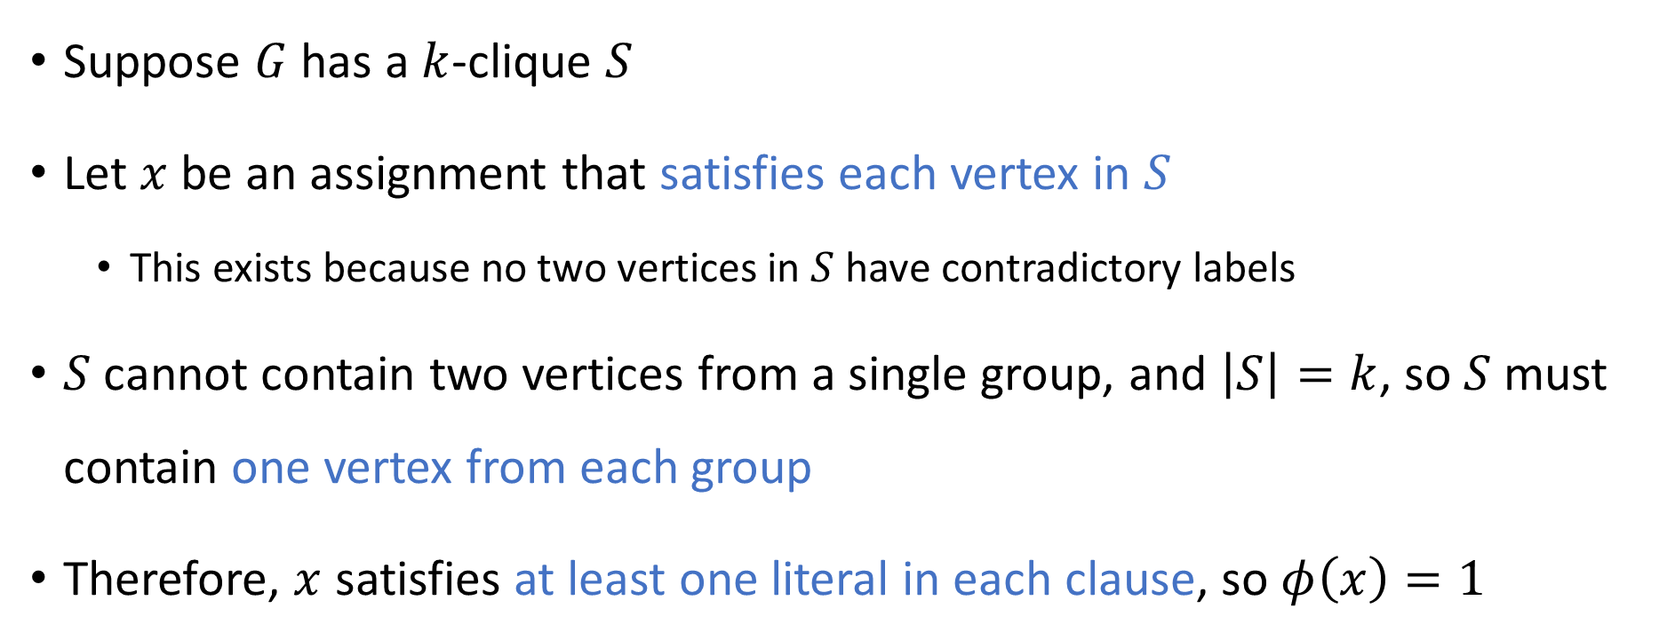
NO maps to NO
$$x_{1}$$
$$x_{2}$$
$${\overline{x}}_{5}$$
$${\overline{x}}_{1}$$
$$x_{2}$$
$$x_{4}$$
$$x_{4}$$
Suppose $G$ has a $k$-clique $S$
Let $x$ be an assignment that satisfies each vertex in $S$
This exists because no two vertices in $S$ have contradictory labels
$S$ cannot contain two vertices from a single group, and $\left|S\right|=k$, so $S$ must contain one vertex from each group
Therefore, $x$ satisfies at least one literal in each clause, so $φ\left(x\right)=1$
$$x_{6}$$
$${\overline{x}}_{3}$$
$$x_{3}$$
$${\overline{x}}_{6}$$
$$x_{1}$$

