Slide 1
CMSC 28100 Introduction to Complexity Theory Autumn 2025 Instructor: William Hoza
⏳

Slide 2
Which problems can be solved through computation?
CLASSICAL

Slide 3

Which languages are in $\text{P}$?

Slide 4

Which languages are not in $\text{P}$?

Slide 5
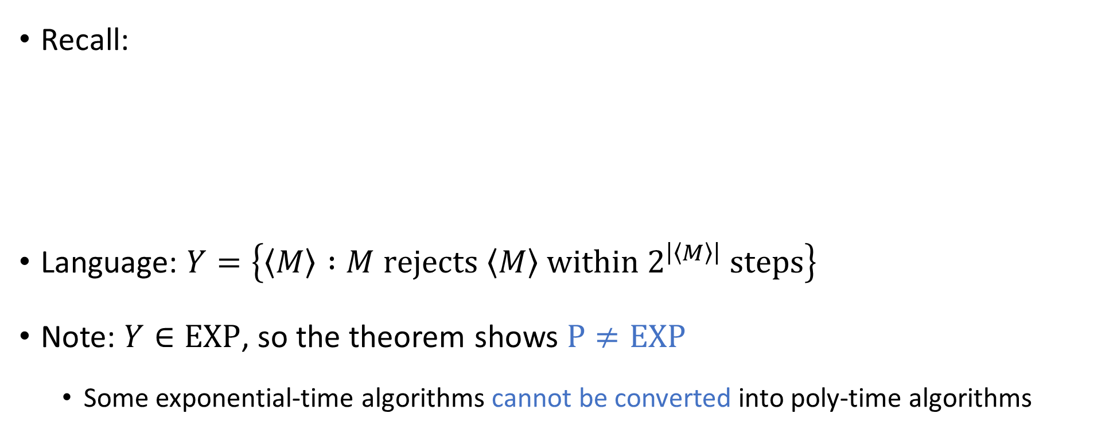
Intractability vs. undecidability
Recall:
Language: $Y=\left\{\left\langle M\right\rangle :M \text{rejects} \left\langle M\right\rangle \text{within} 2^{\left|\left\langle M\right\rangle \right|} \text{steps}\right\}$
Note: $Y∈\text{EXP}$, so the theorem shows $\text{P}≠\text{EXP}$
Some exponential-time algorithms cannot be converted into poly-time algorithms
Theorem: There exists $Y⊆{\left\{0, 1\right\}}^{∗}$ such that $Y$ is decidable, but $Y∉\text{P}$.

Slide 6





All languages
$$\text{HALT}$$
Decidable languages
$$\{\left\langle M\right\rangle :M \text{rejects} \left\langle M\right\rangle \text{within} 2^{\left|\left\langle M\right\rangle \right|} \text{steps}\}$$
$$\text{EXP}$$
$$\text{P}$$
$$\text{PALINDROMES}$$

Slide 7

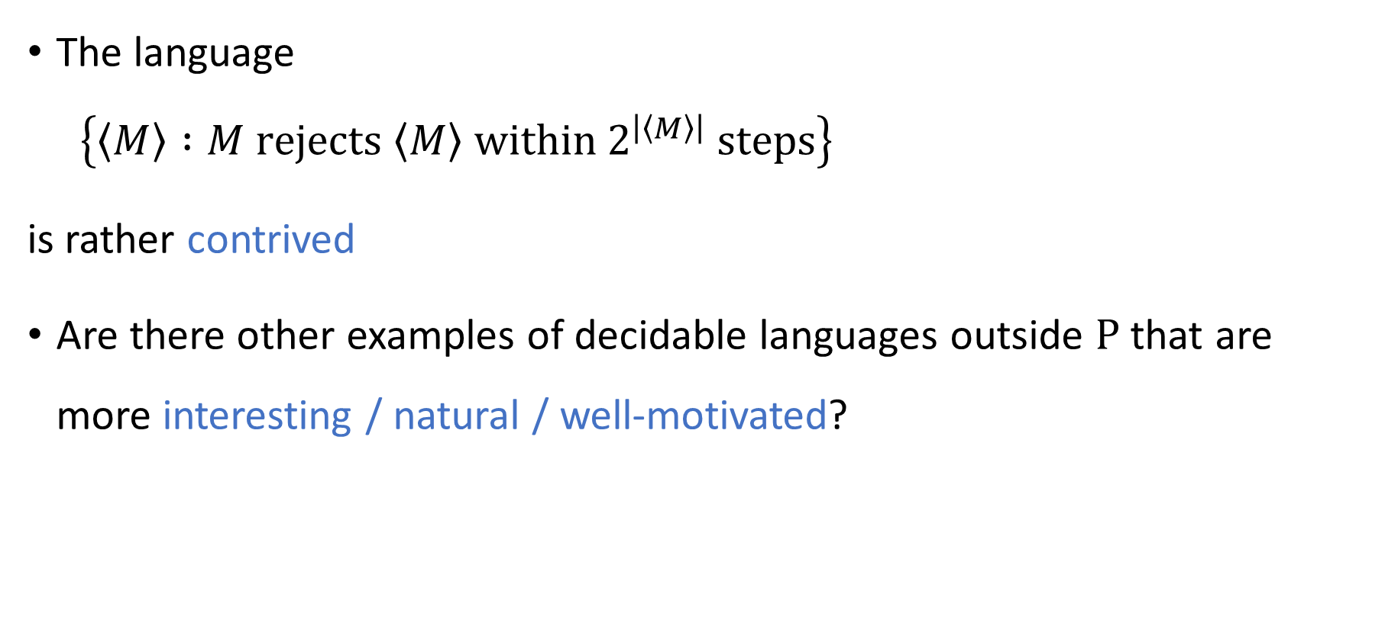
Contrived vs. natural
The language
$$\left\{\left\langle M\right\rangle :M \text{rejects} \left\langle M\right\rangle \text{within} 2^{\left|\left\langle M\right\rangle \right|} \text{steps}\right\}$$ is rather contrived
Are there other examples of decidable languages outside $\text{P}$ that are more interesting / natural / well-motivated?

Slide 8
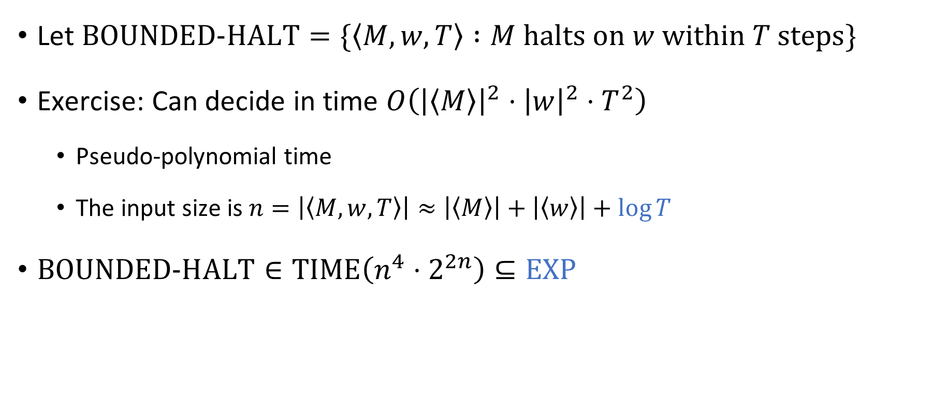
The bounded halting problem
Let $\text{BOUNDED}\text{‑}\text{HALT}=\{\left\langle M, w, T\right\rangle :M \text{halts} \text{on} w \text{within} T \text{steps}\}$
Exercise: Can decide in time $O\left({\left|\left\langle M\right\rangle \right|}^{2}⋅{\left|w\right|}^{2}⋅T^{2}\right)$
Pseudo-polynomial time
The input size is $n=\left|\left\langle M,w,T\right\rangle \right|≈\left|\left\langle M\right\rangle \right|+\left|\left\langle w\right\rangle \right|+\log{T}$
$\text{BOUNDED}\text{‑}\text{HALT}∈\text{TIME}\left(n^{4}⋅2^{2n}\right)⊆\text{EXP}$
Polynomial time?

Slide 9
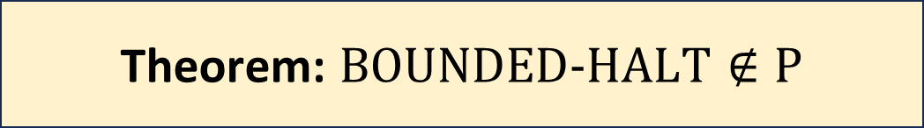
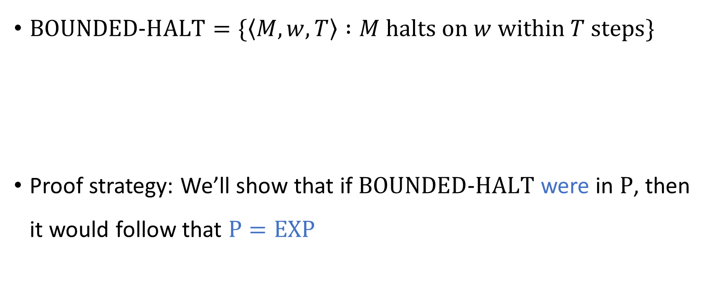
The bounded halting problem
$\text{BOUNDED}\text{‑}\text{HALT}=\{\left\langle M, w, T\right\rangle :M \text{halts} \text{on} w \text{within} T \text{steps}\}$
Proof strategy: We’ll show that if $\text{BOUNDED}\text{‑}\text{HALT}$ were in $\text{P}$, then it would follow that $\text{P}=\text{EXP}$
Theorem: $\text{BOUNDED}\text{‑}\text{HALT}∉\text{P}$

Slide 10







Proof that $\text{BOUNDED}\text{‑}\text{HALT}∉\text{P}$
Assume $B$ is a poly-time TM deciding $\text{BOUNDED}\text{‑}\text{HALT}$
Let $Y∈\text{EXP}$. There is a TM $M$ that $\left\{\begin{aligned} \text{accepts} w \text{within} 2^{{\left|w\right|}^{k}} \text{steps} \text{if} w∈Y \\ \text{loops} \text{if} w∉Y\end{aligned}\right.$
We will construct a poly-time TM $R$ that decides $Y$
Given $w∈{\left\{0, 1\right\}}^{∗}$:
Simulate $B$ on $\left\langle M, w,2^{{\left|w\right|}^{k}} \right\rangle$
If $B$ accepts, accept. If $B$ rejects, reject.
Polynomial time ✔️
If $w∈Y$, then $M$ accepts $w$ within $2^{{\left|w\right|}^{k}}$ steps, so $R$ accepts $w$ ✔️
If $w∉Y$, then $M$ loops on $w$, so $R$ rejects $w$ ✔️
$$R$$

Slide 11


All languages
$$\text{HALT}$$
Decidable languages
$\text{BOUNDED}\text{‑}\text{HALT}$
$$\text{EXP}$$
$$\{\left\langle M\right\rangle :M \text{rejects} \left\langle M\right\rangle \text{within} 2^{\left|\left\langle M\right\rangle \right|} \text{steps}\}$$
$$\text{P}$$
$$\text{PALINDROMES}$$

Slide 12
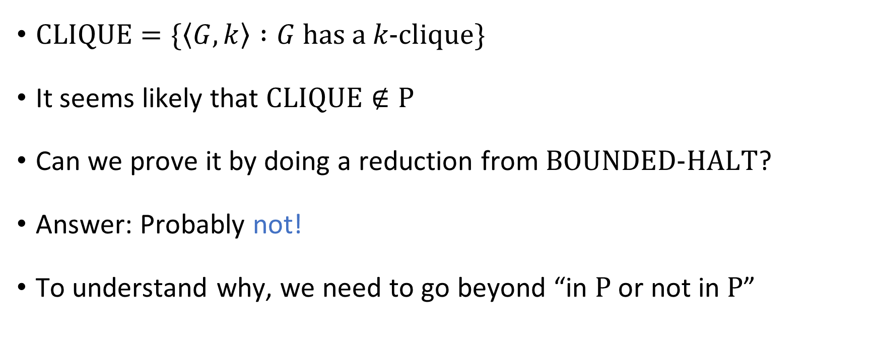

What about $\text{CLIQUE}$?
$\text{CLIQUE}=\{\left\langle G,k\right\rangle :G \text{has} \text{a} k\text{‑}\text{clique}\}$
It seems likely that $\text{CLIQUE}∉\text{P}$
Can we prove it by doing a reduction from $\text{BOUNDED}\text{‑}\text{HALT}$?
Answer: Probably not!
To understand why, we need to go beyond “in $\text{P}$ or not in $\text{P}$”

Slide 13
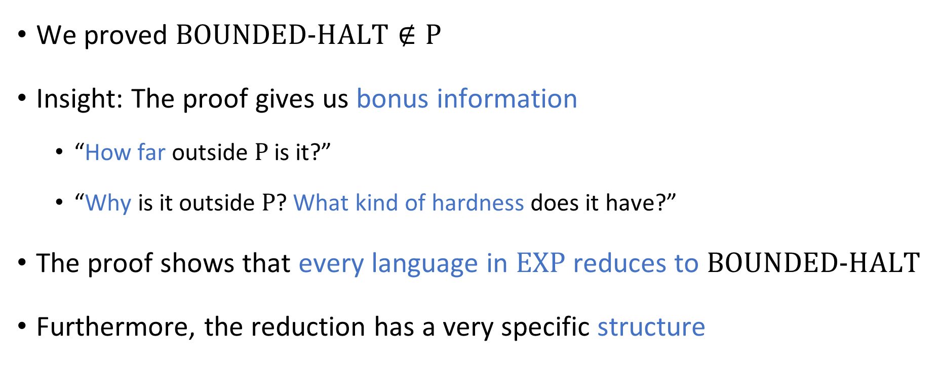

Beyond “it’s not in $\text{P}$”
We proved $\text{BOUNDED}\text{‑}\text{HALT}∉\text{P}$
Insight: The proof gives us bonus information
“How far outside $\text{P}$ is it?”
“Why is it outside $\text{P}$? What kind of hardness does it have?”
The proof shows that every language in $\text{EXP}$ reduces to $\text{BOUNDED}\text{‑}\text{HALT}$
Furthermore, the reduction has a very specific structure

Slide 14
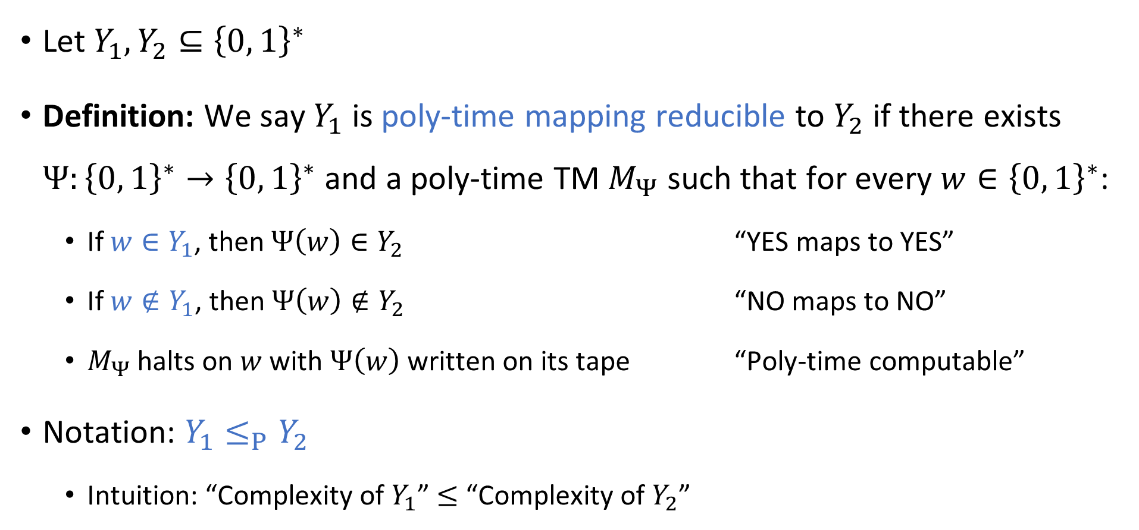
Mapping reductions
Let $Y_{1},Y_{2}⊆{\left\{0, 1\right\}}^{∗}$
Definition: We say $Y_{1}$ is poly-time mapping reducible to $Y_{2}$ if there exists $Ψ:{\left\{0, 1\right\}}^{∗}→{\left\{0, 1\right\}}^{∗}$ and a poly-time TM $M_{Ψ}$ such that for every $w∈{\left\{0, 1\right\}}^{∗}$:
If $w∈Y_{1}$, then $Ψ\left(w\right)∈Y_{2}$ “YES maps to YES”
If $w∉Y_{1}$, then $Ψ\left(w\right)∉Y_{2}$ “NO maps to NO”
$M_{Ψ}$ halts on $w$ with $Ψ\left(w\right)$ written on its tape “Poly-time computable”
Notation: $Y_{1}≤_{P}Y_{2}$
Intuition: “Complexity of $Y_{1}$” $≤$ “Complexity of $Y_{2}$”

Slide 15







Mapping reductions
$Y_{1}≤_{P}Y_{2}$ means there is an efficient way to convert questions of the form “is $w∈Y_{1}$?” into questions of the form “is $w^{′}∈Y_{2}$?”
$$Ψ$$
$$Y_{2}$$
$$Y_{1}$$
$$Ψ$$
$${\left\{0, 1\right\}}^{∗}$$
$${\left\{0, 1\right\}}^{∗}$$

Slide 16
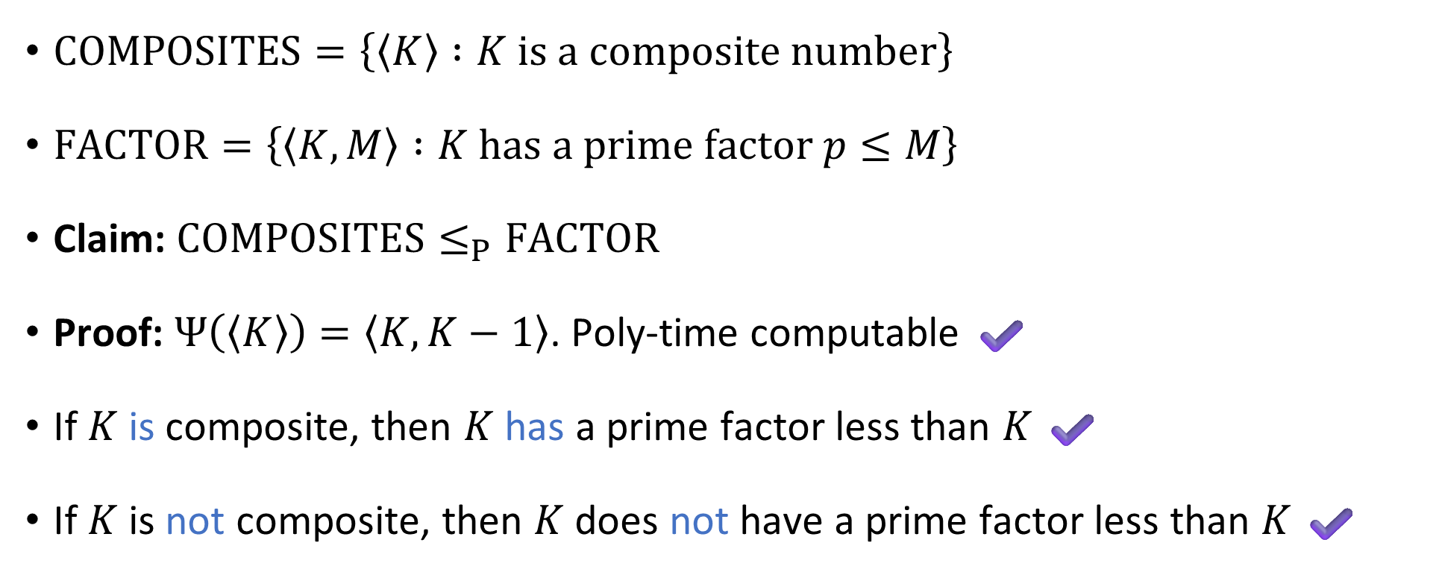
Mapping reduction example
$\text{COMPOSITES}=\left\{\left\langle K\right\rangle :K \text{is} \text{a} \text{composite} \text{number}\right\}$
$\text{FACTOR}=\left\{\left\langle K,M\right\rangle :K \text{has} \text{a} \text{prime} \text{factor} p≤M\right\}$
Claim: $\text{COMPOSITES}≤_{P}\text{FACTOR}$
Proof: $Ψ\left(\left\langle K\right\rangle \right)=\left\langle K,K−1\right\rangle$. Poly-time computable ✔️
If $K$ is composite, then $K$ has a prime factor less than $K$ ✔️
If $K$ is not composite, then $K$ does not have a prime factor less than $K$ ✔️

Slide 17





Reductions: Proving that a language is in $\text{P}$
Let $n=\left|w\right|$ and $m=\left|w^{′}\right|$. What is the relationship between $n$ and $m$?
A: $m≤\text{poly}\left(n\right)$
B: $n≤\text{poly}\left(m\right)$
Let $Y_{1},Y_{2}⊆{\left\{0, 1\right\}}^{∗}$
Claim: If $Y_{1}≤_{P}Y_{2}$ and $Y_{2}∈\text{P}$, then $Y_{1}∈\text{P}$.
Proof: Given $w∈{\left\{0, 1\right\}}^{∗}$:
Compute $w^{′}=Ψ(w)$ (this takes $O\left(n^{k_{1}}\right)$ time)
Check whether $w^{′}∈Y_{2}$ (this takes $O\left(m^{k_{2}}\right)$ time where $m=\left|w^{′}\right|$)
If so, accept; otherwise, reject.
$m≤O\left(n^{k_{1}}\right)$, so the total time is $O\left(n^{k_{1}}+n^{k_{1}⋅k_{2}}\right)=\text{poly}\left(n\right)$
C: $n=m$
D: Not enough information
Respond at PollEv.com/whoza or text “whoza” to 22333

Slide 18

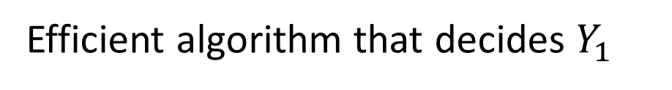



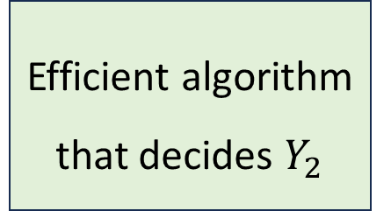
Reductions: Proving that a language is in $\text{P}$
Efficient algorithm that decides $Y_{1}$
$$M_{Ψ}$$
$$w^{′}$$
Efficient algorithm that decides $Y_{2}$
$$w$$
Acc/Rej
Mapping reduction

Slide 19


Reductions: Proving that a language is not in $\text{P}$
Let $Y_{1},Y_{2}⊆{\left\{0, 1\right\}}^{∗}$
Claim: If $Y_{1}≤_{P}Y_{2}$ and $Y_{1}∉\text{P}$, then $Y_{2}∉\text{P}$
Proof: If $Y_{2}$ were in $\text{P}$, then $Y_{1}$ would also be in $\text{P}$

