Slide 1
CMSC 28100 Introduction to Complexity Theory Autumn 2025 Instructor: William Hoza
⏳

Slide 2
Which problems can be solved through computation?

Slide 3






Randomized Turing machines
Input tape ➡
$$⊔$$
1
1
1
0
$$⊔$$
$$⊔$$
Randomness tape ➡
$$⊔$$

Slide 4
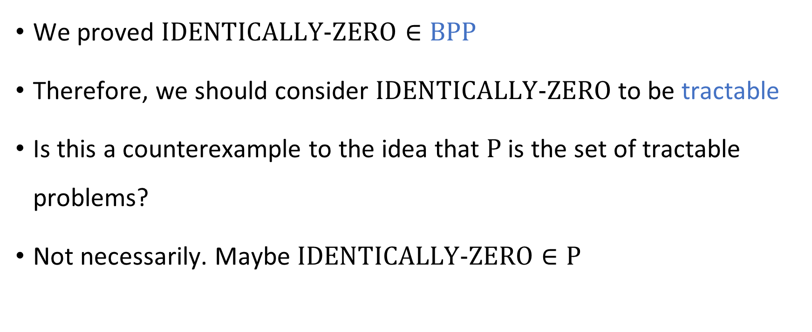
Identity testing: Recap
We proved $\text{IDENTICALLY}‑\text{ZERO}∈\text{BPP}$
Therefore, we should consider $\text{IDENTICALLY}‑\text{ZERO}$ to be tractable
Is this a counterexample to the idea that $\text{P}$ is the set of tractable problems?
Not necessarily. Maybe $\text{IDENTICALLY}‑\text{ZERO}∈\text{P}$

Slide 5

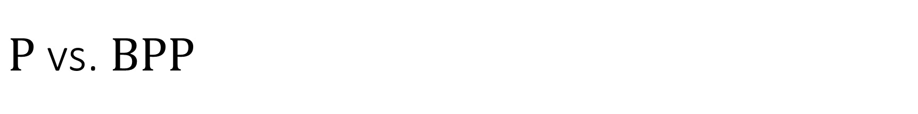


$\text{P}$ vs. $\text{BPP}$
$$\text{BPP}$$
$\text{P}⊆\text{BPP}$
Open question: Does $\text{P}=\text{BPP}$?
Is randomness helpful for computation?
Profound question about the nature of efficient computation
$$\text{P}$$

Slide 6

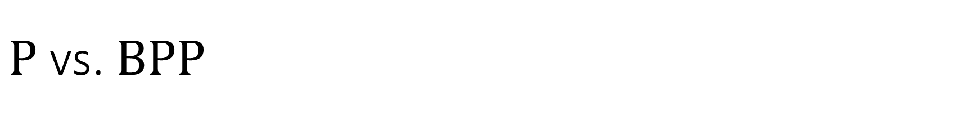
$\text{P}$ vs. $\text{BPP}$
$$\text{BPP}$$
What would it take to prove $\text{P}≠\text{BPP}$?
Define a language $Y$
Prove $Y∈\text{BPP}$
Prove $Y∉\text{P}$
Good candidate: $Y=\text{IDENTICALLY}‑\text{ZERO}$
What would it take to prove $\text{P}=\text{BPP}$?
$$\text{P}$$

Slide 7
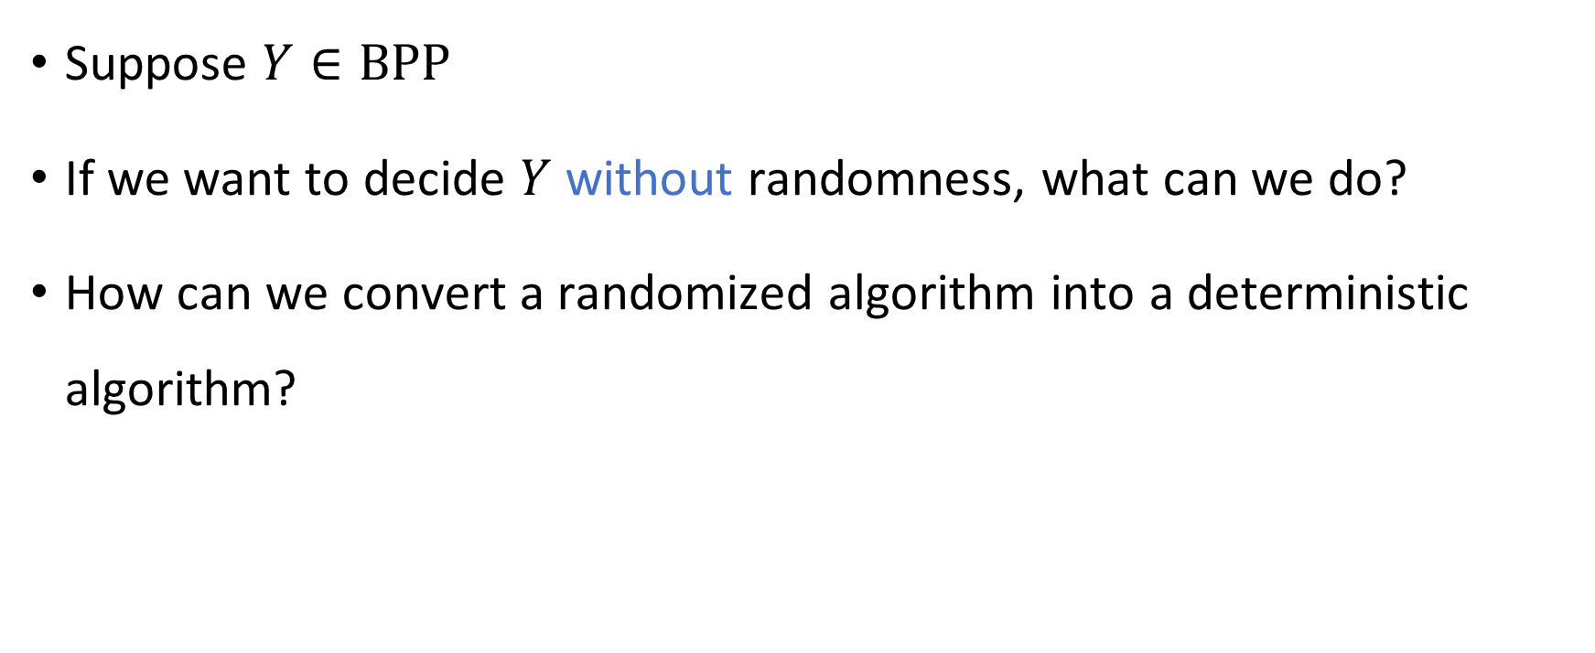
Derandomization
Suppose $Y∈\text{BPP}$
If we want to decide $Y$ without randomness, what can we do?
How can we convert a randomized algorithm into a deterministic algorithm?

Slide 8
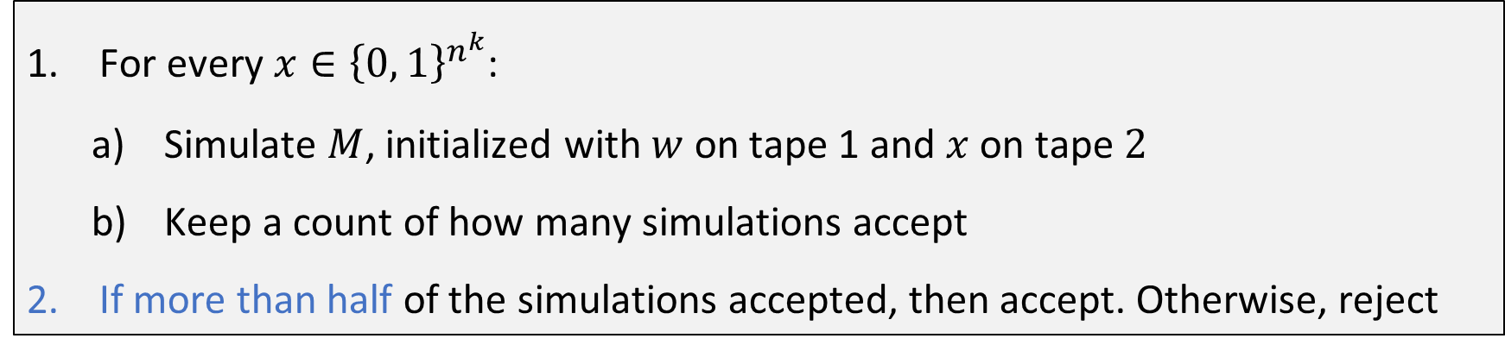

Brute-force derandomization
Let $M$ be a randomized Turing machine that decides $Y$ with error probability $1/3$ and time complexity $n^{k}$
Deterministic algorithm that decides $Y$: Given $w∈{\left\{0, 1\right\}}^{n}$:
For every $x∈{\left\{0, 1\right\}}^{n^{k}}$:
Simulate $M$, initialized with $w$ on tape 1 and $x$ on tape $2$
Keep a count of how many simulations accept
If more than half of the simulations accepted, then accept. Otherwise, reject

Slide 9


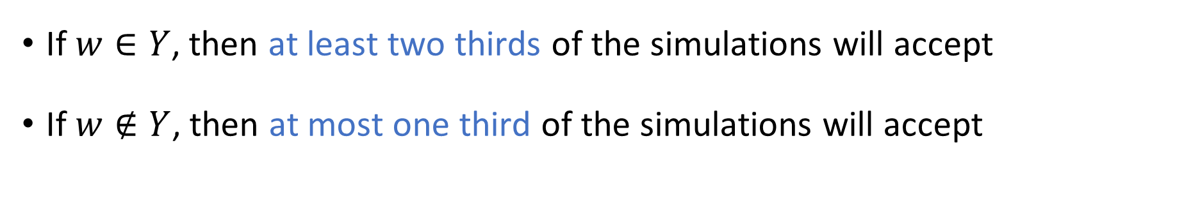



Brute-force derandomization: Correctness
For every $x∈{\left\{0, 1\right\}}^{n^{k}}$:
Simulate $M$, initialized with $w$ on tape 1 and $x$ on tape $2$
Keep a count of how many simulations accept
If more than half of the simulations accepted, then accept. Otherwise, reject
What is the time complexity of the algorithm?
If $w∈Y$, then at least two thirds of the simulations will accept
If $w∉Y$, then at most one third of the simulations will accept
A: $2^{poly\left(n\right)}$
B: $\text{poly}\left(n\right)$
C: $2^{2^{Θ\left(n\right)}}$
D: $∞$
Respond at PollEv.com/whoza or text “whoza” to 22333

Slide 10
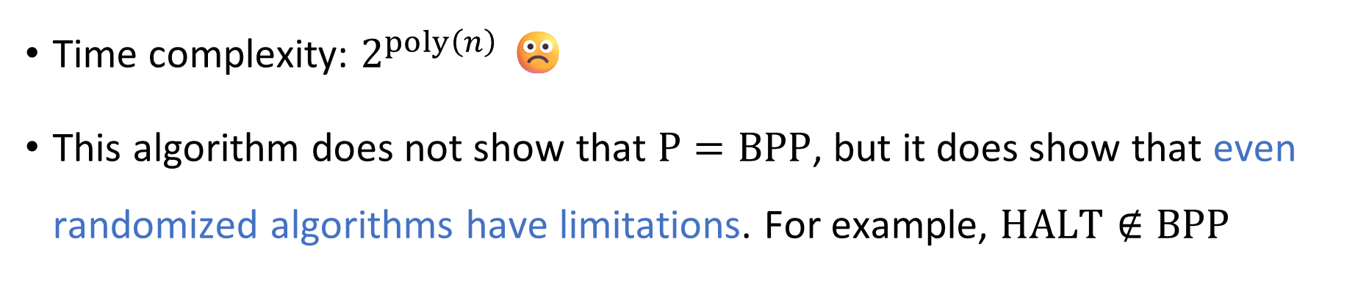
Brute-force derandomization: Time complexity
For every $x∈{\left\{0, 1\right\}}^{n^{k}}$:
Simulate $M$, initialized with $w$ on tape 1 and $x$ on tape $2$
Keep a count of how many simulations accept
If more than half of the simulations accepted, then accept. Otherwise, reject
Time complexity: $2^{poly\left(n\right)}$ ☹️
This algorithm does not show that $\text{P}=\text{BPP}$, but it does show that even randomized algorithms have limitations. For example, $\text{HALT}∉\text{BPP}$

Slide 11
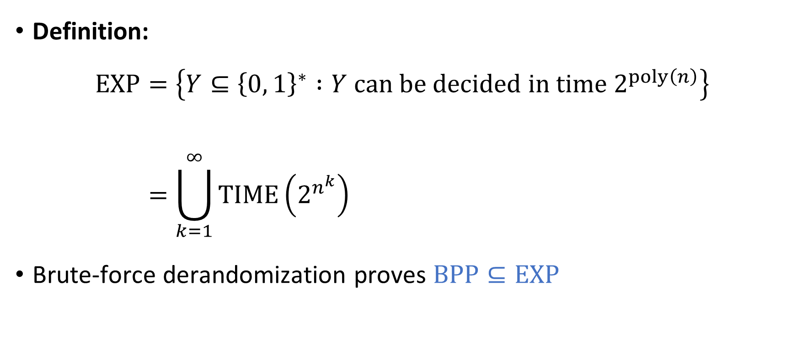

The complexity class $\text{EXP}$
Definition:
$$\text{EXP}=\left\{Y⊆{\left\{0, 1\right\}}^{∗} :Y \text{can} \text{be} \text{decided} \text{in} \text{time} 2^{poly\left(n\right)}\right\} \\ =\bigcup_{k=1}^{∞}{\text{TIME}\left(2^{n^{k}}\right)}$$
Brute-force derandomization proves $\text{BPP}⊆\text{EXP}$

Slide 12







$\text{P}⊆\text{BPP}⊆\text{EXP}$
$$\text{HALT}$$
Decidable languages
$$\text{EXP}$$
$\text{IDENTICALLY}‑\text{ZERO}$ ?
$$\text{BPP}$$
$$\text{P}$$
$$\text{PALINDROMES}$$

Slide 13




Brute-force derandomization: Space complexity
For every $x∈{\left\{0, 1\right\}}^{n^{k}}$:
Simulate $M$, initialized with $w$ on tape 1 and $x$ on tape $2$
Keep a count of how many simulations accept
If more than half of the simulations accepted, then accept. Otherwise, reject
What is the space complexity of the algorithm?
A: $2^{Θ\left(n^{k}\right)}$
B: $\text{poly}\left(n\right)$
C: $2^{2^{Θ\left(n\right)}}$
D: $∞$
Respond at PollEv.com/whoza or text “whoza” to 22333

Slide 14


The complexity class $\text{PSPACE}$
Definition:
$$\text{PSPACE}=\left\{Y⊆{\left\{0, 1\right\}}^{∗} :Y \text{can} \text{be} \text{decided} \text{in} \text{space} \text{poly}\left(n\right)\right\}$$
Brute-force derandomization proves that $\text{BPP}⊆\text{PSPACE}$

Slide 15


$\text{PSPACE}$ vs. $\text{EXP}$
Theorem 1: $\text{BPP}⊆\text{EXP}$
Theorem 2: $\text{BPP}⊆\text{PSPACE}$
Which theorem is stronger?
How does $\text{PSPACE}$ compare to $\text{EXP}$?

Slide 16

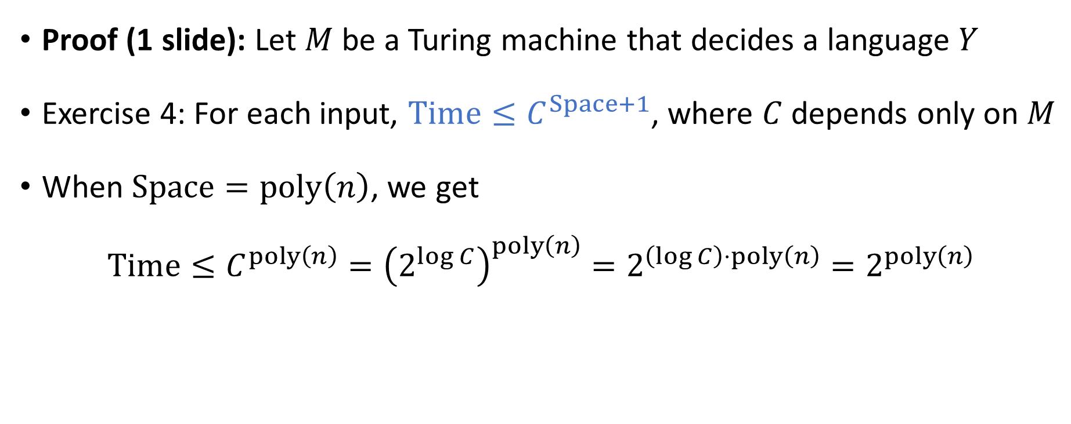
Theorem: $\text{PSPACE}⊆\text{EXP}$
Proof (1 slide): Let $M$ be a Turing machine that decides a language $Y$
Exercise 4: For each input, $\text{Time}≤C^{Space+1}$, where $C$ depends only on $M$
When $\text{Space}=\text{poly}\left(n\right)$, we get
$$\text{Time}≤C^{poly\left(n\right)}={\left(2^{\log{C}}\right)}^{poly\left(n\right)}=2^{\left(\log{C}\right)⋅poly\left(n\right)}=2^{poly\left(n\right)}$$

Slide 17




Decidable languages
$$\text{EXP}$$
$$\text{PSPACE}$$
$$\text{BPP}$$
$$\text{P}$$

Slide 18





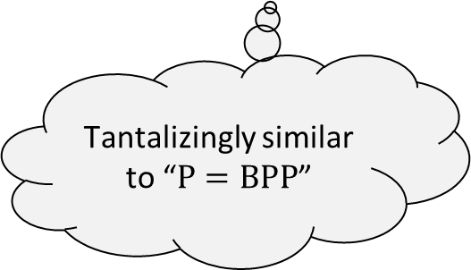


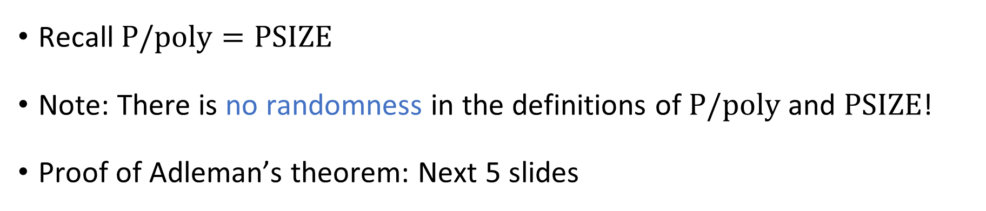









Derandomization beyond brute force
$$∨$$
Adleman’s Theorem: $\text{BPP}⊆\text{P}/\text{poly}$
$$\text{P}/\text{poly}$$
$$∨$$
$$∧$$
$$∧$$
$$∧$$
$$\text{BPP}$$
$$⊕$$
$$⊕$$
Tantalizingly similar to “$\text{P}=\text{BPP}$”
$$\text{P}$$
$$x_{1}$$
$$x_{2}$$
$$x_{3}$$
Recall $\text{P}/\text{poly}=\text{PSIZE}$
Note: There is no randomness in the definitions of $\text{P}/\text{poly}$ and $\text{PSIZE}$!
Proof of Adleman’s theorem: Next 5 slides

Slide 19
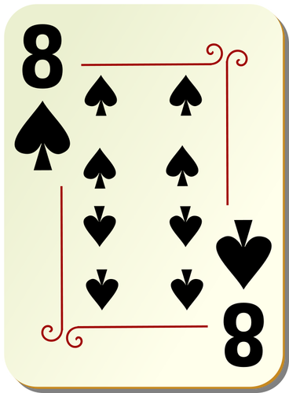
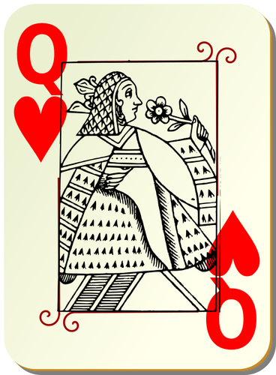
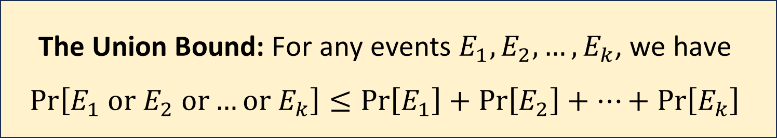

The union bound
Key fact from probability theory:
Example: If we pick two cards from a deck, then
$\operatorname{Pr}\left[\text{card}\text{ 1 }\text{is} \text{a} \text{queen} \text{or} \text{card}\text{ 2 }\text{is} \text{a} \text{queen}\right]≤\frac{1}{13}+\frac{1}{13}=\frac{2}{13}$
The Union Bound: For any events $E_{1},E_{2},…, E_{k}$, we have $$\operatorname{Pr}\left[E_{1} \text{or} E_{2} \text{or}…\text{or} E_{k}\right]≤\operatorname{Pr}\left[E_{1}\right]+\operatorname{Pr}\left[E_{2}\right]+…+\operatorname{Pr}\left[E_{k}\right]$$

Slide 20
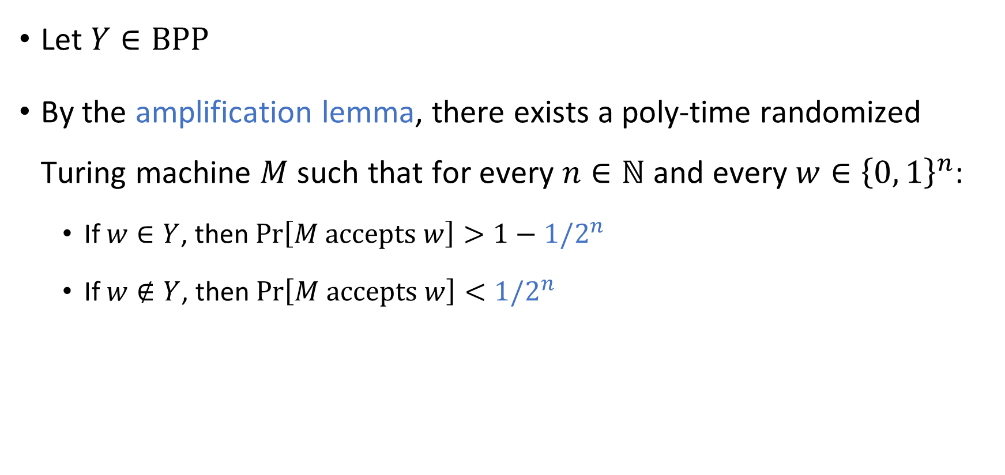
Adleman proof step 1: Amplification
Let $Y∈\text{BPP}$
By the amplification lemma, there exists a poly-time randomized Turing machine $M$ such that for every $n∈ℕ$ and every $w∈{\left\{0, 1\right\}}^{n}$:
If $w∈Y$, then $\operatorname{Pr}\left[M \text{accepts} w\right]>1−1/2^{n}$
If $w∉Y$, then $\operatorname{Pr}\left[M \text{accepts} w\right]<1/2^{n}$

Slide 21
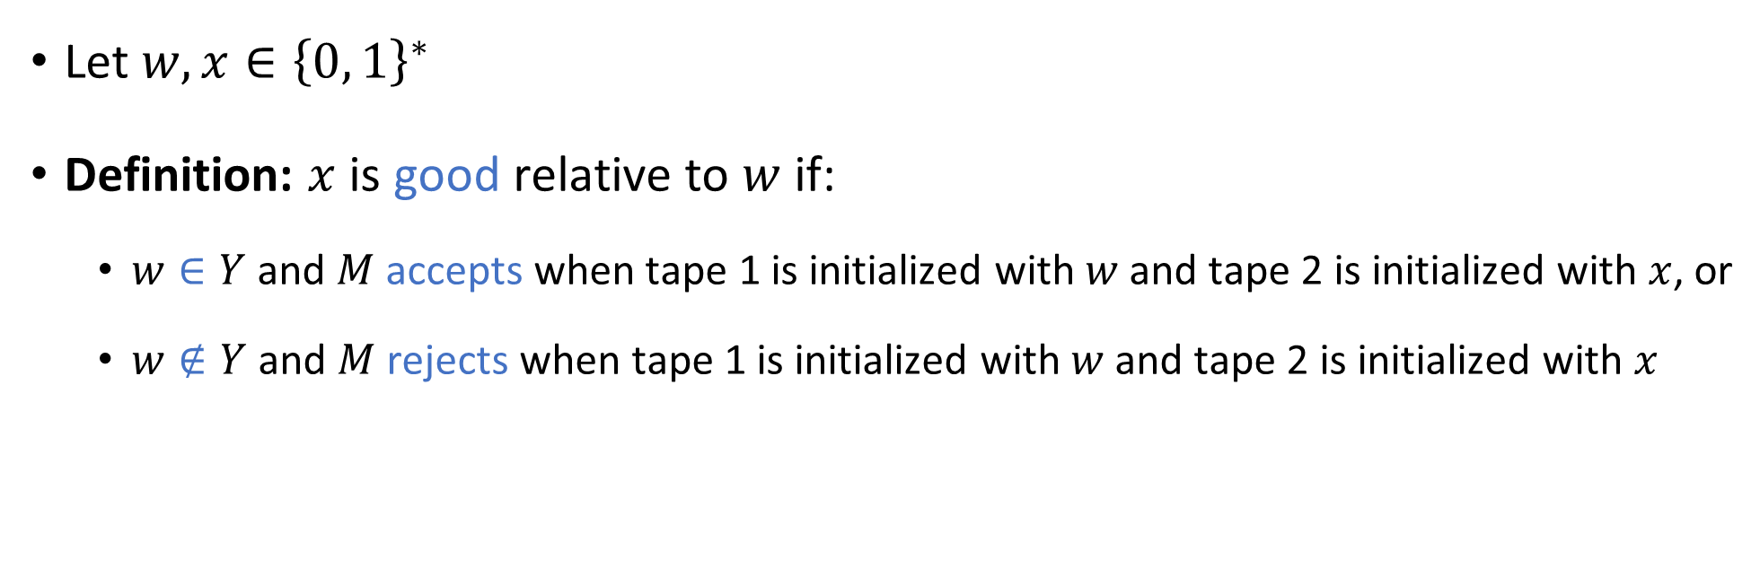
Adleman proof step 2: Good random bits
Let $w,x∈{\left\{0, 1\right\}}^{∗}$
Definition: $x$ is good relative to $w$ if:
$w∈Y$ and $M$ accepts when tape 1 is initialized with $w$ and tape 2 is initialized with $x$, or
$w∉Y$ and $M$ rejects when tape 1 is initialized with $w$ and tape 2 is initialized with $x$

Slide 22
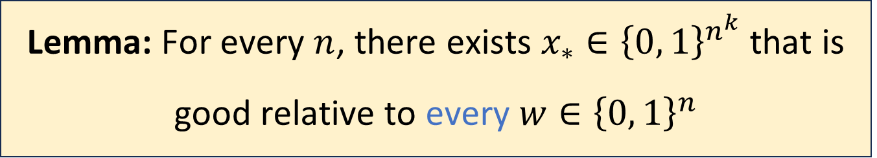
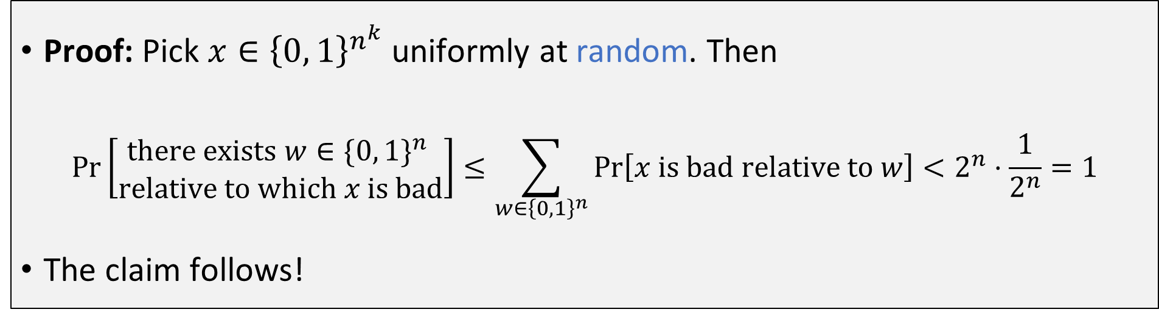
Adleman proof step 2: Good random bits
Lemma: For every $n$, there exists $x_{∗}∈{\left\{0, 1\right\}}^{n^{k}}$ that is good relative to every $w∈{\left\{0, 1\right\}}^{n}$
Proof: Pick $x∈{\left\{0, 1\right\}}^{n^{k}}$ uniformly at random. Then
$$\operatorname{Pr}\left[\begin{matrix}\text{there} \text{exists} w∈{\{0, 1\}}^{n} \\ \text{relative} \text{to} \text{which} x \text{is} \text{bad}\end{matrix}\right]≤\sum_{w∈{\left\{0, 1\right\}}^{n}}{\operatorname{Pr}\left[x \text{is} \text{bad} \text{relative} \text{to} w\right]}<2^{n}⋅\frac{1}{2^{n}}=1$$
The claim follows!
Union Bound

Slide 23
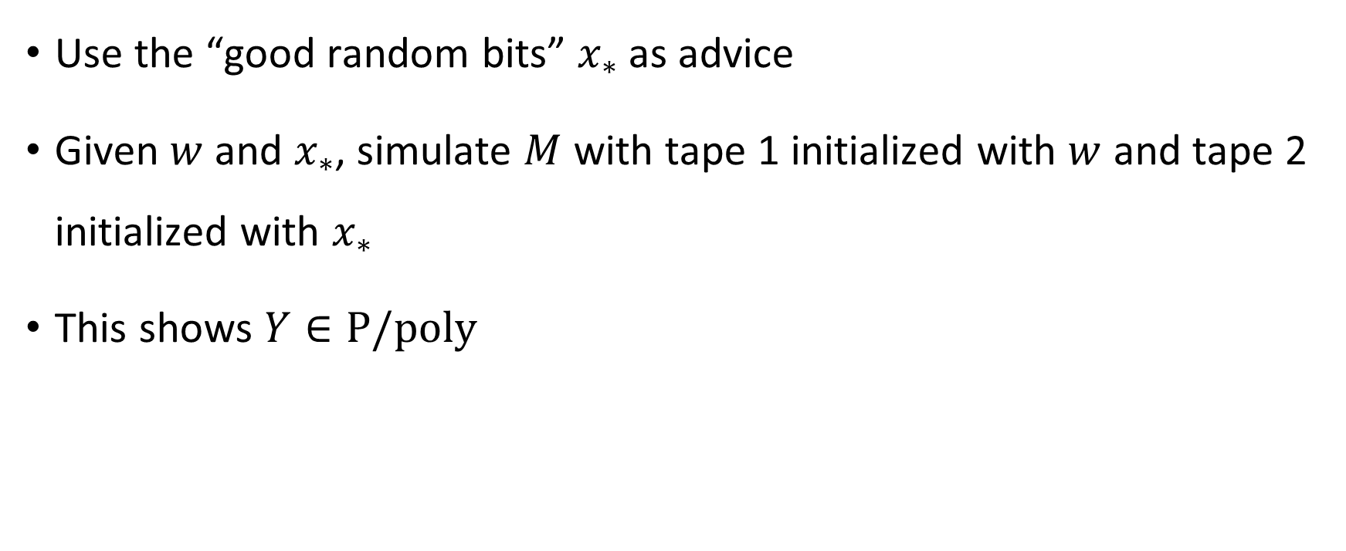
Adleman proof step 3: Advice
Use the “good random bits” $x_{∗}$ as advice
Given $w$ and $x_{∗}$, simulate $M$ with tape 1 initialized with $w$ and tape 2 initialized with $x_{∗}$
This shows $Y∈\text{P}/\text{poly}$

Slide 24
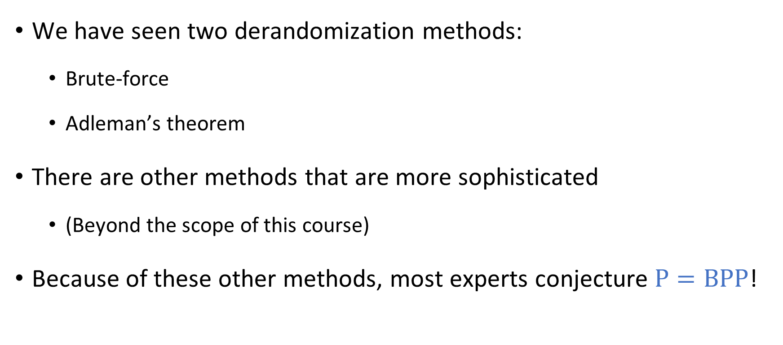



$\text{P}$ vs. $\text{BPP}$
$$\text{BPP}$$
$$\text{P}=\text{BPP}$$
We have seen two derandomization methods:
Brute-force
Adleman’s theorem
There are other methods that are more sophisticated
(Beyond the scope of this course)
Because of these other methods, most experts conjecture $\text{P}=\text{BPP}$!
$$\text{P}$$

Slide 25
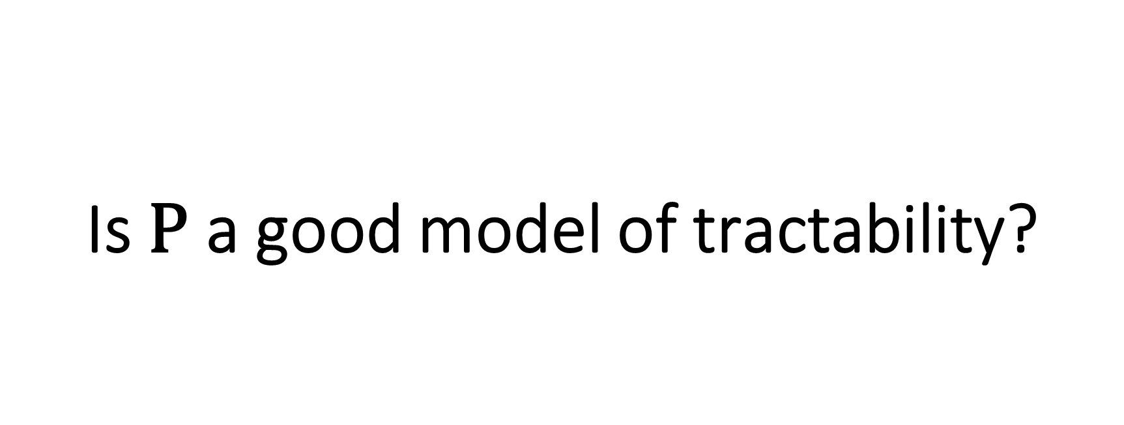
Is $\text{P}$ a good model of tractability?

Slide 26

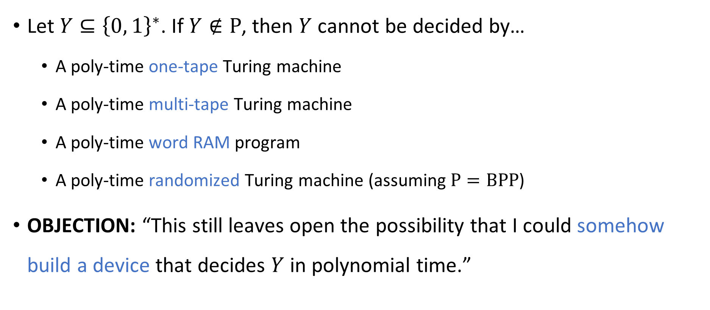
Robustness of $\text{P}$, revisited
Let $Y⊆{\left\{0, 1\right\}}^{∗}$. If $Y∉\text{P}$, then $Y$ cannot be decided by…
A poly-time one-tape Turing machine
A poly-time multi-tape Turing machine
A poly-time word RAM program
A poly-time randomized Turing machine (assuming $\text{P}=\text{BPP}$)
OBJECTION: “This still leaves open the possibility that I could somehow build a device that decides $Y$ in polynomial time.”

Slide 27
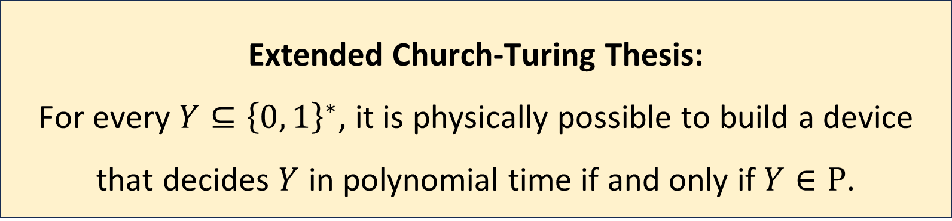
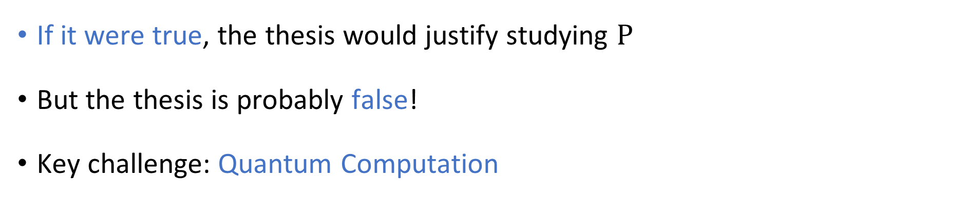
Extended Church-Turing Thesis
Extended Church-Turing Thesis:
For every $Y⊆{\left\{0, 1\right\}}^{∗}$, it is physically possible to build a device that decides $Y$ in polynomial time if and only if $Y∈\text{P}$.
If it were true, the thesis would justify studying $\text{P}$
But the thesis is probably false!
Key challenge: Quantum Computation

Slide 28

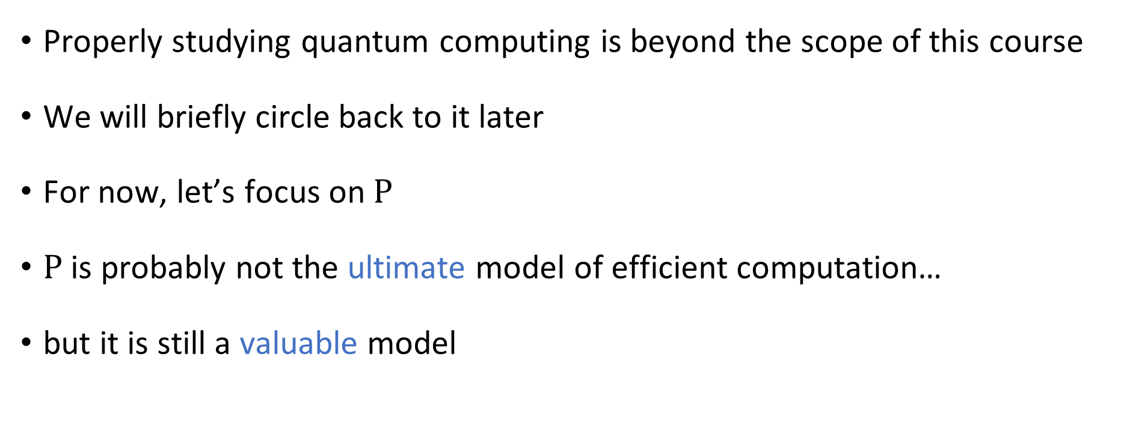
Quantum computing
Properly studying quantum computing is beyond the scope of this course
We will briefly circle back to it later
For now, let’s focus on $\text{P}$
$\text{P}$ is probably not the ultimate model of efficient computation…
but it is still a valuable model

Slide 29
Which problems can be solved through computation?
CLASSICAL

