Slide 1
CMSC 28100 Introduction to Complexity Theory Autumn 2025 Instructor: William Hoza
⏳

Slide 2
Which problems can be solved through computation?

Slide 3
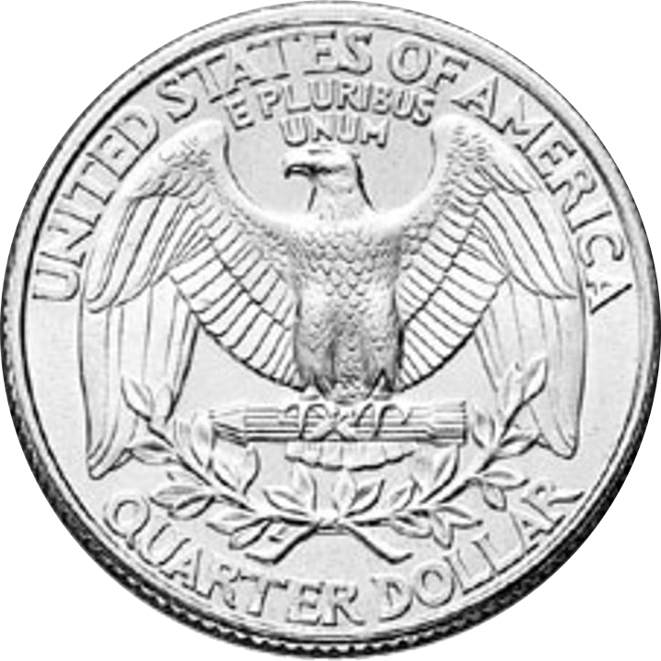





Randomized Turing machines
Input tape ➡
$$⊔$$
1
1
1
0
$$⊔$$
$$⊔$$
Randomness tape ➡
$$⊔$$

Slide 4

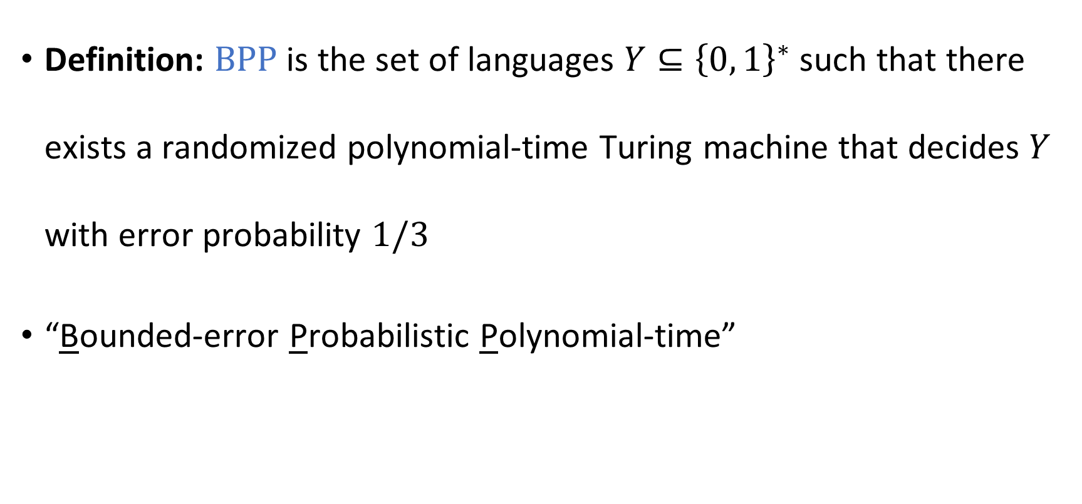

The complexity class $\text{BPP}$
Definition: $\text{BPP}$ is the set of languages $Y⊆{\left\{0, 1\right\}}^{∗}$ such that there exists a randomized polynomial-time Turing machine that decides $Y$ with error probability $1/3$
“Bounded-error Probabilistic Polynomial-time”

Slide 5

Example: High school algebra
“Expand and simplify: $\left(x+1\right)⋅\left(x−1\right)$”
How difficult is this type of exercise?
This type of expression is called an arithmetic formula

Slide 6

Identity testing
Problem: Given an arithmetic formula $F$, determine whether $F≡0$
As a language:
$$\text{IDENTICALLY}‑\text{ZERO}=\left\{\left\langle F\right\rangle :F \text{is} \text{an} \text{arithmetic} \text{formula} \text{and} F≡0\right\}$$

Slide 7
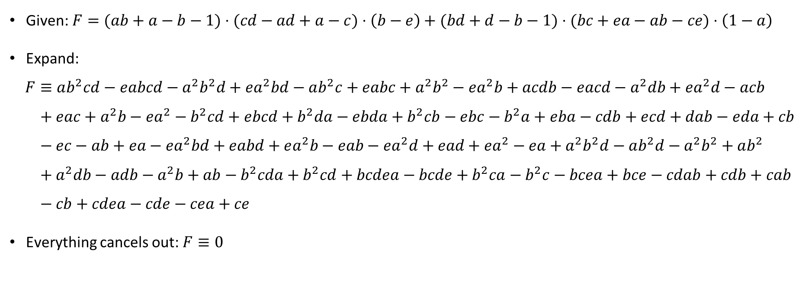
Identity testing example
Given: $F=(ab+a−b−1)⋅(cd−ad+a−c)⋅\left(b−e\right)+(bd+d−b−1)⋅(bc+ea−ab−ce)⋅\left(1−a\right)$
Expand:
$$F≡ab^{2}cd−eabcd−a^{2}b^{2}d+ea^{2}bd−ab^{2}c+eabc+a^{2}b^{2}−ea^{2}b+acdb−eacd−a^{2}db+ea^{2}d−acb \\ + eac+a^{2}b−ea^{2}−b^{2}cd+ebcd+b^{2}da−ebda+b^{2}cb−ebc−b^{2}a+eba−cdb+ecd+dab−eda+cb \\ − ec−ab+ea−ea^{2}bd+eabd+ea^{2}b−eab−ea^{2}d+ead+ea^{2}−ea+a^{2}b^{2}d−ab^{2}d−a^{2}b^{2}+ab^{2} \\ +{ a}^{2}db−adb−a^{2}b+ab−b^{2}cda+b^{2}cd+bcdea−bcde+b^{2}ca−b^{2}c−bcea+bce−cdab+cdb+cab \\ − cb+cdea−cde−cea+ce$$
Everything cancels out: $F≡0$

Slide 8
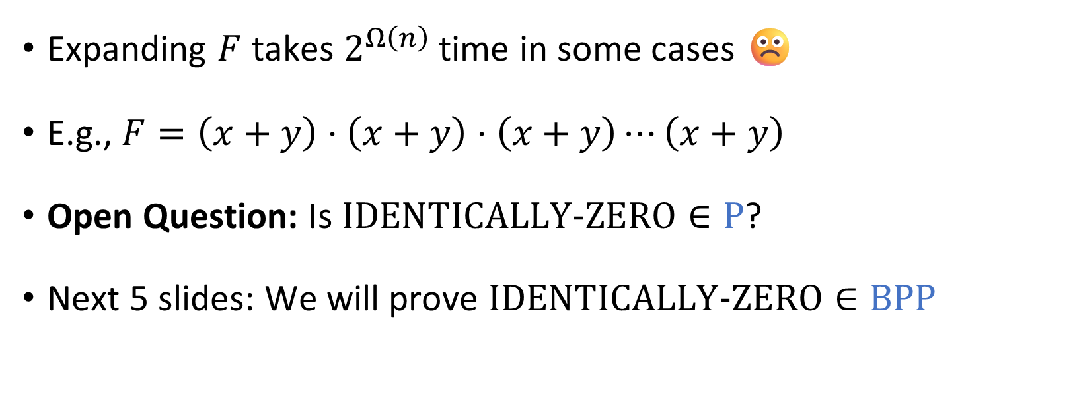
Complexity of identity testing
Expanding $F$ takes $2^{Ω\left(n\right)}$ time in some cases ☹️
E.g., $F=\left(x+y\right)⋅\left(x+y\right)⋅\left(x+y\right)⋯\left(x+y\right)$
Open Question: Is $\text{IDENTICALLY}‑\text{ZERO}∈\text{P}$?
Next 5 slides: We will prove $\text{IDENTICALLY}‑\text{ZERO}∈\text{BPP}$

Slide 9
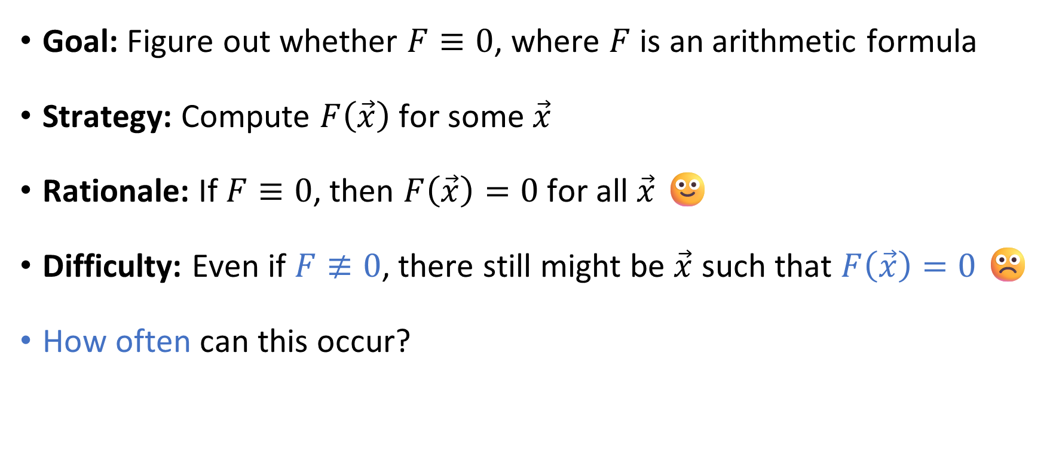
Identity testing algorithm: Approach
Goal: Figure out whether $F≡0$, where $F$ is an arithmetic formula
Strategy: Compute $F\left(\vec{x}\right)$ for some $\vec{x}$
Rationale: If $F≡0$, then $F\left(\vec{x}\right)=0$ for all $\vec{x}$ 🙂
Difficulty: Even if $F≢0$, there still might be $\vec{x}$ such that $F\left(\vec{x}\right)=0$ ☹️
How often can this occur?

Slide 10
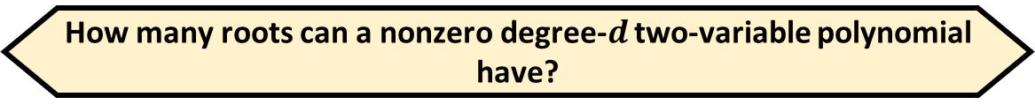
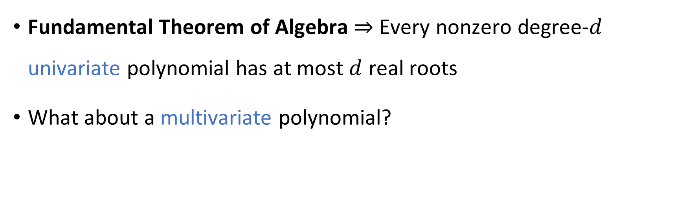
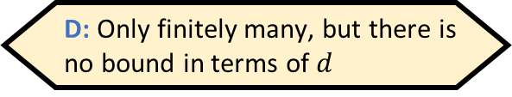


Counting roots
How many roots can a nonzero degree-$d$ two-variable polynomial have?
A: Up to $d$
B: Up to $d^{2}$
C: It might have infinitely many
D: Only finitely many, but there is no bound in terms of $d$
Respond at PollEv.com/whoza or text “whoza” to 22333
Fundamental Theorem of Algebra $⇒$ Every nonzero degree-$d$ univariate polynomial has at most $d$ real roots
What about a multivariate polynomial?

Slide 11
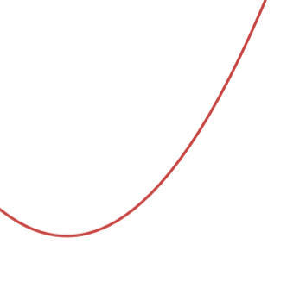

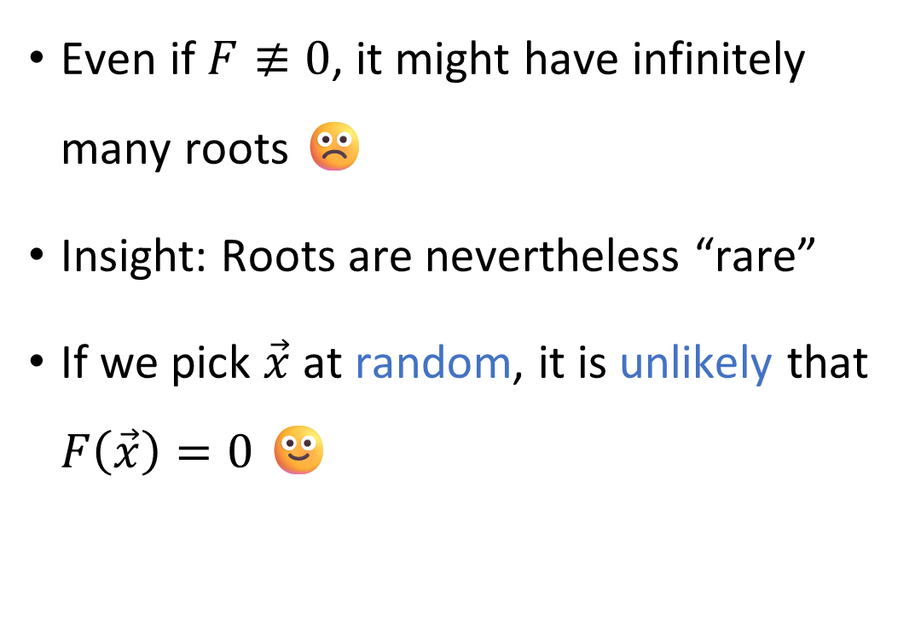



How common are roots?
Roots of $F$, where $F\left(\vec{x}\right)=x_{2}−x_{1}^{2}$
Even if $F≢0$, it might have infinitely many roots ☹️
Insight: Roots are nevertheless “rare”
If we pick $\vec{x}$ at random, it is unlikely that $F\left(\vec{x}\right)=0$ 🙂
$$x_{2}$$
$$x_{1}$$

Slide 12
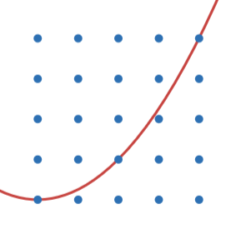
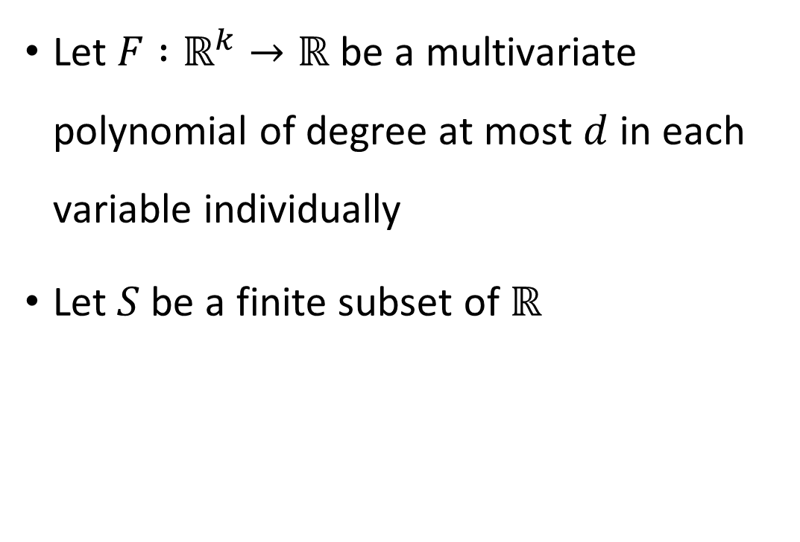

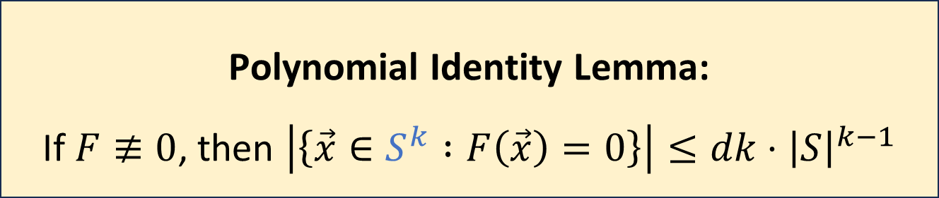
Polynomial Identity Lemma
Roots of $F$, where $F\left(\vec{x}\right)=x_{2}−x_{1}^{2}$
Let $F :ℝ^{k}→ℝ$ be a multivariate polynomial of degree at most $d$ in each variable individually
Let $S$ be a finite subset of $ℝ$
$$x_{2}$$
Polynomial Identity Lemma: If $F≢0$, then $\left|\left\{\vec{x}∈S^{k} :F\left(\vec{x}\right)=0\right\}\right|≤dk⋅{\left|S\right|}^{k−1}$
$$x_{1}$$
Proof: On chalkboard
Notes:
Also commonly called the “Schwartz-Zippel Lemma.” Proof when $k=2$: Write $F\left(x,y\right)=\sum_{i}^{d}{\sum_{j}^{d}{c_{i,j}}x^{i}y^{j}=}\sum_{j=1}^{d}{f_{j}(x)}⋅y^{j}$ where $f_{j_{∗}}≢0$
Write $F_{x}\left(y\right)=F\left(x,y\right)$
Split zeroes into the case $f_{j_{∗}}\left(x\right)=0$ and the case $f_{j_{∗}}\left(x\right)≠0$
The first case happens at most $d$ times
When the second case happens, $F_{x}$ has at most $d$ roots

Slide 13



Theorem: $\text{IDENTICALLY}‑\text{ZERO}∈\text{BPP}$
Given $F$ with $k$ variables and $d$ leaves:
Let $S=\left\{1, …, 3dk\right\}$
Pick $\vec{c}∈S^{k}$ uniformly at random
Construct $F^{′}$ by replacing $x_{i}$ with $c_{i}$
If $\left\langle F^{′}\right\rangle ∈\text{EQUALS}‑\text{ZERO}$, accept, otherwise reject
Polynomial time ✔️
Correctness proof:
Degree $≤d$ (can prove by induction)
If $F≡0$, then $\operatorname{Pr}\left[\text{accept}\right]=1$
If $F≢0$, then by the Polynomial Identity Lemma, we have
$$\operatorname{Pr}\left[\text{accept}\right]=\operatorname{Pr}\left[F\left(\vec{c}\right)=0\right]=\frac{\left|F^{−1}\left(0\right)∩S^{k}\right|}{\left|S^{k}\right|}≤\frac{dk⋅{\left|S\right|}^{k−1}}{{\left|S\right|}^{k}}=\frac{dk}{3dk}=\frac{1}{3}$$
Which of the following best describes the algorithm?
A: The algorithm behaves correctly on most inputs
B: The amount of time it uses is rarely more than polynomial
C: For every input, the algorithm is likely to behave correctly
D: It is likely that for every input, the algorithm behaves correctly
Respond at PollEv.com/whoza or text “whoza” to 22333

Slide 14
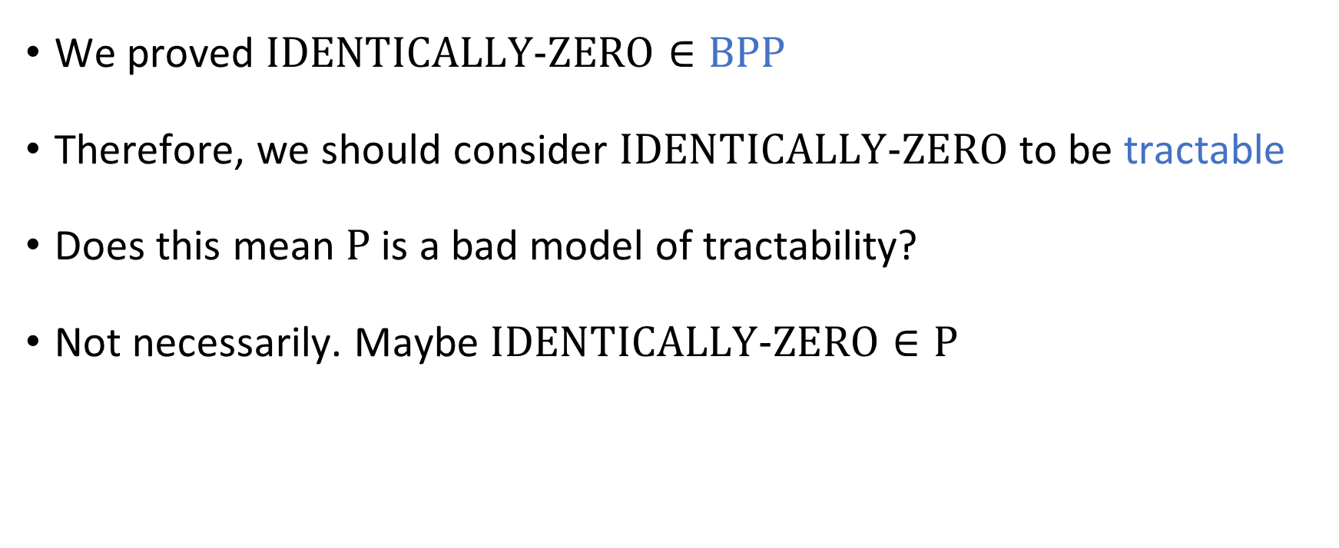
Identity testing: Recap
We proved $\text{IDENTICALLY}‑\text{ZERO}∈\text{BPP}$
Therefore, we should consider $\text{IDENTICALLY}‑\text{ZERO}$ to be tractable
Does this mean $\text{P}$ is a bad model of tractability?
Not necessarily. Maybe $\text{IDENTICALLY}‑\text{ZERO}∈\text{P}$

