Slide 1
Course Summary & Review
Pseudorandomness
Autumn 2023
University of Chicago

Slide 2
Randomness: An expensive computational resource
Treat randomness like time or space
Try to use as little as possible

Slide 3
Part I
Small-Bias Distributions and
Limited Independence

Slide 4
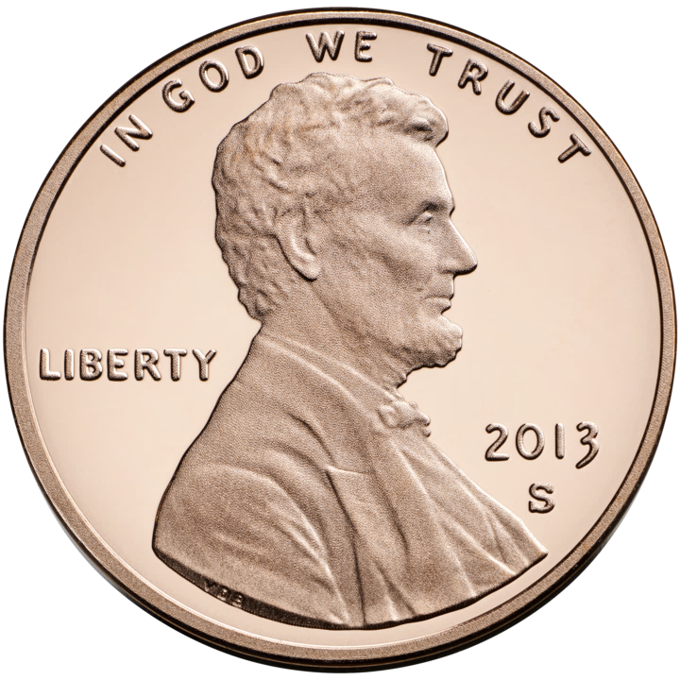
Pseudorandom generators (PRGs)
“Truly random seed”
For every “sufficiently-efficient” observer, the PRG can replace random bits with no significant impact.
$$G$$
$$≈$$

Slide 5
Pseudorandom generators (PRGs)
Let $ℱ$ be a class of functions $f:\{0, 1\}^{n}→ℝ$
An $ε$-PRG for $ℱ$ is a function $G:\{0, 1\}^{s}→\{0, 1\}^{n}$ such that for every $f∈ℱ$,
$$\left|𝔼\left[f\left(G\left(U_{s}\right)\right)\right]−𝔼\left[f\right]\right|≤ε$$
There is a generic nonconstructive proof of the existence of PRGs with small seed lengths
We want explicit constructions

Slide 6
$k$-wise uniformity
Theorem: There is an explicit $k$-wise uniform generator with seed length $O\left(k⋅\log{n}\right)$
Every $k$ of the $n$ coordinates are perfectly random

Slide 7
$ε$-biased distributions
Theorem: There is an explicit $ε$-biased generator with seed length $O\left(\log\left(n/ε\right)\right)$
Fools parity functions $⊕_{i∈S}x_{i}$ with error $ε/2$

Slide 8
Fourier $L_{1}$ norm
Fourier expansion: Every $f:\{0, 1\}^{n}→ℝ$ can be written as $f=\sum_{S⊆\left[n\right]}{\hat{f}\left(S\right)⋅χ_{S}}$
Definition: $L_{1}\left(f\right)=\sum_{S}{\left|\hat{f}\left(S\right)\right|}$
If $X$ is an $ε$-biased distribution, then $X$ fools $f$ with error $ε⋅L_{1}\left(f\right)$
One can use this approach to construct optimal PRGs for juntas, decision trees, and width-2 branching programs

Slide 9
What next?
If you enjoyed Part I of this course, consider studying Analysis of Boolean Functions next

Slide 10
Part II
Expander Graphs

Slide 11
Spectral expansion
Let $G$ be an undirected regular graph with transition matrix $M$
Definition:
$$λ\left(G\right)=\max_{π}{\frac{||πM−u||_{2}}{|\left|π−u\right|{\left.​\right|}_{2}}}$$
where $π$ is a probability vector

Slide 12
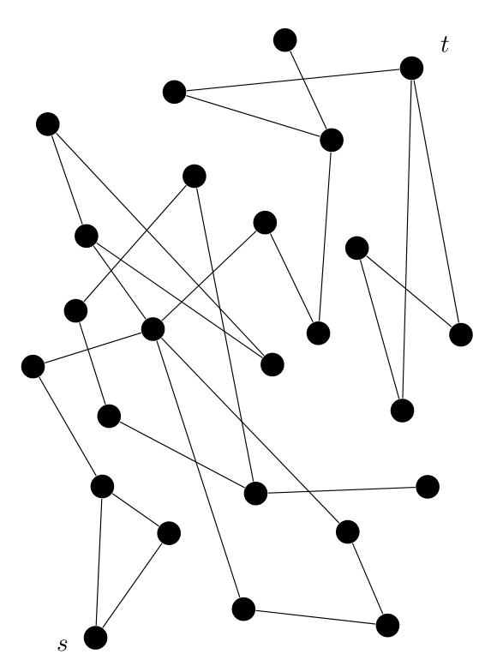
Random walks in undirected graphs
Theorem: Undirected $s$-$t$ connectivity is in $\text{BPL}$
Proof based on analyzing random walk using $λ\left(G\right)$

Slide 13
Explicit expander graphs
An $ε$-spectral expander is an undirected regular graph $G$ with $λ\left(G\right)≤ε$
Theorem: For every $N$ and $ε$, there exists an explicit $ε$-explicit expander on $N$ vertices with degree $\text{poly}(1/ε)$
Expander graphs are well-connected, yet sparse

Slide 14
Expander Mixing Lemma
Let $f:\{0, 1\}^{n}→\{0, 1\}$ be a two-dimensional combinatorial rectangle: $f\left(x,y\right)=g\left(x\right)⋅h\left(y\right)$ for some $g,h:\{0, 1\}^{n/2}→\{0, 1\}$
Sample a uniform random vertex $X$ and a uniform random neighbor $Y$ from an $ε$-spectral expander on vertex set $\{0, 1\}^{n/2}$
Expander Mixing Lemma: $\left(X, Y\right)$ fools $f$ with error $ε$
Generalization: “PRG Characterization of Expander Graphs”

Slide 15
Fooling space-bounded computation
Theorem: There is an explicit PRG (the “INW generator”) with seed length $O\left(S⋅\log{n}\right)$ that generates $n$ pseudorandom bits that can be used to simulate space-$S$ randomized algorithms
(Equivalent: The PRG fools standard-order ROBPs)
Recursive construction based on expander graphs

Slide 16
Reingold’s theorem
Reingold’s Theorem: There is a deterministic log-space algorithm for undirected $s$-$t$ connectivity
Algorithm: Try all seeds to the INW generator
Analysis in terms of the derandomized squaring operation

Slide 17
What next?
If you enjoyed Part II of this course, consider studying Spectral Graph Theory next

Slide 18
Part III
Randomness Extractors

Slide 19
Seeded extractors
$k$-source: Random variable such that $∀x, \operatorname{Pr}\left[X=x\right]≤2^{−k }$
A $\left(k,ε\right)$-extractor is a function $\text{Ext}:\{0, 1\}^{n}→\{0, 1\}^{d}→\{0, 1\}^{m}$ such that for every $k$-source $X$ and every Boolean function $f$,
$\left|𝔼\left[f\left(\text{Ext}\left(X, U_{d}\right)\right)\right]−𝔼\left[f\right]\right|≤ε$

Slide 20
Simulating BPP using low-quality random bits
Theorem (GUV): There exists an explicit $\left(k, ε\right)$-extractor with $d=O\left(\log\left(n/ε\right)\right)$ and $m=\left\lceil k/2\right\rceil$
Consequence: If a BPP algorithm uses $m$ random bits and has failure probability 0.1, then we can efficiently simulate it using any $\left(2m\right)$-source

Slide 21
Nisan-Zuckerman PRG
Theorem: If a language can be decided by a randomized algorithm that uses $S$ bits of space and $\text{poly}\left(S\right)$ random bits, then the language can also be decided by a deterministic algorithm that uses $O\left(S\right)$ bits of space
Proof uses a PRG based on extractors and conditional min-entropy

Slide 22
Randomness-efficient sampling
Definition: An $\left(ε,δ\right)$-sampler for Boolean functions of $m$ bits is a function $\text{Samp}$ such that for every $f:\{0, 1\}^{m}→\{0, 1\}$, we have
$$\underset{x}{Pr}\left[ \left|{\text{Samp}}^{f}\left(x\right)−𝔼\left[f\right]\right|≤ε \right]≥1−δ.$$
Motivation: Trying to decrease the failure probability of a $\text{BPP}$ algorithm without significantly increasing the randomness complexity

Slide 23
Equivalence between extractors and samplers
A $\left(k, ε\right)$-extractor induces an $\left(ε,2^{k−n+1}\right)$-sampler:
$${\text{Samp}}^{f}\left(x\right)=\frac{1}{2^{d}}\sum_{y∈\{0, 1\}^{d}}{f\left(\text{Ext}\left(x,y\right)\right)}$$
There is also a connection the other way
Extractors are essentially equivalent to “averaging” samplers

Slide 24
Random walks on expanders
Let $X_{1},…, X_{D}∈\{0, 1\}^{m}$ be the vertices visited by a random walk through an $ε$-expander, starting from a uniform random $X_{1}$
Let $f:\{0, 1\}^{m}→\{0, 1\}$ be a function and let $μ=𝔼\left[f\right]$
Hitting Property of Expander Walks: $\operatorname{Pr}\left[\bigwedge_{i=1}^{D}{f\left(X_{i}\right)}\right]≤{\left(\left(1 −ε\right)⋅μ+ε⋅1\right)}^{D}$
Expander Chernoff Bound (didn’t discuss): W.h.p., $\frac{1}{D}\sum_{i=1}^{D}{f(X_{i})}≈μ$
Expander $⇒$ Sampler

Slide 25
What next?
If you enjoyed Part III of this course, consider studying Information Theory next

Slide 26
Part IV
Hardness vs. Randomness

Slide 27
Adleman’s theorem
Randomized poly-time algorithms can be simulated by deterministic poly-size circuits
$\text{BPP}⊆\text{P}\text{/}\text{poly}$

Slide 28
PRG $⇒$ hardness
Any PRG that fools a class $ℱ$ can be converted into a function that cannot be computed by $ℱ$
Conventional wisdom: Prove lower bounds against $ℱ$ before trying to design a PRG that fools $ℱ$

Slide 29
Big difference between $\text{BPL}$ and $\text{BPP}$
Constructing an explicit PRG that fools general size-$n$ circuits with seed length $o\left(n\right)$ would require proving breakthrough lower bounds
Proving $\text{P}=\text{BPP}$ seems to be quite difficult
In contrast, optimal explicit PRGs for standard-order ROBPs would not imply any new lower bounds
We can be more optimistic about proving $\text{L}=\text{BPL}$

Slide 30
Hardness $⇒$ PRG
Nisan-Wigderson PRG: Any function that is average-case hard for compositions of $ℱ$ with juntas can be converted into a PRG that fools $ℱ$
Example: There is an explicit PRG that fools constant-depth polynomial-size ${\text{AC}}^{0}$ circuits with seed length $\text{polylog}\left(n\right)$
(Based on the hardness of the parity function)

Slide 31
Impagliazzo-Meka-Zuckerman PRG
A restriction is a string $ρ∈\{0, 1, ⋆\}^{n}$
IMZ requirements:
Design an algorithm for sampling a pseudorandom restriction $ρ$
Show that w.h.p., $f{\left.​\right|}_{ρ}$ has a short description
Under these assumptions, the IMZ framework gives a PRG that fools $f$
Example: PRG for size-$m$ branching programs with seed length $≈\sqrt{m}$

Slide 32
What next?
If you enjoyed Part IV of this course, consider studying Circuit Complexity next

Slide 33
Thank you!
It has been a privilege teaching you
I look forward to reading your expositions
Please fill out the Graduate Course Feedback Form using My.UChicago (deadline is December 10)
Please send me any mistakes you found in the HH text
See you around!

