Slide 1
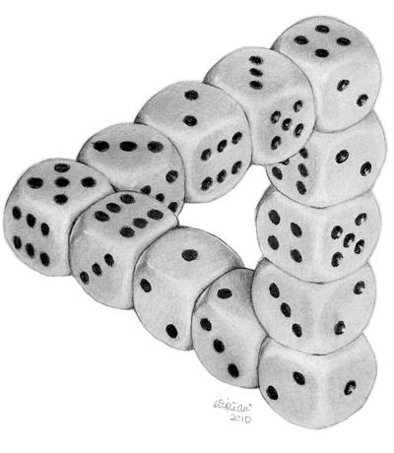
CMSC 39600-1 Topics in Theoretical Computer Science: Pseudorandomness Class 1 September 26, 2023 Instructor: William Hoza
“Dice Illusion” by DeviantArt user Moko-m. (License: CC BY-NC-ND 3.0)

Slide 2
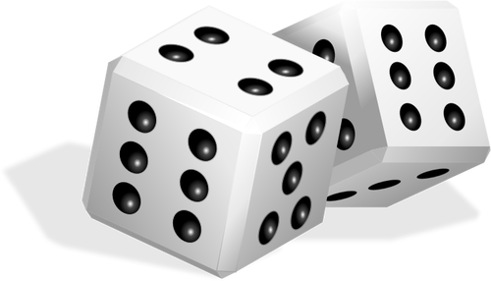
What is the role of randomness in computing?

Slide 3
Randomized algorithms
Algorithm designers often introduce random choices into their algorithms
Hugely popular and successful paradigm since the 1970s

Slide 4
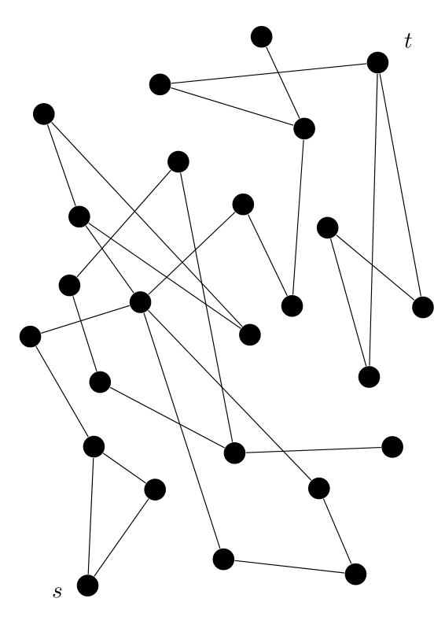
Example: Undirected $s$-$t$ Connectivity
Given: an undirected graph $G$ and two vertices $s, t$
Question: Is there a path from $s$ to $t$?
Theorem: There is a randomized algorithm for this problem that only uses $O\left(\log{n}\right)$ bits of space
Algorithm: Take a random walk from $s$ of length $\text{poly}\left(n\right)$ and check whether we visit $t$
This works! Proof later in this course

Slide 5
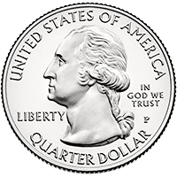
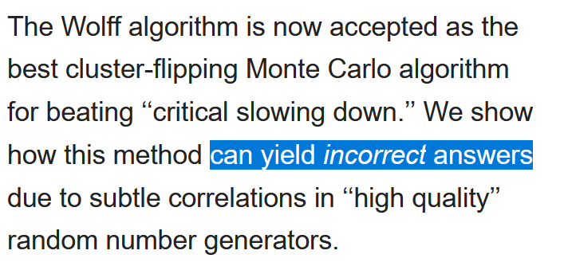
Problem solved?
Where will we get random bits from?
Practitioners use heuristic methods to run randomized algorithms…
…because producing unbiased and independent random bits is difficult

Slide 6
Randomness: An expensive computational resource
We will approach this subject from the perspective of computational complexity theory
Treat randomness like time or space
Try to use as little as possible

Slide 7
Course objective
Pseudorandomness is an active area of research
We will encounter many open problems
Maybe you can help solve some of them!
By the end of this course, you will be in a reasonable position to try your hand at original research on pseudorandomness problems (if you want to)

Slide 8
Plan for the rest of today
Some logistical information
Sneak peak of course topics
Move to whiteboard and begin in earnest

Slide 9
Logistical information
Meetings: Tues/Thurs, 9:30 – 10:50, JCL 354
Office hours: Tues, 11am – 12pm, JCL 311
Four problem sets (proof-based)
Project: You will write an exposition of a theorem that we won’t have time to cover in class. More details later
https://williamhoza.com/teaching/autumn2023-pseudorandomness

Slide 10
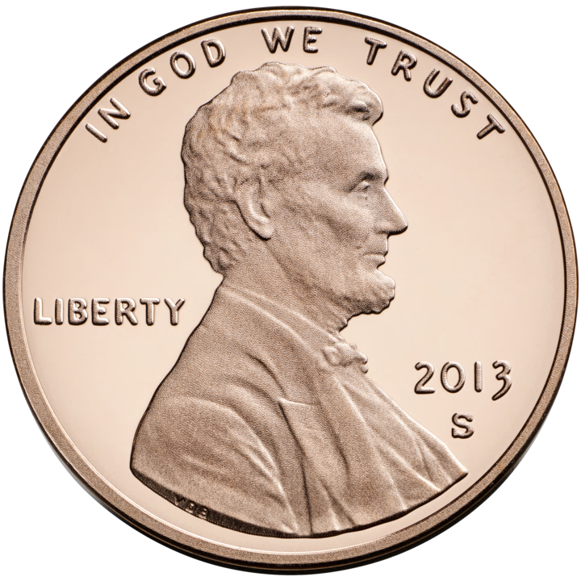
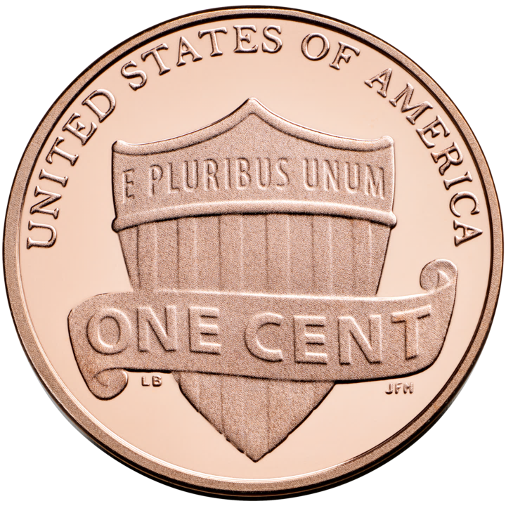
Pseudorandom generators (PRGs)
“Truly random seed”
For every “sufficiently-efficient” observer, the PRG can replace random bits with no significant impact.
$$G$$
$$≈$$

Slide 11
“Sufficiently-efficient observer”
A PRG’s job is to “fool” all “sufficiently-efficient” observers
The precise meanng of “sufficiently-efficient” depends on context
Crytographers: “Let’s fool all polynomial-time computations!”
This would be amazing… but first we need to prove $\text{P}≠\text{NP}$!
This course: Let’s fool restricted models of computation
We will actually prove that our PRGs work

Slide 12
PRG puzzle
0
1
“I’d like three random bits, please. I’m only going to look at two of them — but I’m not telling you which two.”
Challenge: Use two coin tosses to generate three pseudorandom bits that fool this observer
Solution: $G\left(u_{1},u_{2}\right)=\left(u_{1},u_{2},u_{1}⊕u_{2}\right)$
$$↦$$
0
1
1

Slide 13
PRGs in this course
In this course, we will construct PRGs that fool powerful and interesting models of computation, such as
Space-bounded computation
Bounded-depth Boolean circuits
$$∧$$
$$∨$$
$$∨$$
$$∧$$
$$∧$$
$$∧$$
$$∧$$
$$∧$$
$$x_{3}$$
$$x_{1}$$
$${¬x}_{2}$$
$$x_{8}$$
$${¬x}_{6}$$
$$x_{5}$$
$$x_{11}$$
$${¬x}_{4}$$
$${¬x}_{9}$$
$$x_{7}$$
$$x_{10}$$

Slide 14
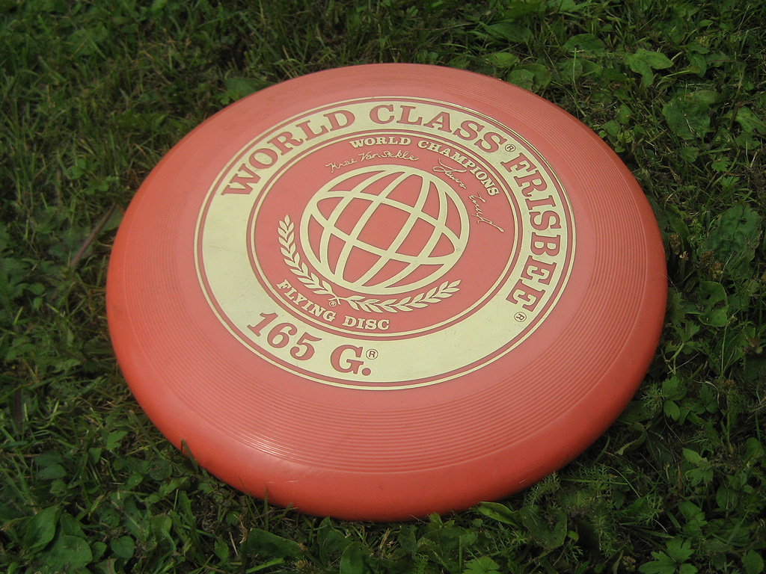
Biased coin puzzle
How can you generate a fair random bit if you only have a biased coin?
(You don’t know the bias)
Solution: (von Neumann, 1951)
Toss the biased coin twice, giving two bits $b_{1},b_{2}$
If $b_{1}≠b_{2}$, halt and output $b_{1}$
If $b_{1}=b_{2}$, return to step 1 and try again!

Slide 15
Randomness extractors in this course
Von Neumann’s trick addresses unknown biases in random bits
Much more challenging: unknown correlations between random bits
We will develop techniques for “extracting” high-quality random bits under minimal assumptions
We will see how extractors can be used to construct PRGs

Slide 16
Derandomization of algorithms
Earlier, we saw an algorithm for undirected $s$-$t$ connectivity that uses randomness and $O\left(\log{n}\right)$ bits of space
Is randomness necessary for this task?
Theorem: There is a deterministic algorithm for undirected $s$-$t$ connectivity that uses only $O\left(\log{n}\right)$ bits of space!
(Proof later in this course)

Slide 17
Grand derandomization challenges
Major Open Problem (“$\text{L}$ vs. $\text{BPL}$”): Can every decision algorithm that uses only $O\left(\log{n}\right)$ bits of space be “derandomized”?
Major Open Problem (“$\text{P}$ vs. $\text{BPP}$”): Can every decision algorithm that runs in polynomial time be derandomized?
What is the intrinsic relationship between randomness and other computational resources?

Slide 18
Summary of course topics
Pseudorandom generators
How to convert a few random bits into many “random enough” bits
Randomness extractors
How to convert low-quality random bits into high-quality random bits
Derandomization of algorithms
How to convert randomized algorithms into deterministic algorithms
This will be our main focus

Slide 19
Now let’s move to the whiteboard

