Slide 1

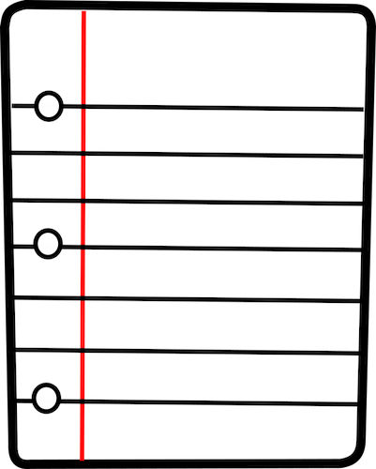

Tutorial: Derandomizing Space-Bounded Computation
Part 2
September 2, 2026
William Hoza
The University of Chicago

Slide 2







The complexity class $\text{BPL}$
$n$ bits
Read-only
input tape
0 | 1 | 1 | 0 | 0 | 0 | 1 | 0 | 1 | 0 | 1 | 0 | 1
$O\left(\log{n}\right)$ bits
Read-write
work tape
1 | 0 | 0 | 1 | 1
Read-once
random tape
1 | 1 | 1 | 0 | 1 | 0 | 0 | 1 | 0 | 1 | 0 | 0 | 0 | 1

Slide 3



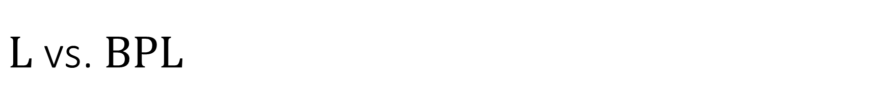

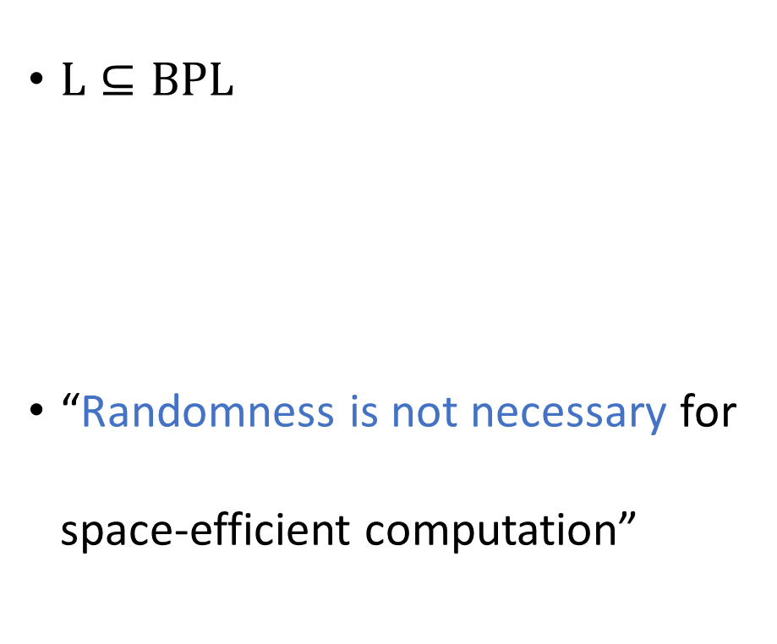
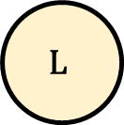
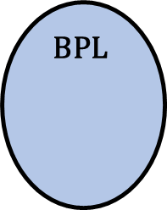
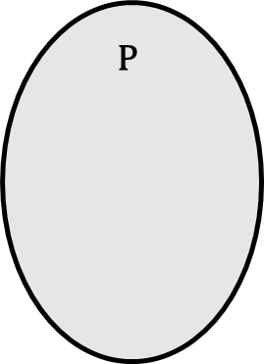

$\text{L}$ vs. $\text{BPL}$
$\text{L}⊆\text{BPL}$
“Randomness is not necessary for space-efficient computation”
$$\text{NP}$$
$$\text{coNP}$$
Conjecture: $\text{L}=\text{BPL}$
$$\text{P}$$
$$\text{BPL}$$
$$\text{L}$$

Slide 4
Outline
Yesterday:
  The INW Approach ✔️
  The Nisan Approach ✔️
Today:
  The Laplacian Approach
  The Restrictions Approach

Slide 5
The Laplacian Approach

Slide 6
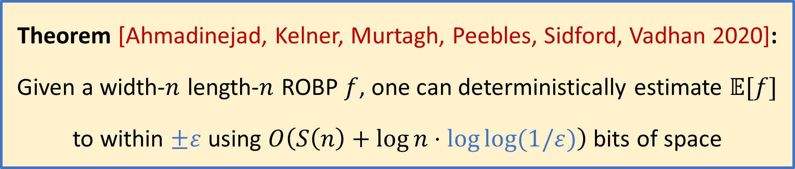
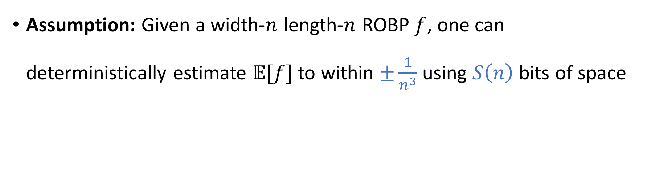
Error reduction
The bottleneck in the INW/Nisan approaches is error accumulation…
Assumption: Given a width-$n$ length-$n$ ROBP $f$, one can deterministically estimate $𝔼[f]$ to within $±\frac{1}{n^{3}}$ using $S\left(n\right)$ bits of space
Theorem [Ahmadinejad, Kelner, Murtagh, Peebles, Sidford, Vadhan 2020]:
Given a width-$n$ length-$n$ ROBP $f$, one can deterministically estimate $𝔼[f]$ to within $±ε$ using $O\left(S\left(n\right)+\log{n}⋅\log{\log{(1/ε})}\right)$ bits of space

Slide 7

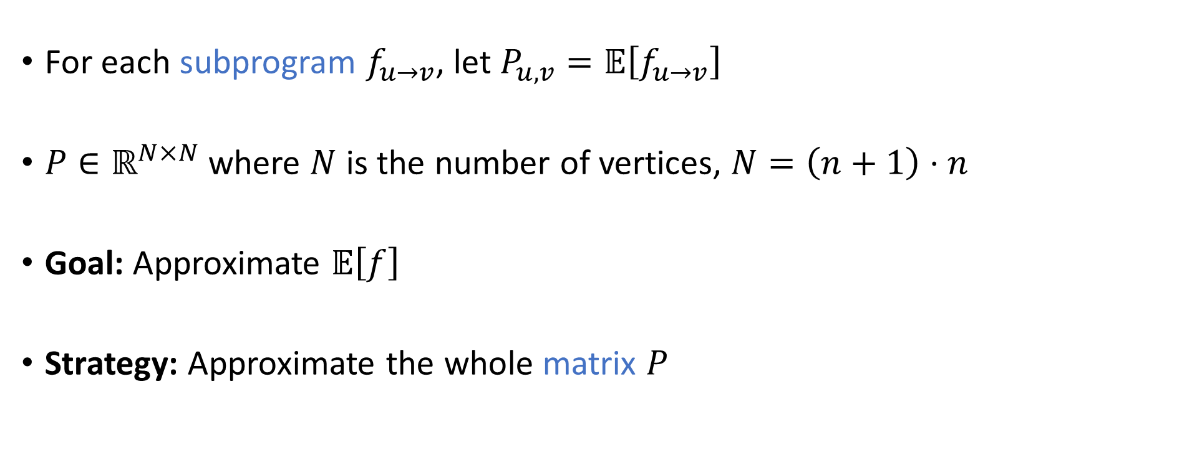

Proof step 1: Subprograms
$$v$$
$$u$$
For each subprogram $f_{u→v}$, let $P_{u,v}=𝔼\left[f_{u→v}\right]$
$P∈ℝ^{N×N}$ where $N$ is the number of vertices, $N=\left(n+1\right)⋅n$
Goal: Approximate $𝔼\left[f\right]$
Strategy: Approximate the whole matrix $P$

Slide 8
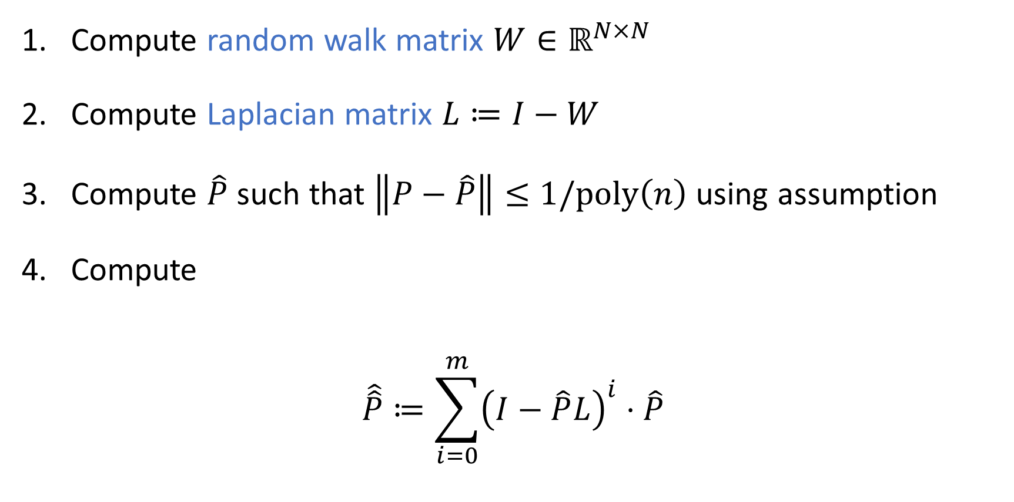
Laplacian and Richardson iteration
[Explanations on whiteboard]
Compute random walk matrix $W∈ℝ^{N×N}$
Compute Laplacian matrix $L≔I−W$
Compute $\hat{P}$ such that $\left\|P−\hat{P}\right\|≤1/\text{poly}\left(n\right)$ using assumption
Compute
$$\hat{\hat{P}}≔\sum_{i=0}^{m}{{\left(I−\hat{P}L\right)}^{i}⋅\hat{P}}$$
“Richardson Iteration”

Slide 9
The Laplacian Approach:
Advanced Topics

Slide 10
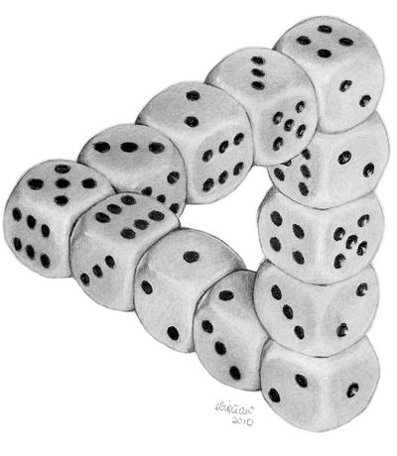
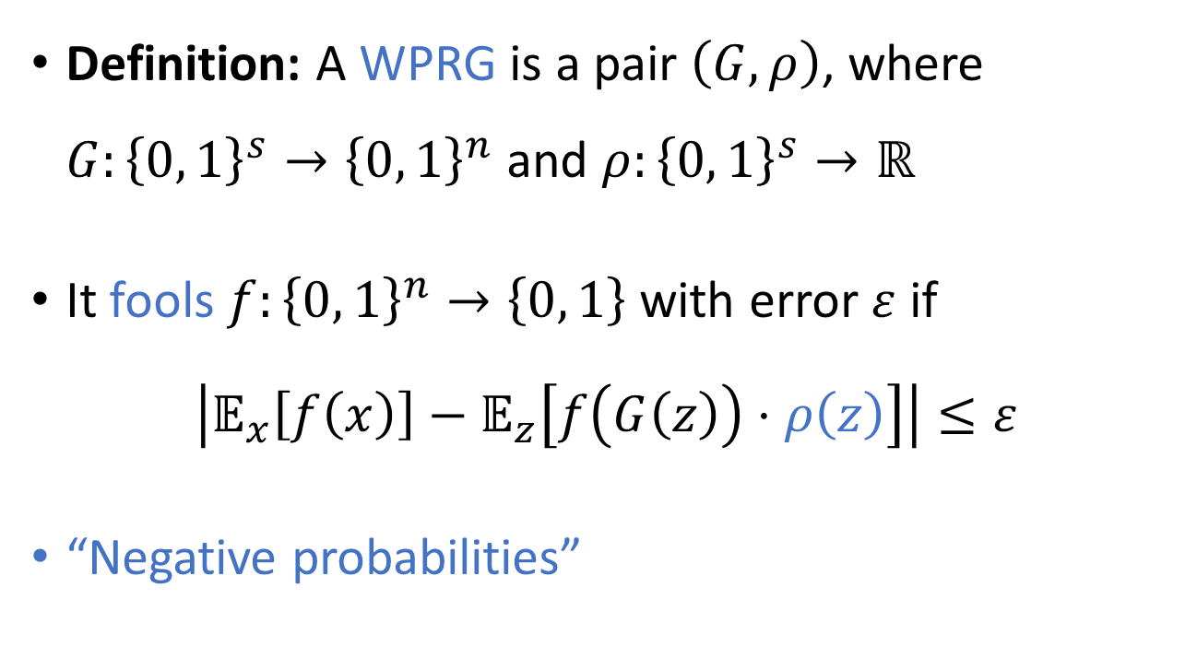
Weighted pseudorandom generators
Definition: A WPRG is a pair $\left(G, ρ\right)$, where $G:{\left\{0, 1\right\}}^{s}→{\left\{0, 1\right\}}^{n}$ and $ρ:{\left\{0, 1\right\}}^{s}→ℝ$
It fools $f:{\left\{0, 1\right\}}^{n}→\left\{0, 1\right\}$ with error $ε$ if
$$\left|𝔼_{x}\left[f\left(x\right)\right]−𝔼_{z}\left[f\left(G\left(z\right)\right)⋅ρ\left(z\right)\right]\right|≤ε$$
“Negative probabilities”
“Dice Illusion” by DeviantArt user Moko-m. (License: CC BY-NC-ND 3.0)

Slide 11
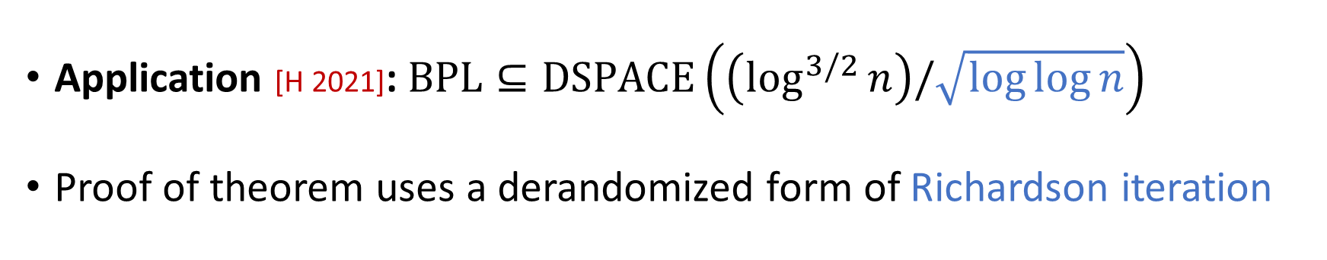
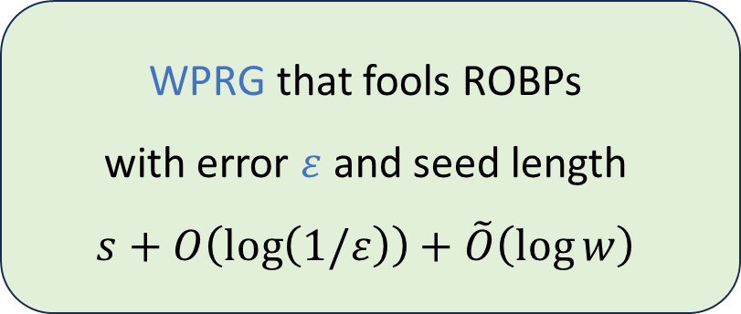
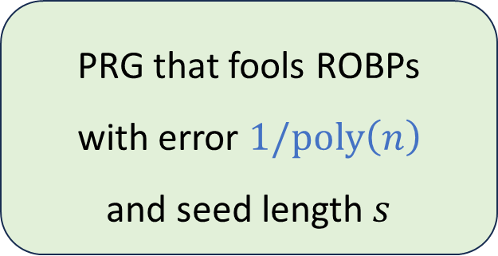
WPRG error reduction
Theorem [BCG 2020] [HZ 2020] [CL 2020] [CDRST 2021] [PV 2021] [H 2021] [CW 2026] [CCDKT 2026]:
PRG that fools ROBPs
with error $1/\text{poly}\left(n\right)$
and seed length $s$
WPRG that fools ROBPs
with error $ε$ and seed length
$$s+O\left(\log\left(1/ε\right)\right)+\tilde{O}\left(\log{w}\right)$$
Application [H 2021]: $\text{BPL}⊆\text{DSPACE}\left(\left(\log^{3/2}{n}\right)/\sqrt{\log{\log{n}}}\right)$
Proof of theorem uses a derandomized form of Richardson iteration

Slide 12
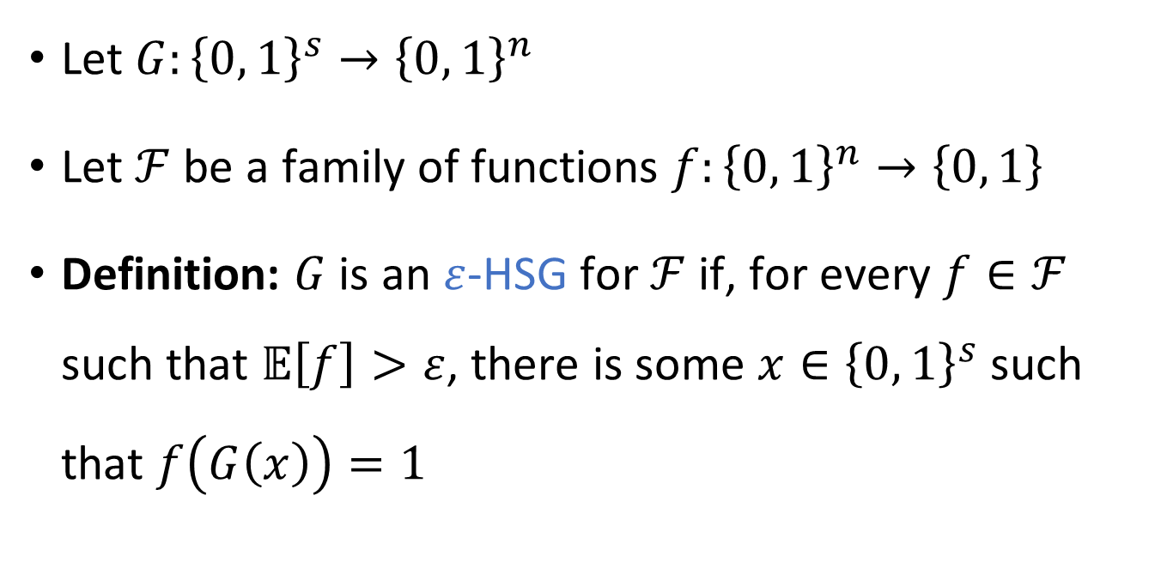
Hitting set generators
HSGs
Let $G:{\left\{0, 1\right\}}^{s}→{\left\{0, 1\right\}}^{n}$
Let $ℱ$ be a family of functions $f:{\left\{0, 1\right\}}^{n}→\left\{0, 1\right\}$
Definition: $G$ is an $ε$-HSG for $ℱ$ if, for every $f∈ℱ$ such that $𝔼\left[f\right]>ε$, there is some $x∈{\left\{0, 1\right\}}^{s}$ such that $f\left(G\left(x\right)\right)=1$
WPRGs
PRGs

Slide 13

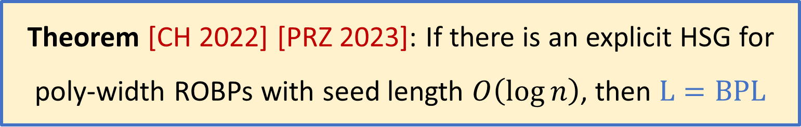

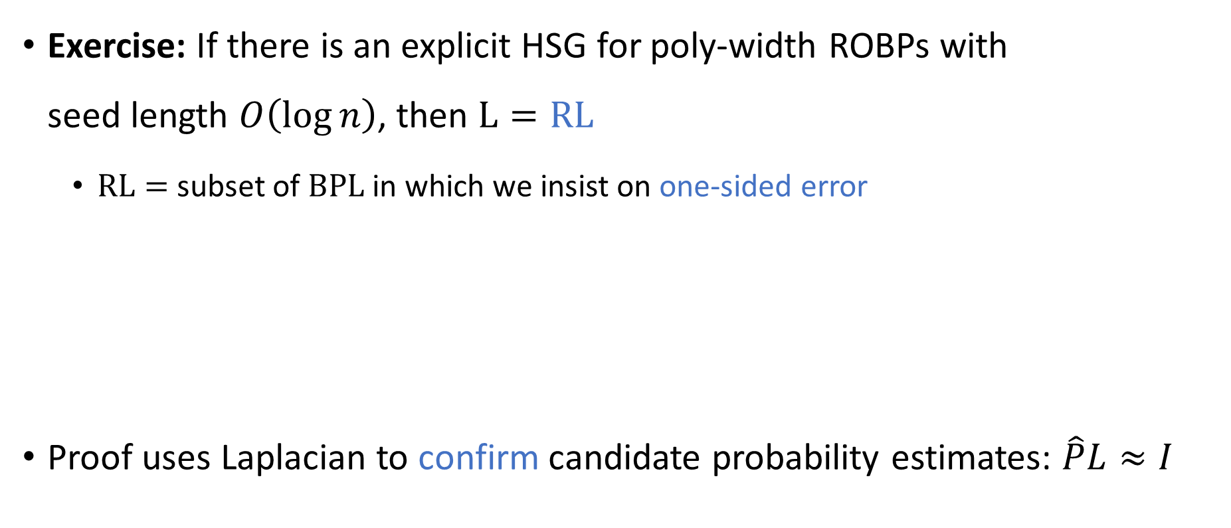



Implications of HSGs
$$\text{P}$$
$$\text{N}\text{L}$$
$$\text{BP}\text{L}$$
Exercise: If there is an explicit HSG for poly-width ROBPs with
seed length $O\left(\log{n}\right)$, then $\text{L}=\text{RL}$
  $\text{RL}=$ subset of $\text{BPL}$ in which we insist on one-sided error
Proof uses Laplacian to confirm candidate probability estimates: $\hat{P}L≈I$
$$\text{R}\text{L}$$
$$\text{L}$$
Theorem [CH 2022] [PRZ 2023]: If there is an explicit HSG for poly-width ROBPs with seed length $O\left(\log{n}\right)$, then $\text{L}=\text{BPL}$

Slide 14
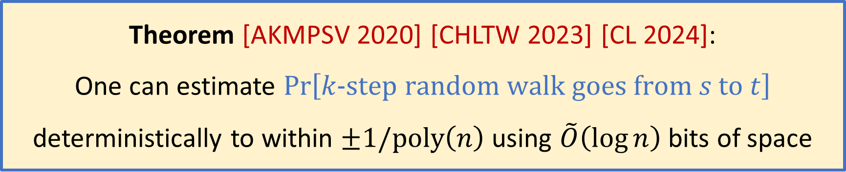
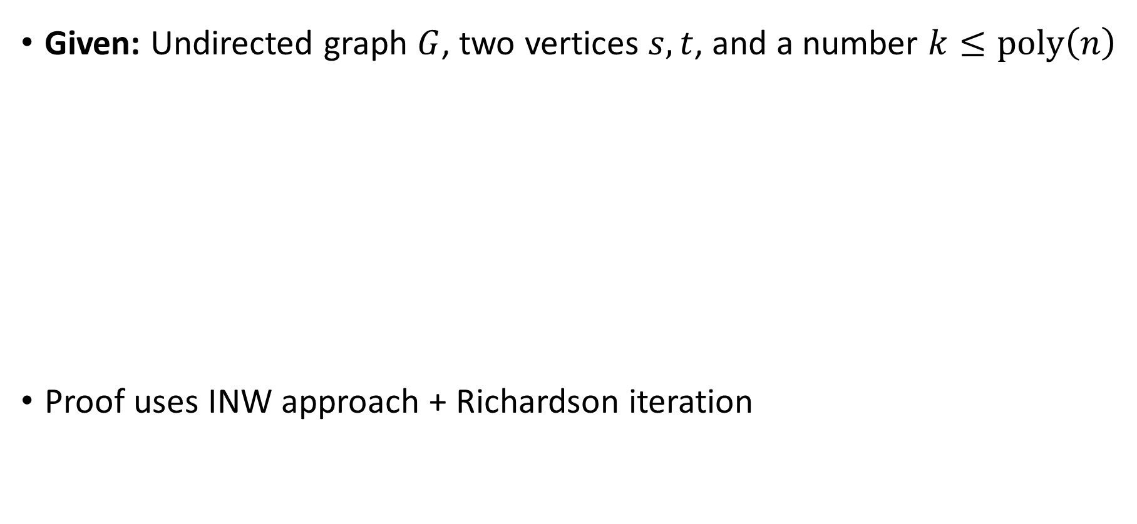
Simulating random walks in undirected graphs
Given: Undirected graph $G$, two vertices $s,t$, and a number $k≤\text{poly}\left(n\right)$
Proof uses INW approach + Richardson iteration
Theorem [AKMPSV 2020] [CHLTW 2023] [CL 2024]:
One can estimate $\operatorname{Pr}\left[k‑\text{step} \text{random} \text{walk} \text{goes} \text{from} s \text{to} t\right]$ deterministically to within $±1/\text{poly}\left(n\right)$ using $\tilde{O}\left(\log{n}\right)$ bits of space

Slide 15
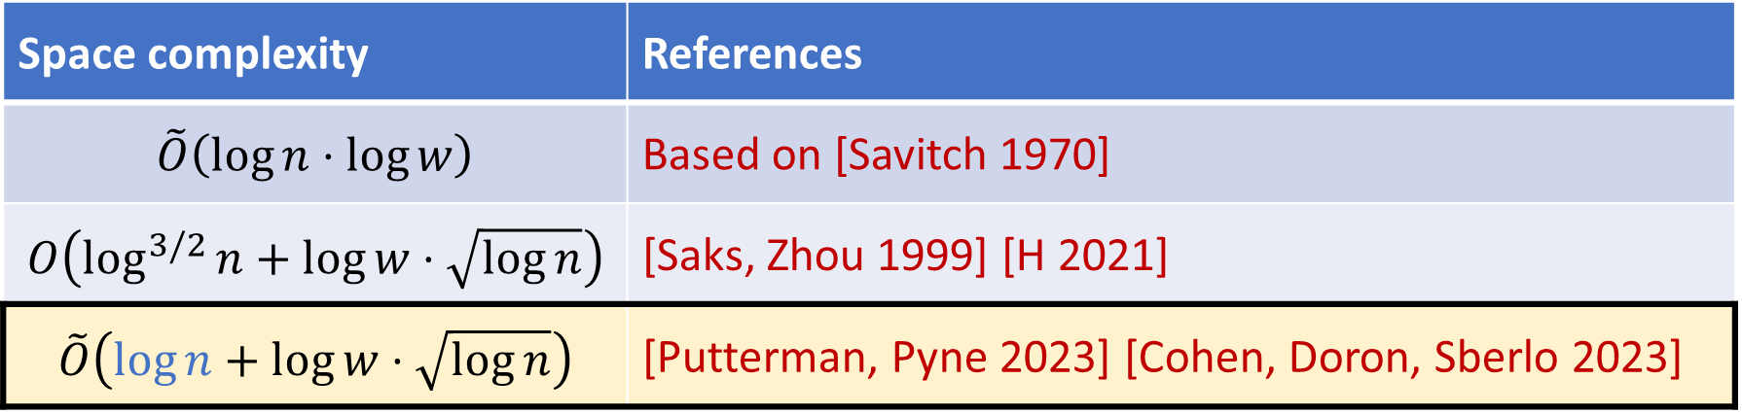
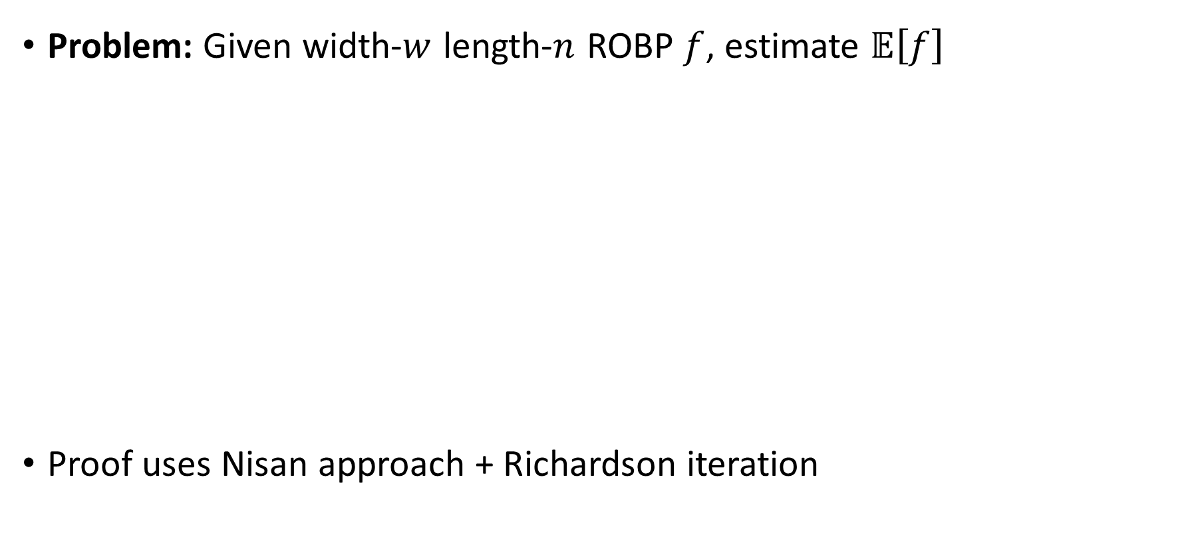
Derandomizing medium-width ROBPs
Problem: Given width-$w$ length-$n$ ROBP $f$, estimate $𝔼\left[f\right]$
Proof uses Nisan approach + Richardson iteration
Space complexity | References
$$\tilde{O}\left(\log{n}⋅\log{w}\right)$$ | Based on [Savitch 1970]
$$O\left(\log^{3/2}{n}+\log{w}⋅\sqrt{\log{n}}\right)$$ | [Saks, Zhou 1999] [H 2021]
$$\tilde{O}\left(\log{n}+\log{w}⋅\sqrt{\log{n}}\right)$$ | [Putterman, Pyne 2023] [Cohen, Doron, Sberlo 2023]

Slide 16


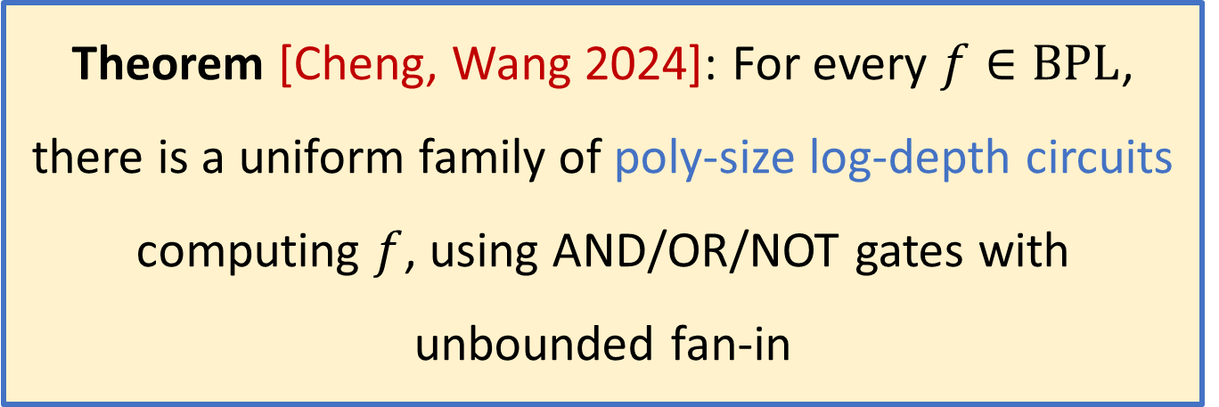












$\text{BPL}$ is contained in uniform ${\text{AC}}^{1}$
$$∧$$
$$∨$$
$$∨$$
$$∨$$
$$∨$$
$$∧$$
$$∧$$
$$∧$$
Theorem [Cheng, Wang 2024]: For every $f∈\text{BPL}$, there is a uniform family of poly-size log-depth circuits computing $f$, using AND/OR/NOT gates with unbounded fan-in
$$x_{1}$$
$$x_{4}$$
$$x_{2}$$
$$¬x_{1}$$
$$x_{3}$$
Proof uses approximate counting + a variant of Richardson iteration

Slide 17
The Restrictions Approach

Slide 18



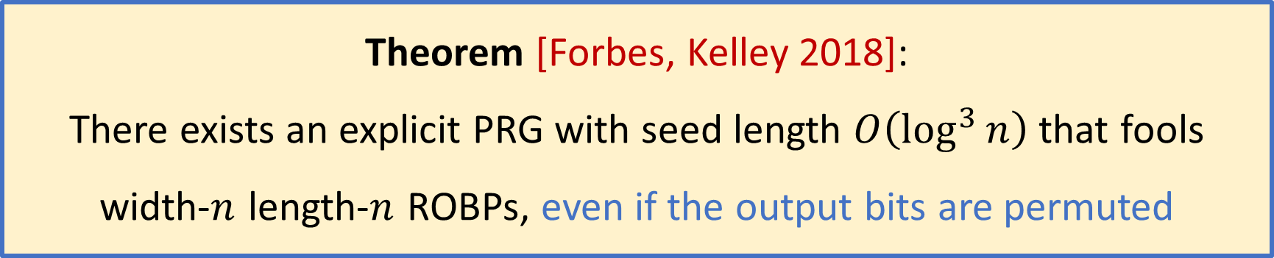



Forbes-Kelley PRG
🔀
Theorem [Forbes, Kelley 2018]:
There exists an explicit PRG with seed length $O\left(\log^{3}{n}\right)$ that fools width-$n$ length-$n$ ROBPs, even if the output bits are permuted
$$x_{5}$$
$$x_{4 }$$
$$x_{1}$$
$$x_{2}$$
$$x_{3}$$
$$x_{6}$$
Nisan/INW provably don’t work! [Tzur 2009] [H, Lv 2025]

Slide 19

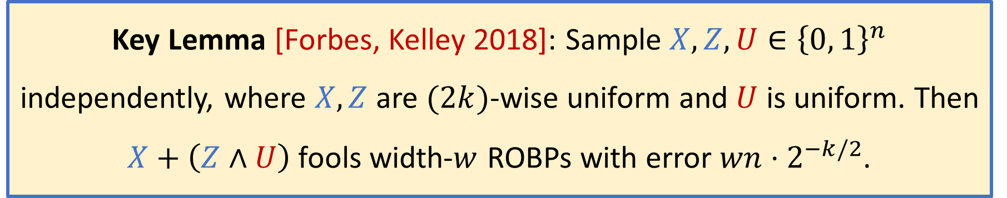
Step 1: Pseudorandomness plus noise
Key Lemma [Forbes, Kelley 2018]: Sample $X,Z,U∈{\left\{0, 1\right\}}^{n}$ independently, where $X,Z$ are $(2k)$-wise uniform and $U$ is uniform. Then $X+\left(Z∧U\right)$ fools width-$w$ ROBPs with error $wn⋅2^{−k/2}$.
[Proof on whiteboard]

Slide 20
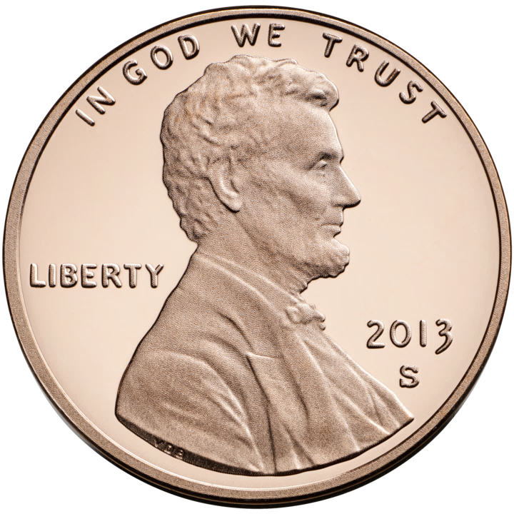




















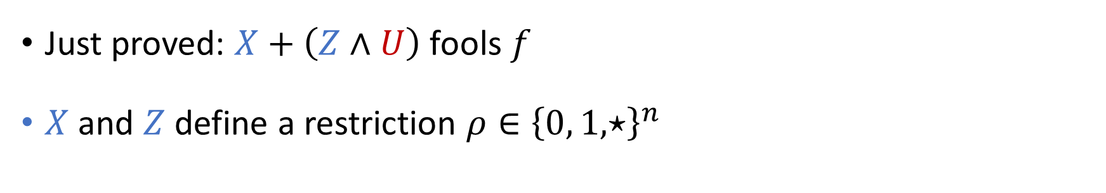
Step 2: Iterated restrictions [Ajtai, Wigderson 1985]
Just proved: $X+\left(Z∧U\right)$ fools $f$
$X$ and $Z$ define a restriction $ρ∈{\left\{0, 1, ⋆\right\}}^{n}$
$$U$$
$$≈$$
$$⋆$$
$$⋆$$
$$⋆$$
$$⋆$$
$$⋆$$
$$X+\left(Z∧U\right)$$
$$≈$$
$$⋆$$
$$⋆$$
$$⋆$$
$$⋆$$
$$⋆$$
$$ρ$$
$$≈$$
$$⋆$$
$$⋆$$
Full PRG!

Slide 21
The Restrictions Approach:
Advanced Topics

Slide 22
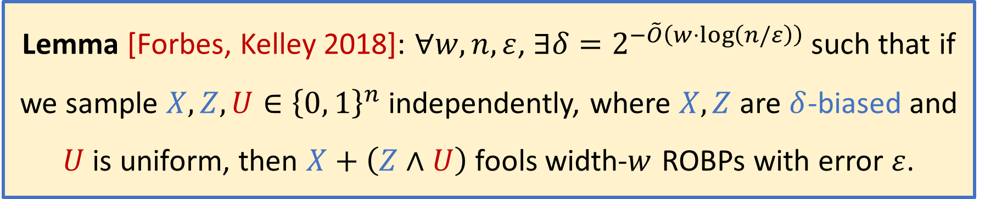
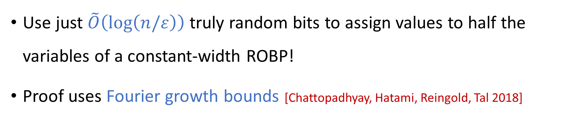
The constant-width case
Lemma [Forbes, Kelley 2018]: $∀w,n,ε$, $∃δ=2^{−\tilde{O}\left(w⋅\log\left(n/ε\right)\right)}$ such that if we sample $X,Z,U∈{\left\{0, 1\right\}}^{n}$ independently, where $X,Z$ are $δ$-biased and $U$ is uniform, then $X+\left(Z∧U\right)$ fools width-$w$ ROBPs with error $ε$.
Use just $\tilde{O}\left(\log\left(n/ε\right)\right)$ truly random bits to assign values to half the variables of a constant-width ROBP!
Proof uses Fourier growth bounds [Chattopadhyay, Hatami, Reingold, Tal 2018]

Slide 23


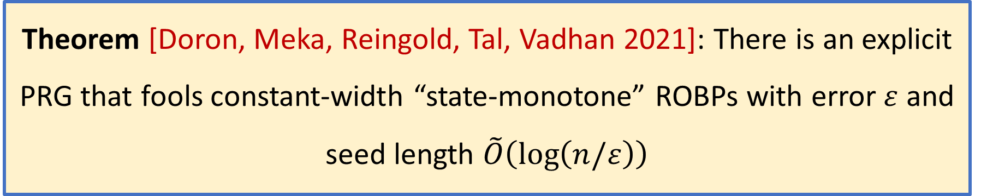









Early termination
$$∧$$
$$∨$$
$$∨$$
$$∨$$
$$x_{2}$$
$${\overline{x}}_{4}$$
$${\overline{x}}_{1}$$
$$x_{3}$$
$$x_{7}$$
$${\overline{x}}_{5}$$
$$x_{6}$$
Theorem [Doron, Meka, Reingold, Tal, Vadhan 2021]: There is an explicit PRG that fools constant-width “state-monotone” ROBPs with error $ε$ and seed length $\tilde{O}\left(\log\left(n/ε\right)\right)$
Proof idea: Show that after $O\left(\log{\log{n}}\right)$ iterations of Forbes-Kelley restrictions, program has simplified whp, so we can do something else

Slide 24
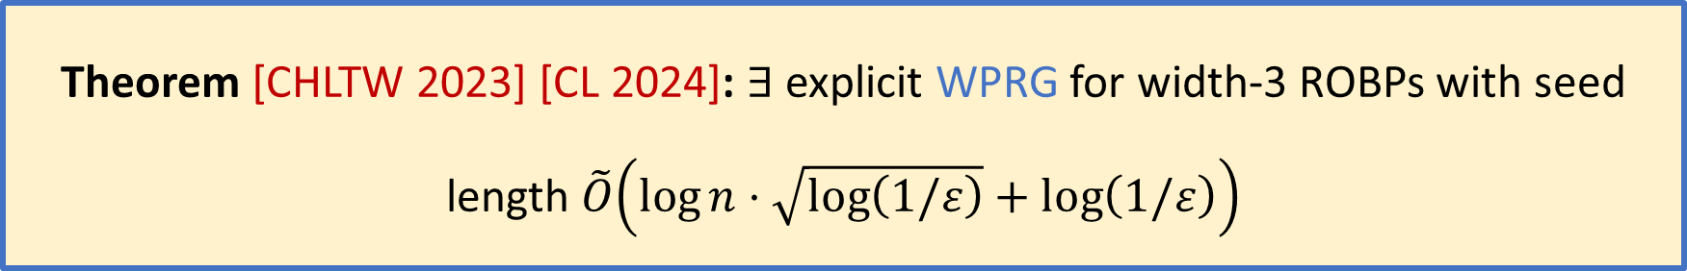
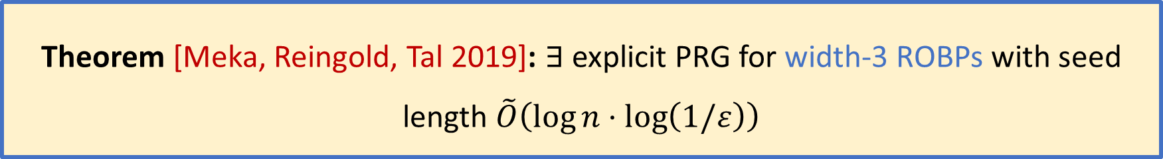
Fooling width-3 programs
Theorem [Meka, Reingold, Tal 2019]: $∃$ explicit PRG for width-3 ROBPs with seed length $\tilde{O}\left(\log{n}⋅\log\left(1/ε\right)\right)$
Theorem [CHLTW 2023] [CL 2024]: $∃$ explicit WPRG for width-3 ROBPs with seed length $\tilde{O}\left(\log{n}⋅\sqrt{\log\left(1/ε\right)}+\log\left(1/ε\right)\right)$
Proof idea: Restrictions with early termination, followed by INW/Laplacian approach

Slide 25








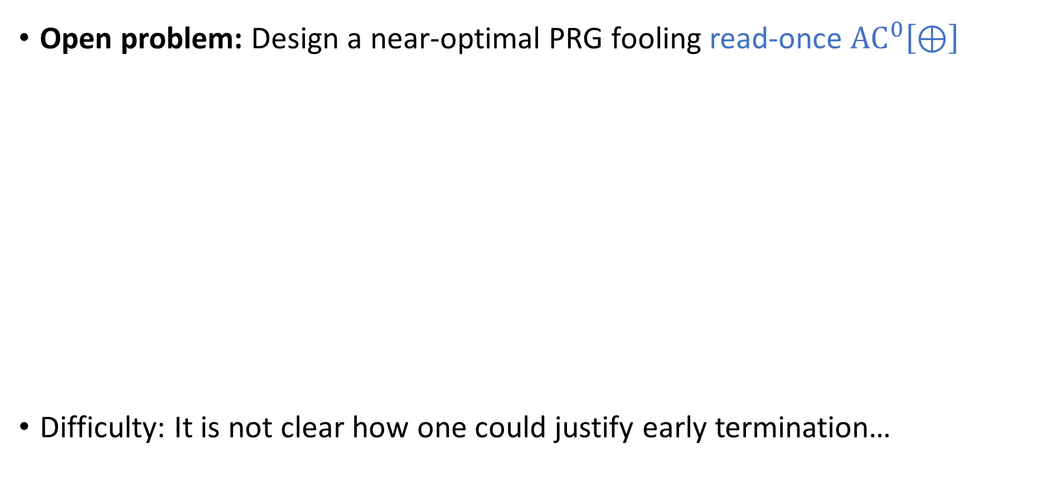











Challenge: Parity gates
Open problem: Design a near-optimal PRG fooling read-once ${\text{AC}}^{0}\left[⊕\right]$
Difficulty: It is not clear how one could justify early termination…
$$∧$$
$$∨$$
$$∨$$
$$⊕$$
$$⊕$$
$$⊕$$
$$⊕$$
$$⊕$$
$$x_{3}$$
$$x_{1}$$
$${¬x}_{2}$$
$$x_{8}$$
$${¬x}_{6}$$
$$x_{5}$$
$$x_{11}$$
$${¬x}_{4}$$
$${¬x}_{9}$$
$$x_{7}$$
$$x_{10}$$

Slide 26

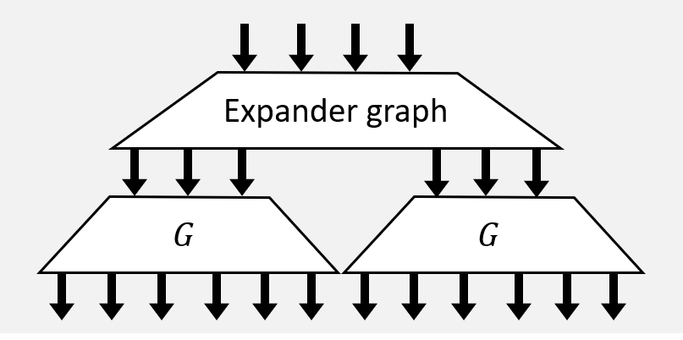
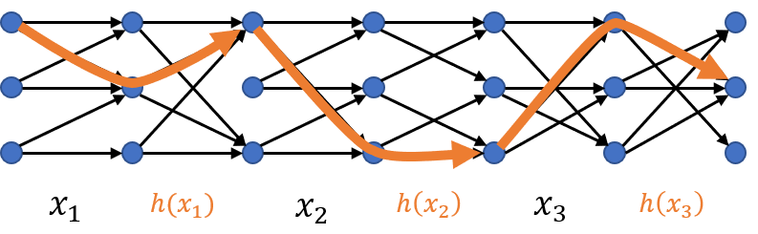
Conclusion
INW
Nisan
Many successful ideas!
You can come up with the next one!
Thanks for listening!
Laplacian
Restrictions

