Slide 1

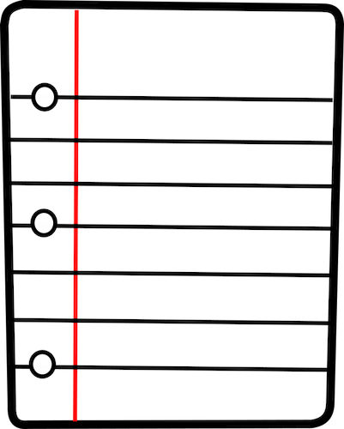

Tutorial: Derandomizing Space-Bounded Computation
Part 1
September 1, 2026
William Hoza
The University of Chicago

Slide 2
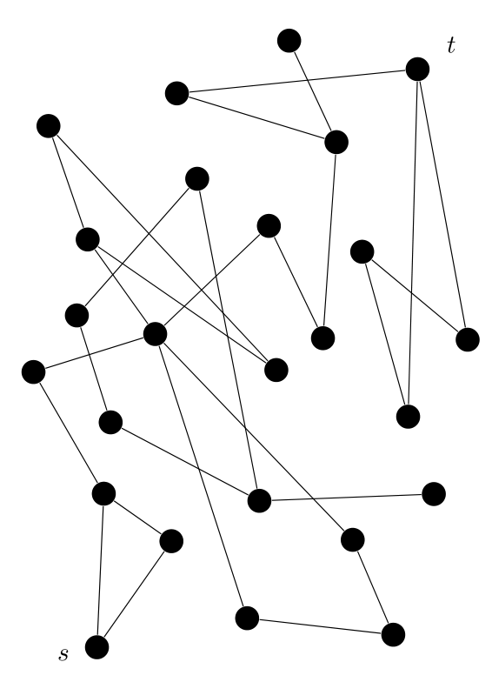
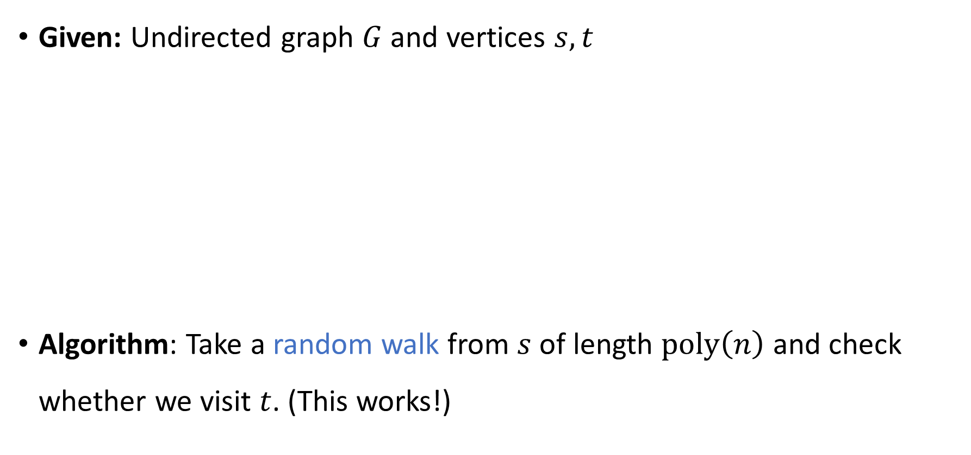
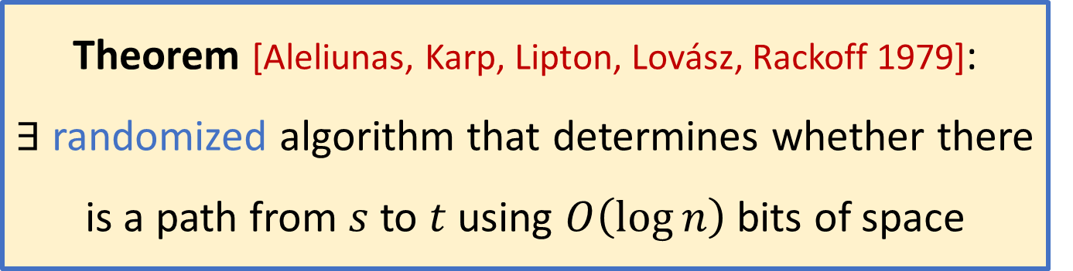
Motivating example
Given: Undirected graph $G$ and vertices $s, t$
Algorithm: Take a random walk from $s$ of length $\text{poly}\left(n\right)$ and check whether we visit $t$. (This works!)
Theorem [Aleliunas, Karp, Lipton, Lovász, Rackoff 1979]:
$∃$ randomized algorithm that determines whether there is a path from $s$ to $t$ using $O\left(\log{n}\right)$ bits of space

Slide 3

😢
No known efficient algorithm
🙂
Efficient randomized algorithm
😄
Efficient deterministic algorithm

Slide 4
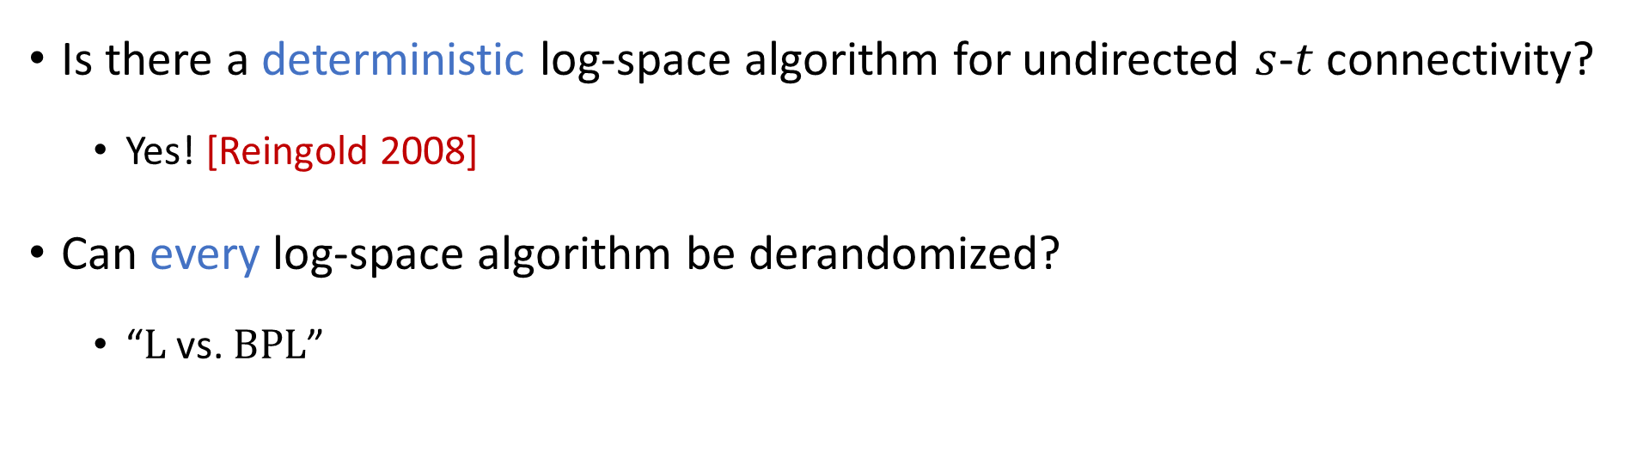
Derandomization
Is there a deterministic log-space algorithm for undirected $s$-$t$ connectivity?
  Yes! [Reingold 2008]
Can every log-space algorithm be derandomized?
  “$\text{L}$ vs. $\text{BPL}$”

Slide 5







The complexity class $\text{BPL}$
$n$ bits
Read-only
input tape
0 | 1 | 1 | 0 | 0 | 0 | 1 | 0 | 1 | 0 | 1 | 0 | 1
$O\left(\log{n}\right)$ bits
Read-write
work tape
1 | 0 | 0 | 1 | 1
Read-once
random tape
1 | 1 | 1 | 0 | 1 | 0 | 0 | 1 | 0 | 1 | 0 | 0 | 0 | 1

Slide 6
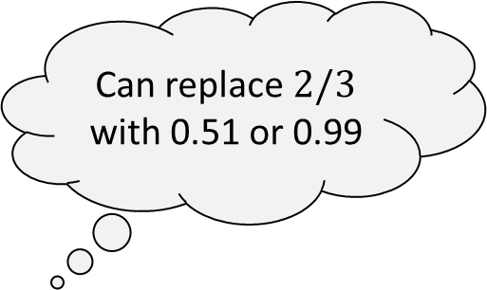
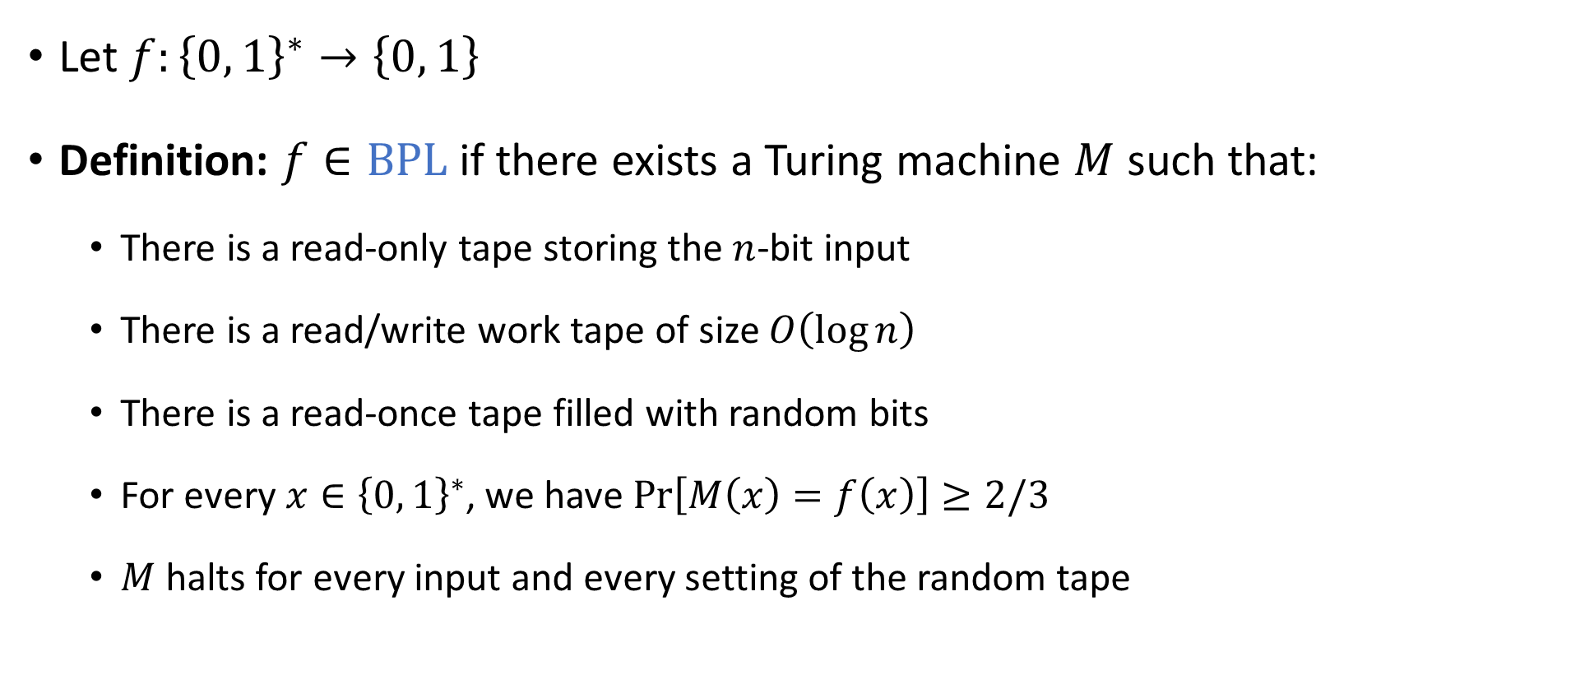

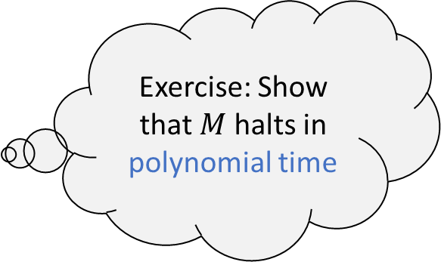
The complexity class $\text{BPL}$
Bounded-error Probabilistic Log-space
Let $f:{\left\{0, 1\right\}}^{∗}→\left\{0, 1\right\}$
Definition: $f∈\text{BPL}$ if there exists a Turing machine $M$ such that:
  There is a read-only tape storing the $n$-bit input
  There is a read/write work tape of size $O\left(\log{n}\right)$
  There is a read-once tape filled with random bits
  For every $x∈{\left\{0, 1\right\}}^{∗}$, we have $\operatorname{Pr}\left[M\left(x\right)=f\left(x\right)\right]≥2/3$
  $M$ halts for every input and every setting of the random tape
Can replace $2/3$ with 0.51 or 0.99
Exercise: Show that $M$ halts in polynomial time

Slide 7

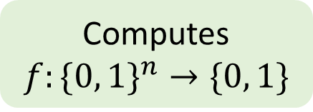
Read-once branching programs (ROBPs)
$$x=$$
$$1$$
$$0$$
$$0$$
$$1$$
$$0$$
$$1$$
Computes
$$f:\{0, 1\}^{n}→\{0, 1\}$$
0
1
acc
$$v_{\text{start}}$$
1
0
1
rej
Width $w$
0
1
1
acc
0
0
0
acc
1
rej
$n+1$ layers ($n=$ length)

Slide 8
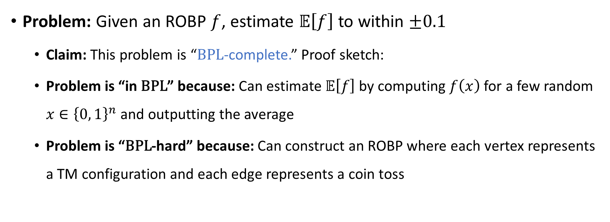
ROBPs and BPL
Problem: Given an ROBP $f$, estimate $𝔼\left[f\right]$ to within $±0.1$
  Claim: This problem is “$\text{BPL}$-complete.” Proof sketch:
  Problem is “in $\text{BPL}$” because: Can estimate $𝔼\left[f\right]$ by computing $f\left(x\right)$ for a few random $x∈{\left\{0, 1\right\}}^{n}$ and outputting the average
  Problem is “$\text{BPL}$-hard” because: Can construct an ROBP where each vertex represents a TM configuration and each edge represents a coin toss

Slide 9



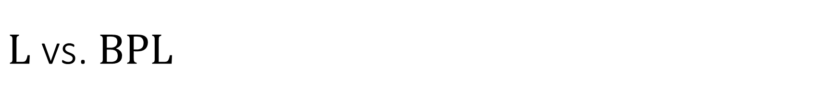

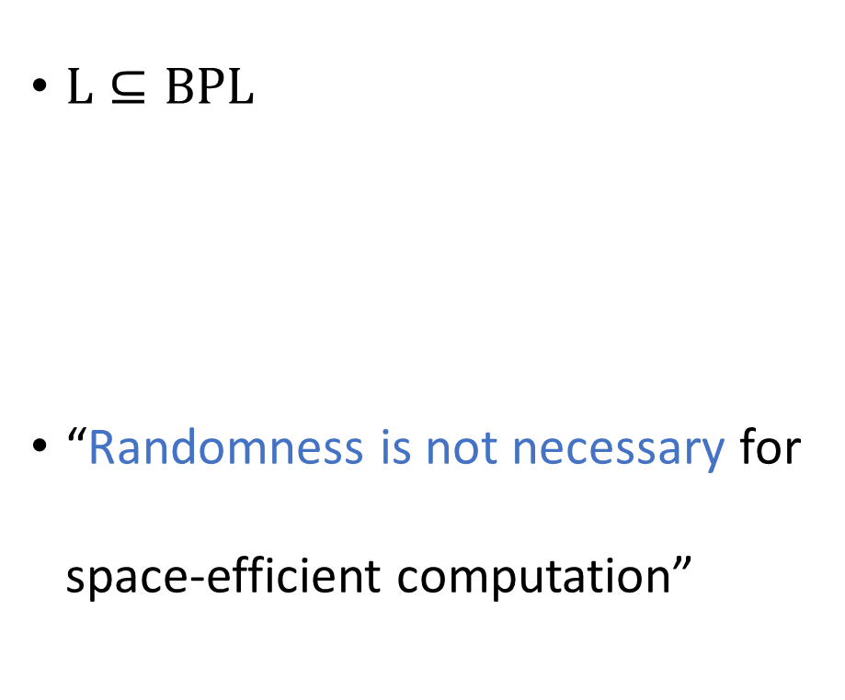
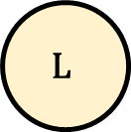
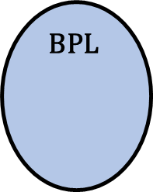
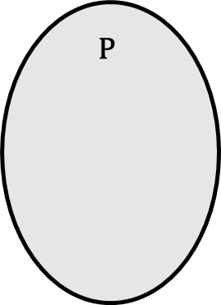
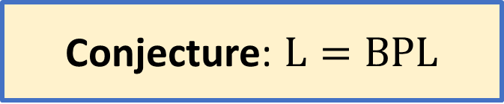
$\text{L}$ vs. $\text{BPL}$
$\text{L}⊆\text{BPL}$
“Randomness is not necessary for space-efficient computation”
$$\text{NP}$$
$$\text{coNP}$$
Conjecture: $\text{L}=\text{BPL}$
$$\text{P}$$
$$\text{BPL}$$
$$\text{L}$$

Slide 10
Outline
Today:
  The INW Approach
  The Nisan Approach
Tomorrow:
  The Laplacian Approach
  The Restrictions Approach
For each approach, we’ll focus on one example theorem

Slide 11
The INW Approach

Slide 12


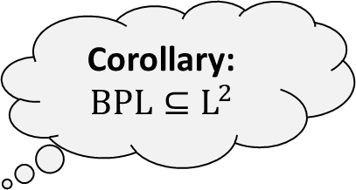
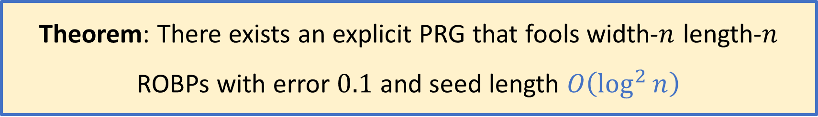
The INW Pseudorandom Generator
Corollary:
$$\text{BPL}⊆{\text{L}}^{2}$$
Theorem: There exists an explicit PRG that fools width-$n$ length-$n$ ROBPs with error $0.1$ and seed length $O\left(\log^{2}{n}\right)$
We’ll present a proof by Impagliazzo, Nisan, and Wigderson (STOC 1994)
Key ingredient: Expander graphs
$$G$$

Slide 13


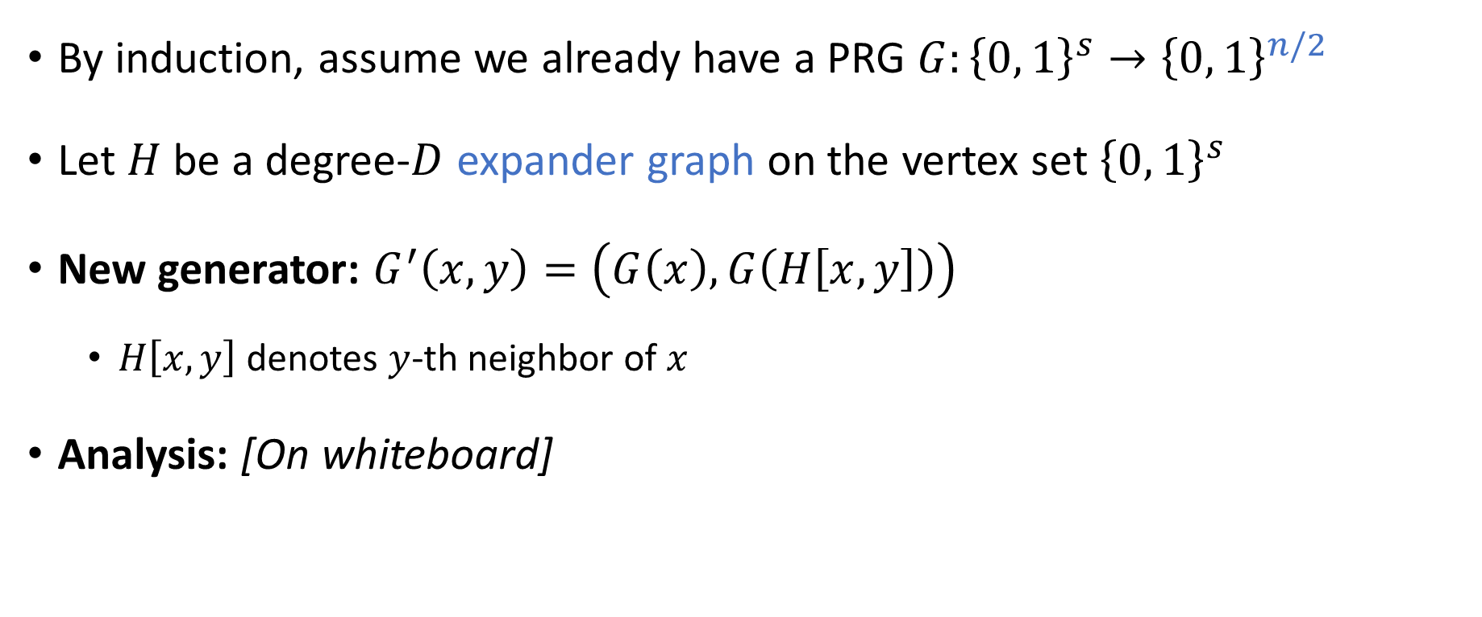
INW construction
By induction, assume we already have a PRG $G:{\left\{0, 1\right\}}^{s}→{\left\{0, 1\right\}}^{n/2}$
Let $H$ be a degree-$D$ expander graph on the vertex set ${\left\{0, 1\right\}}^{s}$
New generator: $G^{′}\left(x,y\right)=\left(G\left(x\right), G\left(H\left[x, y\right]\right)\right)$
  $H\left[x,y\right]$ denotes $y$-th neighbor of $x$
Analysis: [On whiteboard]
Expander graph
$$G$$
$$G$$

Slide 14
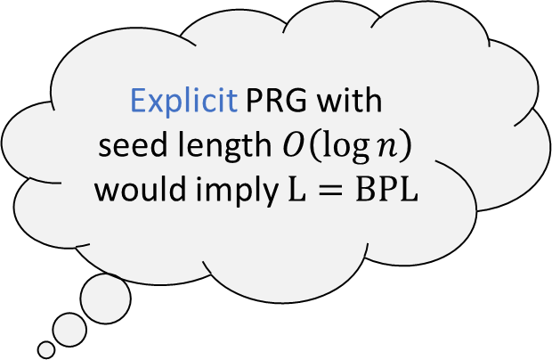
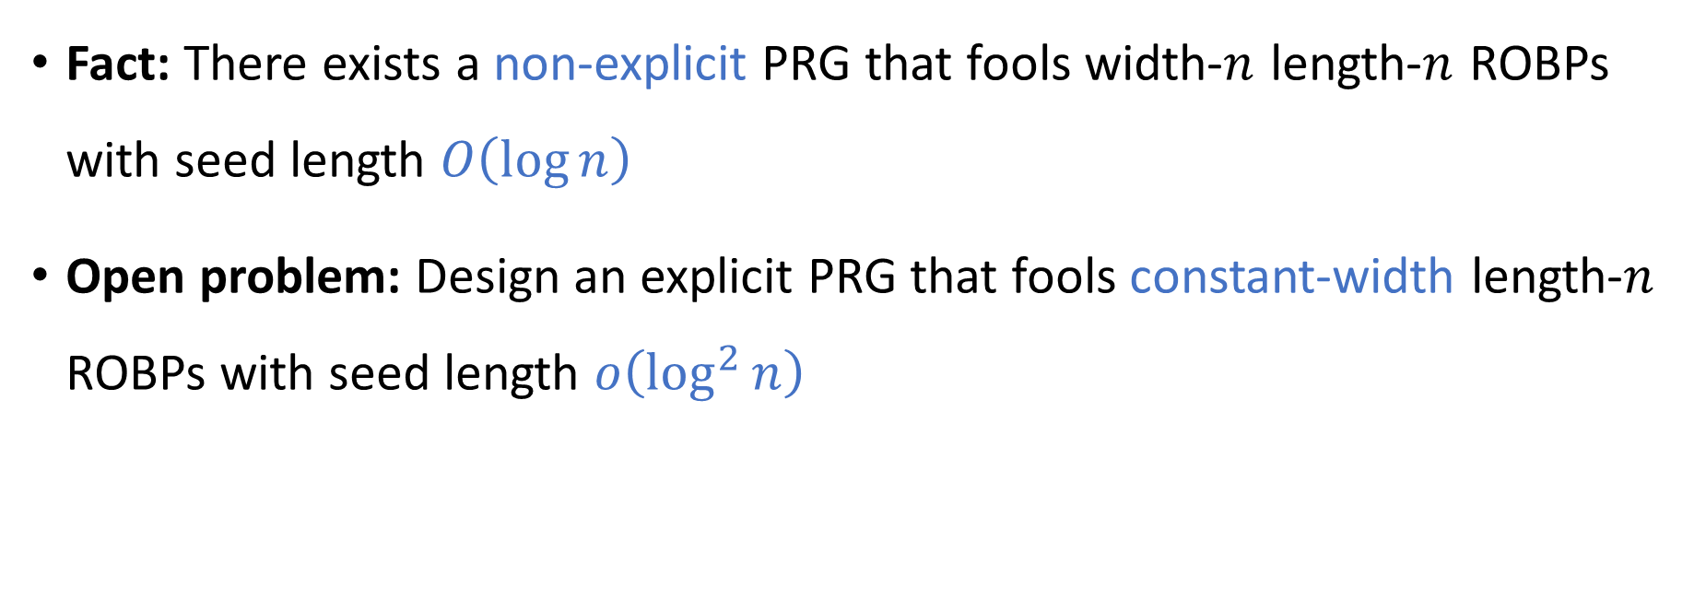
Open problem: Better PRGs
Explicit PRG with seed length $O\left(\log{n}\right)$ would imply $\text{L}=\text{BPL}$
Fact: There exists a non-explicit PRG that fools width-$n$ length-$n$ ROBPs with seed length $O\left(\log{n}\right)$
Open problem: Design an explicit PRG that fools constant-width length-$n$ ROBPs with seed length $o\left(\log^{2}{n}\right)$

Slide 15
The INW Approach:
Advanced Topics

Slide 16
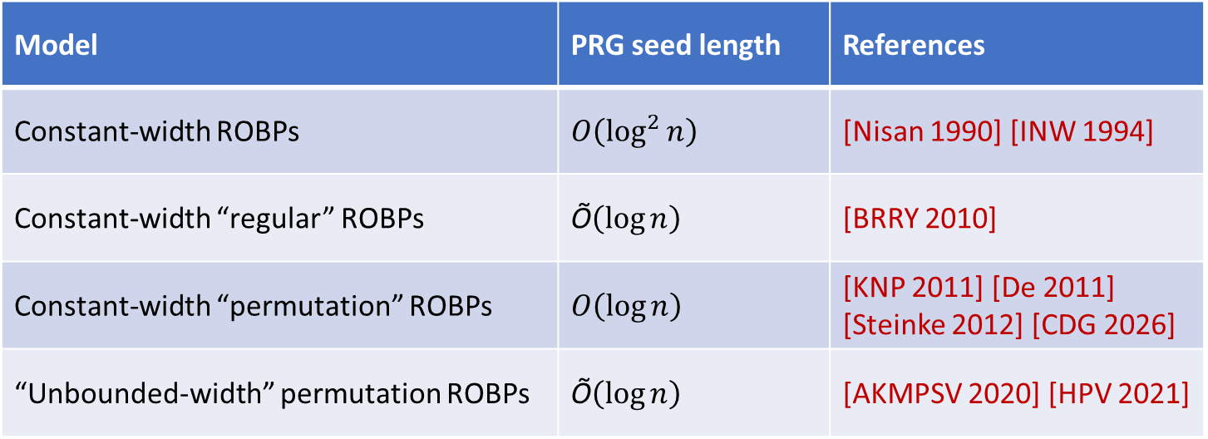
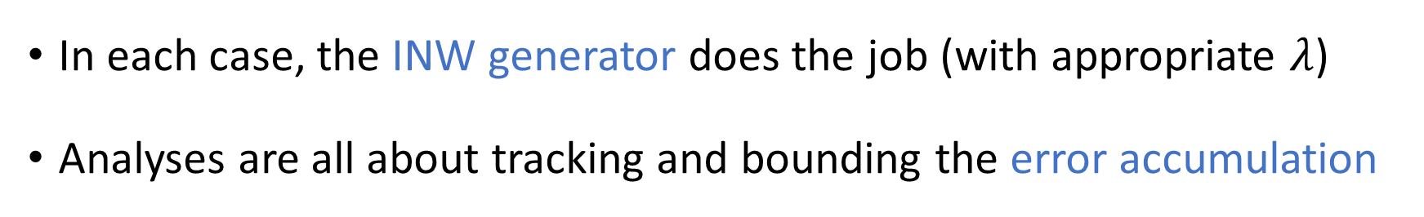
Regular ROBPs / Permutation ROBPs
0
0
Model | PRG seed length | References
Constant-width ROBPs | $O\left(\log^{2}{n}\right)$ | [Nisan 1990] [INW 1994]
Constant-width “regular” ROBPs | $\text{Õ}\left(\log{n}\right)$ | [BRRY 2010]
Constant-width “permutation” ROBPs | $O\left(\log{n}\right)$ | [KNP 2011] [De 2011] [Steinke 2012] [CDG 2026]
“Unbounded-width” permutation ROBPs | $\text{Õ}\left(\log{n}\right)$ | [AKMPSV 2020] [HPV 2021]
0
0
0
In each case, the INW generator does the job (with appropriate $λ$)
Analyses are all about tracking and bounding the error accumulation

Slide 17

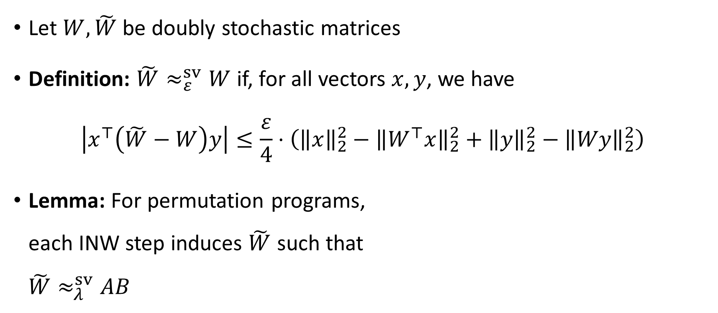

Singular-value approximation
[Ahmadinejad, Peebles, Pyne, Sidford, Vadhan 2023]
Let $W, \tilde{W}$ be doubly stochastic matrices
Definition: $\tilde{W}≈_{ε}^{sv}W$ if, for all vectors $x,y$, we have
$$\left|x^{⊤}\left(\tilde{W}−W\right)y\right|≤\frac{ε}{4}⋅\left({\left\|x\right\|}_{2}^{2}−{\left\|W^{⊤}x\right\|}_{2}^{2}+{\left\|y\right\|}_{2}^{2}−{\left\|Wy\right\|}_{2}^{2}\right)$$
Lemma: For permutation programs,
each INW step induces $\tilde{W}$ such that
$\tilde{W}≈_{λ}^{sv}AB$
$$A$$
$$B$$

Slide 18
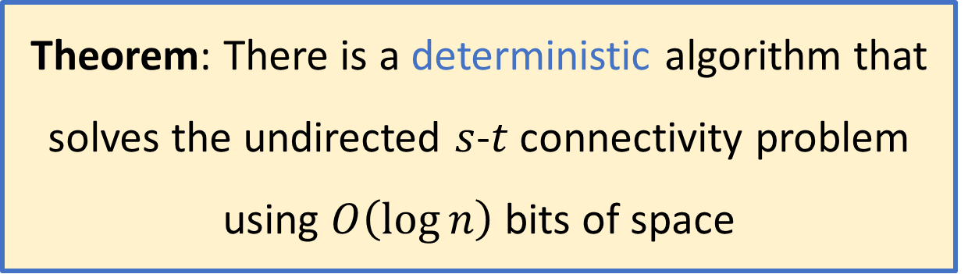

Undirected $s$-$t$ connectivity
Theorem: There is a deterministic algorithm that solves the undirected $s$-$t$ connectivity problem using $O\left(\log{n}\right)$ bits of space
Original proof [Reingold, STOC 2005 / JACM 2008] uses “zig-zag product”
Alternative proof [Rozenman and Vadhan, RANDOM 2005] uses “derandomized square” / INW generator

Slide 19
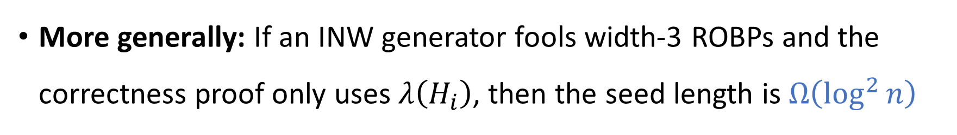
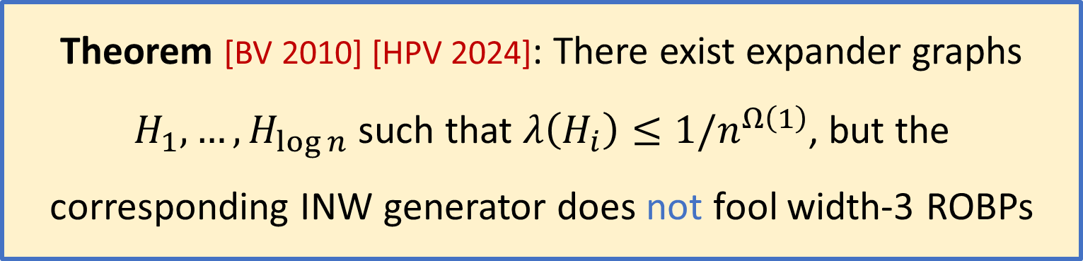
Limitations of INW
Theorem [BV 2010] [HPV 2024]: There exist expander graphs $H_{1},…, H_{\log{n}}$ such that $λ\left(H_{i}\right)≤1/n^{Ω\left(1\right)}$, but the corresponding INW generator does not fool width-3 ROBPs
More generally: If an INW generator fools width-3 ROBPs and the correctness proof only uses $λ\left(H_{i}\right)$, then the seed length is $Ω\left(\log^{2}{n}\right)$

Slide 20
The Nisan Approach

Slide 21

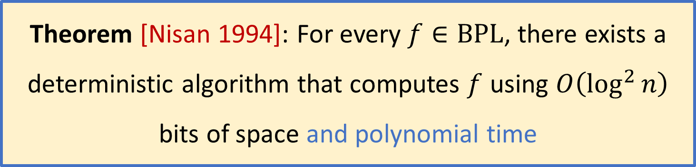

$\text{BPL}⊆\text{SC}$
Theorem [Nisan 1994]: For every $f∈\text{BPL}$, there exists a deterministic algorithm that computes $f$ using $O\left(\log^{2}{n}\right)$ bits of space and polynomial time
Key ingredient: Pairwise uniform hash functions

Slide 22
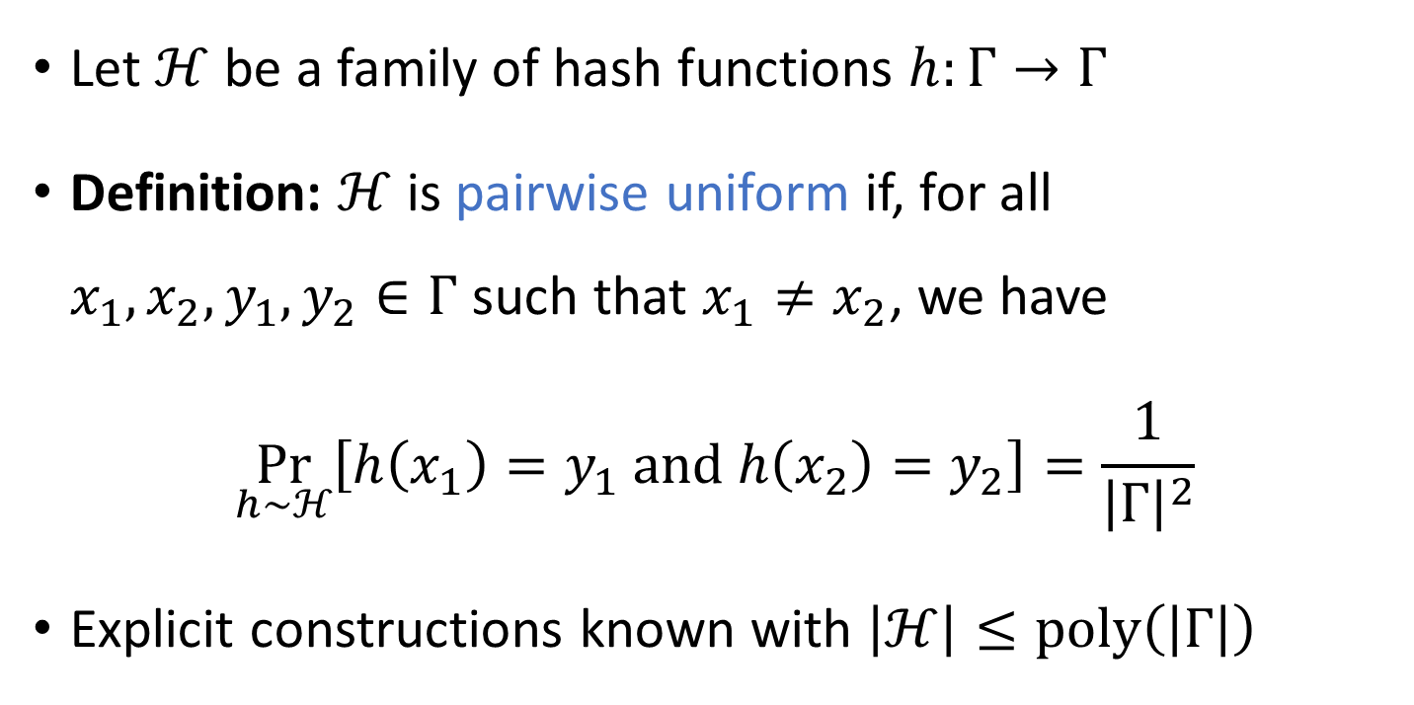
Pairwise uniform hash functions
Let $ℋ$ be a family of hash functions $h:Γ→Γ$
Definition: $ℋ$ is pairwise uniform if, for all $x_{1},x_{2},y_{1},y_{2}∈Γ$ such that $x_{1}≠x_{2}$, we have
$$\underset{h∼ℋ}{Pr}\left[h\left(x_{1}\right)=y_{1} \text{and} h\left(x_{2}\right)=y_{2}\right]=\frac{1}{{\left|Γ\right|}^{2}}$$
Explicit constructions known with $\left|ℋ\right|≤\text{poly}\left(\left|Γ\right|\right)$

Slide 23

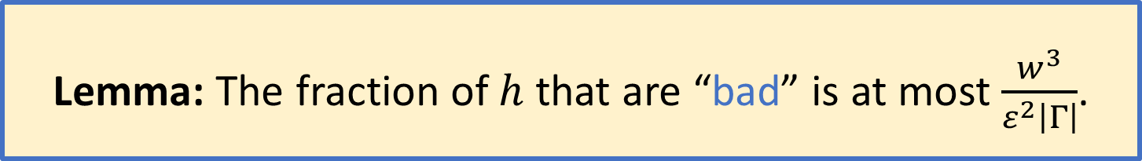
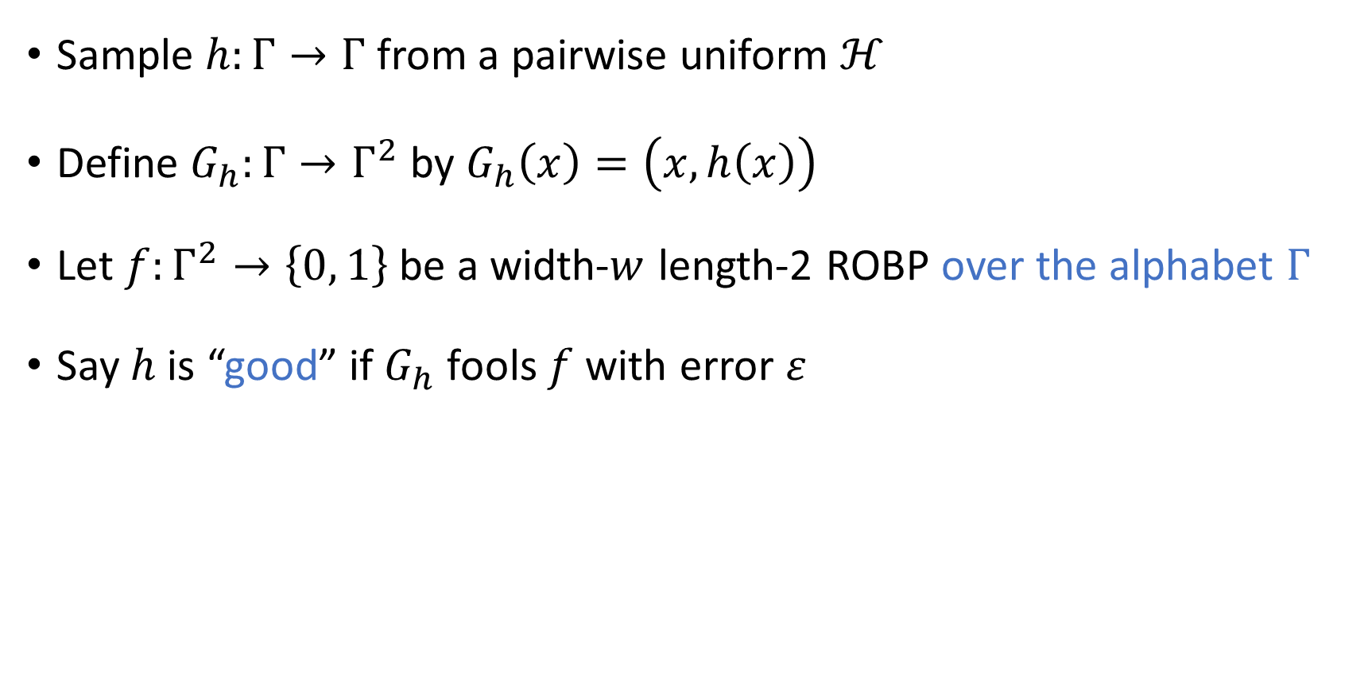



Good hash functions
$$v_{\text{start}}$$
acc
$$\left|Γ\right|$$
rej
$$⋮$$
$$⋮$$
Sample $h:Γ→Γ$ from a pairwise uniform $ℋ$
Define $G_{h}:Γ→Γ^{2}$ by $G_{h}\left(x\right)=\left(x,h\left(x\right)\right)$
Let $f:Γ^{2}→\left\{0, 1\right\}$ be a width-$w$ length-2 ROBP over the alphabet $Γ$
Say $h$ is “good” if $G_{h}$ fools $f$ with error $ε$
acc
Lemma: The fraction of $h$ that are “bad” is at most $\frac{w^{3}}{ε^{2}\left|Γ\right|}$.
[Proof on whiteboard]

Slide 24

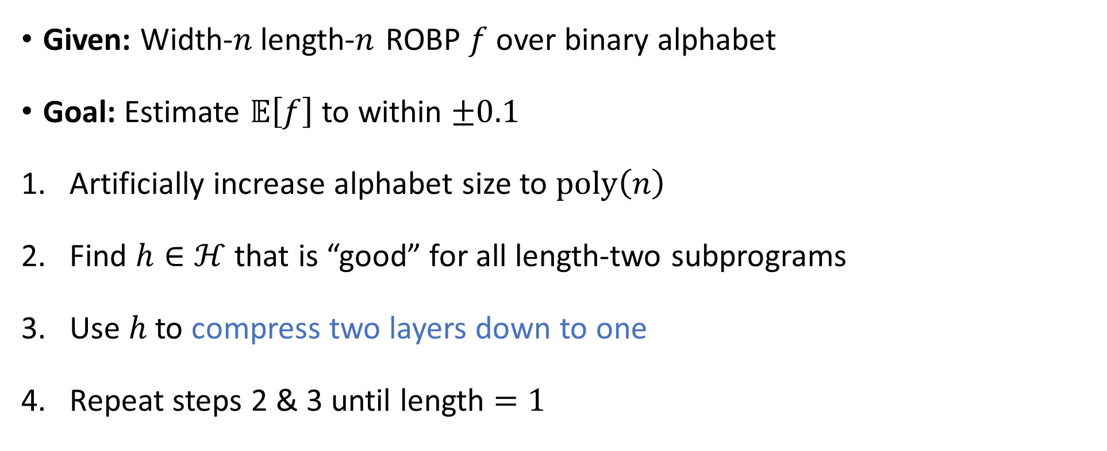




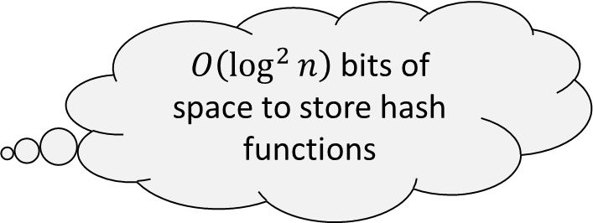


$\text{BPL}⊆\text{SC}$: Proof sketch
$$x_{1}$$
$${h(x}_{1})$$
$$x_{2}$$
$$h\left(x_{2}\right)$$
$$x_{3}$$
$$h\left(x_{3}\right)$$
Given: Width-$n$length-$n$ ROBP $f$ over binary alphabet
Goal: Estimate $𝔼\left[f\right]$ to within $±0.1$
Artificially increase alphabet size to $\text{poly}\left(n\right)$
Find $h∈ℋ$ that is “good” for all length-two subprograms
Use $h$ to compress two layers down to one
Repeat steps 2 & 3 until length $=1$
Exhaustive search (polynomial time)
$O\left(\log^{2}{n}\right)$ bits of space to store hash functions

Slide 25
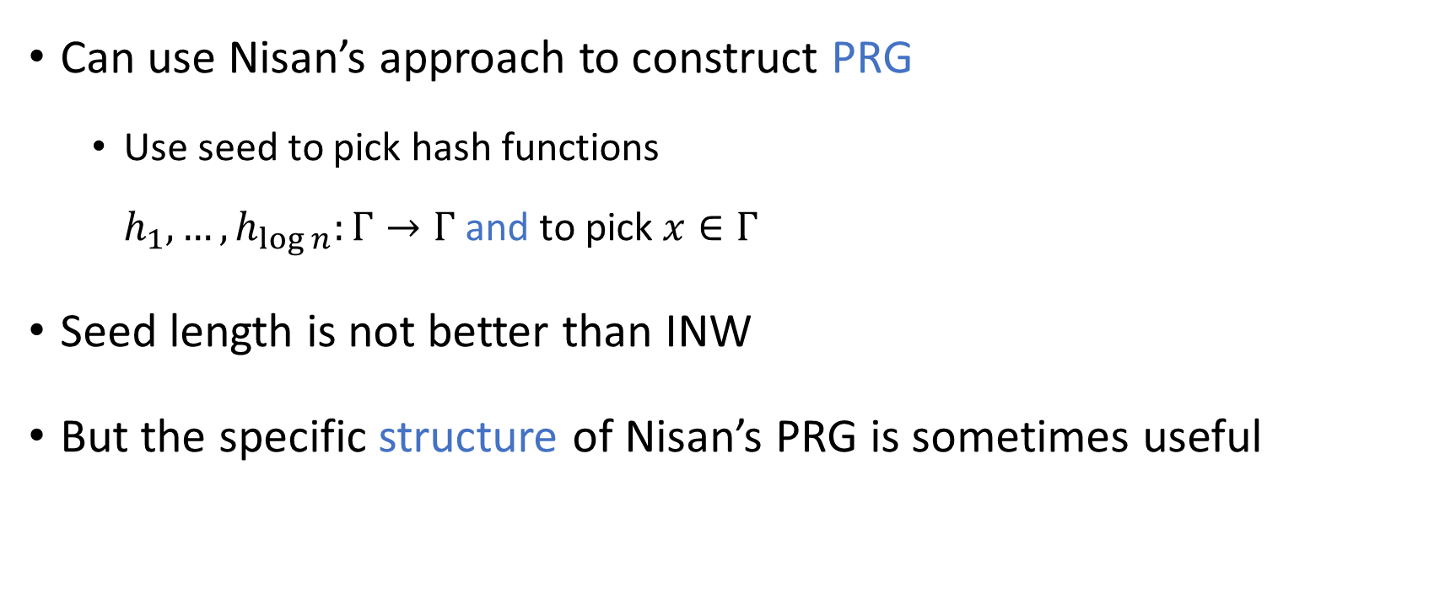
Comparison: INW vs. Nisan
$$G$$
Can use Nisan’s approach to construct PRG
  Use seed to pick hash functions
  $h_{1},…,h_{\log{n}}:Γ→Γ$ and to pick $x∈Γ$
Seed length is not better than INW
But the specific structure of Nisan’s PRG is sometimes useful

Slide 26
The Nisan Approach:
Advanced Topics

Slide 27
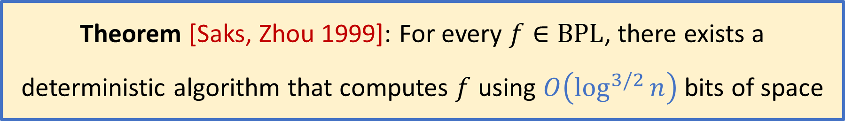

$\text{BPL}⊆{\text{L}}^{3/2}$
Theorem [Saks, Zhou 1999]: For every $f∈\text{BPL}$, there exists a deterministic algorithm that computes $f$ using $O\left(\log^{3/2}{n}\right)$ bits of space
Proof based on reusing Nisan’s hash functions many times, with randomized rounding to break stochastic dependencies
Current state of the art is only slightly better

Slide 28

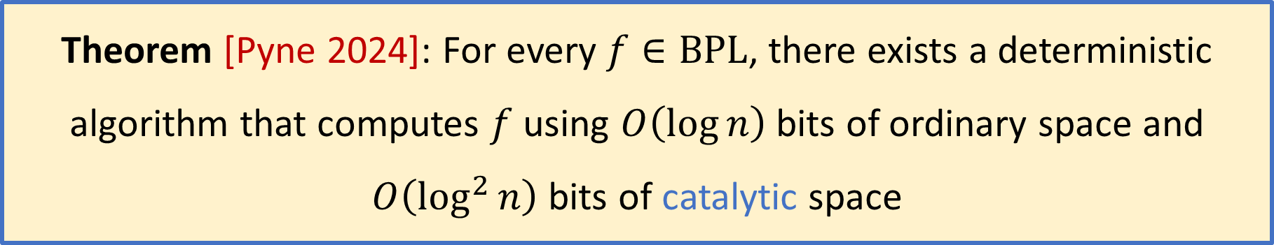
Catalytic derandomization
Theorem [Pyne 2024]: For every $f∈\text{BPL}$, there exists a deterministic algorithm that computes $f$ using $O\left(\log{n}\right)$ bits of ordinary space and $O\left(\log^{2}{n}\right)$ bits of catalytic space
Proof idea: Use initial data as hash functions
Either they are “good,” or else they can be compressed

Slide 29
Summary
Today:
  The INW Approach ✔️
  The Nisan Approach ✔️
Tomorrow:
  The Laplacian Approach
  The Restrictions Approach
Thanks for listening!

