Slide 1
Pseudorandom Generators and Small-Space Derandomization
Simons Institute “Meet the Fellows” Welcome Event
September 9, 2022
🎲
William M. Hoza
Simons Institute
williamhoza@berkeley.edu

Slide 2
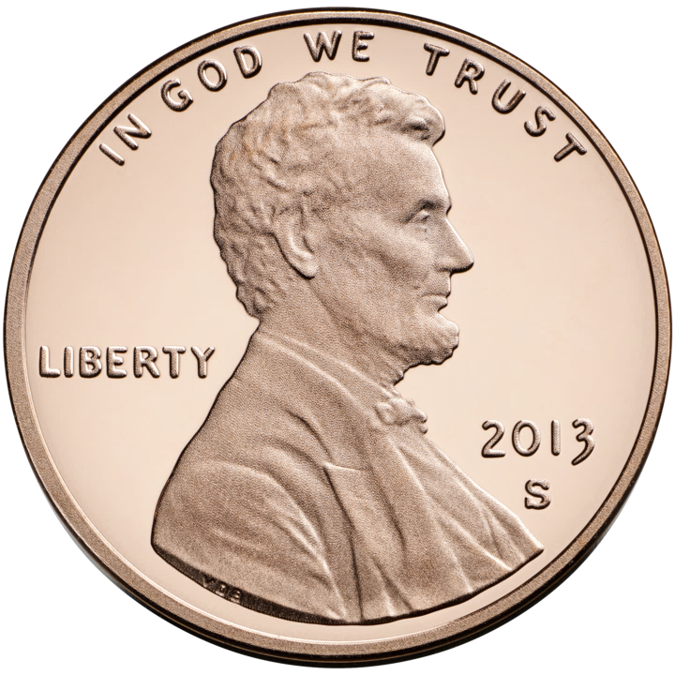
Pseudorandom generators (PRGs)
Let $ℱ$ be a class of functions $f:\{0, 1\}^{n}→\{0, 1\}$
An $ε$-PRG for $ℱ$ is a function $G:\{0, 1\}^{r}→\{0, 1\}^{n}$ such that
$$∀f∈ℱ, \operatorname{Pr}\left[f\left(U_{n}\right)=1\right]≈\operatorname{Pr}\left[f\left(G\left(U_{r}\right)\right)=1\right]$$
($U_{n}=$ the uniform distribution over $\{0, 1\}^{n}$)
Toy example with $r=2$ and $n=3$:
$ℱ=$ depth-2 decision trees
$G\left(x,y\right)=\left(x,y,x⊕y\right)$. Pairwise independence
$$x_{1}$$
0
1
$$x_{2}$$
$$x_{3}$$
0
1
0
1
0
1
1
0

Slide 3
Some examples of my PRG research
Theorem [Hatami, H, Tal, Tell 2022]: $∃$ explicit PRG for constant-depth threshold circuits of size $n^{1+Ω(1)}$ with seed length $n^{1−Ω\left(1\right)}$
Theorem [Doron, Hatami, H 2019]: $∃$ explicit PRG for read-once ${\text{AC}}^{0}$ with seed length $\tilde{O}\left(\log{n}\right)$
Theorem [H, Pyne, Vadhan 2021]: $∃$ explicit PRG for unbounded-width read-once permutation branching programs with seed length $\tilde{O}\left(\log{n}\right)$

Slide 4
Some PRG challenges
Design improved PRGs for space-bounded computation
Design improved PRGs for bounded-depth circuits
E.g., various types of read-once formulas
$$∧$$
$$∨$$
$$∨$$
$$⊕$$
$$⊕$$
$$⊕$$
$$⊕$$
$$⊕$$
$$x_{3}$$
$$x_{1}$$
$${¬x}_{2}$$
$$x_{8}$$
$${¬x}_{6}$$
$$x_{5}$$
$$x_{11}$$
$${¬x}_{4}$$
$${¬x}_{9}$$
$$x_{7}$$
$$x_{10}$$

Slide 5
Why study PRGs?
If you want to use fewer random bits
Randomness is a scarce computational resource, like time or space
If you want to fully derandomize algorithms
Exhaustively try all seeds
If you want to design randomized algorithms
E.g., streaming algorithms
If you want to understand $ℱ$ better
PRG $⇒$ lower bound. A PRG is a highly “refined” lower bound
“Here’s something that $ℱ$ doesn’t understand at all”

Slide 6
Small-space derandomization
A language is in $\text{BPSPACE}(S)$ if it can be decided by a bounded-error randomized algorithm $A$ that runs in space $O\left(S\right)$ and always halts
Conjecture: $∀S≥\log{n},$ $\text{DSPACE}\left(S\right)=\text{BPSPACE}(S)$
“Randomness is not necessary for space-efficient computation”

Slide 7
Some examples of my derandomization research
Theorem [H 2021]: $\text{BPSPACE}\left(S\right)⊆\text{DSPACE}\left(S^{3/2}/\sqrt{\log{S}}\right)$
Previous bound was $O\left(S^{3/2}\right)$ [Saks, Zhou 1995]
Theorem [H 2019]:
Suppose a language can be decided by a randomized algorithm that runs in space $O(\log{n})$ and time $\tilde{O}(n)$
Then $∃$ deterministic log-space algorithm that correctly decides the language on all but a negligible fraction of inputs of each length

Slide 8
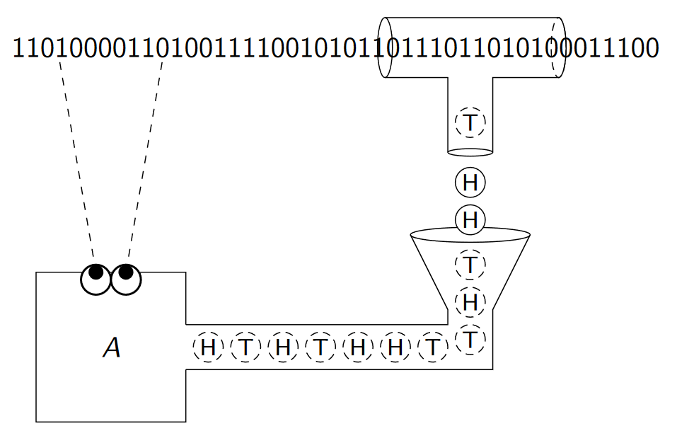
Typically-correct derandomization technique
Use the input as a source of random bits [Goldreich, Wigderson 2002]
To avoid problematic correlations, only use parts of the input that the algorithm is not currently processing

Slide 9
The future of small-space derandomization
The human species has no excuse for having not yet proven $\text{DSPACE}\left(S\right)=\text{BPSPACE}\left(S\right)$
A couple of potentially easier problems:
$\text{BPL}⊆\text{NL}$?
$\text{RL}=\text{coRL}$?
$$\text{NP}$$
$$\text{coNP}$$
$$\text{P}$$
$$\text{BPL}$$
$$\text{L}$$

Slide 10
Other interests
I’m also interested in other areas of complexity theory, e.g., circuit lower bounds
Theorem [Hatami, H, Tal, Tell 2022]: $∀$ constant $d$, $∃F:\{0, 1\}^{n}→\{0, 1\}$ such that:
$F$ can be computed by an explicit depth-$\left(d+1\right)$ ${\text{AC}}^{0}$ circuit of size $O\left(n\right)$
However, $F$ cannot be computed by a depth-$d$ threshold circuit of size $n^{1+γ}$ for some $γ=γ\left(d\right)>0$
Thanks for listening!
Questions?

