Slide 1
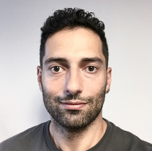
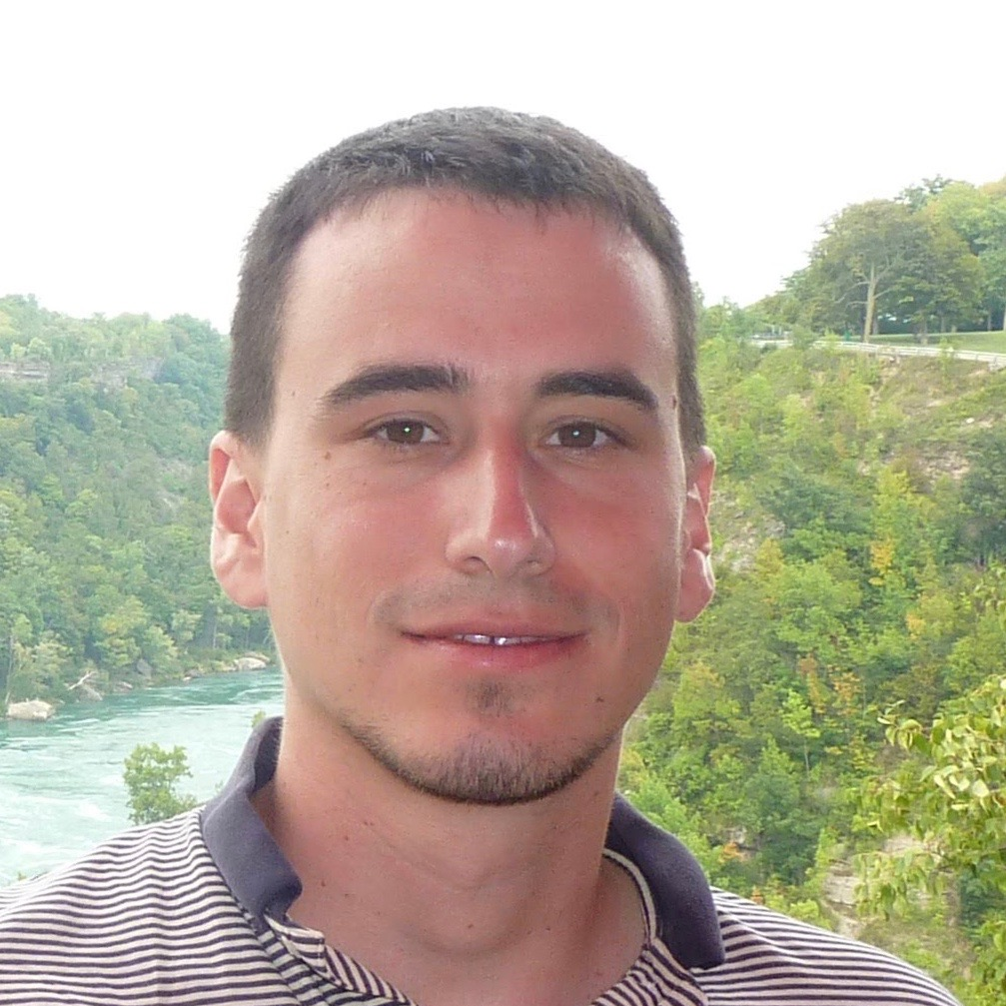
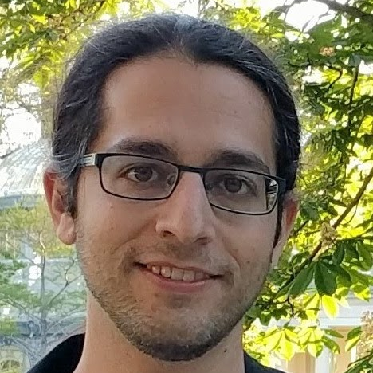
Fooling Constant-Depth Threshold Circuits
UT Austin Theory Seminar
April 15, 2022
Pooya Hatami¹
Ohio State University
pooyahat@gmail.com
William M. Hoza²
Simons Institute
williamhoza@berkeley.edu
Avishay Tal
UC Berkeley
atal@berkeley.edu
Roei Tell
IAS & DIMACS
roei.tell@gmail.com
¹Supported by NSF grant CCF-1947546.
²Supported by the NSF GRFP under Grant DGE-1610403 and by a Harrington Fellowship from UT Austin.

Slide 2
How to prove $\text{P}≠\text{NP}$?
$$C\left(x\right)$$
$$∧$$
Standard approach: Circuit size lower bounds
$∃$ functions with circuit complexity $2^{Ω(n)}$
Current best lower bound for a problem in $\text{NP}$ is only $c⋅n$ ☹️
Let’s try looking at restricted circuit classes…
$$∨$$
$$∨$$
$$∨$$
$$∨$$
$$∧$$
$$∧$$
$$∧$$
$$x_{1}$$
$$x_{2}$$
$$x_{3}$$
$$x_{4}$$
$$x_{5}$$

Slide 3
Lower bounds for ${\text{AC}}^{0}$
Constant-depth circuits are easier to analyze
✔️ Exponential lower bounds
[Ajtai 1983, FSS 1984, Yao 1985, Håstad 1986]
✔️ Average-case hardness
[Ajtai 1983, FSS 1984, Yao 1985, Håstad 1986, BIS 2012, IMP 2012, Håstad 2014]
✔️ Pseudorandom generators
[AW 1985, Nisan 1991, Braverman 2009, TX 2013, Tal 2017, HS 2019, ST 2019, Kelley 2021, Lyu 2022]

Slide 4
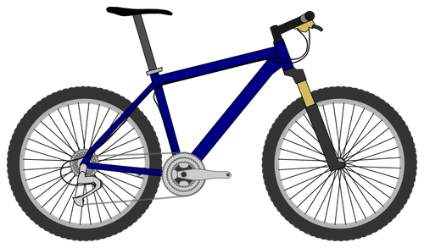
A more challenging class: ${\text{TC}}^{0}$

Slide 5
Linear threshold functions (LTFs)
$$Φ\left(x\right)$$
$Φ:\{0, 1\}^{n}→\{0, 1\}$
$Φ\left(x\right)=\text{1}⇔\sum_{i=1}^{n}{w_{i}x_{i}≥θ}$
Weight vector $w∈ℝ^{n}$
Aka “halfspace”
AND, OR, MAJ, …
$$∑$$
$$w_{1}$$
$$w_{5}$$
$$w_{2}$$
$$w_{4}$$
$$w_{3}$$
$$x_{1}$$
$$x_{2}$$
$$x_{3}$$
$$x_{4}$$
$$x_{5}$$

Slide 6
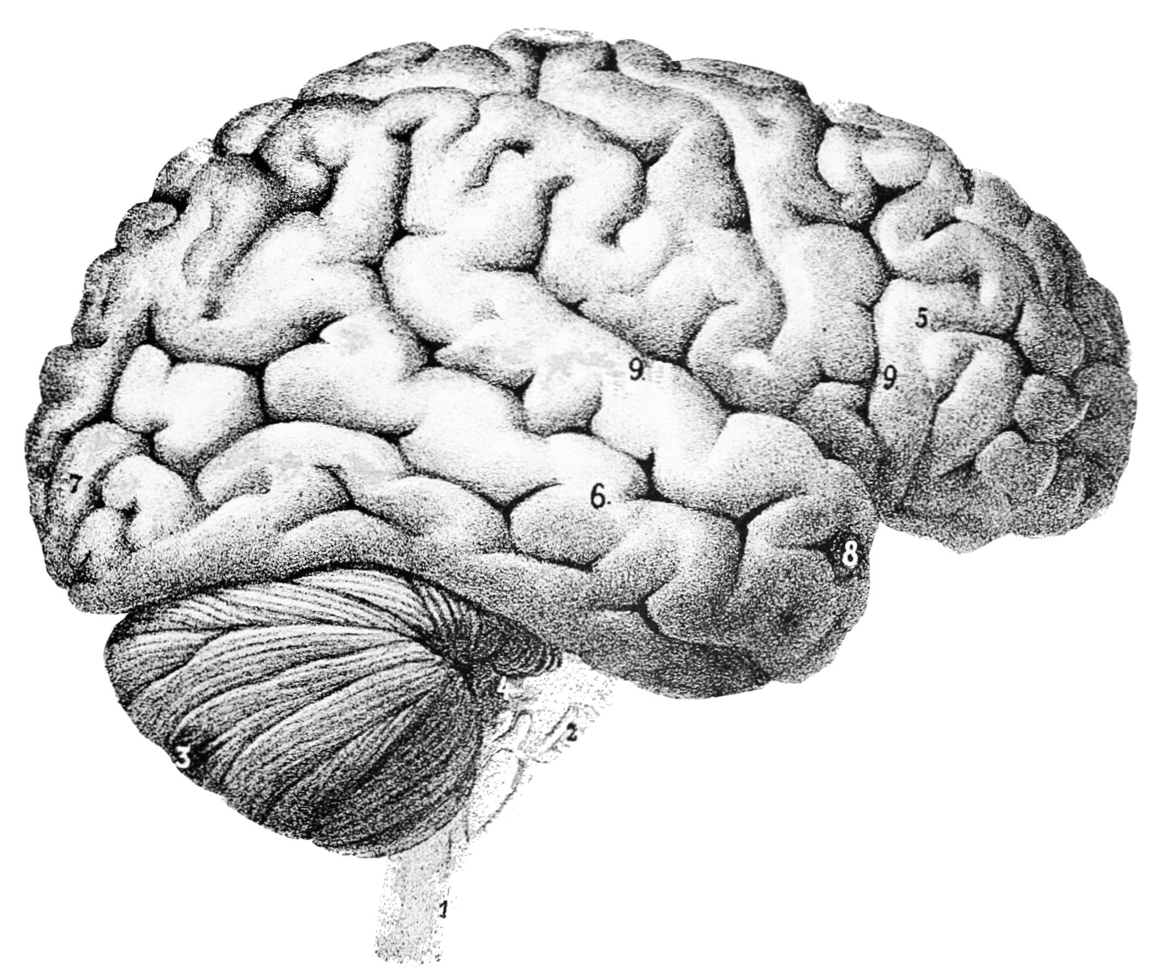
LTF circuits
$$C\left(x\right)$$
$$Φ_{8}$$
$C:\{0, 1\}^{n}→\{0, 1\}$
Gates are arbitrary LTFs
Boolean analogue of a neural network
Size = number of wires
${\text{TC}}^{0}$: Depth = $O(1)$, size = $\text{poly}\left(n\right)$
$$Φ_{4}$$
$$Φ_{5}$$
$$Φ_{6}$$
$$Φ_{7}$$
$$Φ_{1}$$
$$Φ_{2}$$
$$Φ_{3}$$
$$x_{1}$$
$$x_{2}$$
$$x_{3}$$
$$x_{4}$$
$$x_{5}$$

Slide 7
Lower bounds for ${\text{TC}}^{0}$
Can we construct a function in $N\text{P}$ that is not in ${\text{TC}}^{0}$?
❌ So far we cannot even prove $\text{NEXP}⊈{\text{TC}}^{0}$…
✔️ What we can prove: Super-linear lower bounds
Theorem [Impagliazzo, Paturi, Saks 1993]: PARITY cannot be computed by depth-$d$ LTF circuits with $n^{1+δ}$ wires for some $δ=2^{−Θ(d)}$
✔️ Average-case bounds known too [Chen, Santhanam, Srinivasan 2016]
⭐ This work: Pseudorandom generators
$$\text{P}/\text{poly}$$
$${\text{NC}}^{1}$$
$${\text{TC}}^{0}$$
$${\text{AC}}^{0}\left[⊕\right]$$
$${\text{AC}}^{0}$$

Slide 8
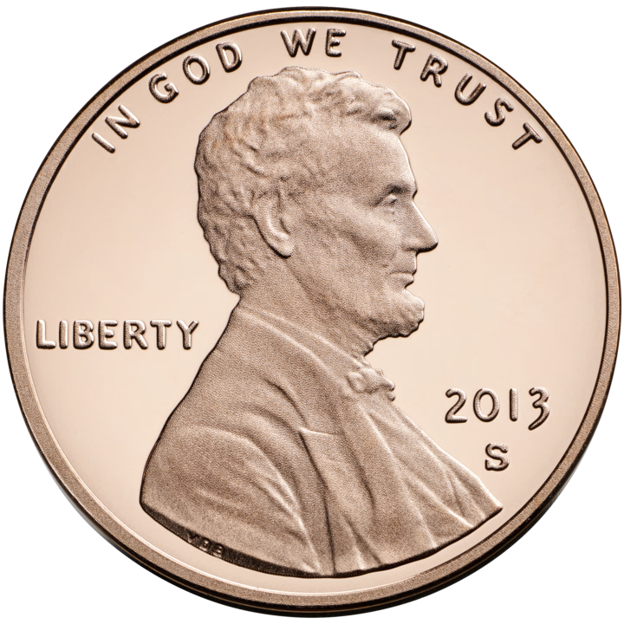
Pseudorandom generators (PRGs)
$G:\{0, 1\}^{s}→\{0, 1\}^{n}$
Let $𝒞$ be a class of functions $C:\{0, 1\}^{n}→\{0, 1\}$
$G$ is a PRG for $𝒞$ with error $ε$ if
$$∀C∈𝒞, \left|\operatorname{Pr}\left[C\left(G\left(U_{s}\right)\right)=1\right]−Pr⁡[C\left(U_{n}\right)=1]\right|≤ε$$
$s=$ “seed length”
Highly “refined” lower bound: $𝒞$ doesn’t understand $G$ at all

Slide 9
Our contribution: PRGs for LTF circuits
Let $n, d∈ℕ$
Theorem: For some $δ=2^{−Θ\left(d\right)}$, there exists an explicit PRG for depth-$d$ LTF circuits on $n$ variables with $n^{1+δ}$ wires
The seed length is $O\left(n^{1−δ}\right)$
The error is $2^{−n^{δ}}$
First nontrivial PRG for $d>2$
Any significant improvement would imply new lower bounds

Slide 10
Circuit Acceptance Probability Problem (CAPP)
CAPP: Given a circuit $C$, estimate $\operatorname{Pr}\left[C\left(U_{n}\right)=1\right]$ with low additive error
Corollary: $∃$ deterministic CAPP algorithm for depth-$d$ LTF circuits with $n^{1+δ}$ wires
Running time is $\exp\left(O\left(n^{1−δ}\right)\right)$, error is $2^{−n^{δ}}$
Context: A deterministic CAPP algorithm for constant-depth poly-size LTF circuits with runtime $2^{n}/n^{ω\left(1\right)}$ would imply $\text{NEXP}⊈{\text{TC}}^{0}$ [SW 2013, BV 2014]
“Algorithmic method”

Slide 11
Restrictions
Our PRG is based on a pseudorandom restriction $R∈\{0, 1, ⋆\}^{n}$
A random variable $R∈\{0, 1, ⋆\}^{n}$ is $p$-regular if
$\operatorname{Pr}\left[R_{i}= ⋆\right]=p$
$\operatorname{Pr}\left[R_{i}=0\right]=\operatorname{Pr}\left[R_{i}=1\right]=(1−p)/2$
(Coordinates are not necessarily independent)

Slide 12
Ajtai-Wigderson PRG framework [AW 1985]
Let $R$ be a $p$-regular restriction
Assume $R^{−1}(⋆)$ can be sampled using $s$ truly random bits
(assigned bits truly random)
Assume that w.h.p., restricted circuit $C{\left.​\right|}_{R}$ can be computed by a class $𝒞_{simple}$
Assume $∃$ PRG $G_{simple}$ for $𝒞_{simple}$with seed length $s$
Then we get a PRG for the original circuit $C$ with seed length $≈p^{−1}⋅s$
Idea: $𝔼\left[C\right]≈𝔼\left[C{\left.​\right|}_{R}\left(G_{simple}\left(U_{s}\right)\right)\right]$. Derandomize $R$ by recursion
Failure probability must be less than $p$

Slide 13
Our two jobs
Show that LTF circuits “simplify” under pseudorandom restrictions
Fool the “simplified” model

Slide 14
Our two jobs
Show that LTF circuits “simplify” under pseudorandom restrictions
Fool the “simplified” model

Slide 15
Simplification of a single gate
$$C\left(x\right)$$
$$Φ_{8}$$
Hope: After applying restriction, LTF becomes extremely biased
Definition: A function $Φ$ is $ε$-close to a constant if $∃b∈\{0, 1\}$ such that
$$Pr⁡[Φ\left(U_{n}\right)=b]≥1−ε$$
$$Φ_{4}$$
$$Φ_{5}$$
$$Φ_{6}$$
$$Φ_{7}$$
$$Φ_{1}$$
$$Φ_{2}$$
$$Φ_{3}$$
$$x_{1}$$
$$x_{2}$$
$$x_{3}$$
$$x_{4}$$
$$x_{5}$$

Slide 16
MAJ becomes biased under restrictions
$$x_{1}$$
$$x_{2}$$
$$x_{3}$$
$$x_{4}$$
$$x_{5}$$
$$x_{6}$$
$$x_{7}$$
$$x_{8}$$
$$x_{9}$$
$$x_{10}$$
$$x_{11}$$
$$x_{12}$$
$$x_{13}$$
$$x_{14}$$
$$x_{15}$$
$$x_{16}$$
$$x_{17}$$
0
1
$$⋆$$
$$⋆$$
1
1
$$⋆$$
0
1
0
0
$$⋆$$
1
1
0
1
1

Slide 17
MAJ becomes biased under restrictions
0
0
0
0
0
1
1
1
1
1
1
1
1
$$⋆$$
$$⋆$$
$$⋆$$
$$⋆$$

Slide 18
MAJ becomes biased under restrictions
Let $R$ be a truly random restriction with $\left|R^{−1}\left(⋆\right)\right|=pn$
Claim: $\operatorname{Pr}\left[\text{MAJ}{\left.​\right|}_{R} \text{is} ε\text{-}\text{close} \text{to} \text{a} \text{constant}\right]≥1−O\left(\sqrt{p\log\left(1/ε\right)}\right)$
Proof step 1: Anti-concentration:
$\underset{R}{Pr}\left[\frac{1}{1}\left|R^{−1}\left(1\right)\right|=\left|R^{−1}\left(0\right)\right|±Δ \right]≤O\left(Δ/\sqrt{n}\right)$
Proof step 2: Concentration:
$\underset{x∈\{0, 1\}^{R^{−1}\left(⋆\right)}}{Pr}\left[\frac{1}{1}\left|x^{−1}\left(1\right)\right|=\left|x^{−1}\left(0\right)\right|±Δ \right]≥1−\exp\left(−Ω\left(\frac{Δ^{2}}{pn}\right)\right)$
Asymptotics of central binomial coefficients
Chernoff/Hoeffding

Slide 19
Any LTF becomes biased under restrictions
Let $R$ be a truly random $p$-regular restriction and let $Φ$ be any LTF
Theorem [CSS 2016]: $\operatorname{Pr}\left[Φ{\left.​\right|}_{R} \text{is} ε\text{-}\text{close} \text{to} \text{a} \text{constant}\right]≥1−p^{Ω\left(1\right)}⋅\log\left(1/ε\right)$
Proof based on concentration and anti-concentration
*Actually we rely on a more technical variant of this result, where:
$R^{−1}\left(⋆\right)$ is a pseudorandom subset of $[n]$…
…with largest-weight variables excluded (non-black-box)…
…and $\operatorname{Pr}\left[R^{−1}\left(⋆\right) \text{is} \text{bad}\right]=ε≪p$, although $\operatorname{Pr}\left[\text{assigned} \text{values} \text{are} \text{bad}\right]=p^{Θ(1)}$
For today’s talk, let’s ignore these technicalities (see paper if curious)
Berry-Esseen theorem
“Critical index” analysis

Slide 20
Simplification of LTF circuits
$$C\left(x\right)$$
$$Φ_{8}$$
Hope: Show that restriction eliminates bottom layer of circuit
Most gates will become $ε$-close to constants
Replace them with constants
Difficulty: Some gates will not become close to constants ($\operatorname{Pr}\left[\text{fail}\right]≫p$)
$$Φ_{4}$$
$$Φ_{5}$$
$$Φ_{6}$$
$$Φ_{7}$$
$$Φ_{1}$$
$$Φ_{2}$$
$$Φ_{3}$$
$$x_{1}$$
$$x_{2}$$
$$x_{3}$$
$$x_{4}$$
$$x_{5}$$

Slide 21
LTF decision trees (LTF-DTs)
Solution: Versatile model $𝒞_{simple}$
Decision tree that can query variables or LTFs, with LTF circuits at leaves
[Chen, Santhanam, Srinivasan 2016]
$$x_{1}$$
$$Φ_{1}(x)$$
$$Φ_{2}(x)$$
$$x_{3}$$
$$x_{6}$$
$$x_{2}$$
$$x_{3}$$
$$C_{1}\left(x\right)$$
$$C_{2}\left(x\right)$$
$$C_{3}\left(x\right)$$
$$C_{4}\left(x\right)$$
$$C_{5}\left(x\right)$$
$$C_{6}\left(x\right)$$
$$C_{7}\left(x\right)$$
$$C_{8}\left(x\right)$$

Slide 23
LTF circuit depth-reduction lemma
Let $C$ be a depth-$d$ LTF circuit with $w$ wires
Let $R$ be a suitable $p$-regular restriction
$\left(p^{−1}\log\left(w/ε\right)\right)$-wise independent $⋆$ positions and truly random assigned bits
Lemma: With probability $1−ε$, $C{\left.​\right|}_{R}$ can be $ε$-approximated by LTF-DT where
Leaves are labeled with depth-$(d−1)$ LTF circuits with $≤w$ wires
# variable queries $≤O\left(\left(p^{7/6}⋅w+p^{−4}\right)⋅\log^{2}\left(w/ε\right)\right)$
# LTF queries $≤O(p^{−2})$
$$p=1/n^{0.001} \\ w=n^{1.001}$$
$$p^{7/6}⋅w≪p⋅n \\ \text{\# }\text{var} \text{queries}≪\text{\# }\text{living} \text{vars}$$

Slide 24
Proof strategy
(Builds on [Chen, Santhanam, Srinivasan 2016])
Whenever some “bad event” occurs, query whoever is responsible
That way, the problematic parts of the circuit can be replaced with constants

Slide 25
Proof cases
$$Φ_{1}$$
$$Φ_{2}$$
$$Φ_{3}$$
“Heavy gates”: Fan-in $≥p^{−5/6}$
vs. “light gates”
“Heavy variables”: Fan-out $≥p^{−7/6}$
vs. “light variables”
$$x_{1}$$
$$x_{2}$$
$$x_{3}$$
$$x_{4}$$
$$x_{5}$$
$$Φ_{1}$$
$$Φ_{2}$$
$$Φ_{3}$$
$$x_{1}$$
$$x_{2}$$
$$x_{3}$$
$$x_{4}$$
$$x_{5}$$

Slide 26
Heavy gates & light variables
Let $m=\text{fan}\text{-}\text{in} \text{of} \text{each} \text{gate}≥p^{−5/6}$ (assume same $m$ for all gates, for simplicity)
Each gate becomes extremely biased except with probability roughly $p^{1/3}$
$𝔼\left[\text{\# }\text{somewhat}\text{-}\text{balanced} \text{gates}\right]≲p^{1/3}⋅\left(\text{\# }\text{gates}\right)≤p^{1/3}⋅w/m$
If total # gates$≲p^{−2}$, query the somewhat-balanced gates
Otherwise, query the living variables feeding into the somewhat-balanced gates
W.h.p., each gate has $O\left(p⋅m+\log\left(w/ε\right)\right)$ living variables
$$𝔼\left[\text{\# }\text{variable} \text{queries}\right]≤O\left(\left(p⋅m+\log\left(w/ε\right)\right)⋅𝔼\left[\text{\# }\text{somewhat}\text{-}\text{balanced} \text{gates}\right]\right) \\ ≤O\left(\left(p^{4/3}⋅w+p^{7/6}⋅w\right)⋅\log\left(w/ε\right)\right)$$
Concentration: “Read-$k$ Chernoff Bound” [GLSS 2015] (use “light variables” assumption)
✔️

Slide 27
Light gates & light variables
$$Φ_{1}$$
Fan-in $≤p^{−5/6}$
Hope: After restriction, fan-in $≤1$
“Connected pair”: Two variables feeding into same light gate
LTF-DT queries all variables in connected pairs where both survive
$𝔼\left[\text{\# }\text{queries}\right]≤2p^{2}⋅\left(\text{\# }\text{connected} \text{pairs}\right)≤{2p}^{2}⋅w⋅p^{−5/6}=2p^{7/6}⋅w$ ✔️
Concentration: Find many gates that don’t share variables. Independent events
$$⋆$$
$$0$$
$$⋆$$

Slide 28
Heavy variables
Fan-out $≥p^{−7/6}$
LTF-DT queries all heavy variables
So # queries $≤p^{7/6}⋅w$ ✔️

Slide 29
Iterating
So far: Under restriction,
Depth-$d$ LTF circuit $⇒$ LTF-DT with depth-$(d−1)$ LTF circuits at leaves
How to get down to depth $d−2$?

Slide 31
LTF-DT circuit-depth-reduction lemma
Let $T$ be an LTF-DT where leaves are labeled with depth-$d$ LTF circuits with $w$ wires
# variable queries $=D$, # LTF queries $=M$
Let $R$ be a suitable $p$-regular restriction
$\left(p^{−1}\left(M+\log\left(w/ε\right)\right)\right)$-wise independent $⋆$ positions and truly random assigned bits
Lemma: With probability $1−ε$, ${T\left.​\right|}_{R}$ can be $ε$-approximated by LTF-DT $T′$ where
Leaves are labeled with depth-$(d−1)$ LTF circuits with $≤w$ wires
# variable queries $≤O\left(p⋅D+\left(p^{7/6}⋅w+p^{−4}\right)⋅\left(M^{2}+\log^{2}\left(w/ε\right)\right)\right)$
# LTF queries $≤M+O(p^{−2})$

Slide 33
Key step of proof: Bounding error
Let ${\text{VARS}}_{ℓ}$ be the event that $R,x$ are consistent with the variable queries on path to $ℓ$
Let ${\text{LTFS}}_{ℓ}$ be the event that $R,x$ are consistent with the LTF queries on path to $ℓ$
$$\underset{R,x}{Pr}\left[T^{′}\left(x\right)≠T{\left.​\right|}_{R}\left(x\right)\right]=\sum_{ℓ leaf of T}{Pr⁡[\text{reach} ℓ∧\text{error} \text{at} ℓ]} \\ =\sum_{ℓ}{Pr⁡[{\text{VARS}}_{ℓ}∧{\text{LTFS}}_{ℓ}}∧\text{error} \text{at} ℓ] \\ ≤\sum_{ℓ}{\operatorname{Pr}\left[{\text{VARS}}_{ℓ}∧\text{error} \text{at} ℓ\right]}=\sum_{ℓ}{\operatorname{Pr}\left[{\text{VARS}}_{ℓ}\right]⋅\operatorname{Pr}\left[\text{error} \text{at} ℓ\right]} \\ ≤ε^{′}⋅𝔼\left[\text{\# }ℓ \text{such} \text{that} {\text{VARS}}_{ℓ} \text{occurs}\right] \\ ≤ε^{′}⋅2^{\# LTF queries}$$

Slide 35
LTF circuit simplification
Theorem: Let $d=O\left(1\right).$ $∀n, w, p, ε, ∃p$-regular restriction distribution $R$ such that
$∀$ depth-$d$ size-$w$ LTF circuits $C:\{0, 1\}^{n}→\{0, 1\}$, with probability $1−ε$, $C{\left.​\right|}_{R}$ can be $ε$-approximated by an LTF-DT where leaves are labeled with individual LTFs and
# variable queries $≤O\left(\left(p^{1+{40}^{−d}}⋅w+p^{−4}\right)⋅\log^{2}\left(w/ε\right)\right)$
# LTF queries $≤O(p^{−2})$
$R^{−1}(⋆)$ can be efficiently sampled using seed length $O\left(p^{−1}⋅\log\left(w/ε\right)⋅log n\right)$
Assigned bits of $R$ are truly random
Derandomized & strengthened version of prior analysis [Chen, Santhanam, Srinivasan 2016]

Slide 36
Our two jobs
Show that LTF circuits “simplify” under pseudorandom restrictions ✔️
Fool the “simplified” model

Slide 37
PRGs for Functions of a Few LTFs
Theorem: $∃$ explicit PRG for ${\text{A}\text{NY}}_{s}∘\text{LTF}$ with seed length
$\tilde{O}\left(\sqrt{n⋅\left(s+\log\left(1/ε\right)\right)}\right)$
(builds on [Kabanets, Koroth, Lu, Myrisiotis, Oliveira 2020])
Construction: Prior PRG for combinatorial rectangles (e.g., Nisan’s PRG for small space)
Analysis overview: Say we want to fool $g\left(Φ_{1}\left(x\right), …, Φ_{s}\left(x\right)\right)$.
Each LTF $Φ_{i}(x)$ can be computed by an efficient randomized multiparty number-in-hand protocol [Nisan 1993, Viola 2015]. Let $p_{i}\left(x\right)$ denote the acceptance probability of the protocol
$∃$ low-degree $g_{robust}$ that computes $g$ and is robust to input errors [Sherstov 2013]
$g\left(Φ_{1}\left(x\right), …, Φ_{s}\left(x\right)\right)≈g_{robust}\left(p_{1}\left(x\right),…,p_{s}\left(x\right)\right)$ pointwise. Fool the latter term-by-term

Slide 38
PRGs for Polytopes
Corollary: $∃$ explicit PRG for ${\text{AND}}_{s}∘\text{LTF}$ with seed length
$$\tilde{O}\left(\sqrt{n⋅\left(s+\log\left(1/ε\right)\right)}\right)$$
Lots of prior work on fooling polytopes and more general classes [Viola 2007] [Lovett, Srinivasan 2011] [Gopalan, O’Donnell, Wu, Zuckerman 2010] [Servedio, Tan 2018] [O’Donnell, Servedio, Tan 2019] [Kabanets, Koroth, Lu, Myrisiotis, Oliveira 2020]
Our dependence on $n$ and $s$ are poor, but we can handle extremely small error such as $ε=2^{−n^{0.99}}$
$n$-dimensional $s$-facet polytope
$$∧$$
LTF
LTF
LTF
$$x_{1}$$
$$x_{2}$$
$$x_{3}$$
$$x_{4}$$
$$x_{5}$$
$$x_{6}$$

Slide 39
PRGs for LTF-DTs
Corollary: $∃$ explicit PRG for LTF-DTs with LTFs at leaves with seed length
$$\tilde{O}\left(\sqrt{n⋅\left(D+M+\log\left(1/ε\right)\right)}\right)$$
where $D=$ # variable queries and $M=$ # LTF queries
Proof: Expand LTF-DT $T$ as
$$T\left(x\right)=\sum_{ℓ leaf of T}{\underset{{\overset{}{}\text{AND}}_{M+2}∘\text{LTF}}{\underbrace{1\left[T \text{on} x \text{reaches} ℓ\right]⋅\underset{}{Φ_{ℓ}\left(x\right)}}}}$$

Slide 40
Our two jobs
Show that LTF circuits “simplify” under pseudorandom restrictions ✔️
Fool the “simplified” model ✔️
That completes proof of main theorem: $∃$ explicit, nontrivial PRG for depth-$d$ LTF circuits with $n^{1+δ}$ wires

Slide 41
Other results in the paper
We construct an improved low-error PRG for De Morgan formulas
Similar techniques. “Hybrid decision tree” models are versatile and useful
See also: [Håstad 2014, CSS 2016, ST 2019, Tal 2017]
More applications of hybrid decision tree models?
We show that depth-$d$ LTF circuits with $n^{1+δ}$ wires cannot compute the Minimum Circuit Size Problem (MCSP)

Slide 42
Conclusions
Open Problem: Design a deterministic CAPP algorithm for poly-size $\text{MAJ}∘\text{MAJ}$ circuits with runtime $2^{n}/n^{ω\left(1\right)}$ and error $1/n^{ω\left(1\right)}$
Exponential lower bounds for $\text{MAJ}∘\text{MAJ}$ circuits are known [HMPST 1993]
The challenge is “merely” to distill/refine/mine the insights of known lower bounds
It would imply that $\text{NEXP}$ does not have poly-size $\text{LTF}∘\text{LTF}$ circuits [CW 2019]
Thanks for listening! Questions?

