Slide 1
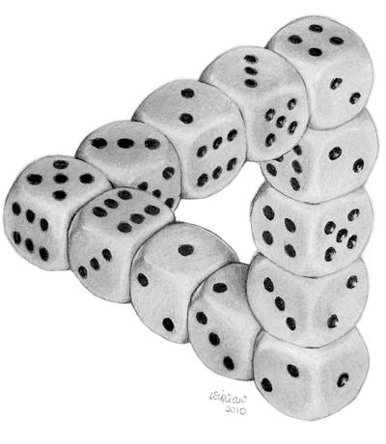
Better Pseudodistributions and Derandomization for Space-Bounded Computation
RANDOM 2021
William M. Hoza
Simons Institute
williamhoza@berkeley.edu
“Dice Illusion” by DeviantArt user Moko-m. (License: CC BY-NC-ND 3.0)
Based on research conducted while the author was a graduate student at the University of Texas at Austin, supported by the NSF GRFP under Grant DGE-1610403 and by a Harrington Fellowship from UT Austin.

Slide 2
Randomness and space complexity
A language is in $\text{BPSPACE}(S)$ if it can be decided by a bounded-error randomized algorithm $A$ that runs in space $O\left(S\right)$ and always halts
Conjecture: $∀S≥\log{n},$ $\text{DSPACE}\left(S\right)=\text{BPSPACE}(S)$
“Randomness is not necessary for space-efficient computation”
Observation: The function $f\left(x\right)≝A\left(y,x\right)$ can be computed by a read-once branching program (ROBP) of width $2^{O\left(S\right)}$
$$f\left(x\right)≝A\left(y,x\right)$$

Slide 3
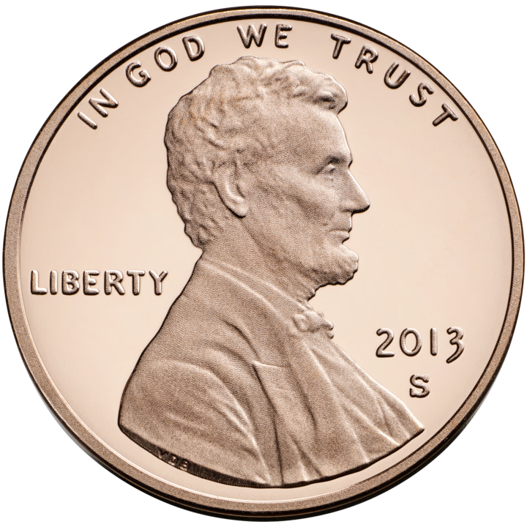
Pseudorandom generators (PRGs)
$G:\{0, 1\}^{r}→\{0, 1\}^{n}$
Want $G$ to fool all ROBPs of width $\text{poly}(n)$:
$$\left|𝔼\left[f\left(G\left(U_{r}\right)\right)\right]−𝔼\left[f\right]\right|≤ε$$
Explicit PRG with optimal seed length $O\left(\log\left(n/ε\right)\right)$ would imply $\text{L}=\text{BPL}$ 🙂
Best explicit PRG [Nisan 1990]: Seed length $O\left(\log^{2}{n}+\log\left(1/ε\right)⋅\log{n}\right)$ 😢
Derandomization without PRGs?

Slide 4
Weighted PRGs (WPRGs)
Introduced recently [Braverman, Cohen, and Garg 2018]
Pair $(G, ρ)$, where $G:\{0, 1\}^{r}→\{0, 1\}^{n}$ and $ρ:\{0, 1\}^{r}→ℝ$
Requirement: $∀$ poly-width ROBP $f$,
$$\left|𝔼_{x}\left[f\left(G\left(x\right)\right)⋅ρ(x)\right]−𝔼\left[f\right]\right|≤ε$$
PRG $⇒$ WPRG $⇒$ Hitting set generator (HSG)
Explicit optimal WPRG would still immediately imply $\text{L}=\text{BPL}$, because we could compute $\sum_{x}{2^{−s}⋅f\left(G\left(x\right)\right)⋅ρ(x)}$
HSG
WPRG
PRG

Slide 5
Generators for width-$n$ length-$n$ ROBPs
Seed length | Type of generator | Reference
$$\tilde{O}\left(\sqrt{n}\right)+O\left(\log\left(1/ε\right)\right)$$ | HSG | Ajtai, Komlós, Szemerédi 1987
$$2^{O\left(\sqrt{\log{n}}\right)}⋅log⁡(1/ε)$$ | PRG | Babai, Nisan, Szegedy 1989
$$O\left(\log^{2}{n}+\log{n}⋅\log\left(1/ε\right)\right)$$ | PRG | Nisan 1990, …
$$\tilde{O}\left(\log^{2}{n}+\log\left(1/ε\right)\right)$$ | WPRG | Braverman, Cohen, Garg 2018
$$O(\log^{2}{n}+\log\left(1/ε\right))$$ | HSG | H, Zuckerman 2018
$$\tilde{O}\left(\log^{2}{n}\right)+O(\log\left(1/ε\right))$$ | WPRG | Chattopadhyay, Liao 2020
$$O\left(\log^{2}{n}\right)+\tilde{O}\left(\log\left(1/ε\right)\right)$$ | WPRG | Cohen, Doron, Renard, Sberlo, Ta-Shma 2021 and Pyne, Vadhan 2021
$$O(\log^{2}{n}+\log\left(1/ε\right))$$ | WPRG | H 2021
Theorem: $∃$ explicit WPRG for width-$n$ length-$n$ ROBPs with seed length
$$O\left(\log^{2}{n}+\log\left(1/ε\right)\right)$$

Slide 6
Theorem: $∃$ explicit WPRG for width-$n$ length-$n$ ROBPs with seed length
$$O\left(\log^{2}{n}+\log\left(1/ε\right)\right)$$
$$ε≪1/\text{poly}\left(n\right)$$
Based on a generic error-reduction procedure:
Moderate-error PRG
Fools width-$n$ length-$n$ ROBPs
Error $1/\text{poly}\left(n\right)$
Seed length $r$
Low-error WPRG
Fools width-$n$ length-$n$ ROBPs
Error $ε$
Seed length $O\left(r+\log\left(1/ε\right)\right)$
$$⇒$$
Builds on similar prior procedure [Cohen, Doron, Renard, Sberlo, Ta-Shma 2021] [Pyne, Vadhan 2021]
Improvement is based on randomness-efficient samplers

Slide 7
Application: Better derandomization of $\text{BPL}$
Deterministic space | Model simulated | Reference
$$O\left(S^{2}\right)$$ | $$\text{NSPACE}(S)$$ | Savitch 1969
$$O\left(S^{2}\right)$$ | Non-halting unbounded-error randomized space-$S$ | Jung 1981 and Borodin, Cook, Pippenger 1983
$$O\left(S^{3/2}\right)$$ | $$\text{BPSPACE}(S)$$ | Saks, Zhou 1995
$$O\left(S^{3/2}/\sqrt{\log{S}}\right)$$ | $$\text{BPSPACE}(S)$$ | H 2021
Theorem: $∀S=S\left(n\right)≥\log{n}$, $\text{BPSPACE}(S)⊆\text{DSPACE}\left(S^{3/2}/\sqrt{\log{S}}\right)$
Proof builds on Saks-Zhou framework using recent prior results on WPRGs [Chattopadhyay, Liao 2020] [Cohen, Doron, Renard, Sberlo, Ta-Shma 2021] [Pyne, Vadhan 2021]
(Our improved WPRG construction is not necessary)

Slide 8
Conclusions
Compared to PRGs, WPRGs can be easier to construct
Compared to HSGs, WPRGs can be more useful
A nice balance
Thanks for listening!

