Slide 1
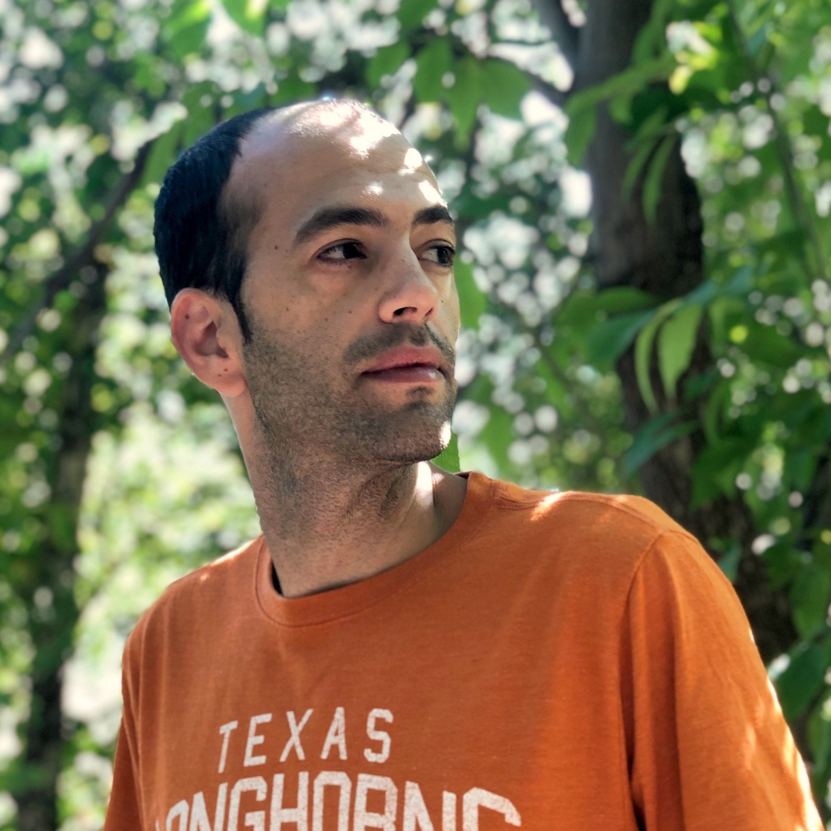
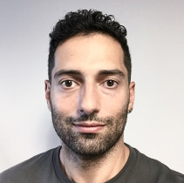
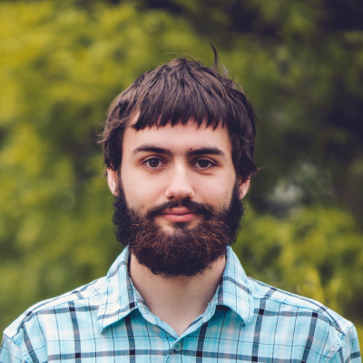
Log-Seed Pseudorandom Generators via Iterated Restrictions
CCC 2020
Dean Doron¹
Stanford
ddoron@stanford.edu
Pooya Hatami²
Ohio State University
pooyahat@gmail.com
William M. Hoza³
University of Texas at Austin
whoza@utexas.edu
¹This work was done while at UT Austin, supported by NSF Grant CCF-1705028.
²This work was done while at UT Austin and supported by a Simons Investigator Award (#409864, David Zuckerman)
³Supported by the NSF GRFP under Grant DGE-1610403 and by a Harrington Fellowship from UT Austin.

Slide 2
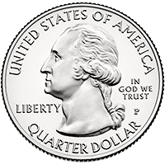
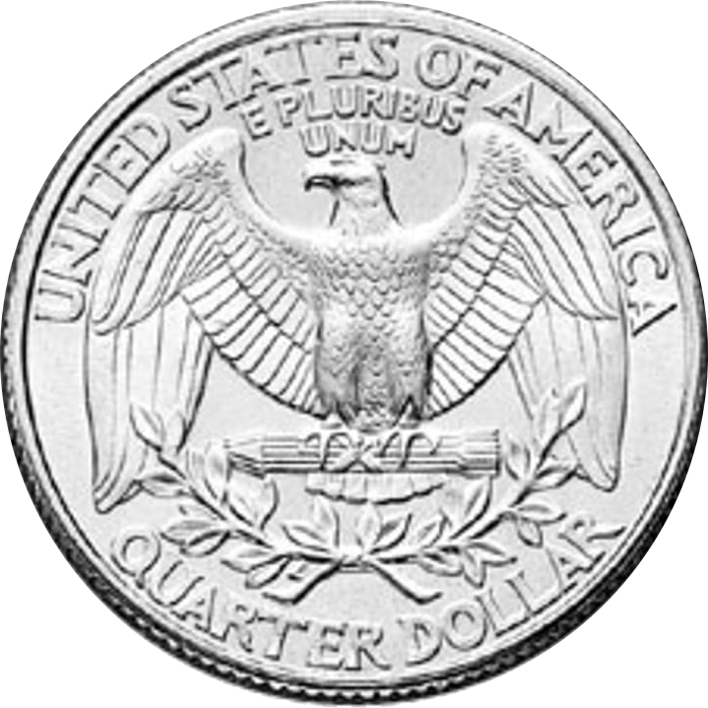
Randomness in computing
Randomness is an expensive computational resource
Like time or space
Using less randomness is better than using more randomness

Slide 3
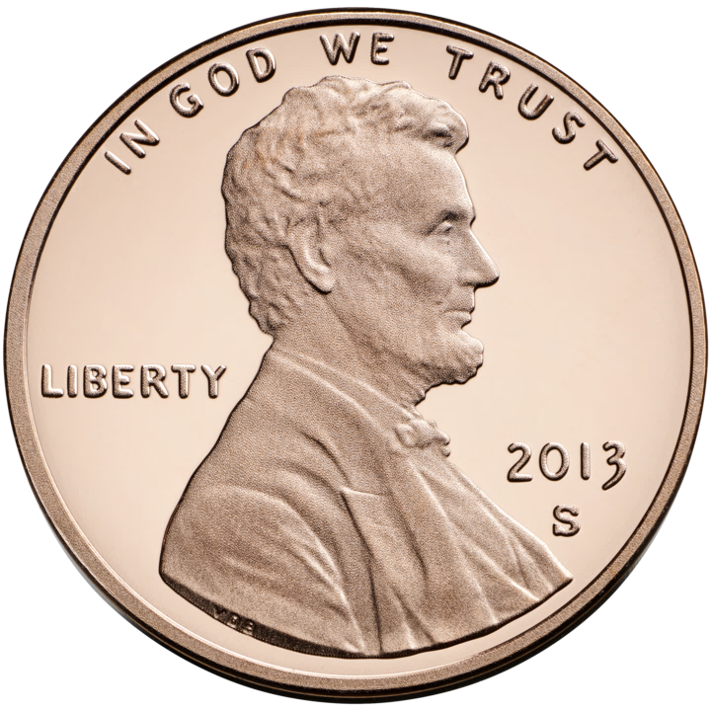
Pseudorandom generators (PRGs)
$G:\{0, 1\}^{s}→\{0, 1\}^{n}$
$G$ fools $f:\{0, 1\}^{n}→\{0, 1\}$ if
$$\left|𝔼\left[f\left(G\left(U_{s}\right)\right)\right]−𝔼\left[f\right]\right|≤ε.$$
Want one $G$ that fools entire class $ℱ$ simultaneously
For “reasonable” $ℱ$, goal is $s=O(\log\left(n/ε\right))$

Slide 4
$\text{L}$ vs. $\text{BPL}$
Conjecture: $\text{L}=\text{BPL}$
“Randomness is not necessary for space-efficient computation”
If there is an explicit PRG for “poly-width ROBPs” with seed length $O(\log{n)}$, then $\text{L}=\text{B}\text{PL}$
Approach 1: Fool poly-width ROBPs, optimize seed length
Stuck at $O\left(\log^{2}{n}\right)$ [Nisan 1990]
Approach 2: Insist on seed length $O(\log{n)}$, optimize $ℱ$

Slide 5
Read-once depth-two ${\text{AC}}^{0}[⊕]$
$$⊕$$
$$∧$$
$$∧$$
$$∧$$
$$∧$$
$$∧$$
$$x_{3}$$
$$x_{1}$$
$${¬x}_{2}$$
$$x_{8}$$
$${¬x}_{6}$$
$$x_{5}$$
$$x_{11}$$
$${¬x}_{4}$$
$${¬x}_{9}$$
$$x_{7}$$
$$x_{10}$$
Special case: Read-once CNFs
Special case: Read-once polynomials over $𝔽_{2}$ (essentially equivalent)
Can be simulated by width-4 ROBPs (after permuting variables)

Slide 6
Prior work and main result
Model | Seed length | Reference
$${\text{AC}}^{0}$$ | $$\text{polylog}(n/ε)$$ | … [Nisan 1991] …
Read-once CNFs | $$O(\log{n}\log\left(1/ε\right))$$ | [Chari, Rohatgi, Srinivasan 1994] [De, Etesami, Trevisan, Tulsiani 2010]
Read-once $\{∧, ∨\}∘\{∧, ∨, ⊕\}$ | $$\tilde{O}\left(\log\left(n/ε\right)\right)$$ | [Gopalan, Meka, Reingold, Trevisan, Vadhan 2012]
Poly-size $\text{SYM}∘ ∧$ | $$\exp\left(O\left(\sqrt{\log\left(n/ε\right)}\right)\right)$$ | [Luby, Veličković, Wigderson 1993]
Read-once ${\text{ACC}}^{0}$ | $$\text{polylog}(n/ε)$$ | [Gavinsky, Lovett, Srinivasan 2012]
Read-once polynomials | $$\tilde{O}(\log\left(n/ε\right)log(1/ε))$$ | [Lee, Viola 2017]
Read-once polynomials | $$\tilde{O}(\log\left(n/ε\right))$$ | [Meka, Reingold, Tal 2019]
Read-once polynomials | $$O(\log\left(n/ε\right){\left(\log{\log{n/ε}}\right)}^{2})$$ | [Lee 2019]
Read-once depth-2 ${\text{AC}}^{0}[⊕]$ | $$O\left(\log{n}\right)+\tilde{O}(\log\left(1/ε\right))$$ | [This work]
Prior PRGs w/ seed length $O\left(\log{n}\right)$:
Can’t fool read-once polynomials
Fool read-once CNFs with constant error
Maintains seed length $O(\log{n})$ with near-optimal error $exp⁡(−\tilde{Ω}\left(\log{n}\right))$
Theorem [This work]: Explicit PRG for read-once depth-2 ${\text{AC}}^{0}[⊕]$ with seed length
$$O\left(\log{n}\right)+\tilde{O}(\log\left(1/ε\right))$$

Slide 7
Ajtai-Wigderson framework
[Ajtai, Wigderson 1985]
[Gopalan, Meka, Reingold, Trevisan, Vadhan 2012]
Want to sample pseudorandom $n$-bit string
Start by sampling pseudorandom restriction $X∈\{0, 1,⋆\}^{n}$
$$⊕$$
$$⊕$$
$$∧$$
$$∧$$
$$∧$$
$$∧$$
$$∧$$
$$∧$$
$$∧$$
$$∧$$
$$∧$$
$$∧$$
$$x_{11}$$
$$x_{11}$$
$${¬x}_{4}$$
$$0$$
$${¬x}_{4}$$
$$x_{3}$$
$$x_{1}$$
$$x_{3}$$
$$1$$
$$x_{8}$$
$$x_{7}$$
$${¬x}_{2}$$
$$x_{8}$$
$${¬x}_{2}$$
$${¬x}_{6}$$
$$1$$
$${¬x}_{9}$$
$$0$$
$$x_{10}$$
$$1$$
$$x_{10}$$
$$x_{5}$$
Then use more restrictions to fool restricted formula
First time achieving seed length $O(\log{n})$ using this framework

Slide 8
Our pseudorandom restriction
Use almost $O\left(\log{n}\right)$-wise independence to select $⋆$ positions of $X$
Set $\text{Pr}\left[\text{not}⋆\right]=2^{−500}$
Use small-bias distribution to fill in other bits of $X$
Total cost: $O\left(\log{n}\right)$ truly random bits
Let $f$ be a read-once depth-2 ${\text{AC}}^{0}\left[⊕\right]$ formula
Theorem:
$$\left|\begin{matrix} \\ 𝔼 \\ X,U\end{matrix}\left[f{\left.​\right|}_{X}\left(U\right)\right]−𝔼\left[f\right]\right|≤\exp\left(−Ω\left(\frac{\log{n}}{\log{\log{n}}}\right)\right)$$

Slide 9
Restriction preserves expectation
Theorem:
$$\left|\begin{matrix} \\ 𝔼 \\ X,U\end{matrix}\left[f{\left.​\right|}_{X}\left(U\right)\right]−𝔼\left[f\right]\right|≤\exp\left(−Ω\left(\frac{\log{n}}{\log{\log{n}}}\right)\right)$$
For simplicity, assume $f$ is a read-once polynomial, e.g. $f\left(x\right)=x_{3}x_{5}⊕x_{2}x_{6}$
Proof involves casework based on degree statistics of $f$
I’ll focus on most interesting case

Slide 10
Bias function
Let $Z∈\{0, 1\}^{n}$ indicate locations of $⋆$ (assume “good”)
For any $f$, define bias function $\tilde{f}$: [Gopalan, Meka, Reingold, Trevisan, Vadhan 2012]
$\tilde{f}\left(x\right)=\begin{matrix} \\ 𝔼 \\ U\end{matrix}\left[f\left(x+Z∧U\right)\right]∈[0, 1]$
Want to show that small-bias fools $\tilde{f}$
$$f$$
$$x_{1}$$
$$⋆$$
$$x_{3}$$
$$x_{4}$$
$$⋆$$
$$⋆$$
$$x_{7}$$
$$⋆$$

Slide 11
Relative to expectation
Switch to $±1$, so
$$f\left(x\right)=\prod_{i=1}^{m}{f_{i}\left(x\right)}$$
Express bias function of $f_{i}$ relative to its expectation: $\overline{f_{i}}\left(x\right)≝\frac{\tilde{f_{i}}\left(x\right)}{𝔼\left[f_{i}\right]}−1$ $\tilde{f_{i}}\left(x\right)=𝔼\left[f_{i}\right]⋅\left(1+\overline{f_{i}}\left(x\right)\right)$
$$\tilde{f}=\prod_{i=1}^{m}{\tilde{f_{i}}}=𝔼\left[f\right]⋅\prod_{i=1}^{m}{\left(1+\overline{f_{i}}\right)}=𝔼\left[f\right]+𝔼\left[f\right]⋅\sum_{k=1}^{m}{S_{k}\left(\overline{f_{1}},…,\overline{f_{m}}\right)}$$

Slide 12
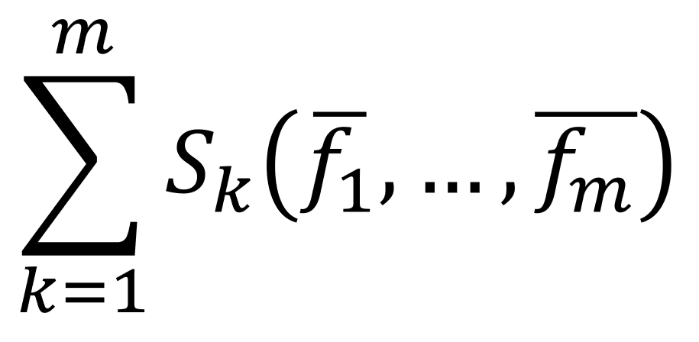
Previous approach: Symmetric polynomials
[Gopalan, Meka, Reingold, Trevisan, Vadhan 2012]
Works best if $f$ is homogeneous, say $\text{deg}\left(f\right)=d$
Recall elementary symmetric polynomials:
$$S_{k}\left(y_{1},…, y_{m}\right)=\sum_{\left|I\right|=k}{\prod_{i∈I}{y_{i}}}$$
$$\tilde{f}=\prod_{i=1}^{m}{\tilde{f_{i}}}=𝔼\left[f\right]⋅\prod_{i=1}^{m}{\left(1+\overline{f_{i}}\right)}=𝔼\left[f\right]+𝔼\left[f\right]⋅\sum_{k=1}^{m}{S_{k}\left(\overline{f_{1}},…,\overline{f_{m}}\right)}$$
Error

Slide 13
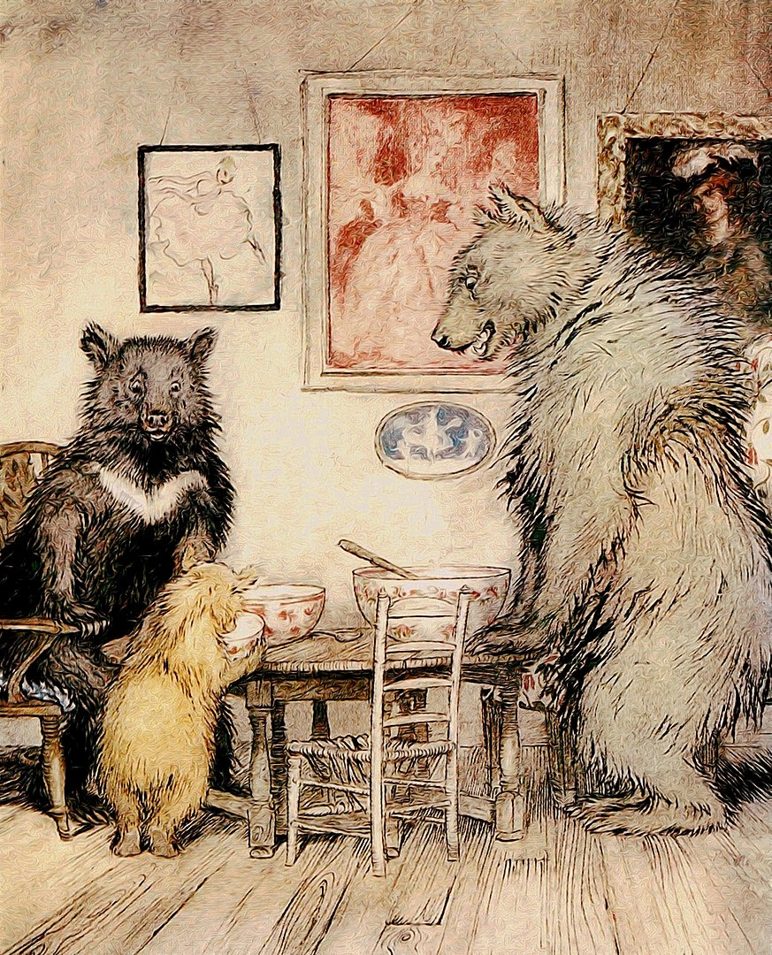
Previous approach to bounding error
Must bound expectation of under small-bias distribution
Let $k_{0}=Θ\left(\frac{\log{n}}{d}\right)$ and consider three regimes
$k≤k_{0}$: Use Fourier $L_{1}$ bound
Assume $m≤3^{d}$ (otherwise use different approach)
# monomials in $S_{k}$: $\left({m \atop k}\right)≤m^{k}≤3^{dk_{0}}≤\text{poly}(n)$
$k≈k_{0}$: Show that w.h.p., $\left|S_{k}\left(\overline{f_{1}},…,\overline{f_{m}}\right)\right|≤\frac{\exp\left(−Ω\left(kd\right)\right)}{\sqrt{k!}}≤\frac{1}{poly\left(n\right)⋅\sqrt{k!}}$
Each bias function has very low variance due to averaging
$k>k_{0}$: Use tail bound for symmetric polynomials
Theorem: If $S_{k_{0}}$ and $S_{k_{0}+1}$ are both near-zero, then subsequent $S_{k}$’s are all near-zero
[Gopalan, Meka, Reingold, Trevisan, Vadhan 2012] [Gopalan, Yehudayoff 2014]

Slide 14
The non-homogeneous case
Partition terms of $f$ into buckets based on degree
Bucket $B_{j}$ contains all terms with degree approximately ${1.1}^{j}$
Within each bucket, there is a good choice of $k_{0}=Θ\left(\frac{\log{n}}{deg}\right)$, so small-bias distribution fools that bucket’s bias function
What about across buckets?

Slide 15
Previous approach: XOR lemma
Generic XOR lemma for small-bias distributions
[Gopalan, Meka, Reingold, Trevisan, Vadhan 2012], [Meka, Reingold, Tal 2019]
Let $\tilde{F_{1}},…, \tilde{F_{Q}}$ be $[−1, 1]$-valued functions on disjoint variables
If $δ$-bias $ε$-fools each $\tilde{F_{j}}$, then ${(δ}^{Q})$-bias fools $\prod_{j=1}^{Q}{\tilde{F_{j}}}$ with error ${16}^{Q}⋅ε$
In our case, $\tilde{F_{j}}=$ bias function of bucket $j$
Penalty: Factor of $Q$ in seed length
$Q=\text{\# }\text{buckets}=O(\log{\log{n}})$

Slide 16
Symmetric polynomials are too blunt
$$\tilde{f}−𝔼[f]=𝔼\left[f\right]⋅\sum_{k=1}^{m}{S_{k}\left(\overline{f_{1}},…,\overline{f_{m}}\right)}$$
Suppose $\text{deg}\left(f\right)=d$ and $k≈k_{0}=Θ\left(\frac{\log{n}}{d}\right)$
Each monomial of $S_{k}$ involves $k$ of the terms $\overline{f_{1}},…,\overline{f_{m}}$
But that’s not exactly the “right” way to count
Each monomial of $S_{k}$ involves $kd=Θ\left(\log{n}\right)$ of the input variables $x_{1},…,x_{n}$
That’s why $k_{0}=Θ\left(\frac{\log{n}}{d}\right)$ is a good choice
$$S_{3}\left(\overline{f_{1}},\overline{f_{2}},\overline{f_{3}},\overline{f_{4}}\right)=\overline{f_{1}}\overline{f_{2}}\overline{f_{3}}+\overline{f_{1}}\overline{f_{2}}\overline{f_{4}} \\ +\overline{f_{1}}\overline{f_{3}}\overline{f_{4}}+\overline{f_{2}}\overline{f_{3}}\overline{f_{4}}$$
$$\overline{f_{1}}\left(x\right)=\frac{1}{16}\begin{matrix} \\ 𝔼 \\ x_{1},x_{2}\end{matrix}\left[\text{AND}\left(x_{1},x_{2},x_{3},x_{4}\right)\right]−1$$

Slide 17
The need for new polynomials
$$\tilde{f}=𝔼\left[f\right]⋅\prod_{i=1}^{m}{\left(1+\overline{f_{i}}\right)}=𝔼\left[f\right]⋅\sum_{I⊆[m]}{\prod_{i}{\overline{f_{i}}}}$$
Organizing using $S_{k}$ lets us keep track of # $\overline{f_{i}}$ participating in each summand
But we want to keep track of # $x_{i}$ participating in each summand
Let’s reorganize using new polynomials

Slide 18
Subset-wise symmetric polynomials
Fix partition $\left[m\right]=B_{1}⊔B_{2}⊔…⊔B_{Q}$
Let $\vec{k}=\left({\vec{k}}_{1},{\vec{k}}_{2},…,{\vec{k}}_{Q}\right)∈ℕ^{Q}$ where $ℕ=$ nonnegative integers
For $y∈ℝ^{m}$,
$$S_{\vec{k}}\left(y\right)≝\sum_{\begin{matrix}I⊆\left[m\right] \\ ∀j,\left|B_{j}∩I\right|={\vec{k}}_{j}\end{matrix}}{\prod_{i∈I}{y_{i}}}$$
Old $S_{k}(y)$: $k=$ “How many $y_{i}$’s in each monomial?”
New $S_{\vec{k}}(y)$: ${\vec{k}}_{j}=$ “How many $y_{i}$’s from $B_{j}$ in each monomial?”

Slide 19
Norm counting input variables
Recall: Bucket $B_{j}$ contains all terms with degree approximately ${1.1}^{j}$
For each $\vec{k}=\left({\vec{k}}_{1},{\vec{k}}_{2},…,{\vec{k}}_{Q}\right)∈ℕ^{Q}$, define
$$\left\|\vec{k}\right\|=\sum_{j=1}^{Q}{{1.1}^{j}⋅{\vec{k}}_{j}}$$
Recall: ${\vec{k}}_{j}$ counts # terms in $B_{j}$ in each monomial of $S_{\vec{k}}\left(\overline{f_{1}},…,\overline{f_{m}}\right)$
So each monomial of $S_{\vec{k}}\left(\overline{f_{1}},…,\overline{f_{m}}\right)$ involves $Θ\left(\left\|\vec{k}\right\|\right)$ of the input variables $x_{1},…,x_{n}$

Slide 20
The new expansion
$$\tilde{f}=𝔼\left[f\right]⋅\prod_{i=1}^{m}{\left(1+\overline{f_{i}}\right)}=𝔼\left[f\right]⋅\sum_{\vec{k}∈ℕ^{Q}}{S_{\vec{k}}\left(\overline{f_{1}},…,\overline{f_{m}}\right)}$$
Split sum at $\left\|\vec{k}\right\|=Θ(\log{n})$
We extend tail bounds for symmetric polynomials to the case of subset-wise symmetric polynomials
No longer need XOR lemma here

Slide 21
Iterating the restriction
Our restriction
Assigns values to a tiny constant fraction of inputs
Preserves the expectation of the formula to within $±\exp\left(−\tilde{Ω}\left(\log{n}\right)\right)$
Costs $O(\log{n})$ truly random bits
We need to assign values to all inputs
Insight: If $f$ only reads $n′$ variables ($n^{′}<n$), restriction should only cost $O(\log{n^{′}})$ truly random bits
Can be justified using “$k$-wise $δ$-bias” distributions

Slide 22
Cheaper and cheaper restrictions
Assume $f$ is homogeneous of degree $d=Θ(\log{n})$
Restriction keeps $p$-fraction of variables alive, $p≈1$
After $i$ restrictions, we should have $\text{deg}≈p^{i}d$
Assume we always have # terms $≤{16}^{deg⁡}$ (otherwise use different approach)
After $i$ restrictions, # relevant variables $=n^{′}≤p^{i}d⋅{16}^{p^{i}d}≤{17}^{p^{i}d}$
So next restriction costs $O\left(\log{n^{′}}\right)=O(p^{i}d)$ truly random bits
Total cost of $t$ restrictions:
$$\sum_{i=0}^{t−1}{C⋅p^{i}d}≤\sum_{i=0}^{∞}{C⋅p^{i}d}=O\left(d\right)=O(\log{n})$$

Slide 23
Our PRG
Iterate our restriction $O(\log{\log{\log{n}}})$ times
At this point there are only $\exp\left(O\left(\frac{\log{n}}{{(\log{\log{n}})}^{2}}\right)\right)$ variables alive
Use prior PRG [Lee 2019] to finish the job

Slide 24
Conclusions
[Gavinsky, Lovett, Srinivasan 2012]: Pseudorandom generators for read-once ${\text{ACC}}^{0}$. In CCC 2012, pages 287-297.
[Gopalan, Meka, Reingold, Trevisan, Vadhan 2012]: Better pseudorandom generators from milder pseudorandom restrictions. In FOCS 2012, pages 120-129.
[Gopalan, Yehudayoff 2014]: Inequalities and tail bounds for elementary symmetric polynomials with applications. arXiv:1402.3543
[Lee 2019]: Fourier bounds and pseudorandom generators for product tests. In CCC 2019, pages 7:1-7:25.
[Lee, Viola 2017]: More on bounded independence plus noise: Pseudorandom generators for read-once polynomials. ECCC TR17-167.
[Luby, Veličković, Wigderson 1993]: Deterministic approximate counting of depth-2 circuits. In ISTCS 1993, pages 18-24.
[Meka, Reingold, Tal 2019]: Pseudorandom generators for width‑3 branching programs. In STOC 2019, pages 626-637.
[Nisan 1990]: Pseudorandom generators for space-bounded computation. In Combinatorica, volume 12, issue 4, pages 449-461, 1992. (Preliminary version in STOC 1990)
[Nisan 1991]: Pseudorandom bits for constant depth circuits. In Combinatorica, volume 11, pages 63-70, 1991.
PRG/HSG for read-once CNFs with optimal seed length $O(\log\left(n/ε\right))$?
Thanks for watching!
Contact us if you have questions!
References
[Ajtai, Wigderson 1985]: Deterministic simulation of probabilistic constant depth circuits. In Advances in Computing Research, volume 5, issue 1, pages 199-222, 1989. (Preliminary version in FOCS 1985)
[Chari, Rohatgi, Srinivasan 1994]: Improved algorithms via approximations of probability distributions. In JCSS, volume 61, issue 1, pages 81-107, 2000. (Preliminary version in STOC 1994)
[De, Etesami, Trevisan, Tulsiani 2010]: Improved pseudorandom generators for depth 2 circuits. In APPROX/RANDOM 2010, pages 504-517.

