Slide 1
Hitting Sets for Regular Branching Programs
CCC 2022
Andrej Bogdanov¹
CUHK
William M. Hoza²
Simons Institute
Gautam Prakriya
CUHK
Edward Pyne³
Harvard $→$ MIT
¹Supported by RGC GRF CUHK 14209419 and CUHK 14209920. Part of the work was completed at the Simons Institute for the Theory of Computing, UC Berkeley.
²This work was done while the author was visiting the Simons Institute for the Theory of Computing.
³Supported by NSF grant CCF-1763299.

Slide 2
Randomness and space complexity
A language is in $\text{BPL}$ if it can be decided by a bounded-error randomized algorithm $A$ that runs in space $O\left(\log{n}\right)$ and always halts
Conjecture: $\text{L}=\text{BPL}$
“Randomness is not necessary for space-efficient computation”
Observation: The function $f\left(x\right)≝A\left(y,x\right)$ can be computed by a poly-width read-once branching program (ROBP)

Slide 3
Read-once branching programs (ROBPs)
$$x=$$
$$1$$
$$0$$
$$0$$
$$1$$
$$0$$
$$1$$
0
1
$$v_{\text{start}}$$
✔️
1
0
1
❌
Computes
$$f:\{0, 1\}^{n}→\{0, 1\}$$
Width $w$
0
1
1
✔️
0
0
0
❌
1
❌
$n+1$ layers ($n=$ length)

Slide 4
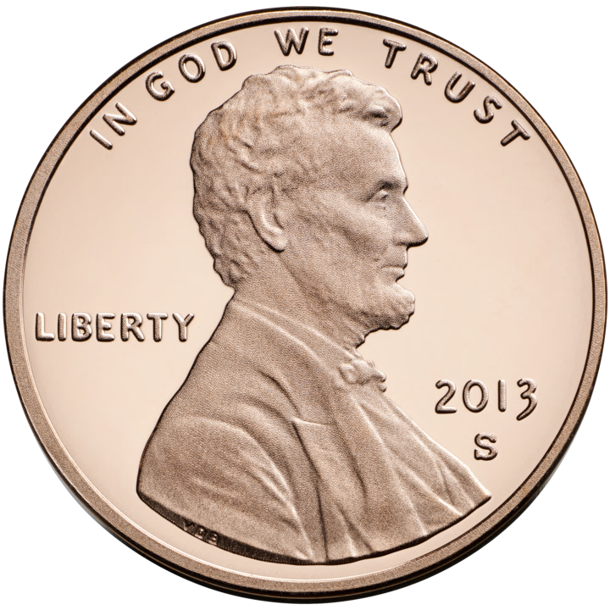
Pseudorandom generators (PRGs)
$G:\{0, 1\}^{s}→\{0, 1\}^{n}$
Want $G$ to fool every width-$w$ ROBP $f$:
$$\left|𝔼\left[f\left(G\left(U_{s}\right)\right)\right]−𝔼\left[f\right]\right|≤ε$$
$∃$ non-explicit PRG with seed length $O\left(\log\left(nw/ε\right)\right)$
Explicit PRG with optimal seed length would imply $\text{L}=\text{BPL}$ 🙂
[Nisan 1990]: $∃$ explicit PRG with seed length
$$O\left(\log{n}⋅\log\left(nw/ε\right)\right)$$

Slide 5
The dependence on $n$ (length)
Seed length of Nisan’s PRG:
$=O\left(\log^{2}{n}+\log{n}⋅\log{w}+\log{n}⋅\log\left(1/ε\right)\right)$
For $w=2$: $∃$ explicit PRG with seed length $O\left(\log\left(n/ε\right)\right)$ 😀 [SZ 1995] [BDVY 2013]
For $w=3$: $∃$ explicit PRG with seed length $\tilde{O}\left(\log{n}⋅\log\left(1/ε\right)\right)$ 🙂 [MRT 2019]
For $w=4$: No explicit PRG is known that is better than Nisan’s PRG 😢
However, we can do better for special types of ROBPs…
$$O\left(\log{n}⋅\log\left(nw/ε\right)\right)$$

Slide 6
Regular ROBPs
An ROBP is regular if every vertex that is not in the first layer has exactly two incoming edges [Braverman, Rao, Raz, Yehudayoff 2010] [De 2011] [Reingold, Steinke, Vadhan 2013] [Lee, Pyne, Vadhan 2022]

Slide 7
Braverman-Rao-Raz-Yehudayoff PRG
Seed length of Nisan’s PRG:
$$O\left(\log^{2}{n}+\log{n}⋅\log{w}+\log{n}⋅\log\left(1/ε\right)\right)$$
This is an improvement when $w≪n$ and $ε≫1/n$
What about large width, e.g., $w=n$?
What about small error, e.g., $ε=1/n$?
Theorem [BRRY 2010]: $∃$ explicit PRG for regular ROBPs with seed length
$$\tilde{O}\left(\log{n}⋅\log{w}+\log{n}⋅\log\left(1/ε\right)\right)$$

Slide 8
Hitting set generators (HSGs)
$G:\{0, 1\}^{s}→\{0, 1\}^{n}$
For every width-$w$ regular ROBP $f$,
$$\text{if} 𝔼\left[f\right]>ε, \text{then} ∃x \text{such} \text{that} f\left(G\left(x\right)\right)=1$$
“One-sided PRG”

Slide 9
HSGs for regular ROBPs
Seed length of BRRY PRG for regular ROBPs:
$$\tilde{O}\left(\log{n}⋅\log{w}+\log{n}⋅\log\left(1/ε\right)\right)$$
Theorem [BRRY 2014]: $∃$ explicit HSG for regular ROBPs with seed length
$$O\left(w⋅\log{n}\right)=O\left(w⋅\log{n}+\log{n}⋅\log\left(1/ε\right)\right)$$
Without loss of generality, we can assume that $\log\left(1/ε\right)<w$
So the real improvement is replacing $\tilde{O}$ with $O$ (a factor of $\log{\log{n}}$)

Slide 10
Contribution 1: Unbounded-width ROBPs
Seed length of BRRY PRG for regular ROBPs:
$$\tilde{O}\left(\log{n}⋅\log{w}+\log{n}⋅\log\left(1/ε\right)\right)$$
Theorem [this work]: $∃$ explicit HSG for unbounded-width regular ROBPs that have only one accept state with seed length $\tilde{O}\left(\log{n}⋅\log\left(1/ε\right)\right)$
Adds to recent work studying “unbounded-width single-accept-state” programs [H, Pyne, Vadhan 2021] [Pyne, Vadhan 2021] [Pyne, Vadhan 2022] [Lee, Pyne, Vadhan 2022]
For programs with $a$ accept states, our seed length is $\tilde{O}\left(\log{n}⋅\log\left(a/ε\right)\right)$

Slide 11
Contribution 2: Low-threshold HSGs
Seed length of BRRY PRG for regular ROBPs:
$$\tilde{O}\left(\log{n}⋅\log{w}+\log{n}⋅\log\left(1/ε\right)\right)$$
Theorem [this work]: $∃$ explicit HSG for regular ROBPs with seed length
$$\tilde{O}\left(\log{n}⋅\log{w}+\log{n}⋅\sqrt{\log\left(1/ε\right)}+\log\left(1/ε\right)\right)$$
E.g., when $ε=1/n$ and $w=2^{O\left(\sqrt{\log{n}}\right)}$, our seed length is $\tilde{O}\left(\log^{3/2}{n}\right)$

Slide 12
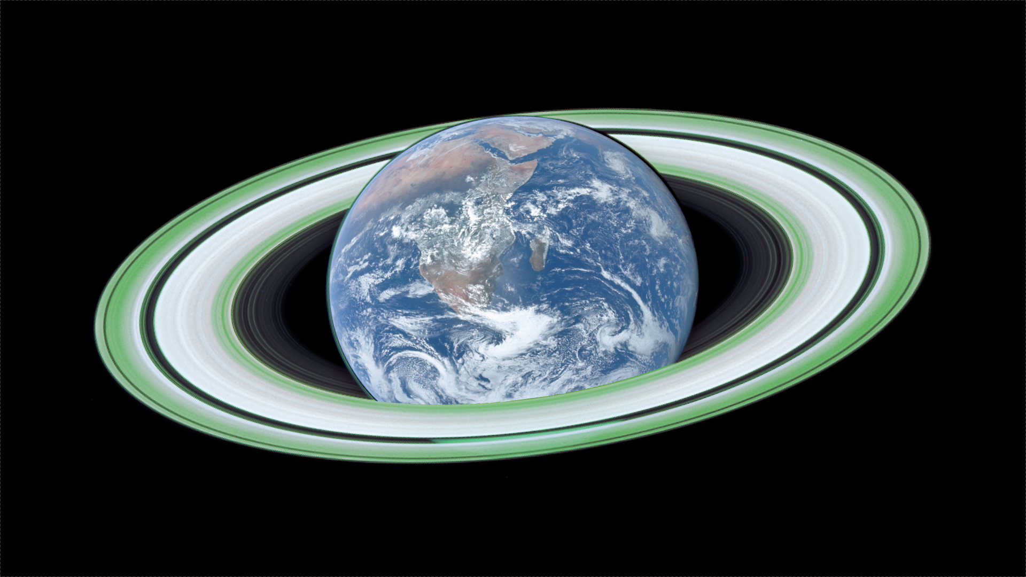
Best of both worlds?
Compared to BRRY:
Our first construction eliminates the $\log{n}⋅\log{w}$ term (assuming only one accept state)
Our second construction improves the $\log{n}⋅\log\left(1/ε\right)$ term
Can we get both improvements simultaneously?

Slide 13
Prior work: Yes, for permutation ROBPs…
A permutation ROBP is a regular ROBP such that incoming edges have distinct labels
Permutation ROBPs have been studied in many prior works [BV 2010] [KNP 2011] [De 2011] [Steinke 2012] [RSV 2013] [CHHL 2018] [HPV 2021] [PV 2021a] [PV 2021b] [PV 2022]
Can Pyne and Vadhan’s result be generalized to regular ROBPs?
Theorem [Pyne, Vadhan 2021]: $∃$ explicit HSG* for unbounded-width, single-accept-state permutation ROBPs with seed length $\tilde{O}\left(\log^{3/2}{n}+\log{n}⋅\sqrt{\log\left(1/ε\right)}+\log\left(1/ε\right)\right)$
*In fact, they construct something stronger than an HSG called a “weighted PRG”

Slide 14
Contribution 3: Reduction to regular ROBPs
Theorem: Let $c$ be a large enough constant.
Assume $∃$ explicit $ε$-HSG for regular ROBPs of width ${\left(nw/ε\right)}^{c}$ and length $c⋅n⋅\log\left(nw/ε\right)$
Then $∃$ explicit $O\left(ε\right)$-HSG for all width-$w$ length-$n$ ROBPs with the same seed length
The proof builds heavily on prior work [Reingold, Trevisan, Vadhan 2006], which proves an analogous theorem in a different setting (“pseudo-converging walks” on digraphs)
Corollary: If we could generalize the Pyne-Vadhan seed length for permutation ROBPs to the case of regular ROBPs, then we would get an explicit HSG for all width-$n$ length-$n$ ROBPs with seed length $\tilde{O}\left(\log^{3/2}{n}\right)$

Slide 15
The optimal parameter regime
Another corollary: If there are explicit HSGs for regular ROBPs with optimal seed length $O\left(\log\left(nw/ε\right)\right)$, then $\text{L}=\text{RL}=\text{BPL}$
(To handle $\text{BPL}$, we combine our reduction with prior work [Cheng, H 2020])

Slide 16
Our two unconditional HSGs
Remainder of this talk: Our two HSGs
Key to both: Analysis of a new branching program model
“Unanimity programs”

Slide 17
Unanimity programs
$$x=$$
$$1$$
$$0$$
$$0$$
$$1$$
$$0$$
$$1$$
$$f\left(x\right)=0$$
0
1
$$v_{\text{start}}$$
✔️
❌
✔️
✔️
❌
❌
✔️
1
0
✔️
✔️
1
✔️
✔️
❌
❌
❌
0
1
1
❌
✔️
❌
✔️
✔️
✔️
✔️
0
0
0
❌
✔️
✔️
❌
❌
✔️
❌
1
✔️
✔️
❌
❌
✔️
✔️
❌
Rule: If every vertex visited is labeled ✔️, then the program outputs 1

Slide 18
Unanimity programs vs. ROBPs
Unanimity programs
ROBPs
A width-$w$ unanimity program can be simulated by a width-$\left(w+1\right)$ ROBP 🥱
However, among regular programs, unanimity makes a big difference
${\text{AND}}_{n}$ can be computed by a width-2 regular unanimity program
${\text{AND}}_{n}$ cannot be computed by a width-$n$ regular ROBP

Slide 19
PRGs for regular unanimity programs
Lemma:
Let $G$ be a PRG for width-$\left(2w\right)$ regular ROBPs with error $ε$
Then $G$ is also a PRG for width-$w$ regular unanimity programs with error $2ε$
Proof strategy: Show that regular unanimity programs can be simulated by randomized regular ROBPs
I.e., we will design a distribution over regular ROBPs

Slide 20
Simulating a regular unanimity program $f(x)$
$$v_{\text{start}}$$
✔️
✔️
❌
✔️
✔️
✔️
✔️
$$\text{rej}\left(x\right) =$$
$$0$$
$$0$$
$$0$$
$$1$$
$$0$$
$$0$$
In general, $\text{rej}(x)∈\{0, 1\}^{n}$ and $f\left(x\right)=1⇔\text{rej}(x)=0^{n}$
Pick $U∈\{0, 1\}^{n}$ uniformly at random and let $g_{U}\left(x\right)=\left\langle \text{rej}(x),U\right\rangle \text{mod} 2$
If $f\left(x\right)=1$, then $\text{rej}(x)=0^{n}$, so $𝔼_{U}\left[g_{U}\left(x\right)\right]=0$
If $f\left(x\right)=0$, then $\text{rej}(x)≠0^{n}$, so $𝔼_{U}\left[g_{U}\left(x\right)\right]=1/2$
Let’s design a regular ROBP that computes $g_{U}(x)$

Slide 21
How to compute $g_{U}\left(x\right)=\left\langle \text{rej}\left(x\right), U\right\rangle \text{mod} 2$
✔️
✔️
✔️
✔️
❌
✔️
❌
✔️
❌
✔️
❌
✔️
❌
❌
$$f$$
❌
✔️
❌
✔️
❌
✔️
❌
✔️
❌
✔️
❌
✔️
✔️
✔️
✔️
✔️
✔️
✔️
✔️
❌
✔️
❌
✔️
❌
✔️
❌
✔️
✔️
$$U =$$
$$0$$
$$1$$
$$0$$
$$0$$
$$1$$
$$0$$

Slide 22
How to compute $g_{U}\left(x\right)=\left\langle \text{rej}\left(x\right), U\right\rangle \text{mod} 2$
✔️
❌
✔️
✔️
❌
❌
✔️
$$f$$
✔️
✔️
✔️
✔️
❌
❌
❌
❌
✔️
❌
✔️
✔️
✔️
✔️
✔️
❌
✔️
✔️
❌
❌
✔️
✔️
✔️
✔️
✔️
❌
❌
❌
❌
✔️
❌
✔️
✔️
✔️
✔️
$$U =$$
$$0$$
$$1$$
$$0$$
$$0$$
$$1$$
$$0$$

Slide 23
How to compute $g_{U}\left(x\right)=\left\langle \text{rej}\left(x\right), U\right\rangle \text{mod} 2$
✔️
✔️
✔️
✔️
❌
❌
❌
❌
✔️
✔️
❌
✔️
✔️
❌
❌
❌
❌
✔️
✔️
✔️
❌
✔️
✔️
❌
If $f$ is regular, then so is $g_{U}$
✔️
✔️
✔️
✔️
❌
❌
❌
✔️
✔️
✔️
✔️
✔️
✔️
❌
❌
❌
❌
✔️
✔️
❌
✔️
✔️
✔️
✔️
$$U =$$
$$0$$
$$1$$
$$0$$
$$0$$
$$1$$
$$0$$

Slide 24
Completing the proof of the lemma
Lemma:
Let $G$ be a PRG for width-$\left(2w\right)$ regular ROBPs with error $ε$
Then $G$ is also a PRG for width-$w$ regular unanimity programs with error $2ε$
We showed $f\left(x\right)=1−2𝔼_{U}\left[g_{U}\left(x\right)\right]$
$G$ fools every $g_{U}$, so it also fools $f$

Slide 25
Why the lemma is useful

Slide 26
Unbounded-width regular ROBPs
(Refinement of prior arguments by [H, Pyne, Vadhan 2021])
We show that $∃$ bounded-width $\tilde{f}$ that approximates $f$
Say a vertex $v$ is “typical” if $p_{→v}>ε$
Let $\tilde{f}\left(x\right)=1⇔\left(f\left(x\right)=1 \text{and} f\left(x\right) \text{only} \text{visits} \text{typical} \text{vertices}\right)$
There are fewer than $1/ε$ typical vertices in each layer
We show that $\tilde{f}$ can be computed by a regular unanimity program of width $O\left(1/ε\right)$
We also show that $\underset{x}{Pr}\left[\tilde{f}\left(x\right)≠f\left(x\right)\right]≤ε$

Slide 27
Low-threshold HSG
(Refinement of prior arguments by [H, Zuckerman 2018])
We want to find a path from $v_{start}$ to an accepting vertex (✔️)
Easier: Let’s find a path from $v_{start}$ to an “auspicious” vertex
(Say a vertex is “auspicious” if $p_{v→}≥Kε$ where $K=2^{\sqrt{\log\left(1/ε\right)}}$)
$∃$ width-$w$ regular unanimity program $g$ such that
$$g\left(x\right)=0⇔f\left(x\right) \text{visits} \text{an} \text{auspicious} \text{vertex}$$
We show that $\underset{x}{Pr}\left[f\left(x\right) \text{visits} \text{an} \text{auspicious} \text{vertex}\right]≥Ω\left(1/K\right)$
Fool $g$ with error $Θ\left(1/K\right)⇒$ visit auspicious vertex with probability $Ω\left(1/K\right)$

Slide 28
Summary
We present two improved HSGs for regular ROBPs
The first HSG is tailored to the large-width regime, e.g., $w=n$
The second HSG is tailored to the low-threshold regime, e.g., $ε=1/n$
If we could achieve both improvements simultaneously, we would get improved HSGs for all ROBPs (a breakthrough)
Thanks for watching!

