Slide 1
Improved Derandomization of Space-Bounded Computation
William Hoza
PhD Proposal
Advisor: David Zuckerman

Slide 2
Coins are costly (duh)
Randomness is an expensive computational resource
Like time or space
Using less randomness is better than using more randomness

Slide 3
No known efficient algorithm
Efficient randomized algorithm
Efficient deterministic algorithm

Slide 4
Randomized space-bounded algorithms
Language $L$ is in $\text{BPSPACE}(S)$ if there is a space-$O(S)$ algorithm $A$ such that
$x∈L⇒\text{Pr}\left[A\left(x\right)=1\right]≥\frac{2}{3}$
$x∉L⇒\text{Pr}\left[A\left(x\right)=1\right]≤\frac{1}{3}$
$A$ always halts
$A$ reads each random bit only once.

Slide 5
Power of randomness?
Conjecture: $∀S≥\log{n},$
$\text{DSPACE}\left(S\right)=\text{BPSPACE}(S)$
“Randomness is not necessary for space-efficient computation”
By padding, sufficient to consider $S=\log{n}$:
$$\text{L}\overset{?}{=}\text{BPL}$$

Slide 6
Read-once branching programs (ROBPs)
Read-once
$$x=$$
$$1$$
$$0$$
$$0$$
$$1$$
$$0$$
$$1$$
This is the big difference between $\text{BPL}$ and $\text{BPP}$
0
1
$$v_{\text{acc}}$$
$$v_{\text{start}}$$
1
0
1
Computes
$$f:\{0, 1\}^{n}→\{0, 1\}$$
Width
0
1
1
0
0
0
1
$$V_{0}$$
$$V_{1}$$
$$V_{2}$$
$$⋯$$
$$V_{n}$$

Slide 7
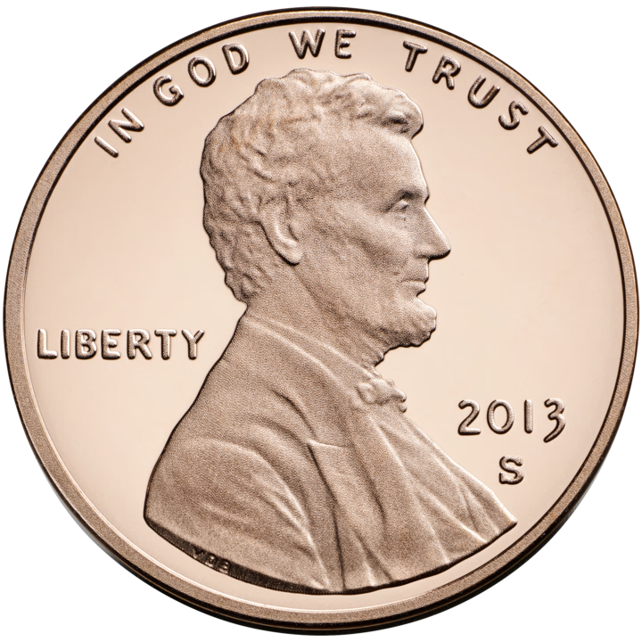
Pseudorandom generators (PRGs)
$G:\{0, 1\}^{s}→\{0, 1\}^{n}$
$G$ fools $f:\{0, 1\}^{n}→\{0, 1\}$ if
$$\left|𝔼\left[f\left(G\left(U_{s}\right)\right)\right]−𝔼\left[f\right]\right|≤ε.$$
$∃$ nonexplicit PRG fooling poly-width ROBPs with seed length $O(\log\left(n/ε\right))$
Matching explicit construction $⇒$ $\text{L}=\text{BPL}$
Stuck at [Nisan 1990]: Seed length $O\left(\log\left(n/ε\right)\log{n}\right)$

Slide 8
My thesis research
Near-optimal PRGs for increasingly powerful models of computation

Slide 9
Can “simulate” $\text{BPL}$
Poly-Width Arbitrary-Order ROBPs
Poly-Width ROBPs
More powerful models
Poly-Width Regular ROBPs
Read-Once De Morgan Formulas
Constant-Width Arbitrary-Order ROBPs
Poly-Width Permutation ROBPs
Read-Once ${\text{AC}}^{0}[⊕]$
Constant-Width Arbitrary-Order Monotone ROBPs
Constant-Width ROBPs
O(1)-Accept-Vertex Poly-Width Permutation ROBPs
[upcoming joint work]
Width-3 Arbitrary-Order ROBPs
[MRT19]
Read-Once ${\text{AC}}^{0}$
[DHH19]
Read-Once Polynomials
[LV17, MRT19, Lee19, DHH20]
Constant-Width Regular ROBPs
[BRRY10, De11]
Width-3 ROBPs
[MRT19]
Explicit PRGs known with seed length $\tilde{O}(\log{n})$
Constant-Width Arbitrary-Order Permutation ROBPs
[CHHL18]
Width-2 Arbitrary-Order ROBPs
[SZ95, BDVY13]
Read-Once CNFs
[DETT10, GMRTV12, DHH20]
Constant-Width Permutation ROBPs
[KNP11, De11, Ste12]
Width-2 ROBPs
[SZ95, BDVY13]
Parities
[NN93, …]
Conjunctions
[NN93, …]

Slide 10
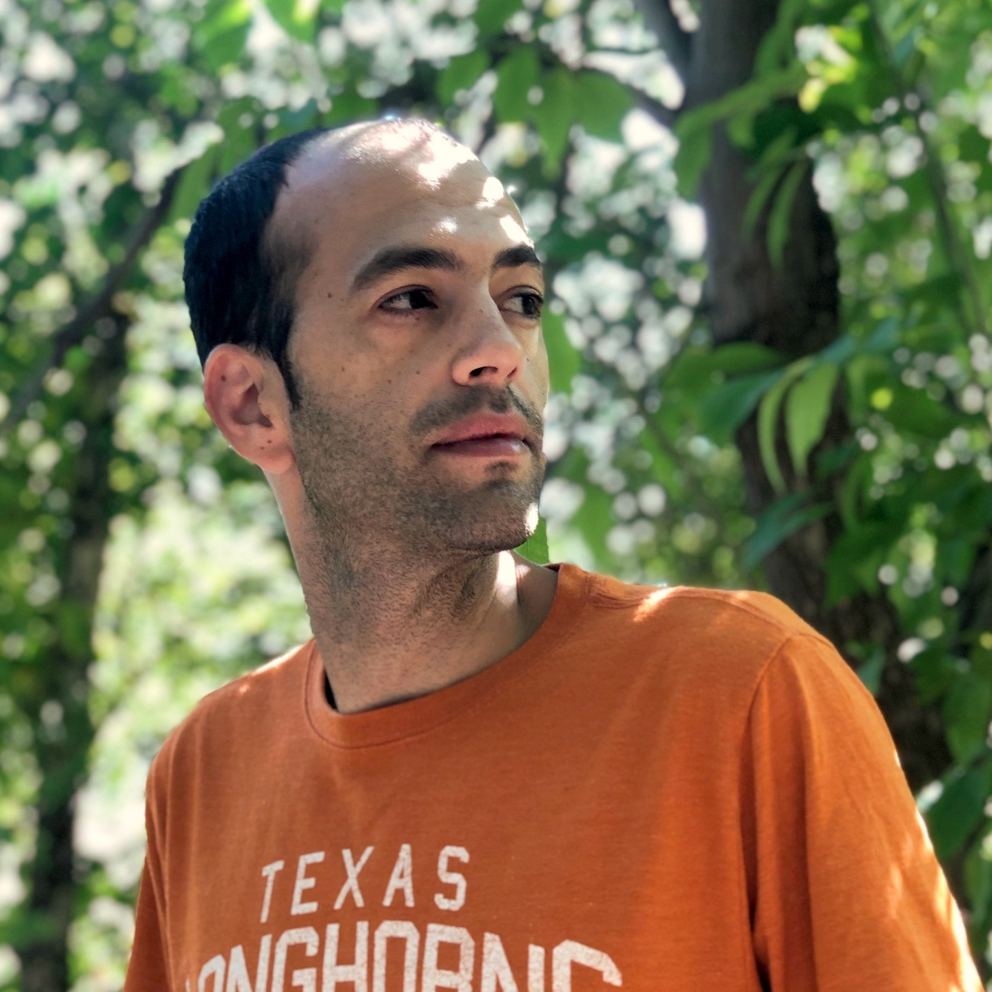
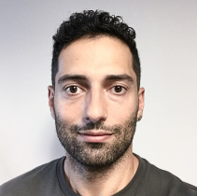
Near-Optimal Pseudorandom Generators
for Constant-Depth Read-Once Formulas
In CCC 2019
Joint work with:
Dean Doron
Stanford
Pooya Hatami
Ohio State University

Slide 11
Read-once ${\text{AC}}^{0}$
$$∧$$
$$∨$$
$$∨$$
$$∧$$
$$∧$$
$$∧$$
$$∧$$
$$∧$$
$$x_{3}$$
$$x_{1}$$
$${¬x}_{2}$$
$$x_{8}$$
$${¬x}_{6}$$
$$x_{5}$$
$$x_{11}$$
$${¬x}_{4}$$
$${¬x}_{9}$$
$$x_{7}$$
$$x_{10}$$

Slide 12
PRGs for read-once ${\text{AC}}^{0}$
Seed length | Model fooled | Reference
$$O(n^{0.001})$$ | $${\text{AC}}^{0}$$ | Ajtai, Wigderson 1989
$$O(\log^{2d+6}{n})$$ | $${\text{AC}}^{0}$$ | Nisan 1991
$$\tilde{O}(\log^{d+4}{n})$$ | $${\text{AC}}^{0}$$ | Trevisan, Xue 2013
$$\tilde{O}(\log^{d+1}{n})$$ | Read-once ${\text{AC}}^{0}$ | Chen, Steinke, Vadhan 2015
$$\tilde{O}(\log^{2}{n})$$ | Arbitrary-order constant-width ROBPs | Forbes, Kelley 2018
$$\tilde{O}(\log{n})$$ | Read-once ${\text{AC}}^{0}$ | Doron, Hatami, H 2019
$d=$ depth
Theorem [joint with Dean Doron and Pooya Hatami]:
$∃$ explicit PRG for read-once ${\text{AC}}^{0}$ with seed length
$$\log\left(n/ε\right)⋅O{\left(d\log{\log\left(n/ε\right)}\right)}^{2d+2}$$

Slide 13
Pseudorandom restriction
Assume by recursion: PRG for depth $d$ with seed length $\tilde{O}(\log{n})$
Let’s sample $X∈\{0, 1, ⋆\}^{n}$ for depth $d+1$
Recursively sample $G_{d},G_{d}^{′}∈\{0, 1\}^{n}$
Sample $D, D^{′}∈\{0,1\}^{n}$ from small-bias distribution
For $y, z∈\{0, 1\}^{n}$, define $\text{Res}\left(y, z\right)∈\{0, 1, ⋆\}^{n}$ by replacing $y_{i}$ with $⋆$ whenever $z_{i}=1$
$X=\text{Res}\left(G_{d}⊕D,G_{d}^{′}⊕D′\right)$ (seed length $\tilde{O}(\log{n})$)

Slide 14
Forbes-Kelley: Restriction preserves $𝔼[f]$
Theorem [Forbes, Kelley 2018]: Let $X=\text{Res}(Y, Z)$, where $Y$ and $Z$ are independent and have small bias. For any constant-width ROBP $f$,
$$\begin{matrix} \\ 𝔼 \\ X,U\end{matrix}\left[f{\left.​\right|}_{X}\left(U\right)\right]≈𝔼\left[f\right]$$
$$X=\text{Res}\left(G_{d}⊕D,G_{d}^{′}⊕D^{′}\right)$$
Can simulate read-once ${\text{AC}}^{0}$

Slide 15
Forbes-Kelley PRG
Restriction assigns values to half the variables
Repeat $O(\log{n})$ times $⇒$ assign values to all variables
$⇒$ PRG with seed length $\tilde{O}(\log^{2}{n})$
We want to do better

Slide 16
Simplification under pseudorandom restrictions
Let $f$ be a read-once ${\text{AC}}^{0}$ formula
Let $R=\text{Res}(U_{n}, U_{n}^{′})$ (“truly random restriction”)
Complexity measure: $Δ(f)≝$ maximum fan-in of any gate other than root
[Chen, Steinke, Vadhan 2015] $⇒$ for $t=\text{poly}(\log{\log{n}})$,
$$\text{P}\text{r}\left["Δ\left(f{\left.​\right|}_{R^{∘t}}\right)≤\text{polylog} n"\right]≈1$$
We show that the same holds for our pseudorandom restriction $X$
Simplification is in read-once ${\text{AC}}^{0}$ (sort of)
$$X=\text{Res}\left(G_{d}⊕D,G_{d}^{′}⊕D^{′}\right)$$

Slide 17
Fooling the simpler formula
$$∧$$
When $Δ$ is small, prior PRG [Meka, Reingold, Tal 2019] fools formula with seed length $\tilde{O}(\log{n})$

Slide 18
Can “simulate” $\text{BPL}$
Poly-Width Arbitrary-Order ROBPs
Poly-Width ROBPs
More powerful models
Poly-Width Regular ROBPs
Read-Once De Morgan Formulas
Constant-Width Arbitrary-Order ROBPs
Poly-Width Permutation ROBPs
Read-Once ${\text{AC}}^{0}[⊕]$
Constant-Width Arbitrary-Order Monotone ROBPs
Constant-Width ROBPs
O(1)-Accept-Vertex Poly-Width Permutation ROBPs
[upcoming joint work]
Width-3 Arbitrary-Order ROBPs
[MRT19]
Read-Once ${\text{AC}}^{0}$
[DHH19]
Read-Once Polynomials
[LV17, MRT19, Lee19, DHH20]
Constant-Width Regular ROBPs
[BRRY10, De11]
Width-3 ROBPs
[MRT19]
Explicit PRGs known with seed length $\tilde{O}(\log{n})$
Constant-Width Arbitrary-Order Permutation ROBPs
[CHHL18]
Width-2 Arbitrary-Order ROBPs
[SZ95, BDVY13]
Read-Once CNFs
[DETT10, GMRTV12, DHH20]
Constant-Width Permutation ROBPs
[KNP11, De11, Ste12]
Width-2 ROBPs
[SZ95, BDVY13]
Parities
[NN93, …]
Conjunctions
[NN93, …]

Slide 19
Additional PRG results
Theorem [Doron, Hatami, H 2019]: $∃$ explicit PRG for read-once ${\text{AC}}^{0}[⊕]$ with seed length
$$\tilde{O}\left(t+\log\left(n/ε\right)\right)$$
where $t=$ # of parity gates
Theorem [Doron, Hatami, H 2020]: $∃$ explicit PRG for read-once depth-2 ${\text{AC}}^{0}\left[⊕\right]$ with seed length
$$O\left(\log{n}\right)+\tilde{O}\left(\log\left(1/ε\right)\right)$$

Slide 20
Future near-log-seed PRG research

Slide 21
Can “simulate” $\text{BPL}$
Poly-Width Arbitrary-Order ROBPs
Poly-Width ROBPs
More powerful models
Poly-Width Regular ROBPs
Read-Once De Morgan Formulas
Constant-Width Arbitrary-Order ROBPs
Poly-Width Permutation ROBPs
Read-Once ${\text{AC}}^{0}[⊕]$
Constant-Width Arbitrary-Order Monotone ROBPs
Constant-Width ROBPs
O(1)-Accept-Vertex Poly-Width Permutation ROBPs
[upcoming joint work]
Width-3 Arbitrary-Order ROBPs
[MRT19]
Read-Once ${\text{AC}}^{0}$
[DHH19]
Read-Once Polynomials
[LV17, MRT19, Lee19, DHH20]
Constant-Width Regular ROBPs
[BRRY10, De11]
Width-3 ROBPs
[MRT19]
Explicit PRGs known with seed length $\tilde{O}(\log{n})$
Constant-Width Arbitrary-Order Permutation ROBPs
[CHHL18]
Width-2 Arbitrary-Order ROBPs
[SZ95, BDVY13]
Read-Once CNFs
[DETT10, GMRTV12, DHH20]
Constant-Width Permutation ROBPs
[KNP11, De11, Ste12]
Width-2 ROBPs
[SZ95, BDVY13]
Parities
[NN93, …]
Conjunctions
[NN93, …]

Slide 22
My thesis research
Near-optimal PRGs for increasingly powerful models of computation
Improved black-box derandomizations (relaxations of PRGs) for ROBPs

Slide 23
Pseudorandom pseudodistributions
A PRG is a function $G:\{0, 1\}^{d}→\{0, 1\}^{n}$ such that for all $f∈ℱ$,
$$\left|𝔼\left[f\left(G\left(U_{d}\right)\right)\right]−𝔼\left[f\right]\right|≤ε$$
[Braverman, Cohen, Garg 2018] A pseudorandom pseudodistribution (PRPD) is a pair $(G,ρ)$ where $ρ:\{0, 1\}^{d}→ℝ$ and
$$\left|𝔼_{x}\left[f\left(G\left(x\right)\right)ρ\left(x\right)\right]−𝔼\left[f\right]\right|≤ε$$
$ε$-PRG $⇒$ $ε$-PRPD because we can take $ρ=1$

Slide 24
Deterministic samplers
[Braverman, Cohen, Garg 2018] A pseudorandom pseudodistribution (PRPD) is a pair $(G,ρ)$ where $ρ:\{0, 1\}^{d}→ℝ$ and
$$\left|𝔼_{x}\left[f\left(G\left(x\right)\right)ρ\left(x\right)\right]−𝔼\left[f\right]\right|≤ε$$
[Cheng, H 2020] A deterministic sampler is a det algorithm $A$ that makes queries to $f$ and outputs $A^{f}∈ℝ$ such that $\left|A^{f}−𝔼\left[f\right]\right|≤ε$
$ε$-PRPD $⇒$ deterministic $ε$-sampler because we can set
$$A^{f}=2^{−d}\sum_{x∈\{0, 1\}^{d}}{f\left(G\left(x\right)\right)ρ(x)}$$

Slide 25
Hitting set generators (HSGs)
[Cheng, H 2020] A deterministic sampler is a det algorithm $A$ that makes queries to $f$ and outputs $A^{f}∈ℝ$ such that $\left|A^{f}−𝔼\left[f\right]\right|≤ε$
A hitting set generator (HSG) is a function $G$ such that if $𝔼\left[f\right]≥ε$, then there is at least one seed $x$ such that $f\left(G\left(x\right)\right)=1$
Deterministic $ε$-sampler $⇒$ $O(ε)$-HSG, because if $𝔼\left[f\right]>2ε$, then $A^{f}≠A^{0}$
(Assume $0∈ℱ$)

Slide 26
Relationships between derandomization goals
Distinguishing $𝔼\left[f\right]=0$ vs. $𝔼\left[f\right]≥ε$
HSG
Estimating $𝔼\left[f\right]±ε$
Deterministic sampler
PRPD
PRG

Slide 27
Simple Optimal Hitting Sets for Small-Success RL
To appear in SICOMP; preliminary version in FOCS 2018
Joint work with:
David Zuckerman
UT Austin

Slide 28
HSGs for width-$n$ length-$n$ ROBPs
Seed length | Type of generator | Reference
$$2^{O\left(\sqrt{\log{n}}\right)}⋅log⁡(1/ε)$$ | PRG | Babai, Nisan, Szegedy 1989
$$O\left(\log^{2}{n}+\log{n}\log\left(1/ε\right)\right)$$ | PRG | Nisan 1990, …
$$\tilde{O}\left(\log^{2}{n}+\log\left(1/ε\right)\right)$$ | PRPD | Braverman, Cohen, Garg 2018
$$O(\log^{2}{n}+\log\left(1/ε\right))$$ | HSG | H, Zuckerman 2018
$$\tilde{O}\left(\log^{2}{n}\right)+O(\log\left(1/ε\right))$$ | PRPD | Chattopadhyay, Liao 2020
Theorem [joint with David Zuckerman]:
$∃$ explicit HSG for width-$n$ length-$n$ ROBPs with seed length $O\left(\log^{2}{n}+\log\left(1/ε\right)\right)$.

Slide 29
Structural lemma for ROBPs
6% chance of accept
Let $f$ be a width-$n$ length-$n$ ROBP with $𝔼\left[f\right]=ε≪1/n^{3}$
Lemma: $∃$ vertex $u$ such that
$$\operatorname{Pr}\left[\text{reach} u\right]≥\frac{1}{2n^{3}} \text{and} \operatorname{Pr}\left[\text{accept} | \text{reach} u\right]≥εn$$
Proof: Say $u$ is a milestone if $\operatorname{Pr}\left[\text{accept} | \text{reach} u\right]∈[εn,2εn]$
Every accepting path passes through a milestone, because acceptance probability at most doubles in each step
$$ε=\operatorname{Pr}\left[\text{accept}\right]≤\sum_{u milestone}{\operatorname{Pr}\left[\text{reach} u \text{and} \text{accept}\right]} \\ \frac{1}{2n}≤\sum_{u milestone}{\operatorname{Pr}\left[\text{reach} u\right]⋅2εn}$$
3% chance of accept
0% chance of accept

Slide 30
Iterating the structural lemma
$$u_{0}=v_{start}$$
$$v_{acc}=u_{t}$$
$$u_{2}$$
$$u_{1}$$
$$u_{3}$$
$$\operatorname{Pr}\left[\text{accept}\right]=ε$$
$$nε$$
$$n^{2}ε$$
$$n^{3}ε$$
$$n^{t}ε=1$$

Slide 31
Idea of our HSG
Use Nisan’s PRG for each individual hop $u_{i}→u_{i+1}$
Use a disperser to recycle the seed from one hop to the next

Slide 32
Additional black-box derandomization results
Regime | Type of derandomization | Seed length / space complexity | Reference
$$w=n$$ | HSG | $$O\left(\log^{2}{n}+\log\left(1/ε\right)\right)$$ | H, Zuckerman 2018
$$n=\text{polylog} w$$ | HSG | $$O\left(\log\left(w/ε\right)\right)$$ | H, Zuckerman 2018
$$w=O(1)$$ | Deterministic sampler | $$O\left(\log^{2}{n}+\log\left(1/ε\right)\right)$$ | Cheng, H 2020
$w=$width
$n=$ length

Slide 33
Future black-box-derandomization research
Optimal PRPDs for ROBPs in regime length $≤\text{polylog}$width?
Better HSGs for width-4 ROBPs?

Slide 34
My thesis research
Near-optimal PRGs for increasingly powerful models of computation
Improved black-box derandomizations (relaxations of PRGs) for ROBPs
New derandomization methods for $\text{BPL}$ that go beyond black-box techniques

Slide 35
Beyond black-box methods
PRGs, PRPDs, deterministic samplers, hitting sets…
All imply black-box derandomization
A nice feature, but it suggests we have room for improvement
We’re fighting with our hands tied behind our backs
Why not take a peek at the ROBP? Maybe we can get an advantage!
Precedent: $\text{BPL}⊆\text{DSPACE}(\log^{3/2}{n})$, $\text{BPL}⊆\text{SC}$

Slide 36
Hitting Sets Give Two-Sided Derandomization of Small Space
In CCC 2020; invited to ToC special issue
Joint work with:
Kuan Cheng
UT Austin $→$ Peking University

Slide 37
Relationships between derandomization goals
Distinguishing $𝔼\left[f\right]=0$ vs. $𝔼\left[f\right]≥ε$
?
HSG
Estimating $𝔼\left[f\right]±ε$
Deterministic sampler
PRPD
PRG

Slide 38
Using HSGs
Trivial: Explicit HSGs $⇒$ derandomization of $\text{RP}$, $\text{RL}$, etc.
Theorem [Andreev, Clementi, Rolim 1996]: If $∃$ poly-time HSG for size-$n$ circuits with seed length $O(\log{n})$, then $\text{P}=\text{BPP}$
Theorem [joint with Kuan Cheng]:
If $∃$ log-space HSG for width-$n$ length-$n$ ROBPs with seed length $O\left(\log{n}\right)$, then $\text{L}=\text{BPL}$

Slide 39
Estimated visit probabilities
Let $f$ be a width-$n$ length-$n$ ROBP
Let $t=\tilde{O}\left(n^{6}/ε^{2}\right)$
Let’s use an HSG $G:\{0, 1\}^{s}→\{0, 1\}^{n^{3}t}$ to estimate $𝔼\left[f\right]±ε$
Think of $x∈\{0, 1\}^{n^{3}t}$ as a list of $n$-bit sample inputs: $t$ per vertex
Define ${\hat{p}}_{→v}(x)$ to be the fraction of $v$’s sample inputs that cause $f$ to visit $v$

Slide 40
Algorithm for estimating $𝔼\left[f\right]±ε$
Hope: $∀v, {\hat{p}}_{→v}\left(x\right)≈p_{→v}$ (accuracy)
Find seed $y$ such that $G(y)$ is locally consistent, i.e.,
$$∀i, ∀v∈V_{i}, {\hat{p}}_{→v}\left(G\left(y\right)\right)≈\sum_{u∈V_{i−1}}{{\hat{p}}_{→u}\left(G\left(y\right)\right)⋅p_{u→v}}$$
Output ${\hat{p}}_{v_{acc}}\left(G\left(y\right)\right)$
Accuracy can be checked by a poly-width ROBP (hard-code $p_{→v}$)
A random $x$ is accurate w.h.p., so $∃y$ such that $G(y)$ is accurate
Accuracy $⇒$ Local Consistency $⇒$ Accuracy

Slide 41
Additional non-black-box results
Theorem [H, Zuckerman 2018]:
$$\left(ε\text{-}\text{success} \text{RL}\right)⊆\text{DSPACE}\left(\log^{3/2}{n}+\log{n}\log{\log\left(1/ε\right)}\right)$$
Theorem [H 2019]: $∀L∈\text{BPTISP}\left(\tilde{O}\left(n\right),\log{n}\right)$, $∃$ deterministic log-space algorithm that correctly decides $L$ on most inputs of each length

Slide 42
Future research on non-black-box methods
Combine [Cheng, H 2020] with [Saks, Zhou 1995]? (Hopefully get improved conditional two-sided derandomization assuming non-optimal HSG)
$\text{RL}$ vs. $\text{coRL}$?
Spectral methods?

Slide 43
Conclusions
PRG research continues to be fruitful and promising
The gold standard of derandomization
Relaxations of PRGs are easier to construct
PRPDs, Deterministic Samplers, HSGs
Looking inside the ROBP can give an advantage
The key to $\text{L}=\text{BPL}$?
Thanks for listening!

