Slide 1
Derandomizing Space-Bounded Computation via Pseudorandom Generators and their Generalizations
PhD Defense
June 4, 2021
Student: William Hoza
Advisor: David Zuckerman
Supported by the NSF GRFP under Grant DGE-1610403 and by a Harrington Fellowship from UT Austin.

Slide 2
Coins are costly
Randomness is an expensive computational resource
Like time or space
Using less randomness is better than using more randomness

Slide 3
😢
🙂
😄
No known efficient algorithm
Efficient randomized algorithm
Efficient deterministic algorithm

Slide 4
Randomized space-bounded algorithms
Language $L$ is in $\text{BPSPACE}(S)$ if $∃$ randomized algorithm $A$ such that
$x∈L⇒\text{Pr}\left[A\left(x\right)=1\right]≥\frac{2}{3}$
$x∉L⇒\text{Pr}\left[A\left(x\right)=1\right]≤\frac{1}{3}$
$A$ uses $O(S)$ bits of space and always halts
$A$ reads each random bit only once

Slide 5
Power of randomness?
Conjecture: $∀S≥\log{n},$
$\text{DSPACE}\left(S\right)=\text{BPSPACE}(S)$
“Randomness is not necessary for space-efficient computation”
Logarithmic case ($\text{L}=\text{BPL}$) implies general case
This dissertation: Progress toward proving $\text{L}=\text{BPL}$

Slide 6
Part I: Pseudorandom Generators

Slide 7
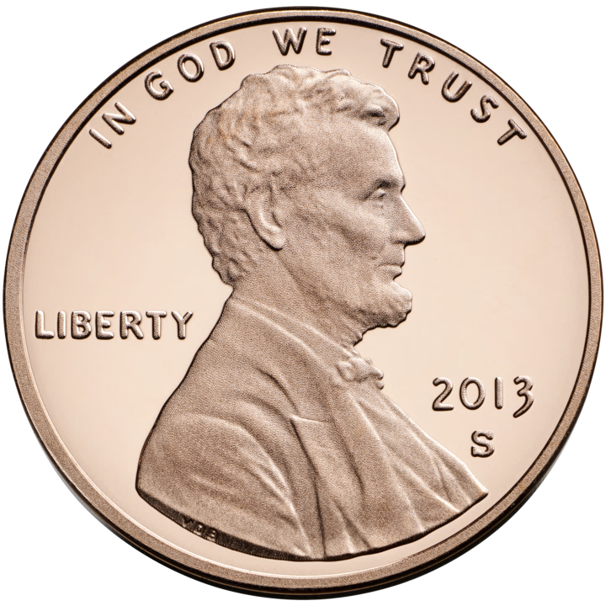
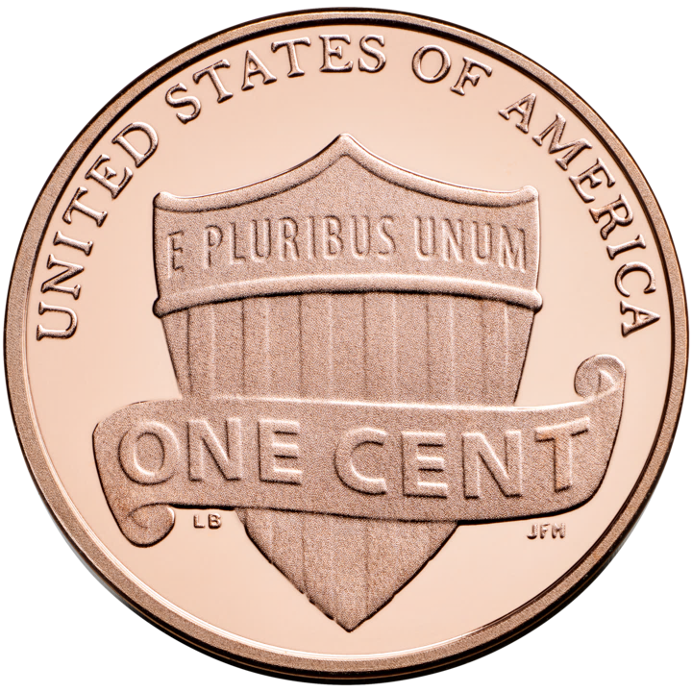
Pseudorandom generators (PRGs)
$G:\{0, 1\}^{s}→\{0, 1\}^{n}$
$G$ fools $f:\{0, 1\}^{n}→\{0, 1\}$ if
$$\left|𝔼\left[f\left(G\left(U_{s}\right)\right)\right]−𝔼\left[f\right]\right|≤ε$$
Want PRGs that fool entire classes of functions with smallest possible seed length

Slide 8
Read-once branching programs (ROBPs)
$$x=$$
$$1$$
$$0$$
$$0$$
$$1$$
$$0$$
$$1$$
0
1
$$v_{\text{acc}}$$
$$v_{\text{start}}$$
1
0
1
Computes
$$f:\{0, 1\}^{n}→\{0, 1\}$$
Width
0
1
1
0
0
0
1
$n+1$ layers ($n=$ length)

Slide 9
Using PRGs for derandomization
Let $A$ be a randomized log-space algorithm and let $y$ be an input
The function $f\left(x\right)≝A\left(y,x\right)$ can be computed by a poly-width ROBP
PRG that fools such programs $⇒$ deterministically estimate acceptance probability:
$$𝔼\left[f\right]≈2^{−s}⋅\sum_{x∈\{0, 1\}^{s}}{f\left(G\left(x\right)\right)}$$
$∃$ nonexplicit PRG fooling poly-width ROBPs with seed length $O(\log\left(n/ε\right))$
Matching explicit construction would imply $\text{L}=\text{BPL}$ 🙂
Best explicit PRG [Nisan 1990]: Seed length $O\left(\log^{2}{n}+\log\left(1/ε\right)⋅\log{n}\right)$ 😢

Slide 10
PRGs for models related to $\text{L}$ vs. $\text{BPL}$
More luck with PRGs for special cases and related models
Hope:
Develop PRG-related skills and knowledge
Eventually we can design a better PRG for poly-width ROBPs
Popular research paradigm, especially in last 10 years

Slide 11
Can “simulate” $\text{BPL}$
Poly-Width Arbitrary-Order ROBPs
Poly-Width ROBPs
More powerful models
Poly-Width Regular ROBPs
Constant-Width Arbitrary-Order ROBPs
Read-Once ${\text{TC}}^{0}$
Poly-Width Permutation ROBPs
Read-Once ${\text{AC}}^{0}[⊕]$
Constant-Width Arbitrary-Order Monotone ROBPs
[DMRTV21]
Constant-Width ROBPs
O(1)-Accept-Vertex Poly-Width Permutation ROBPs
[HPV21]
Width-3 Arbitrary-Order ROBPs
[MRT19]
Read-Once ${\text{AC}}^{0}$
[DHH19]
Read-Once Polynomials
[LV17, MRT19, Lee19, DHH20]
Constant-Width Regular ROBPs
[BRRY10, De11]
Width-3 ROBPs
[MRT19]
Explicit PRGs known with seed length $\tilde{O}(\log{n})$
Constant-Width Arbitrary-Order Permutation ROBPs
[CHHL18]
Width-2 Arbitrary-Order ROBPs
[SZ95, BDVY13]
Read-Once CNFs
[DETT10, GMRTV12, DHH20]
Constant-Width Permutation ROBPs
[KNP11, De11, Ste12]
Width-2 ROBPs
[SZ95, BDVY13]
Parities
[NN93, …]
Conjunctions
[NN93, …]

Slide 12
Pseudorandom Generators for
Unbounded-Width Permutation Branching Programs
In ITCS 2021
Joint work with:
Edward Pyne
Harvard
Salil Vadhan
Harvard

Slide 13
Permutation ROBPs
Assumption: No collisions among edges with the same label
Model of reversible computation
Permutation $⇒$ “regular” (degree = 2)
Much prior research on PRGs for permutation / regular ROBPs [Brody, Verbin 2010] [De 2011] [Koucký, Nimbhorkar, Pudlák 2011] [Steinke 2012] [Reingold, Steinke, Vadhan 2013] [Braverman, Rao, Raz, Yehudayoff 2014] [Chattopadhyay, Hatami, Hosseini, Lovett 2019]
For constant-width permutation ROBPs, prior work achieves seed length
$$O\left(\log{n}⋅\log\left(1/ε\right)\right)$$
0
0
0
0
0

Slide 14
What about wider programs?
Poly-width unrestricted ROBPs capture $\text{BPL}$
Theorem [RTV 2006]: Optimal PRGs for poly-width regular ROBPs would imply $\text{L}=\text{RL}$
Saks-Zhou derandomization method involves quasipoly-width ROBPs
Little previously known, even for permutation ROBPs
Seed length $\tilde{O}\left(\log{n}\right)$ was known only when $w≪n$

Slide 15
Unbounded-width permutation BPs
Let’s go all the way to unbounded $w$. Unlimited space complexity!
Theorem: $∃$ explicit $ε$-PRG (the INW PRG) for unbounded-width permutation ROBPs with seed length
$$\tilde{O}\left(\log{n}⋅\log\left(1/ε\right)\right).$$
Crucial assumption: only one accept vertex
Only previous result: Seed length $O\left(\log^{2}{n}+\log{n}⋅\log\left(1/ε\right)\right)$ [De 2011]
Proof concepts: Derandomized square [Rozenman, Vadhan 2005] and unit-circle approximation [Ahmadinejad, Kelner, Murtagh, Peebles, Sidford, Vadhan 2020]

Slide 16
Seed length lower bound
Let $G:\{0, 1\}^{s}→\{0, 1\}^{n}$
Theorem: If $G$ is an $ε$-PRG for unbounded-width permutation ROBPs, then
$$s≥\tilde{Ω}\left(\log{n}⋅\log\left(1/ε\right)\right).$$
First known case where multiplicative $log⁡(1/ε)$ penalty is unavoidable

Slide 17
The hard family: Testing permutations
Let $π:\{0, 1\}^{n/2}→\{0, 1\}^{n/2}$ be any permutation
Lemma: $∃$ exponential-width permutation ROBP $f$ such that
$$f\left(x, y\right)=1⇔π\left(x\right)=y$$
Proof sketch: State space is $\{0, 1\}^{n/2}$, start state is $0^{n/2}$
XOR $x$ into the state, then apply $π$ to state, then XOR $y$ into state
Accept state is $0^{n/2}$

Slide 18
Permutation-based distinguishers
Let $\left(X, Y\right)$ be a distribution over $\{0, 1\}^{n/2}×\{0, 1\}^{n/2}$
Want permutation ROBP that distinguishes $(X, Y)$ from $U_{n}$
Approach: Use permutation $π$ that maximizes $\operatorname{Pr}\left[π\left(X\right)=Y\right]$
Maximum-weight bipartite matching problem
Complete bipartite graph $K_{N,N}$ where $N=2^{n/2}$
Edge $(x, y)$ has weight $\operatorname{Pr}\left[\left(X, Y\right)=\left(x, y\right)\right]$
$$π$$

Slide 19
Kőnig-Egerváry theorem for fractional edge weights
Edge weights
Vertex weights
Let $N∈ℕ$ and $p:\left[N\right]×\left[N\right]→[0, ∞)$
Thm: $∃$ permutation $π:\left[N\right]→[N]$ and functions $q,r:\left[N\right]→\left[0, ∞\right)$ such that
$$∀x,y, p\left(x, y\right)≤q\left(x\right)+r\left(y\right)$$
$$\sum_{x∈[N]}{p\left(x,π\left(x\right)\right)}=\sum_{x∈[N]}{q(x)}+\sum_{y∈[N]}{r(y)}$$
Can be proven using LP duality

Slide 20
Using a permutation to make a prediction 🔮
Let $(X, Y)$ be random vars with $\text{Supp}\left(X\right)=𝒳⊆[N]$ and $\text{Supp}(Y)=𝒴⊆\left[N\right]$
Lemma: $∃$permutation $π:\left[N\right]→[N]$ with $\operatorname{Pr}\left[π\left(X\right)=Y\right]≥2^{−H\left[X|Y\right]−H\left[Y|X\right]}$
Proof: By Jensen’s inequality,
$$2^{−H\left[X|Y\right]−H\left[Y|X\right]}≤\begin{matrix}| \\ 𝔼 \\ .^{\left(x, y\right)∼\left(X, Y\right)}\end{matrix}\left[\operatorname{Pr}\left[X=x | Y=y\right]⋅\operatorname{Pr}\left[Y=y | X=x\right]\right]$$
$$=\sum_{x∈𝒳}{\sum_{y∈𝒴}{\operatorname{Pr}\left[\left(X, Y\right)=\left(x,y\right)\right]⋅}\operatorname{Pr}\left[X=x | Y=y\right]⋅\operatorname{Pr}\left[Y=y | X=x\right]}$$

Slide 21
$$=\sum_{x∈𝒳}{\sum_{y∈𝒴}{\operatorname{Pr}\left[\left(X, Y\right)=\left(x,y\right)\right]⋅}\operatorname{Pr}\left[X=x | Y=y\right]⋅\operatorname{Pr}\left[Y=y | X=x\right]}$$
(Apply Kőnig-Egerváry to get $π$, $q$, $r$)
$$≤\sum_{x∈𝒳}{\sum_{y∈𝒴}{\left(q\left(x\right)+r\left(y\right)\right)⋅\operatorname{Pr}\left[X=x | Y=y\right]⋅\operatorname{Pr}\left[Y=y | X=x\right]}} \\ ≤\sum_{x∈𝒳}{\sum_{y∈𝒴}{\left(q\left(x\right)⋅\operatorname{Pr}\left[Y=y | X=x\right]+r\left(y\right)⋅\operatorname{Pr}\left[X=x | Y=y\right]\right)}} \\ =\sum_{x∈𝒳}{q(x)}+\sum_{y∈𝒴}{r(y)} \\ ≤\sum_{x∈\left[N\right]}{q\left(x\right)}+\sum_{y∈\left[N\right]}{r\left(y\right)}=\operatorname{Pr}\left[π\left(X\right)=Y\right]$$

Slide 22
Finishing seed length lower bound proof
If $(X, Y)$ $ε$-fools unbounded-width permutation branching programs…
Then $\operatorname{Pr}\left[π\left(X\right)=Y\right]≤\underset{\left(x,y\right)∼U_{n}}{Pr}\left[π\left(x\right)=y\right]+ε≤2ε$
Therefore, $H\left[X | Y\right]+H\left[Y | X\right]≥Ω\left(\log\left(1/ε\right)\right)$
By the chain rule, this implies $H\left[X,Y\right]≥\frac{1}{2}\left(H\left[X\right]+H\left[Y\right]\right)+Ω\left(\log\left(1/ε\right)\right)$
Repeating recursively, we get $H\left[X,Y\right]≥\tilde{Ω}\left(\log{n}⋅\log\left(1/ε\right)\right)$

Slide 23
Can “simulate” $\text{BPL}$
Poly-Width Arbitrary-Order ROBPs
Poly-Width ROBPs
More powerful models
Poly-Width Regular ROBPs
Constant-Width Arbitrary-Order ROBPs
Read-Once ${\text{TC}}^{0}$
Poly-Width Permutation ROBPs
Read-Once ${\text{AC}}^{0}[⊕]$
Constant-Width Arbitrary-Order Monotone ROBPs
[DMRTV21]
Constant-Width ROBPs
O(1)-Accept-Vertex Poly-Width Permutation ROBPs
[HPV21]
Width-3 Arbitrary-Order ROBPs
[MRT19]
Read-Once ${\text{AC}}^{0}$
[DHH19]
Read-Once Polynomials
[LV17, MRT19, Lee19, DHH20]
Constant-Width Regular ROBPs
[BRRY10, De11]
Width-3 ROBPs
[MRT19]
Explicit PRGs known with seed length $\tilde{O}(\log{n})$
Constant-Width Arbitrary-Order Permutation ROBPs
[CHHL18]
Width-2 Arbitrary-Order ROBPs
[SZ95, BDVY13]
Read-Once CNFs
[DETT10, GMRTV12, DHH20]
Constant-Width Permutation ROBPs
[KNP11, De11, Ste12]
Width-2 ROBPs
[SZ95, BDVY13]
Parities
[NN93, …]
Conjunctions
[NN93, …]

Slide 24
Can “simulate” $\text{BPL}$
Poly-Width Arbitrary-Order ROBPs
Poly-Width ROBPs
More powerful models
Poly-Width Regular ROBPs
Constant-Width Arbitrary-Order ROBPs
Read-Once ${\text{TC}}^{0}$
Poly-Width Permutation ROBPs
Read-Once ${\text{AC}}^{0}[⊕]$
Constant-Width Arbitrary-Order Monotone ROBPs
[DMRTV21]
Constant-Width ROBPs
O(1)-Accept-Vertex Poly-Width Permutation ROBPs
[HPV21]
Width-3 Arbitrary-Order ROBPs
[MRT19]
Read-Once ${\text{AC}}^{0}$
[DHH19]
Read-Once Polynomials
[LV17, MRT19, Lee19, DHH20]
Constant-Width Regular ROBPs
[BRRY10, De11]
Width-3 ROBPs
[MRT19]
Explicit PRGs known with seed length $\tilde{O}(\log{n})$
Constant-Width Arbitrary-Order Permutation ROBPs
[CHHL18]
Width-2 Arbitrary-Order ROBPs
[SZ95, BDVY13]
Read-Once CNFs
[DETT10, GMRTV12, DHH20]
Constant-Width Permutation ROBPs
[KNP11, De11, Ste12]
Width-2 ROBPs
[SZ95, BDVY13]
Parities
[NN93, …]
Conjunctions
[NN93, …]

Slide 25
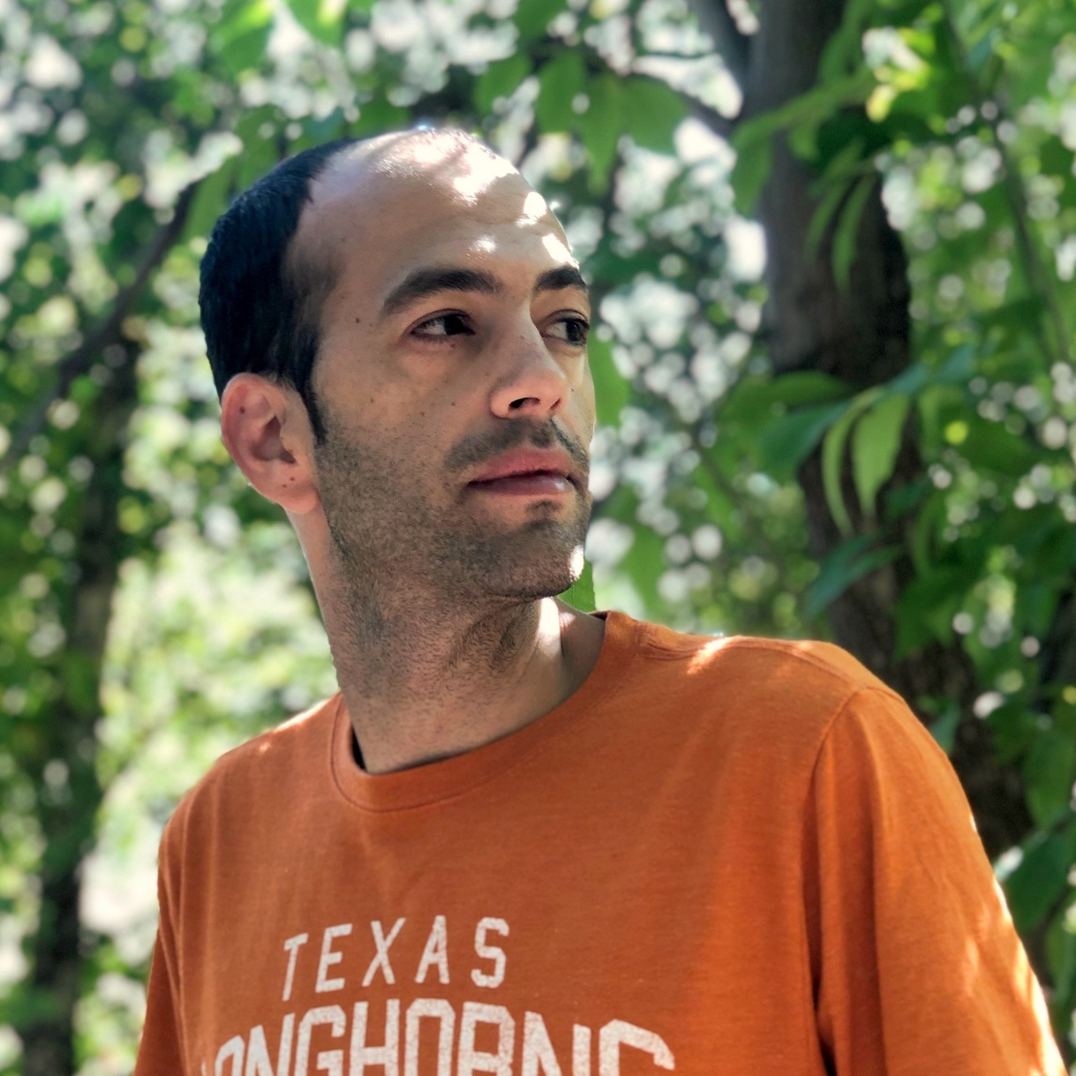
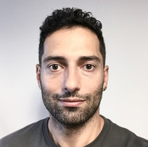
Near-Optimal Pseudorandom Generators
for Constant-Depth Read-Once Formulas
In CCC 2019
Joint work with:
Dean Doron
Stanford
Pooya Hatami
Ohio State University

Slide 26
Read-once ${\text{AC}}^{0}$
$$∧$$
$$∨$$
$$∨$$
$$∧$$
$$∧$$
$$∧$$
$$∧$$
$$∧$$
$$x_{3}$$
$$x_{1}$$
$${¬x}_{2}$$
$$x_{8}$$
$${¬x}_{6}$$
$$x_{5}$$
$$x_{11}$$
$${¬x}_{4}$$
$${¬x}_{9}$$
$$x_{7}$$
$$x_{10}$$
Depth-$d$ read-once ${\text{AC}}^{0}$ formulas can be simulated by width-$(d+1)$ ROBPs…
…after reordering variables. Classic PRGs (Nisan, INW, etc.) don’t work
These ROBPs have many collisions – “opposite” of permutation ROBPs

Slide 27
PRGs for read-once ${\text{AC}}^{0}$
$d=$ depth
Seed length | Model fooled | Reference
$$O(n^{0.001})$$ | $${\text{AC}}^{0}$$ | Ajtai, Wigderson 1989
$$O(\log^{2d+6}{n})$$ | $${\text{AC}}^{0}$$ | Nisan 1991
$$\tilde{O}(\log^{d+4}{n})$$ | $${\text{AC}}^{0}$$ | Trevisan, Xue 2013
$$\tilde{O}(\log^{d+1}{n})$$ | Read-once ${\text{AC}}^{0}$ | Chen, Steinke, Vadhan 2015
$$\tilde{O}(\log^{2}{n})$$ | Arbitrary-order constant-width ROBPs | Forbes, Kelley 2018
$$\tilde{O}(\log{n})$$ | Read-once ${\text{AC}}^{0}$ | Doron, Hatami, H 2019
$$\tilde{O}(\log{n})$$ | Arbitrary-order constant-width monotone ROBPs | Doron, Meka, Reingold, Tal, Vadhan 2021
Theorem: $∃$ explicit PRG for read-once ${\text{AC}}^{0}$ with seed length
$$\log\left(n/ε\right)⋅O{\left(d\log{\log\left(n/ε\right)}\right)}^{2d+2}$$
Proof ideas: Iterated restrictions, building on Forbes-Kelley
Key contribution: Read-once ${\text{AC}}^{0}$ simplifies under pseudorandom restrictions

Slide 28
Can “simulate” $\text{BPL}$
Poly-Width Arbitrary-Order ROBPs
Poly-Width ROBPs
More powerful models
Poly-Width Regular ROBPs
Constant-Width Arbitrary-Order ROBPs
Read-Once ${\text{TC}}^{0}$
Poly-Width Permutation ROBPs
Read-Once ${\text{AC}}^{0}[⊕]$
Constant-Width Arbitrary-Order Monotone ROBPs
[DMRTV21]
Constant-Width ROBPs
O(1)-Accept-Vertex Poly-Width Permutation ROBPs
[HPV21]
Width-3 Arbitrary-Order ROBPs
[MRT19]
Read-Once ${\text{AC}}^{0}$
[DHH19]
Read-Once Polynomials
[LV17, MRT19, Lee19, DHH20]
Constant-Width Regular ROBPs
[BRRY10, De11]
Width-3 ROBPs
[MRT19]
Explicit PRGs known with seed length $\tilde{O}(\log{n})$
Constant-Width Arbitrary-Order Permutation ROBPs
[CHHL18]
Width-2 Arbitrary-Order ROBPs
[SZ95, BDVY13]
Read-Once CNFs
[DETT10, GMRTV12, DHH20]
Constant-Width Permutation ROBPs
[KNP11, De11, Ste12]
Width-2 ROBPs
[SZ95, BDVY13]
Parities
[NN93, …]
Conjunctions
[NN93, …]

Slide 29
Can “simulate” $\text{BPL}$
Poly-Width Arbitrary-Order ROBPs
Poly-Width ROBPs
More powerful models
Poly-Width Regular ROBPs
Constant-Width Arbitrary-Order ROBPs
Read-Once ${\text{TC}}^{0}$
Poly-Width Permutation ROBPs
Read-Once ${\text{AC}}^{0}[⊕]$
Constant-Width Arbitrary-Order Monotone ROBPs
[DMRTV21]
Constant-Width ROBPs
O(1)-Accept-Vertex Poly-Width Permutation ROBPs
[HPV21]
Width-3 Arbitrary-Order ROBPs
[MRT19]
Read-Once ${\text{AC}}^{0}$
[DHH19]
Read-Once Polynomials
[LV17, MRT19, Lee19, DHH20]
Constant-Width Regular ROBPs
[BRRY10, De11]
Width-3 ROBPs
[MRT19]
Explicit PRGs known with seed length $\tilde{O}(\log{n})$
Constant-Width Arbitrary-Order Permutation ROBPs
[CHHL18]
Width-2 Arbitrary-Order ROBPs
[SZ95, BDVY13]
Read-Once CNFs
[DETT10, GMRTV12, DHH20]
Constant-Width Permutation ROBPs
[KNP11, De11, Ste12]
Width-2 ROBPs
[SZ95, BDVY13]
Parities
[NN93, …]
Conjunctions
[NN93, …]

Slide 30
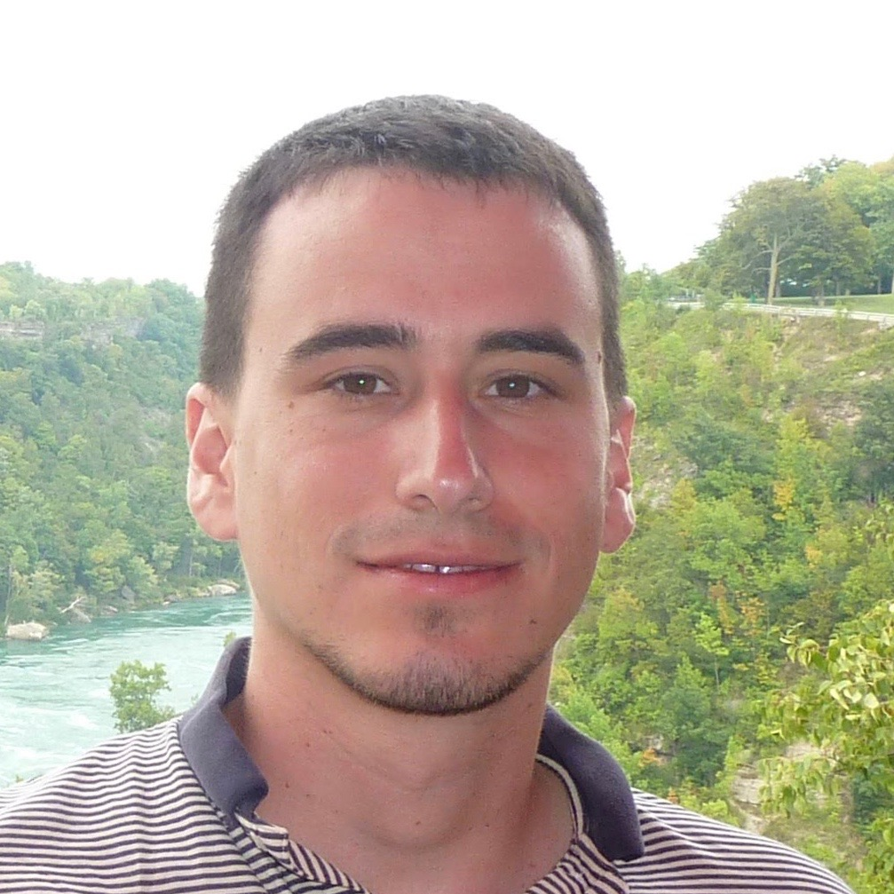
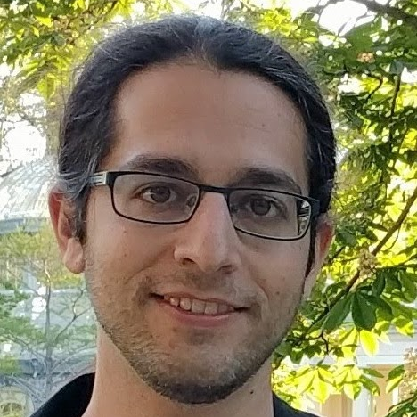
Fooling Constant-Depth Threshold Circuits
ECCC 2021
Joint work with:
Pooya Hatami
Ohio State University
Avishay Tal
UC Berkeley
Roei Tell
MIT

Slide 31
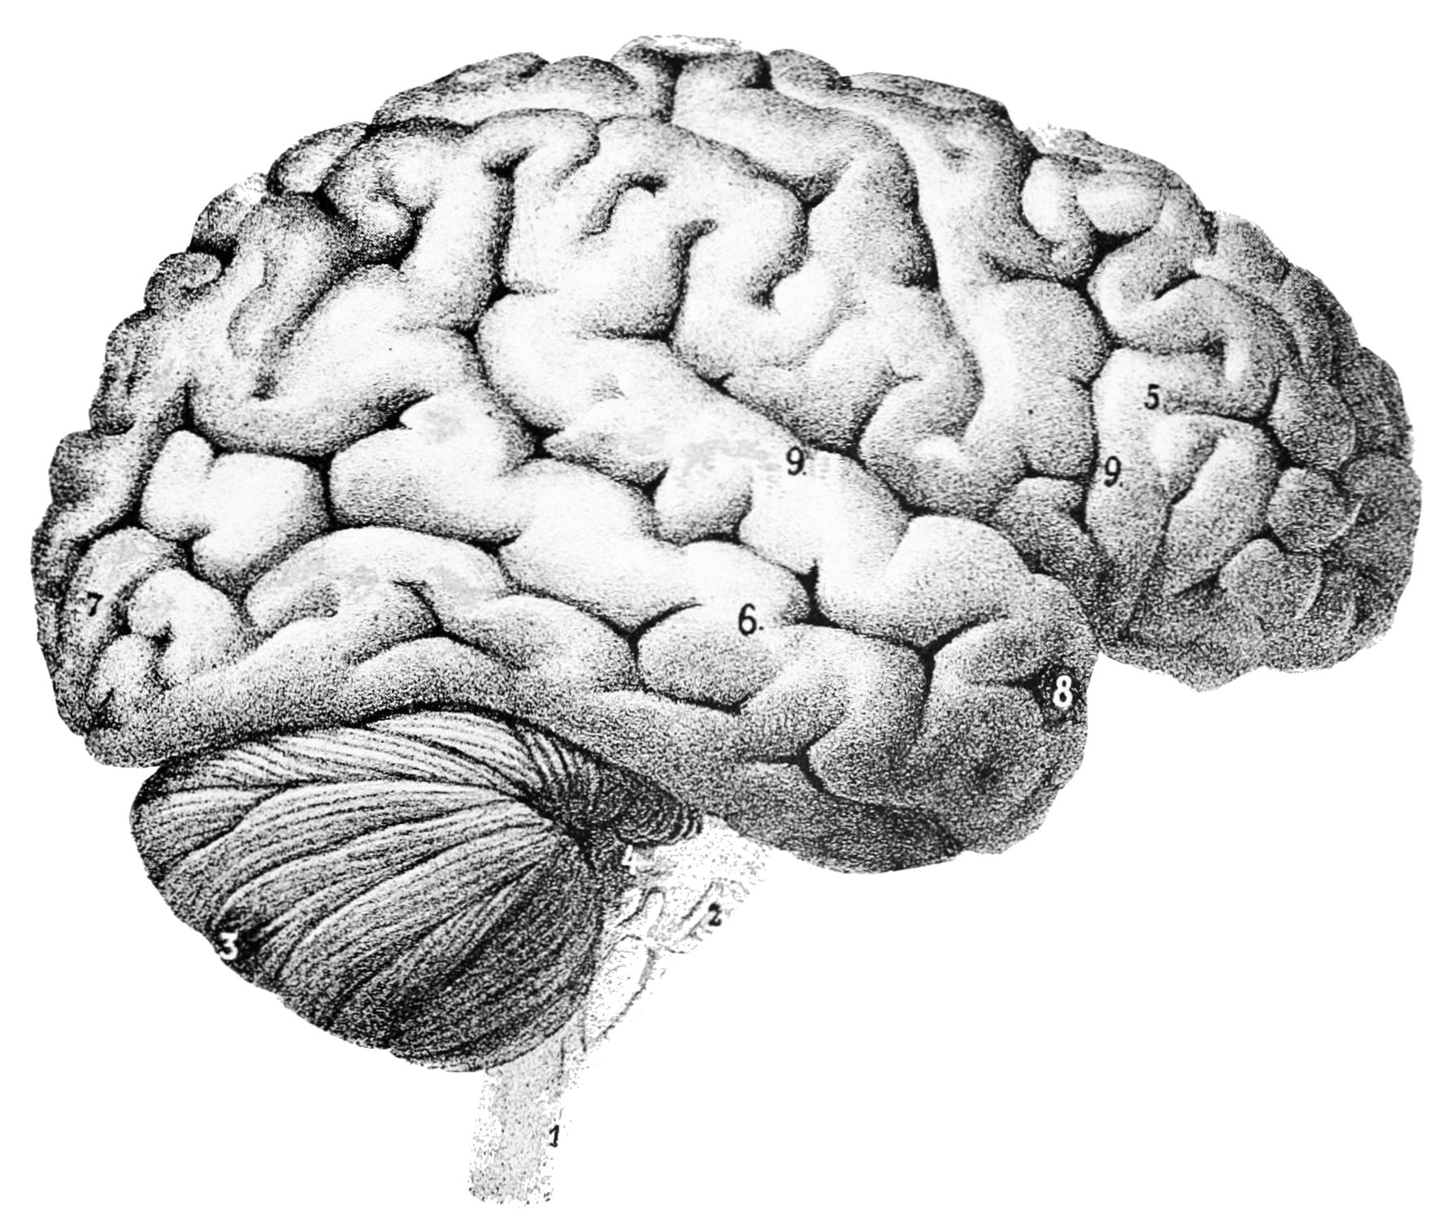
Threshold circuits
$C:\{0, 1\}^{n}→\{0, 1\}$
Each gate $Φ_{i}$ is an arbitrary linear threshold function
Crude model of a brain
Size = number of wires
${\text{TC}}^{0}$: Depth = $O(1)$, size = $\text{poly}\left(n\right)$
Read-once ${\text{TC}}^{0}$ is especially relevant…
But let’s focus on read-many case
$$C\left(x\right)$$
$$Φ_{8}$$
$$Φ_{4}$$
$$Φ_{5}$$
$$Φ_{6}$$
$$Φ_{7}$$
$$Φ_{1}$$
$$Φ_{2}$$
$$Φ_{3}$$
$$x_{1}$$
$$x_{2}$$
$$x_{3}$$
$$x_{4}$$
$$x_{5}$$

Slide 32
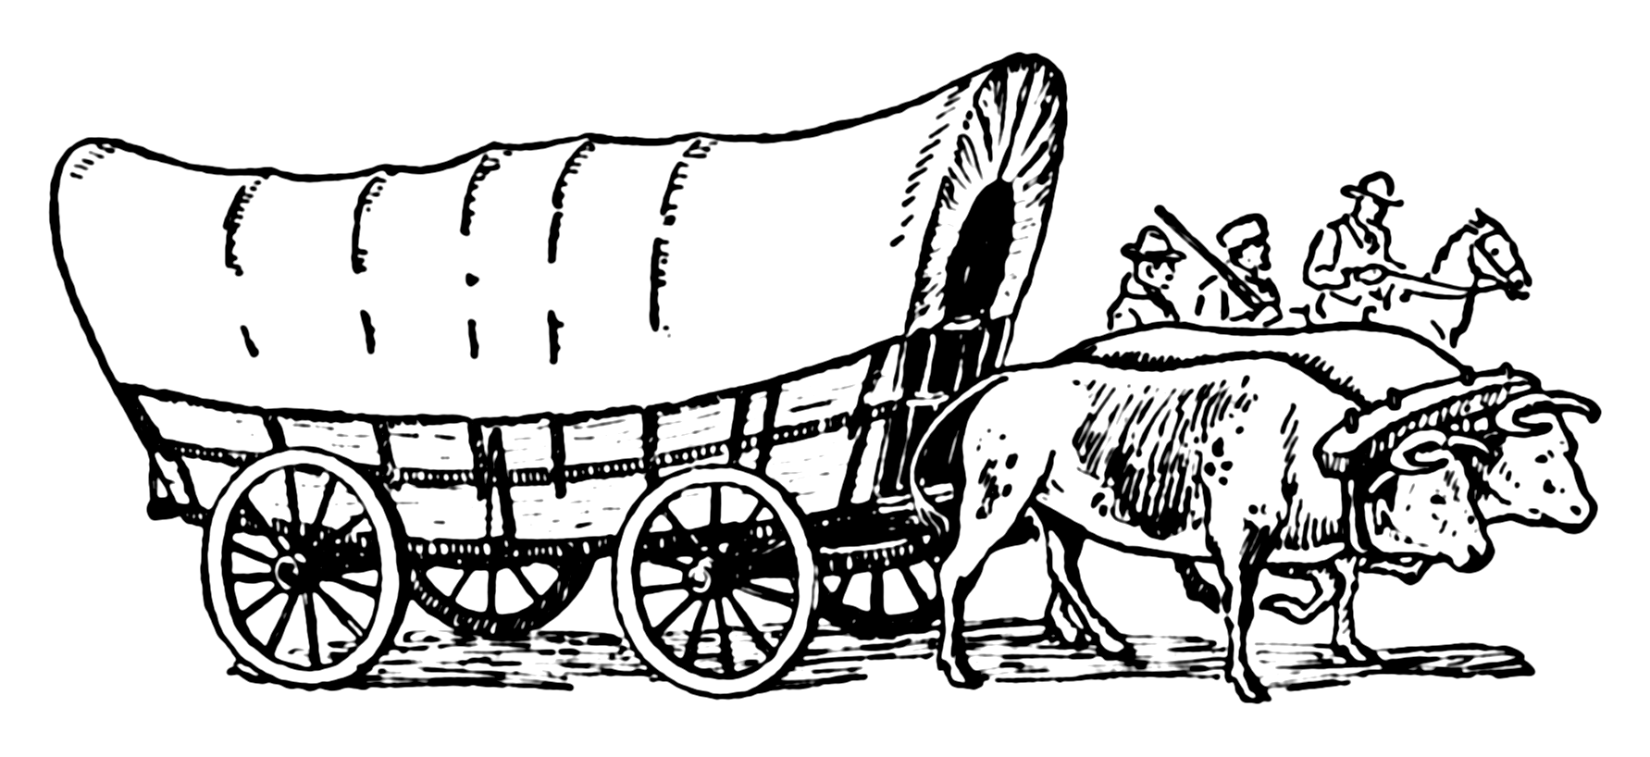
Frontier of complexity theory
Best lower bounds are for slightly-superlinear-size threshold circuits
Theorem [Impagliazzo, Paturi, Saks 1993]: PARITY cannot be computed by depth-$d$ threshold circuits with fewer than $n^{1+δ}$ wires, where $δ=2^{−O(d)}$
Average-case lower bounds also known [Chen, Santhanam, Srinivasan 2016]
No prior nontrivial PRGs

Slide 33
PRGs for threshold circuits
Size = number of wires
Let $n, d∈ℕ$
Theorem: $∃δ=2^{−O(d)}$, $∃$ explicit PRG for depth-$d$ size-$n^{1+δ}$ threshold circuits on $n$ input variables with seed length $O\left(n^{1−δ}\right)$ and error $2^{−n^{δ}}$.
Any significant improvement would imply new lower bounds
Some ideas in the proof:
New “slightly non-black-box” restriction lemma for threshold functions
Carefully engineered hybrid decision tree / threshold model of computation

Slide 34
Part II: Generalizations of PRGs

Slide 35
Hitting set generators (HSGs)
Let $ℱ$ be a class of functions $f:\{0, 1\}^{n}→\{0, 1\}$
Hitting set generator (HSG): Function $G:\{0, 1\}^{s}→\{0, 1\}^{n}$ such that $∀f∈ℱ$, $𝔼\left[f\right]≥ε⇒∃x \text{such} \text{that} f\left(G\left(x\right)\right)=1$
Clearly PRG $⇒$ HSG. An HSG is a “one-sided PRG”
Try all seeds $⇒$ derandomize algorithms that have one-sided error ($\text{RL}$, $\text{RP}$, etc.)
Studied since the 80s [Ajtai, Komlós, Szemerédi 1987] and considered standard

Slide 36
Weighted pseudorandom generators (WPRGs)
Pair $(G, ρ)$, where $G:\{0, 1\}^{s}→\{0, 1\}^{n}$ and $ρ:\{0, 1\}^{s}→ℝ$, such that $∀f∈ℱ$,
$$\left|𝔼_{x}\left[f\left(G\left(x\right)\right)⋅ρ(x)\right]−𝔼\left[f\right]\right|≤ε$$
Aka “pseudorandom pseudodistribution generator”
Introduced recently [Braverman, Cohen, and Garg 2018]
PRG $⇒$ WPRG $⇒$ HSG
Explicit WPRG $⇒$ derandomize algorithms with two-sided error by computing $\sum_{x}{2^{−s}⋅f\left(G\left(x\right)\right)⋅ρ(x)}$
HSG
WPRG
PRG

Slide 37
Simple Optimal Hitting Sets for Small-Success RL
In FOCS 2018 and SICOMP 2020
Joint work with:
Better Pseudodistributions and Derandomization for Space-Bounded Computation
In ECCC 2021
+
David Zuckerman
UT Austin

Slide 38
Generators for width-$n$ length-$n$ ROBPs
Seed length | Type of generator | Reference
$$\tilde{O}\left(\sqrt{n}\right)+O\left(\log\left(1/ε\right)\right)$$ | HSG | Ajtai, Komlós, Szemerédi 1987
$$2^{O\left(\sqrt{\log{n}}\right)}⋅log⁡(1/ε)$$ | PRG | Babai, Nisan, Szegedy 1989
$$O\left(\log^{2}{n}+\log{n}⋅\log\left(1/ε\right)\right)$$ | PRG | Nisan 1990, …
$$\tilde{O}\left(\log^{2}{n}+\log\left(1/ε\right)\right)$$ | WPRG | Braverman, Cohen, Garg 2018
$$O(\log^{2}{n}+\log\left(1/ε\right))$$ | HSG | H, Zuckerman 2018
$$\tilde{O}\left(\log^{2}{n}\right)+O(\log\left(1/ε\right))$$ | WPRG | Chattopadhyay, Liao 2020
$$O\left(\log^{2}{n}\right)+\tilde{O}\left(\log\left(1/ε\right)\right)$$ | WPRG | Cohen, Doron, Renard, Sberlo, Ta-Shma 2021 and Pyne, Vadhan 2021
$$O(\log^{2}{n}+\log\left(1/ε\right))$$ | WPRG | H 2021
Theorem: $∃$ explicit WPRG for width-$n$ length-$n$ ROBPs with seed length
$$O\left(\log^{2}{n}+\log\left(1/ε\right)\right)$$

Slide 39
Better derandomization of $\text{BPSPACE}(S)$
Deterministic space | Model simulated | Reference
$$O\left(S^{2}\right)$$ | $$\text{NSPACE}(S)$$ | Savitch 1969
$$O\left(S^{2}\right)$$ | Non-halting unbounded-error randomized space-$S$ | Jung 1981 and Borodin, Cook, Pippenger 1983
$$O\left(S^{3/2}\right)$$ | $$\text{BPSPACE}(S)$$ | Saks, Zhou 1995
$$O\left(S^{3/2}/\sqrt{\log{S}}\right)$$ | $$\text{BPSPACE}(S)$$ | H 2021
Theorem: $∀S=S\left(n\right)≥\log{n}$,
$$\text{BPSPACE}(S)⊆\text{DSPACE}\left(S^{3/2}/\sqrt{\log{S}}\right)$$
Proof based on combination of old tools and recent WPRG technology

Slide 40
Decreasing the error of a PRG
We will sketch WPRG construction
Based on a generic reduction:
Plug in Nisan’s PRG to get a WPRG with seed length $O\left(\log^{2}{n}+\log\left(1/ε\right)\right)$
$$ε≪1/\text{poly}\left(n\right)$$
Moderate-error PRG
Fools width-$n$ length-$n$ ROBPs
Error $1/\text{poly}\left(n\right)$
Seed length $s$
Low-error WPRG
Fools width-$n$ length-$n$ ROBPs
Error $ε$
Seed length $O\left(s+\log\left(1/ε\right)\right)$
$$⇒$$

Slide 41
Inverse Laplacian perspective
[Ahmadinejad, Kelner, Murtagh,
Peebles, Sidford, Vadhan 2020]
Easy to compute
Let $W∈ℝ^{N×N}$ be the random walk matrix of ROBP $f$, where $N=n⋅(n+1)$
$W_{u,v}=$ probability that one random step from $u$ goes to $v$
Let $P∈ℝ^{N×N}$ be the matrix of long-range visit probabilities
$P_{u,v}=$ probability that a random walk from $u$ to the layer containing $v$ arrives at $v$
We have $P=W^{0}+W^{1}+W^{2}+⋯+W^{n}$
Note $W^{n+1}=0$
So $PW=P−I$, and therefore $P=L^{−1}$ where $L=I−W$ (“Laplacian”)
One entry is $𝔼[f]$

Slide 42
Preconditioned Richardson iteration
[Ahmadinejad, Kelner, Murtagh,
Peebles, Sidford, Vadhan 2020]
Moderate-error PRG $⇒$ matrix $\hat{P}$ of estimated long-range visit probabilities
$\left|{\hat{P}}_{u,v}−P_{u,v}\right|≤1/\text{poly}\left(n\right)$ 🚶
$\hat{P}L=I−E$ for some error matrix $E$
Define $\hat{\hat{P}}=\hat{P}+E\hat{P}+E^{2}\hat{P}+⋯+E^{m}\hat{P}$ 🏋️
Then $\hat{\hat{P}}L=\left(I−E\right)+E\left(I−E\right)+E^{2}\left(I−E\right)+⋯+E^{m}\left(I−E\right)=I−E^{m+1}$
For $m=O\left(\frac{\log\left(1/ε\right)}{\log{n}}\right)$, this implies $\left|{\hat{\hat{P}}}_{u,v}−P_{u,v}\right|≤ε$ 💪
Low-error approximate inverse of $L$

Slide 43
Interpreting as WPRG
[Cohen, Doron, Renard, Sberlo, Ta-Shma 2021] [Pyne, Vadhan 2021]
Matrix equations can be “unraveled”
$$\left|𝔼\left[f\right]−\sum_{i=1}^{K}{σ_{i}⋅𝔼\left[f\left(A_{i}\right)\right]}\right|≤ε$$
$K=\text{poly}(1/ε)$
$σ_{i}∈\{±1\}$
Random variable $A_{i}$: Concatenation of truncations of $O\left(\frac{\log\left(1/ε\right)}{\log{n}}\right)$ independent samples from moderate-error PRG
Sampling $A_{i}$ costs $O\left(\frac{s}{\log{n}}⋅\log\left(1/ε\right)\right)$ truly random bits… ☹

Slide 44
♻️ Recycling seeds using a sampler [H 2021]
$$s=O(\log^{2}{n})$$
Let $G$ be moderate-error PRG with seed length $s$
Let $\text{Samp}:\{0, 1\}^{O\left(s+\log\left(1/ε\right)\right)}×\{0, 1\}^{O(\log{n})}→\{0, 1\}^{s}$ be a sampler/extractor
Pick $X$ u.a.r. and let $G′\left(y\right)=G\left(\text{Samp}\left(X, y\right)\right)$, so $G′$ has seed length $O\left(\log{n}\right)$
$∀f$, w.h.p. over $X$, $G′$ fools every subprogram of $f$ with error $1/\text{poly}\left(n\right)$
That’s good enough for preconditioned Richardson iteration
Including $X$, total seed length is $O\left(s+\log\left(1/ε\right)\right)$

Slide 45
PRGs are harder to construct
WPRGs and especially HSGs seem to be easier to construct than PRGs
Many cases where best known HSGs/WPRGs are better than best known PRGs
For unbounded-width permutation ROBPs and $ε=1/n$, there is an inherent gap!
$∀$ PRG, seed length is $Ω\left(\log^{2}{n}\right)$ [H, Pyne, Vadhan 2021]
$∃$ HSG with seed length $O(\log{n})$ [H, Pyne, Vadhan 2021]
$∃$ explicit WPRG with seed length $\tilde{O}\left(\log^{3/2}{n}\right)$ [Pyne, Vadhan 2021]
For poly-width ROBPs, maybe HSGs with seed length $O(\log{n})$ will come first
What would that imply?

Slide 46
Hitting Sets Give Two-Sided Derandomization of Small Space
In CCC 2020; invited to ToC special issue
Joint work with:
Kuan Cheng
Peking University

Slide 47
What if we had optimal HSGs?
Trivial to derandomize algorithms with one-sided error ($\text{RP}$, $\text{RL}$, etc.)
Proof idea: Use HSG $G$ with output length $n^{c}$ to analyze ROBP of length $n$
Each $\left(n^{c}\right)$-bit string encodes a (sparse) distribution over $\{0, 1\}^{n}$
Find seed $x$ such that $G(x)$ induces locally consistent probability estimates
Theorem [Andreev, Clementi, Rolim 1996]: If $∃$ poly-time HSG for size-$n$ circuits with seed length $O(\log{n})$, then $\text{P}=\text{BPP}$
Theorem: If $∃$ log-space HSG for width-$n$ length-$n$ ROBPs with seed length $O\left(\log{n}\right)$, then $\text{L}=\text{BPL}$

Slide 48
PRGs vs. WPRGs vs. HSGs
PRG
🥇
WPRG
HSG
🥈
🥈
All imply $\text{L}=\text{BPL}$
If optimal, then PRG $≻$ WPRG $≃$ HSG
If non-optimal, then PRG $≻$ WPRG $≻$ HSG
?
?
Applications in streaming algorithms
PRG
🥇
WPRG
?
?
🥈
HSG
🥉
Can be plugged into Saks-Zhou framework

Slide 49
Conclusions

Slide 50
Summary
PRGs for models of computation related to $\text{L}$ vs. $\text{BPL}$
Unbounded-width permutation ROBPs with Ted Pyne and Salil Vadhan
Read-once ${\text{AC}}^{0}$ formulas with Dean Doron and Pooya Hatami
Slightly-superlinear-size ${\text{TC}}^{0}$ circuits with Pooya Hatami, Avishay Tal, and Roei Tell
­Relaxations of PRGs for ROBPs: Constructions and applications
HSGs and WPRGs with optimal dependence on $ε$ HSGs with David Zuckerman
Derandomizing space-$S$ algorithms in space $O\left(S^{3/2}/\sqrt{\log{S}}\right)$
Optimal HSGs for ROBPs would imply $\text{L}=\text{BPL}$ (not just $\text{L}=\text{RL}$) with Kuan Cheng

Slide 51
Suggested open problems
Better PRGs for read-once ${\text{AC}}^{0}\left[⊕\right]$? How about for read-once ${\text{TC}}^{0}$?
Prove $\text{BPL}⊆\text{NL}$? How about $\text{RL}=\text{coRL}$?
Thanks for listening!
Questions?

